Slide 1
Air Pollution:Air Quality- Environmental Justice, Social Rights and Effective Action
4 December 2017
Paul Lincoln

Slide 2
Purpose
How air pollution/poor air quality is a health inequalities issue
What do we know about effective interventions and plans and action at national and local levels?
How this could be tackled at source?
Air pollution as a human (social) right issues
How the air pollution agenda could be a tipping point for environmental justice and a more fundamental approach to healthy and sustainable places

Slide 3
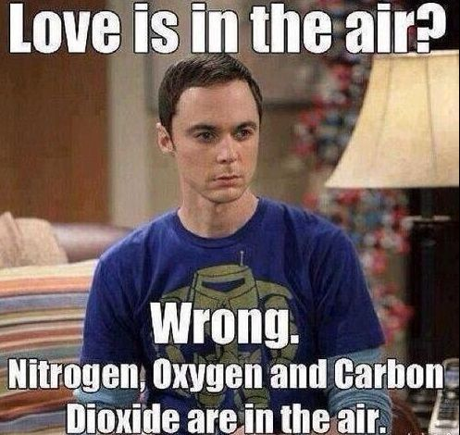
Air pollution

Slide 4
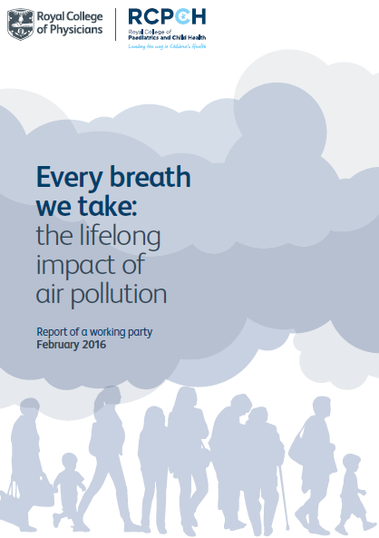
Who is most at risk?
Air pollution is harmful to everyone.
However, some people suffer more than others because they:
live in deprived areas, which often have higher levels of air pollution
live, learn or work near busy roads
are more vulnerable because of their age (e.g. children, older people) or existing medical conditions
Notes:
Health inequality issues

Slide 5
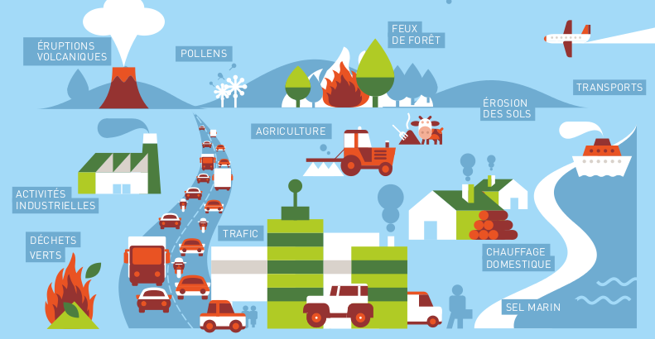
What causes air pollution?
Forest fires
Volcanic eruptions
Pollens
Aircraft at take-off
add to NO₂ (cruise aircraft emissions are blown away)
Dust blown off soil, roads and distant deserts adds to PM
Farming adds to PM - as fertiliser breaks down it forms PM.
Industry
adds to PM and NO₂, and can release gases that turn into PM.
Adapted from www.developpement-durable.gouv.fr
Shipping exhaust adds to PM and NO₂
Bonfires and fireworks add to PM
Road traffic and rail exhaust adds to PM and NO₂. Brake, tyre and road/rail wear add to PM.
Building and home heating
Gas heating makes NO₂, wood (including from CHP) and coal heating make PM.
The sea releases salt and sulphur adding to PM
Notes:
Air pollution comes from many different sources, man-made and natural
In terms of the sulphur cycle, dimethylsulphide (DMS), a waste produced by phytoplankton, is released from the ocean into the atmosphere where it undergoes oxidation (Royal Society, 2007)

Slide 6
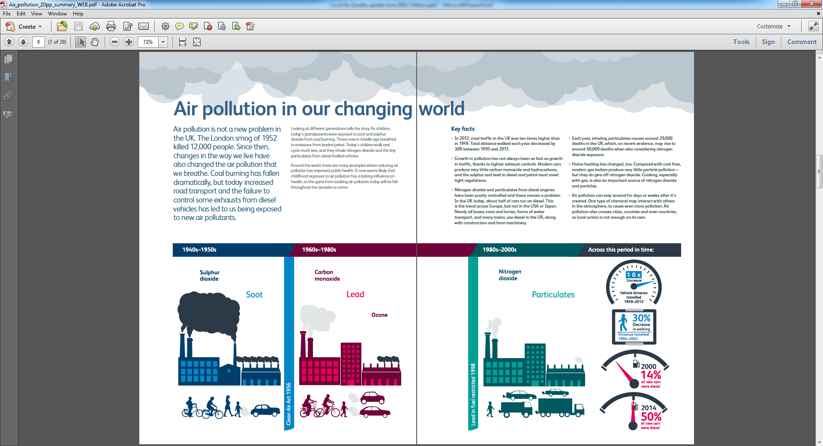
Traffic related air pollution
© Royal College of Physicians 2016
Notes:
Defining the problem – changing pollutants and sources

Slide 7
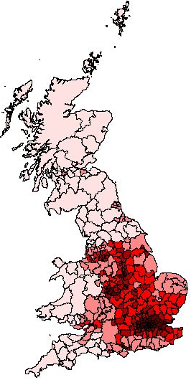

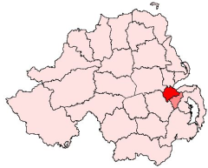
Annual mean background
PM_{2.5} (μg/m³) in 2010
Fraction of mortality (%) attributable to anthropogenic PM_{2.5}
Notes:
Annual mean PM2.5 in 2010 (PCM: Pollution Climate Mapping model)
Spatial resolution: 1x1 km
Annual mean? 13 ug/m3 in the SE
Thus in the south of England, where the rural background is around 10-11 μg m-3, the urban background concentrations are around 13-17 μg m-3. (AQEG, 2012)

Slide 8
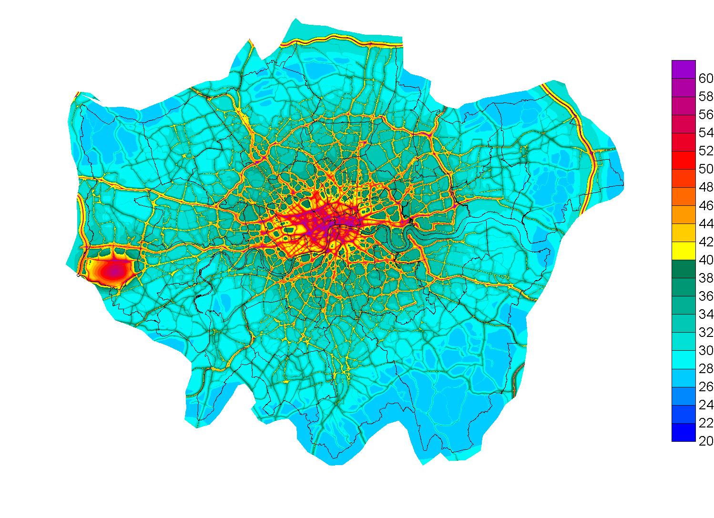
Air Pollution in London – Nitrogen dioxide
Source: Professor Frank Kelly (2012)

Slide 9
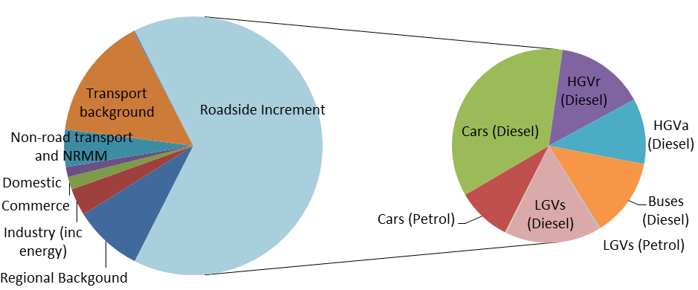
Nitrogen oxides (NO_{x}) sources
(Defra, 2015)
Notes:
Defra National Air Quality Plan (December 2015):
On average transport is responsible for 80% of NOx emissions at the roadside in areas where we need to act to reduce levels. Figure 1 provides an overview of the breakdown of NOx emissions in 2013 and of the traffic sources.
Figure 1: Average NOx source apportionment on UK road links outside London exceeding an annual mean NO2 concentration of 40μg/m3 in 2013

Slide 10
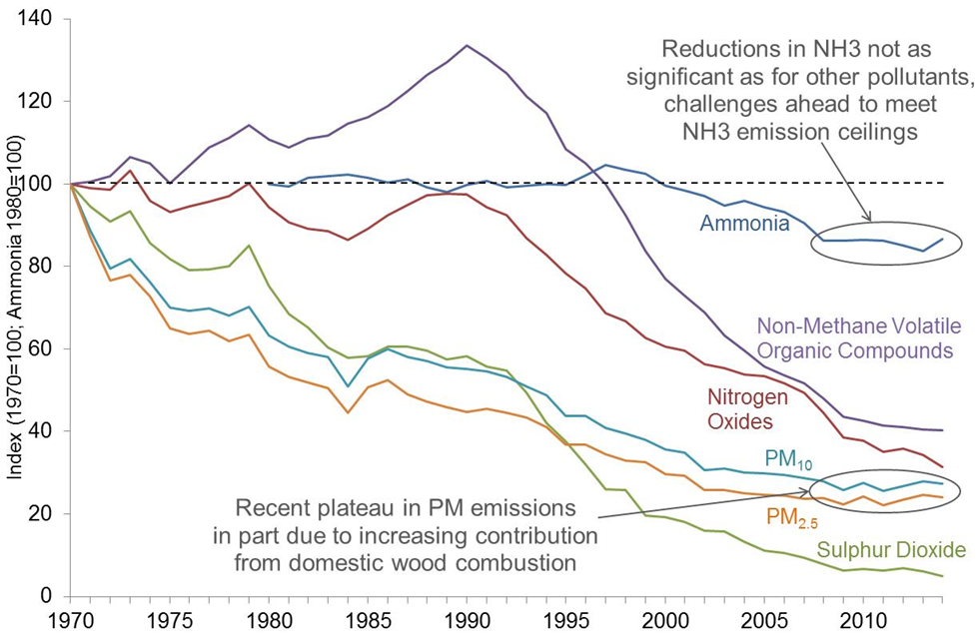
The story so far…….
Notes:
seen how effective legislation can be particularly in the last 20-30 years.
Plateau regions and current evidence suggests further challenge.
Uncertainties more significant, trends more difficult to infer and
Unintended effects can be very much more significant.
Emissions aren’t everything, - NOx
Key Question: What opportunities are they to improve our understanding of emissions and recognise the most effective options for reducing these further

Slide 11

Interesting developments along the journey!

Slide 12
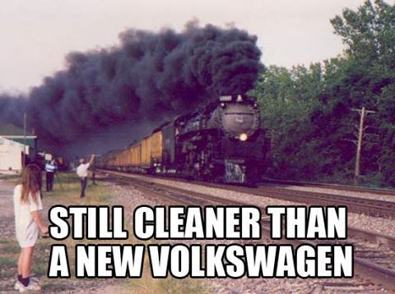
The saga continues

Slide 13
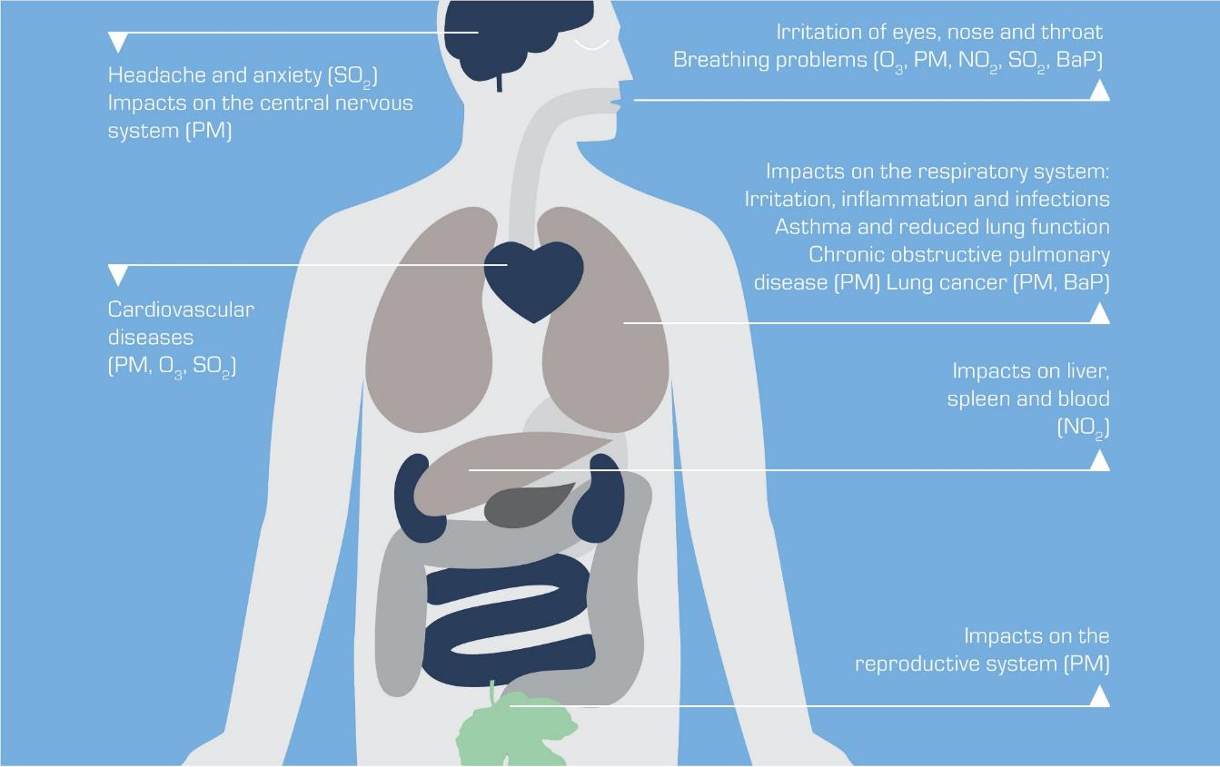
Health effects of particulate matter (PM)
COMEAP estimated the mortality burden of human-made particulate pollution in the UK in 2008 as:
  An effect equivalent to 29,000 deaths per year
  Average loss of 6 months of life expectancy from birth
A few hours of PM_{2.5} over 35µg/m³ irritates the eyes, nose and throat. It can cause breathing problems and asthma attacks in sensitive people.
Ultrafine PM has been found in samples of brain and central nervous system tissue.
Years of exposure to even low levels of PM_{2.5} (10-25 µg/m³) can lead to lung cancer and incurable lung disease, and reduced lung function.
Heart and blood vessel diseases like strokes and hardening of the arteries are one of the main effects of air pollution. These can be caused by a few years exposure to even low levels of PM_{2.5} (over about 10µg/m³).
Exposure for a few hours to high levels of PM_{2.5} (over about 50 µg/m³) can bring on existing illness or strokes and heart attacks in ill people.
Figure adapted from the EEA publication “Health Impacts of Air Pollution”
Ultrafine PM can get into the blood then throughout the body. Ultrafine particles have been found in bodily organs.
Very high levels of air pollution, not found in the UK, are associated with premature births and low birth weight
Notes:
Small particles from smoke, soot and dust can get into the lungs and blood and be transported around the body.
The effects of air pollution on health vary between individuals and sub-groups of the population. In particular air pollution is known to affect the elderly, children, and those suffering from chronic respiratory diseases (e.g. bronchitis and asthma) and heart disease.

Slide 14
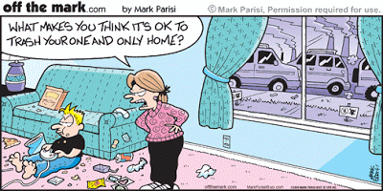
Air pollution – the generations

Slide 15

Future Generations Act

Slide 16
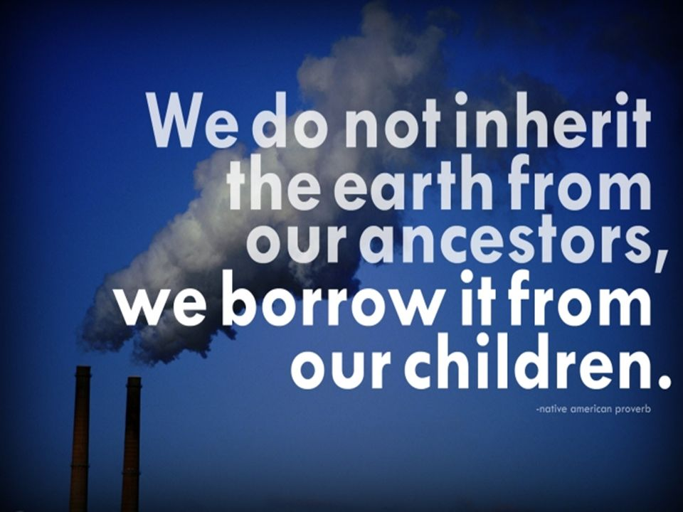

Slide 17
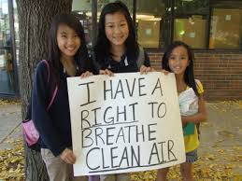
Awareness raising

Slide 18
Social rights
Social rights - progressive realisation
International legal obligation – if evidence available and it is affordable
Moral obligation
Develop the public health narrative

Slide 19
NICE:PHE guideline on outdoor air pollution
Planning (including planning new developments, providing infrastructure to support low- and zero-emission travel, and considerations for urban vegetation and street trees)
Clean Air Zones (including congestion charging zones)
Reducing emissions from public sector transport services and vehicle fleets (including procuring of public sector vehicles)
Smooth driving and speed reduction (including reduced speed in urban areas and physical traffic calming measures)
Cycle routes (including siting and design of cycle routes)
Awareness raising (for the general public, businesses, and healthcare professionals)
Notes:
NICE guideline
The Department of Health in England asked NICE to produce guidance on reducing the ill-effects of outdoor air pollution on health. The draft NICE guideline focuses on the cost-effectiveness of local interventions which aim to reduce exposure to transport related air pollution. The recommendations are related to:
Planning (including planning new developments, providing infrastructure to support low- and zero-emission travel, and considerations for urban vegetation and street trees)
Clean Air Zones (including congestion charging zones)
Reducing emissions from public sector transport services and vehicle fleets (including procuring of public sector vehicles)
Smooth driving and speed reduction (including reduced speed in urban areas and physical traffic calming measures)
Cycle routes (including siting and design of cycle routes)
Awareness raising (for the general public, businesses, and healthcare professionals)
The guideline is aimed at local government elected members and at local authority staff working in transport, planning, local air quality management (LAQM) and in both public and environmental health. It may also be relevant for healthcare professionals, employers, people working in the voluntary sector and non-governmental organisations or in education, and the general public.
The draft NICE guidance suggests that by minimising the need for motorised travel in new developments, and by providing an infrastructure that will support low and zero emission travel (such as improved cycling and walking routes and charge points for electric vehicles), and by restricting access for polluting vehicles, they can create clean air zones, which will benefit all who live there.

Slide 20
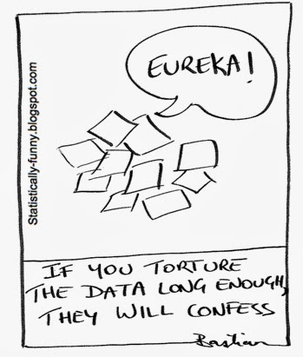
Evidence

Slide 21
Features
Fundamental basis for planning – systematic, strategic and sustainable approach
Low and zero emission goals
Public awareness and engagement
Health inequalities and equality
Co –benefits such as active travel, accident prevention, climate change, sustainable development, the urban scape, flora and fauna etc.

Slide 22
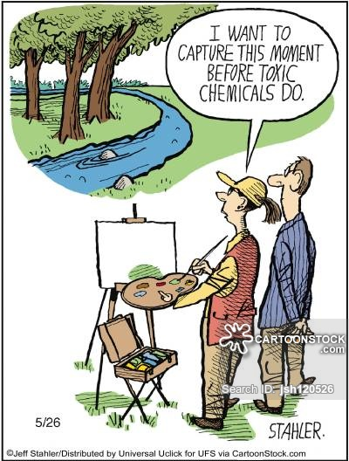
Planning - air quality/pollution

Slide 23
Planning
Strategic and regional plans
All local authority departments
Assess site plans
Travel plans
Trees and vegetation
Supplementary planning guidance and community infrastructure levy

Slide 24
Reducing emissions from public sector transport services and fleet vehicles
Driver training – fuel efficient driving, vehicle emissions, smooth driving, idling, maintenance, financial savings
Technical measures
Monitoring fleets fuel consumption
Procurement

Slide 25
Defra air quality plans
Source: Defra (2016)
NICE: Consider including progressive targets to reduce pollutant levels below air quality limits
Notes:
Defra new air quality plan included the establishment of Clean Air Zones (Defra, 2016):
“Clean Air Zones improve the urban environment to support public health and the local economy, making cities more attractive places to live, work, do business and spend leisure time. They support cities to grow and transition to a low emission economy thus ensuring these benefits are sustainable for the long term.”
In order to bring the UK into legal compliance and to reduce concentrations of nitrogen dioxide below 40 μg/m3 Clean Air Zones will be introduced in five cities. Under this Plan, by 2020 the most polluting diesel vehicles - old polluting buses, coaches, taxis and lorries - will be discouraged from entering the centres of Birmingham, Leeds, Southampton, Nottingham and Derby.

Slide 26
Clean Air Zones – DEFRA elements
Mandatory and voluntary basis (without charging)
Low to zero emission or move to ultra low emission
Groups of vehicles
Public transport- low/zero emission
Integrated public transport
Park and ride
Urban traffic management
Parking
etc.

Slide 27
Clean air zones
National air quality framework
EU limits or below
Support for low/zero emission travel, active travel
Fuel efficient driving initiatives e.g. no idling areas, driver training, smooth traffic flow
Public awareness initiatives
Working across LA boundaries
Congestion charging zones

Slide 28
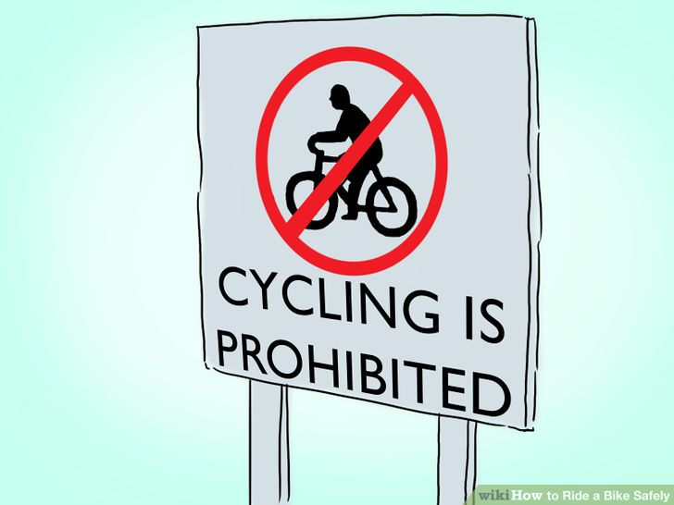

Slide 29
Cycle routes
Siting
Design

Slide 30

Smooth driving and speed reduction

Slide 31
Smooth driving and speed reduction
Motorways and major roads
Reduced speed in urban areas

Slide 32
Awareness raising
General public, health system, businesses and workplaces
At risk groups
ST and LT exposure

Slide 33
Economic Analysis
Measures recommended in
the guidance
Outline scheme costs
Benefit to cost ratios

Slide 34
 | Indicative financial costs in first year | Total indicative benefits in first year | Indicative case study cost benefit ratio | Indicative cost per QALY gained | Case study verdict | Applicability to typical UK local authority
Off road cycle paths | £61,100 | £853,236 | 14 | £5,075 | Cost effective | Optimistic scenario modelled1
Bypass construction | £265,250 | £2,620,276 | 10 | £6,971 | Cost effectiveness uncertain due to data quality issues | Highly dependent on local circumstances
Motorway barriers | £240,985 | £626,883 | 3 | £25,199 | Cost effectiveness uncertain due to data quality issues | Optimistic scenario modelled1
Street washing and sweeping | £25,825 | £3,849,845 | 149 | £441 | Cost effective | Optimistic scenario modelled1
One off road closures | Unknown | £39,020 | N/A | N/A | Cost effectiveness uncertain due to data quality issues | Does not reflect typical closure scenario
Low emission zones | £598,157 | £15,939,949 | 27 | £2,465 | Long term cost effectiveness uncertain | Some dependency on local circumstances
Speed restrictions | £37,500 | £1,905,673 | 51 | £1,293 | Cost effective | Optimistic scenario modelled1
Vehicle idling (at schools) | £19,000 | £830,908 | 44 | £1,572 | Cost effective | Optimistic scenario modelled1

Slide 35
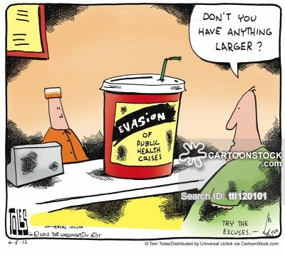
Action - Upstream stupid!

Slide 36
Further developments
NICE:PHE guidance on indoor air pollution (February 2018)
DEFRA NO2 kerbside strategy, July 2017
Governments – Clean Air Strategy, 2018
London T charge
PHE evidence reviews
PHE modelling tools- health and economic impact
Lancet Commission - global pollution
Client Earth

Slide 37
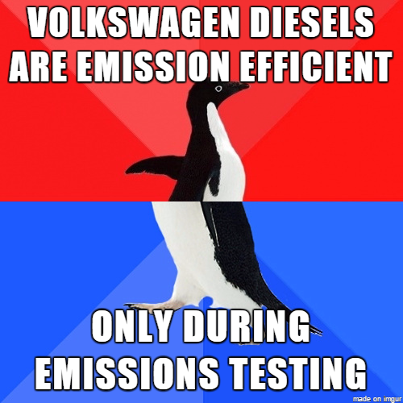
New road vehicle test September 2017

Slide 38


Slide 39


Slide 40
Health and wider co-benefits
Tackle avoidable NCD’s and health inequalities
Accident prevention
Public transport
Active travel
Wellbeing
Flora and fauna
Health places -connected neighbourhood, aesthetics etc.
Improved housing
Reduces noise pollution
Health creating economy – sustainable economic development

Slide 41
A jigsaw of health issues
W Acknowledgements to Duncan Vernon – West Midlands Combined Authority
Notes:
Historically transport has focussed on protecting people from exposure to risks – particulate matter, traffic injury or noise.
Shift to promoting positive health

Slide 42
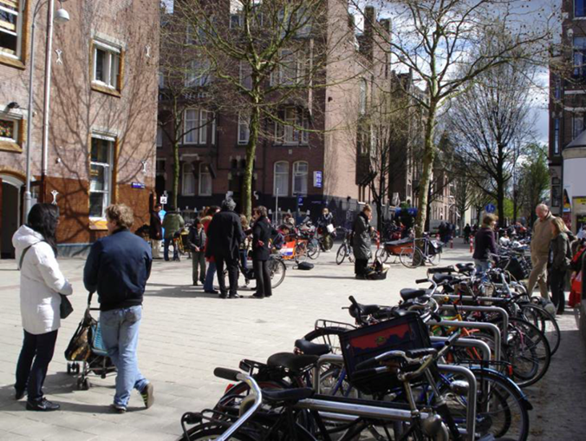
Healthy environments can:
promote physical activity in everyday life (walking, cycling),
which can help maintain healthy weights
facilitate easy access to
healthy, affordable food
promote active travel,
fewer injuries, connected
neighbourhoods, cleaner
air and economic
development
enable good housing
Notes:
In other words, the built and natural environment can help make healthy choices, easier choices
Source: Improving the health of Londoners. Transport Action Plan. Transport for London. 2014

Slide 43
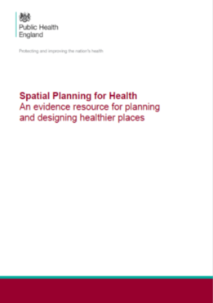

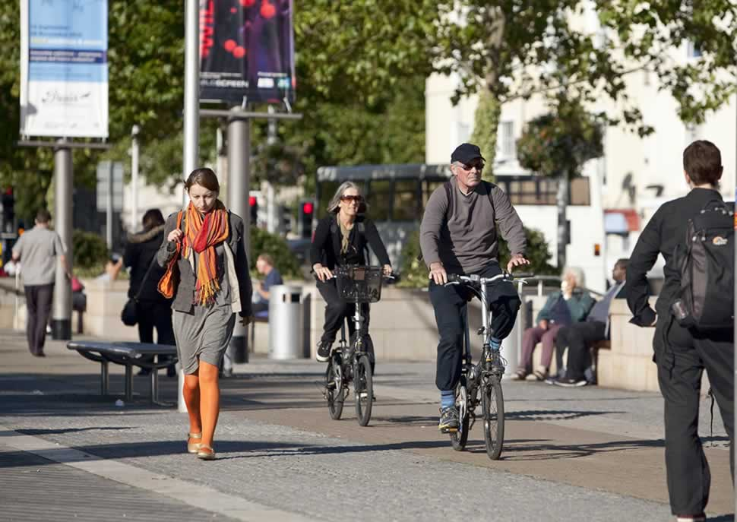
PHE Spatial Planning for Health
Neighbourhood Design
Housing
Healthy Food
Natural Environment
Transport
Notes:
We are shortly hoping to publish further guides looking at the evidence base for the built and natural environment on health looking at 5 key paramenters as shown on the slide
In addition we are hoping to publish shortly a briefing looking at the evidence base to support good practice on designing Healthy High Streets

Slide 44
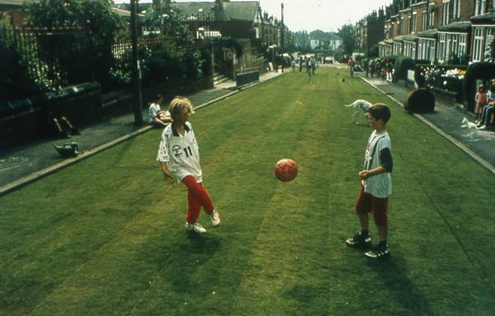
What if streets were not just large car parks?

Slide 45
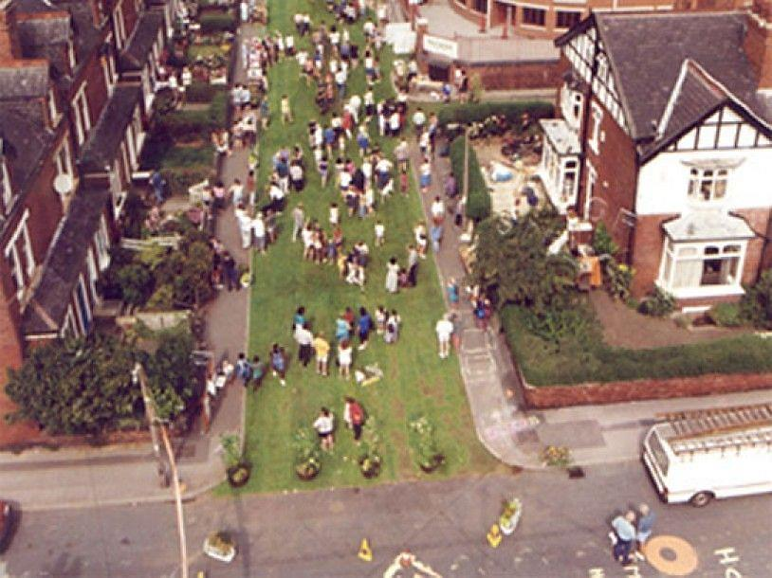
The adults might follow the children

Slide 46
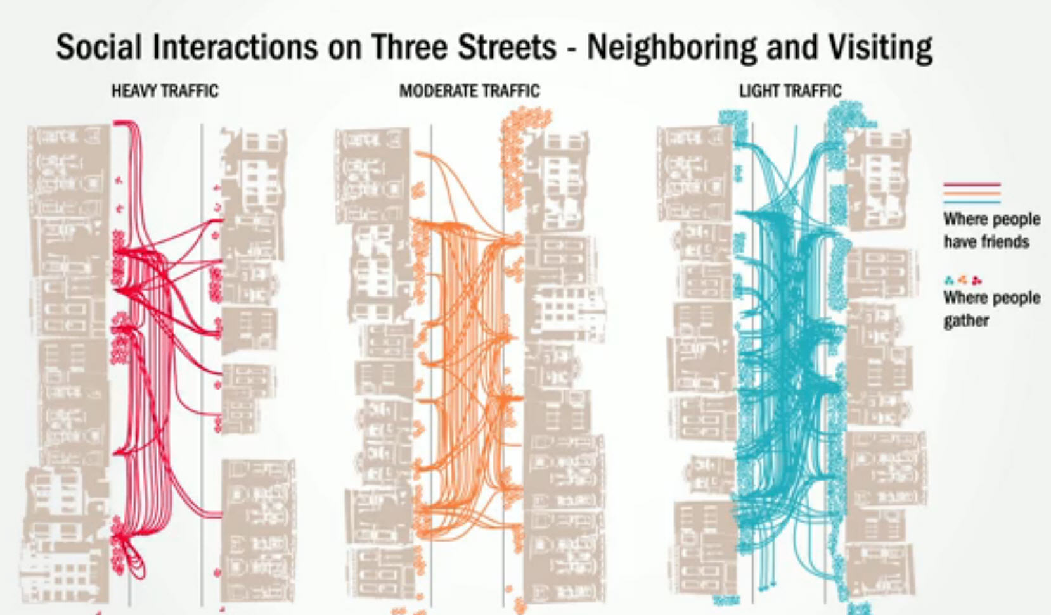
Improved mental wellbeing and resilience
Acknowledgements to Duncan Vernon

Slide 47
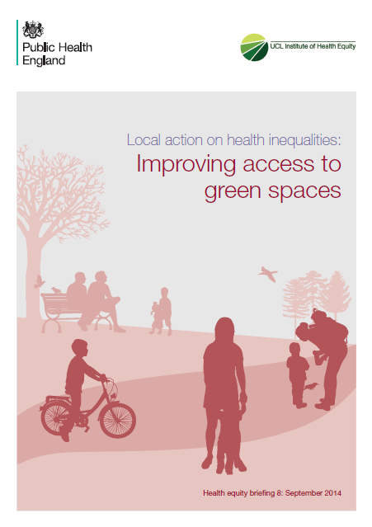
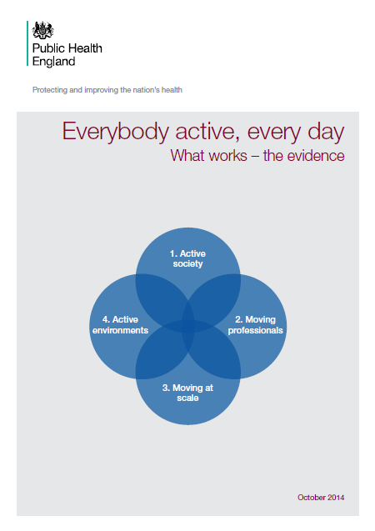
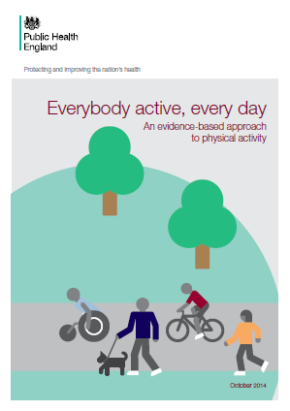
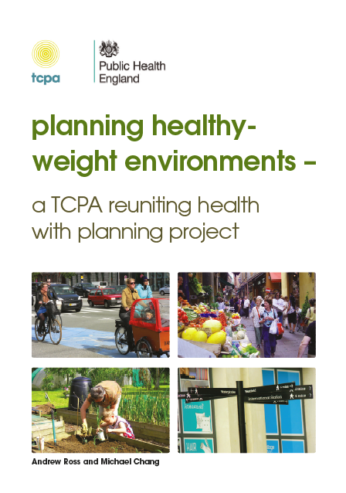
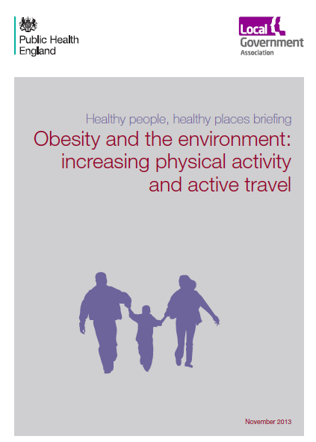
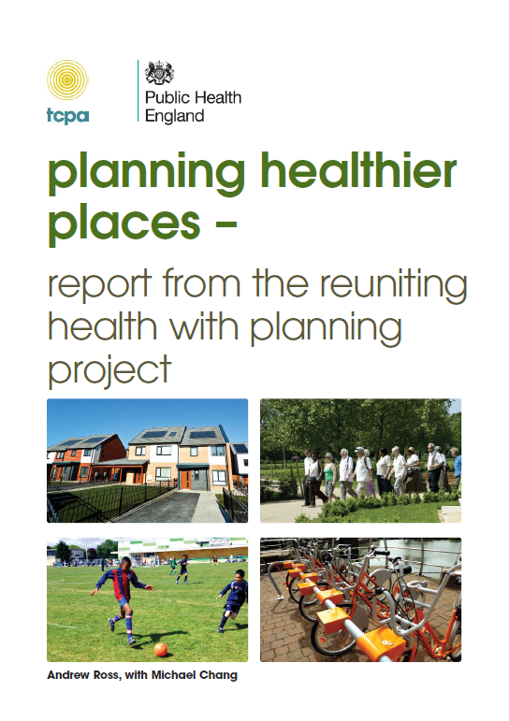

PHE Briefing and Evidence Reviews

Slide 48

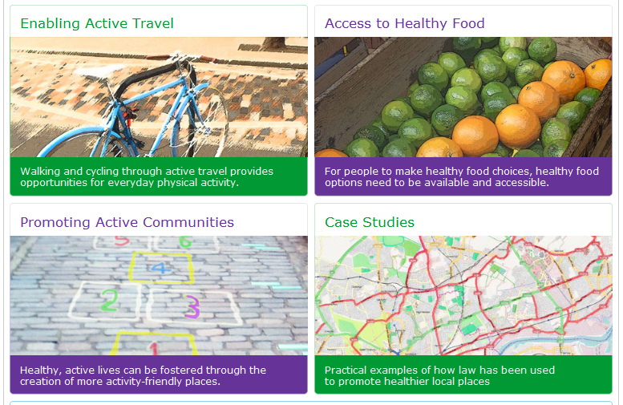

web-based resource

Slide 49
Opportunity
Build a narrative and action around healthy places and a healthy planet
Ensuring health is part of the planning considerations – housing, business, care and transport etc.
Sustainable prosperity
Social justice
Tackle vested interests
Accentuate the positive and more aspirational about healthy neighbourhoods

Slide 50
Issues
Retrofitting- cars and houses
Impact of new modes of transport and autonomous transport
Planning
Greater awareness
Off shore pollution
And finally but not least

Slide 51
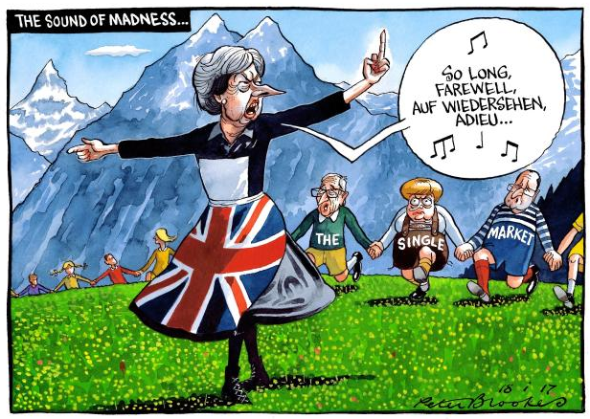
Brexit

Slide 52


Slide 53

Defra/PHE/LGA air pollution toolkit
A resource for public health teams that can be used to communicate the health effects of air pollution at a local level
Getting to grips with air pollution
Air Pollution: a public health issue. A Briefing for elected members
Understanding air pollution in your area
Engaging local decision-makers about air pollution
Communicating with the public during air pollution episodes
Communicating with the public about air pollution
Notes:
A resource for public health teams that can be used effectively to communicate the health effects of air pollution at a local level so that cost-effective local action on air pollution reduction is taken.
It comprises of:
Getting to grips with air pollution - This guide describes the latest evidence, outlines the role of Public Health officials can play, highlights techniques to get a better understanding of the local issues, and presents evidence-based principles for communicating with the public on air pollution.
Air Pollution: a public health issue. A Briefing for elected members
Four short guides to help Directors of Public Health and their teams to take action:
Understanding air pollution in your area
Engaging local decision-makers about air pollution
Communicating with the public during air pollution episodes
Communicating with the public about air pollution
The briefings and guides have been informed by research with Directors of Public Health and their teams about their information needs, and research with the public to inform approaches to public communication.

Slide 54
Final reflections
Major inequalities and human rights issue
Major lessons need to be learnt
Great opportunity to deal with a range of linked fundamental issues and develop a salutogenic and ecological public health approach

Slide 55
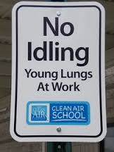
The public health message – “No Idling”

Slide 56


Slide 57
Changing the narrative
Changing infrastructure
Changing behaviours
Health Impact Assessment of Transport Initiatives: A Guide - Health Scotland

