Slide 1
ENGLAND’S HEALTH DIVIDE
TIM DORAN
UNIVERSITY OF YORK

Slide 2
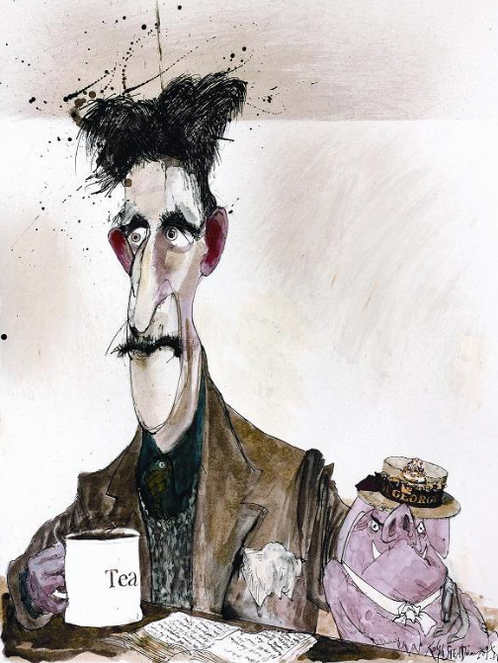
“…a smudge of smoke and misery hidden by the curve of the earth’s surface…”
Source: Orwell G, Homage to Catalonia
Notes:
“Southern England, probably the sleekest landscape in the world. It is difficult when you pass that way, to believe that anything is really happening anywhere. Earthquakes in Japan, famines in China, revolutions in Mexico? Don’t worry, the milk will be on the doorstep tomorrow morning, The New Statesman will come out on Friday. The industrial towns were far away, a smudge of smoke and misery hidden by the curve of the earth’s surface.”

Slide 3
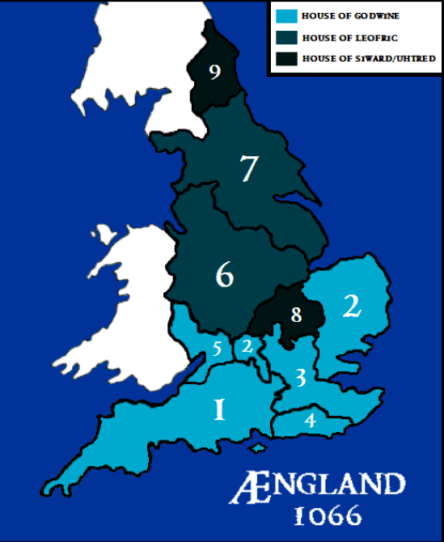
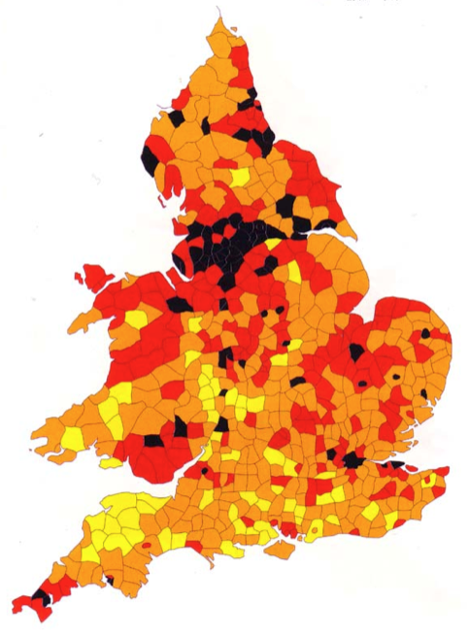
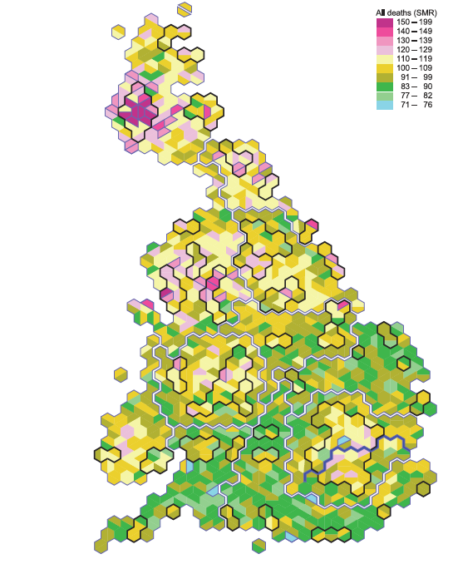
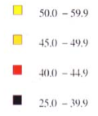
1086
1851
2001
SOURCES: WOODS R, SHELTON N, DORLING D.
Notes:
Maps:
Map 1) Tax-raising powers at the time of the Norman Conquest, showing wealth concentrated in the South of England.
Map 2) Mortality in Victorian England & Wales.
Map 3) Cartogram of Great Britain – hexes represent local authority areas, so map is re-scaled according to resident population. Colours represent standardised mortality rates in 2001, showing areas of high mortality rates concentrated in the North.

Slide 4
EXCESS MORTALITY, NORTH OF ENGLAND
Northern excess mortality (ages 0-75)
Year

Slide 5
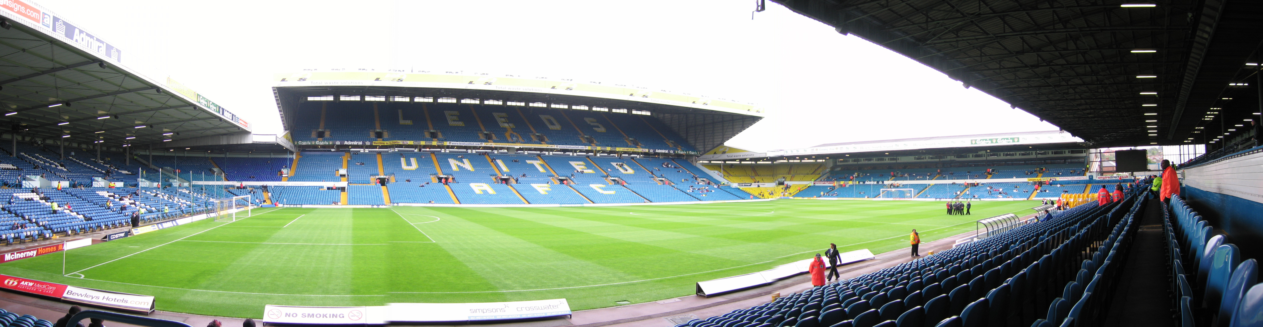
Notes:
Picture:
Leeds United football stadium, capacity 38,000.
Each year the premature deaths in the North of England (compared with the South) would fill the stadium.
The population of York every 3.5 years

Slide 6
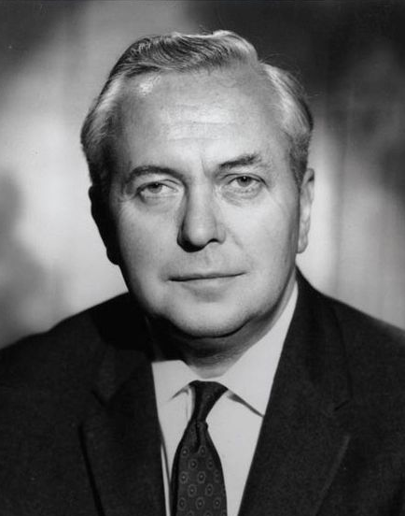
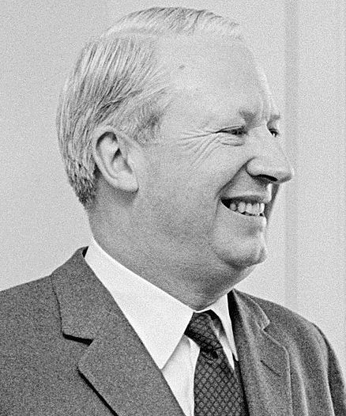
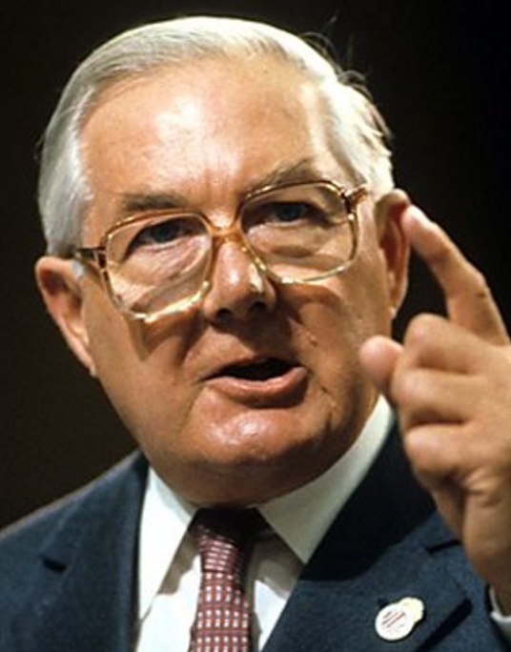
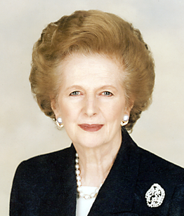


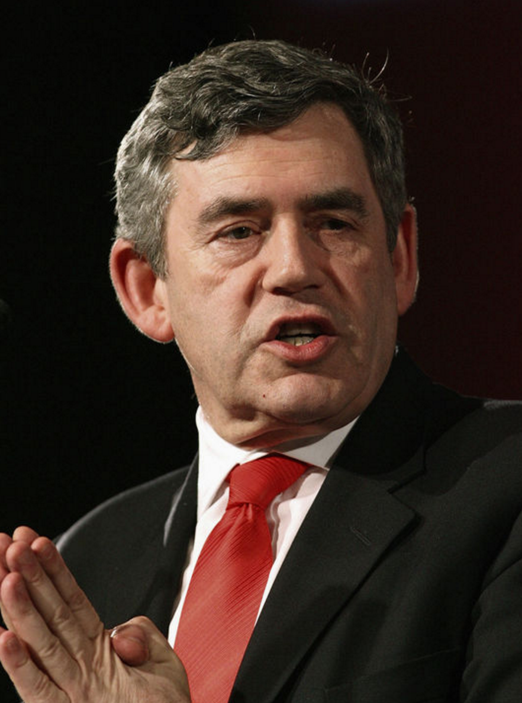
Northern excess mortality (ages 0-75)
Year

Slide 7
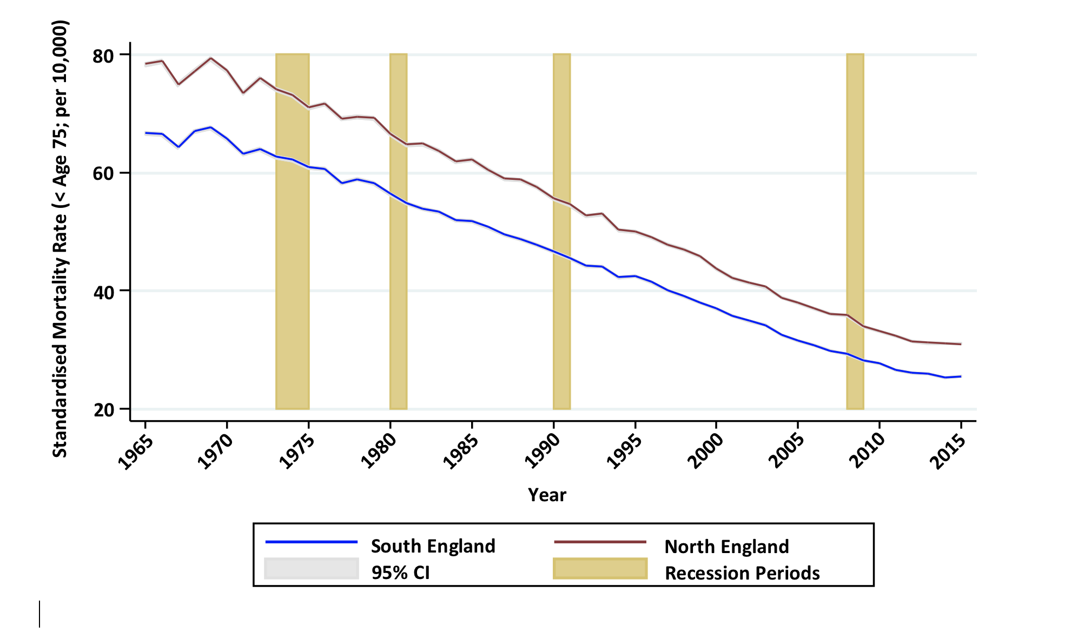
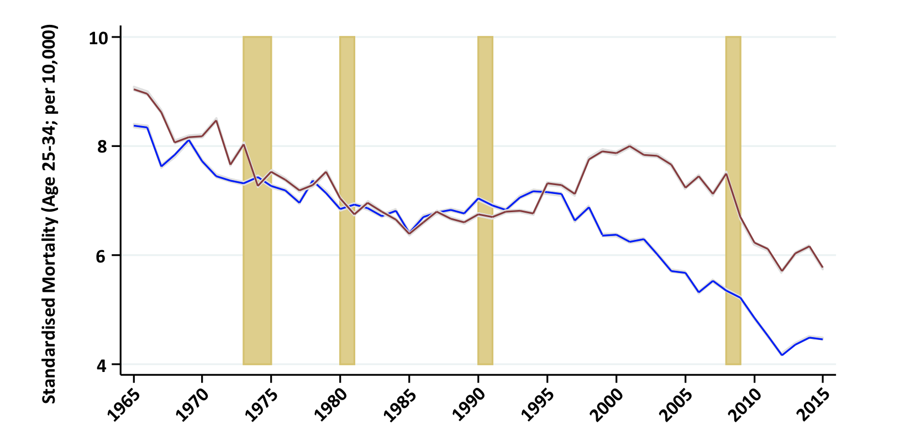
MORTALITY RATES, 1965-2015
AGE <75
AGE 25-34

Slide 8
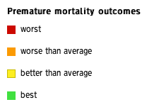
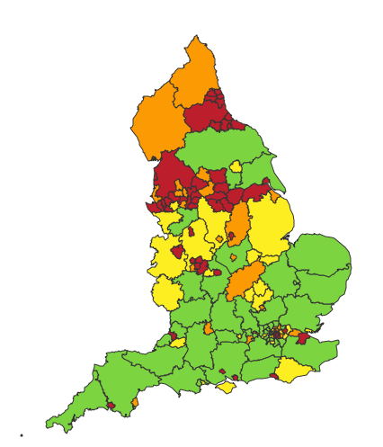
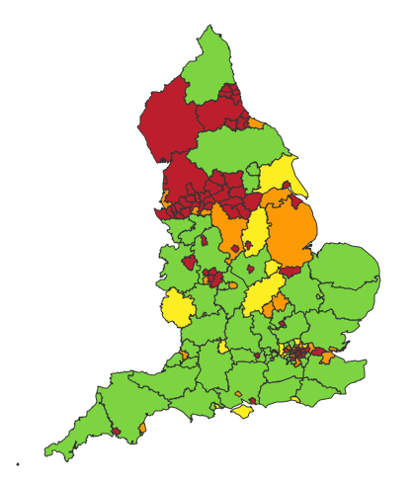
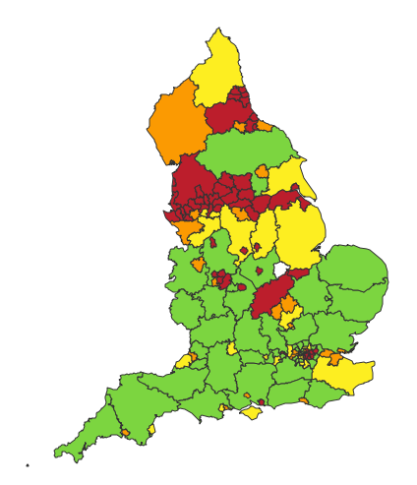
CAUSES OF DEATH
CANCER
CARDIOVASCULAR
DISEASE
RESPIRATORY DISEASE

Slide 9
EMERGENCY ADMISSIONS

Slide 10
CAUSES
CAUSES

Slide 11
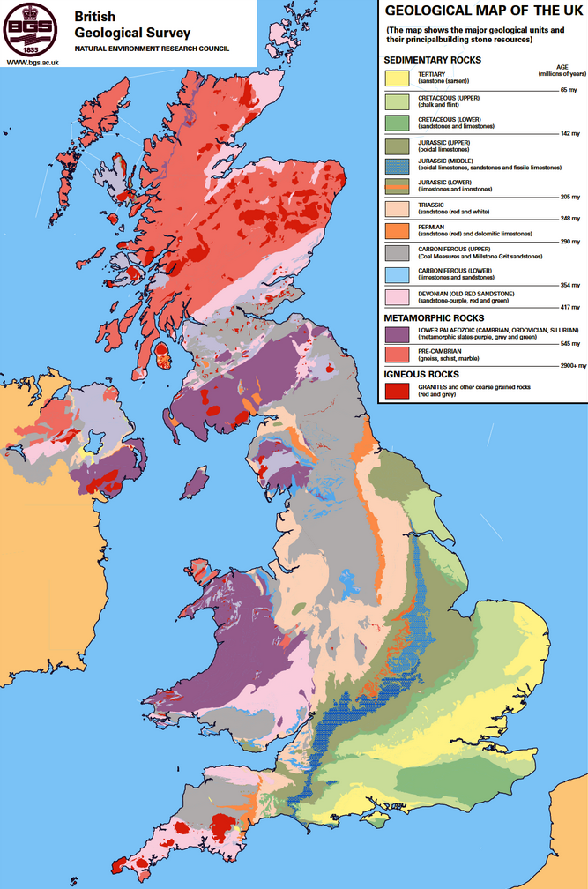
GEOGRAPHY
GEOLOGY
N: Igneous
S: Sedimentary
CLIMATE
N: Cold, wet
S: Warm, dry
INDUSTRY
N: Mining
S: Arable farming
SOURCE: BRITISH GEOLOGICAL SURVEY
Notes:
Rock gets younger as you move south and east.
The red and purple is granite and slate, and then bands of sediment were laid down over millions of years.
There is a very conspicuous band of Jurassic rock (~150m years old) running along that familiar line between the Severn and the Wash.
Is this just coincidence?
Creates a channel for the Avon and Nene – a physical boundary that became an administrative boundary.
There are all sorts of reasons why geology might affect health.
1) Above that line is old grit and coal, below it is young chalk and sandstone. Older rock gives rise to softer water with lower mineral content, and that is associated with cardiovascular disease.
2) A ridge of hills – the Pennines – runs up the spine of England trapping wet air coming in from the Atlantic creating a relatively cold and wet climate in the North and a warm, dry, sunny climate in the South and East. Lack of sunshine can have physiological and psychological effects, and affects the kind of crops that you can grow and the diet that you have.
3) Geology also has other indirect effects: it determines the types of industry that develop. In the North you have coal and iron. A damp climate turns out to be ideal if you’re trying to weave cotton. So the Industrial Revolution took root in the North, which you would think would have produced some prosperity, but there are numerous reasons why it didn’t:
Those industries required a lot of cheap labour quickly, living and working in conditions that were damaging to health.
Whilst the disease associated with industry stayed in the North, a lot of the money moved South towards the capital.
Entire communities became dependent on those industries without ever becoming wealthy. When the coal ran out and the mills closed there was often no Plan B, and those areas went into steep decline.
This all affects migration…
Old igneous and metamorphic rock in the north (Wales and Scotland) – granite (really old) and slate.
Overlaid with younger sediments as you move south.
Carboniferous grit and coal laid down over limestone in the north ~350m years ago.
Sandstone and chalk in the south ~65m years ago.
Dividing band of Jurassic limestone and sandstone, about ~150m years old.
These older rocks also give rise to soft water with a relatively low mineral content, which in turn is associated with higher rates of ischaemic heart disease and stroke.
Wet air coming in from the west – the Atlantic and the pole – hits the Pennines and falls as rain. It also creates ideal damp conditions for spinning cotton.

Slide 12
SOCIAL STATUS
% IN POOR HEALTH
SOURCE: DORAN, BMJ 2004, 328: 1043-1045

Slide 13
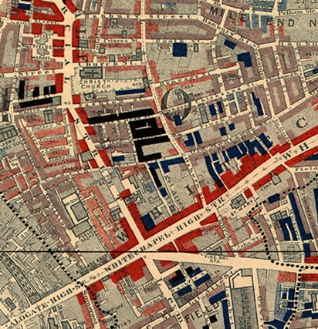
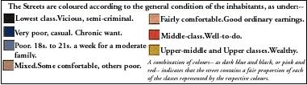
THE CAPITAL
“London is nourished by the literal consumption of bone and sinew from the country...”
SOURCE: BOOTH C, LIFE AND LABOUR OF THE PEOPLE IN LONDON
Notes:
Charles Booth:
“London is nourished by the literal consumption of bone and sinew from the country; by the absorption every year of large numbers of persons of stronger physique, who raise the standard of health... only to give place to a fresh set of recruits, after London life for one or two generations has reduced them...”

Slide 14
SOLUTIONS
Notes:
RDAs created in 1998 to help develop regional economies – recently abolished in favour of Local Enterprise Partnerships (initially given no money cf £2billion for RDAs, then asked to compete for a share of £1.4 billion local growth fund.

Slide 15
LOCAL BUDGETS
SOURCE: TAYLOR-ROBINSON ET AL, BMJ 20 JUNE 2013

Slide 16
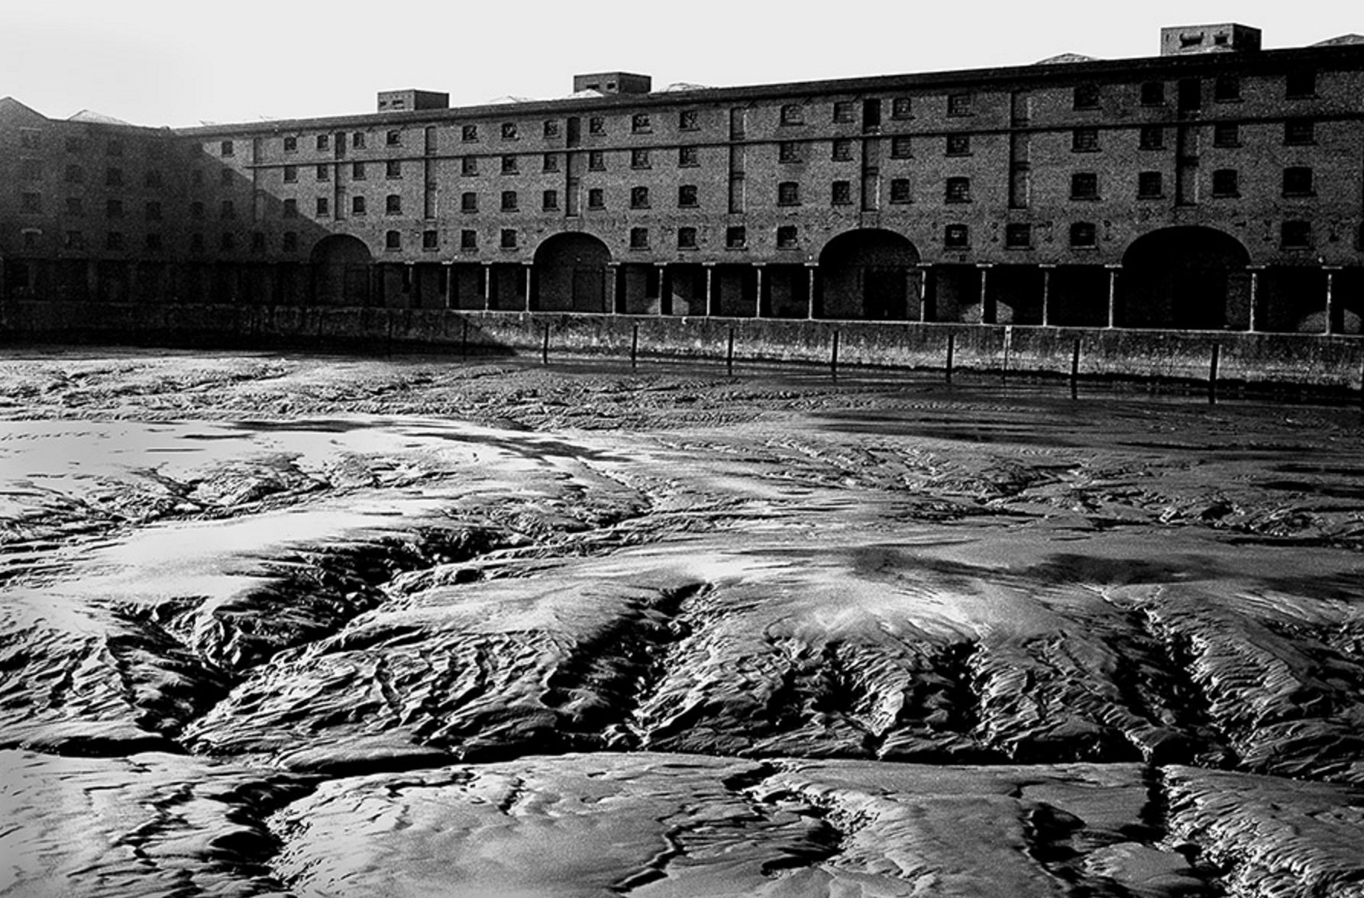
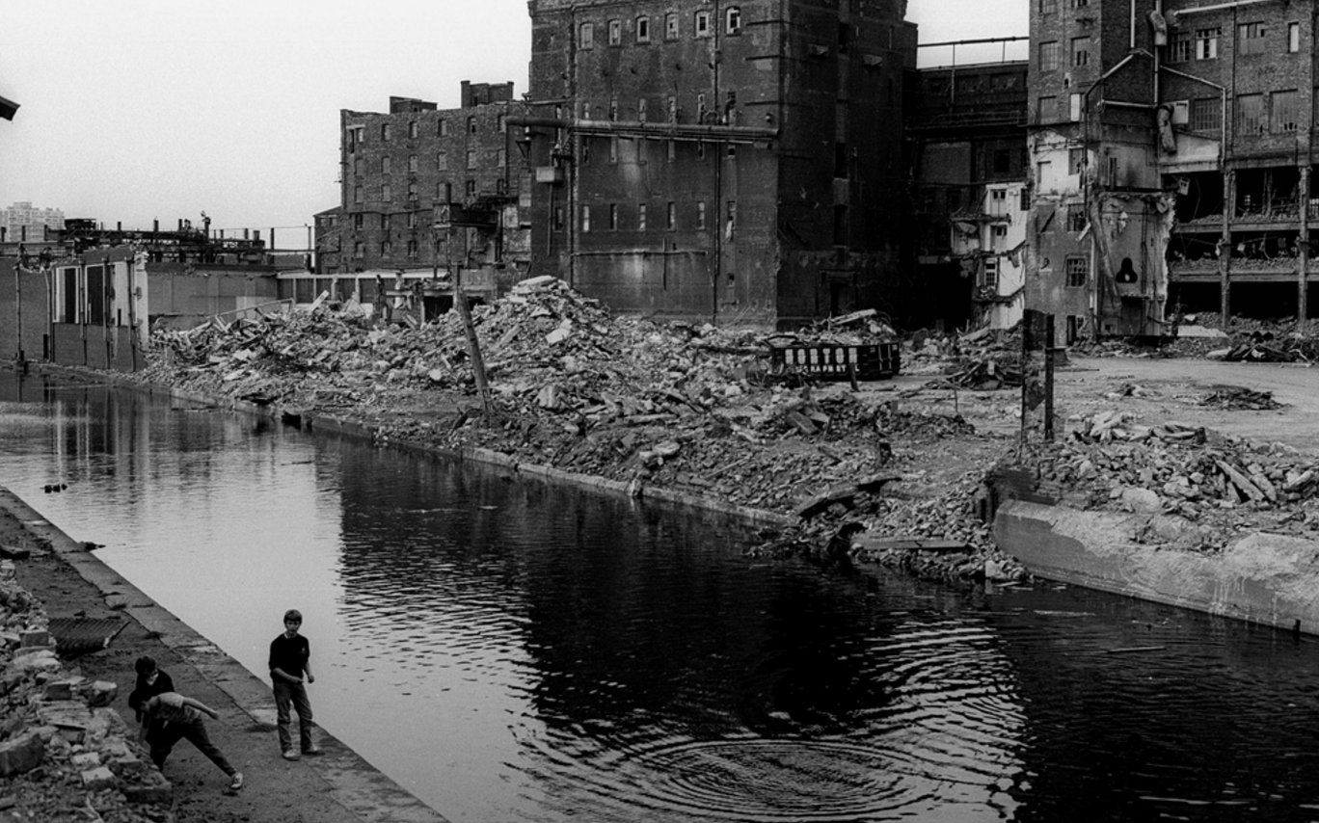
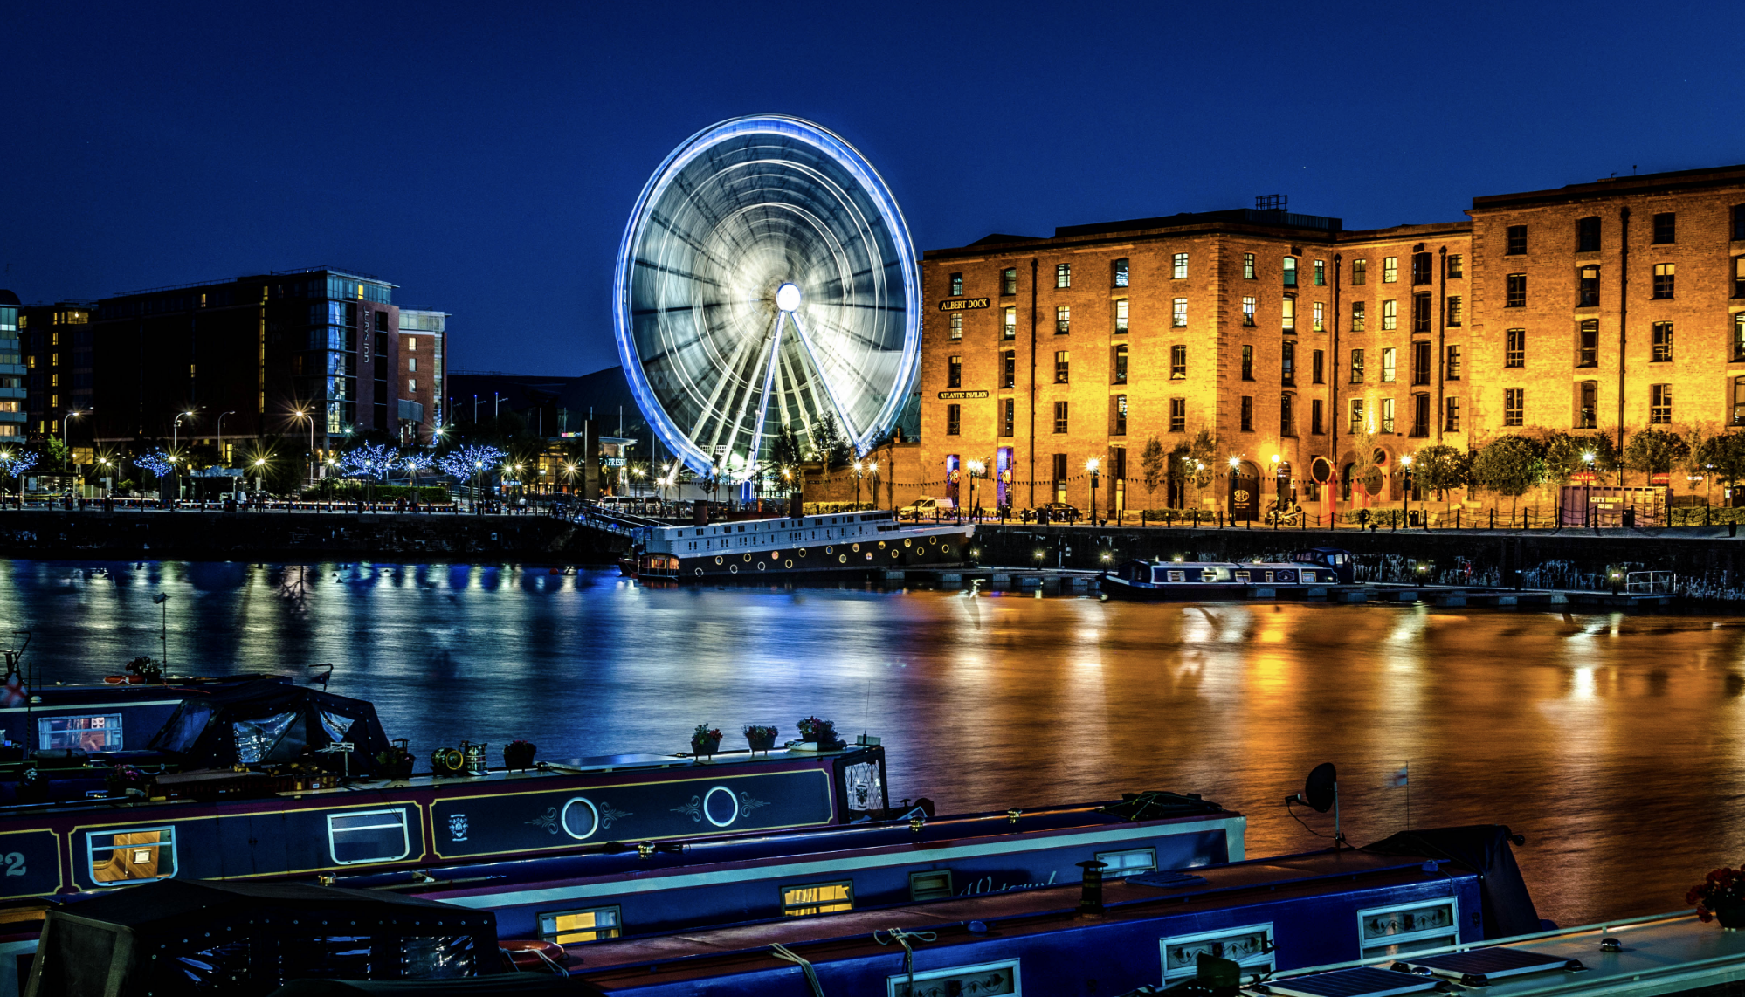


Slide 17
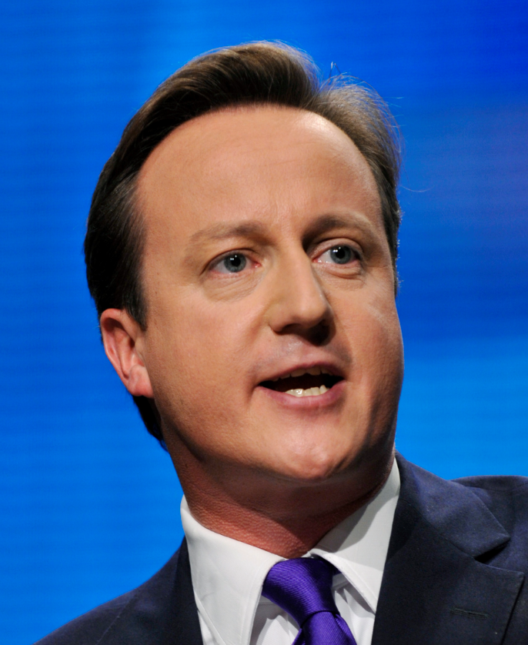
“…let's make Blackpool the centre of Europe for the shale gas industry.”
“HS2 is about bringing North and South together in our national endeavour.”
Notes:
We’re building an economy for North and South…

Slide 18
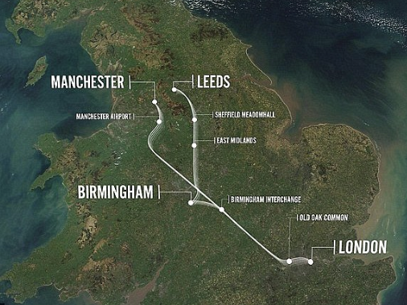
“Where you have one dominant capital and you connect [it] to peripheral cities by high speed rail, the bulk of the gains accrue to the capital.
The evidence for that is very strong.”
SOURCE: TOMANEY J, IMPACTS OF HIGH SPEED RAIL (CM201012)
Notes:
£42 billion

Slide 19
SPEND (£MILLIONS)
SOURCE: IPPR, ON THE WRONG TRACK, 2011
Notes:
National Infrastructure Plan: £30 billion transport infrastructure spend - 91% of the spend is in the South
NE: £13m - £5 per head
London: £27,324m - £2,731 per head

Slide 20
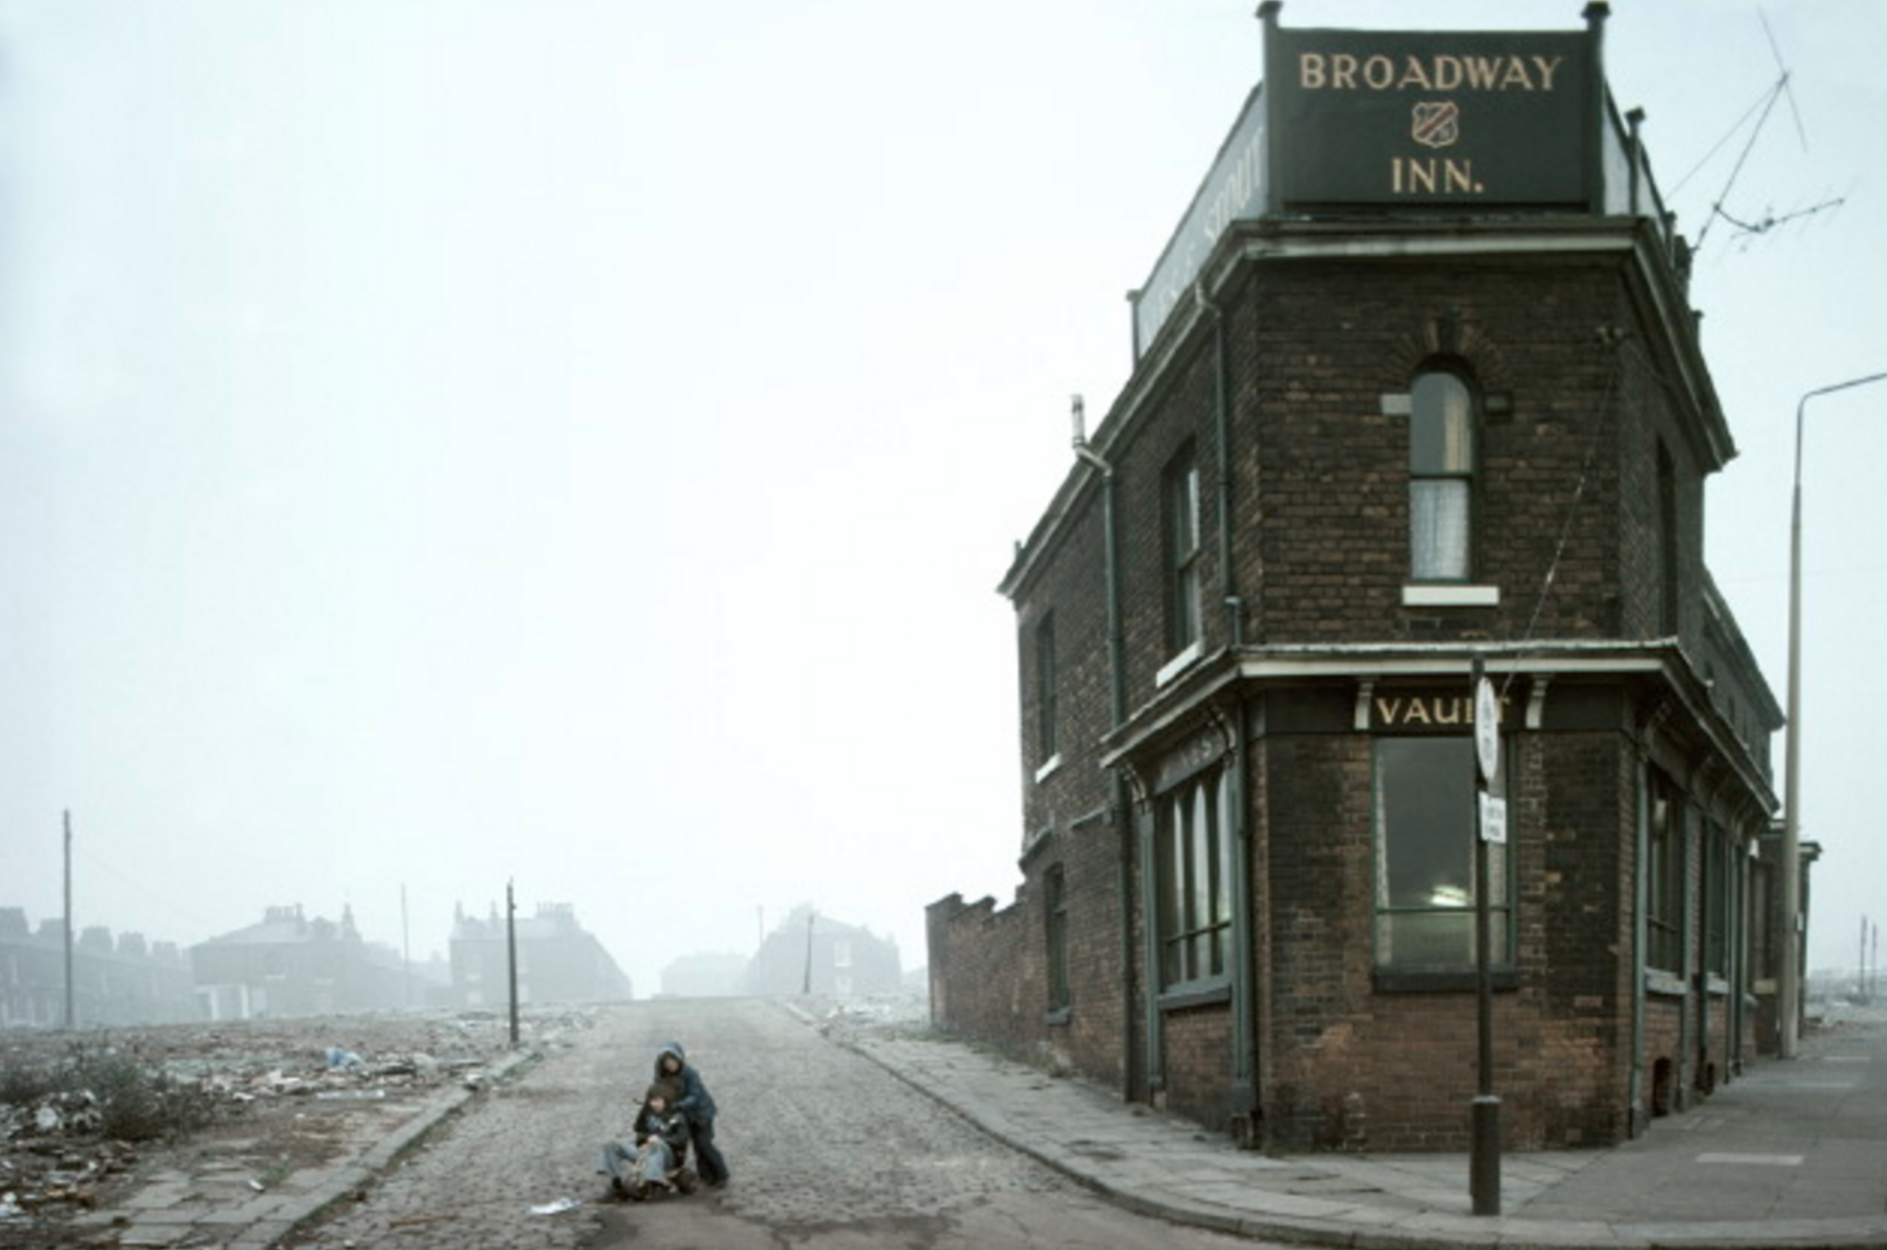
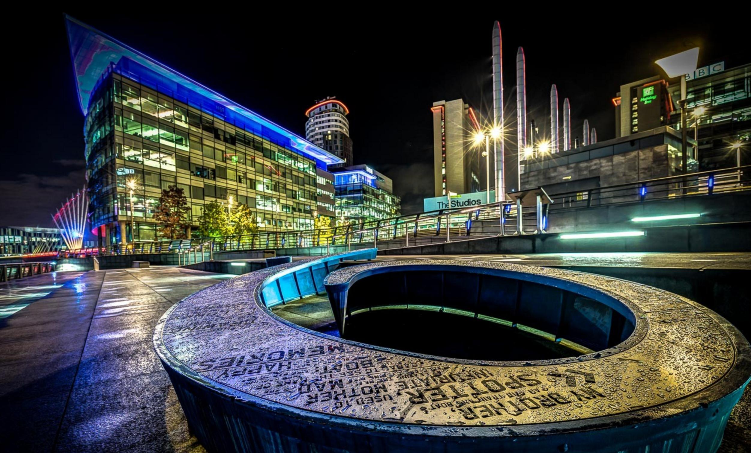
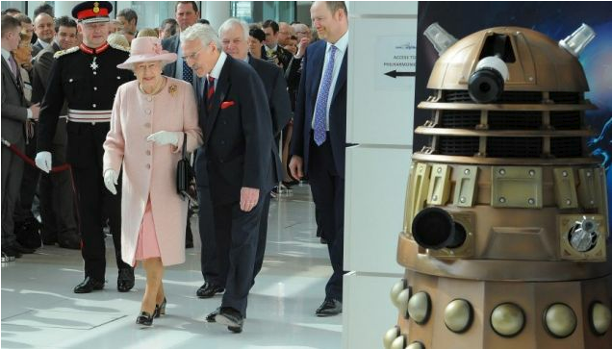

“The objectives were… to serve audiences in the north of England… and provide economic and other benefits to the region.”
Notes:
The BBC is public property – every household in the UK with a licence contributes £145.50 towards its £5 billion budget.
The BBC has regional outposts, but over 90% of its resources are concentrated in London. This has two main effects:
A massive redistribution of wealth from the provinces to the capital.
It gives the UK’s key news and cultural outlet a London-centric view of the world.
Move cost £573-942 million
2,300 people directly employed (but only 254 from Greater Manchester and 39 people from Salford)

Slide 21
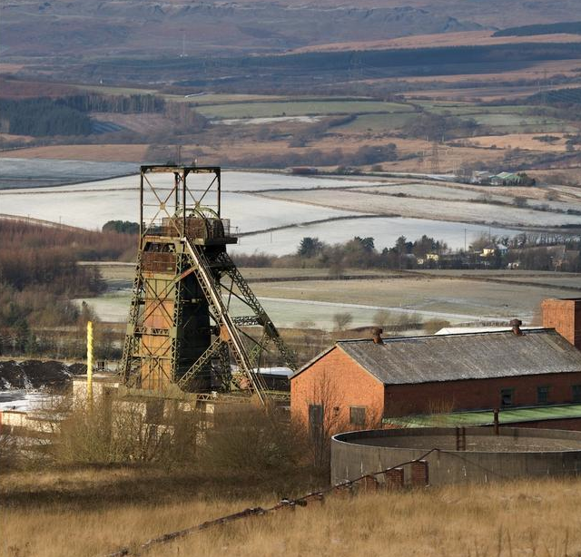
GLYNCORRWG
POPULATION 1900
(64% SOCIAL CLASS V)
SCREENING FOR:
BLOOD PRESSURE
BMI
CHOLESTEROL
DIABETES
LUNG FUNCTION
SMOKING
MORTALITY
6% BELOW
NATIONAL AVERAGE
SOURCE: TUDOR HART ET AL, BMJ 1991; 302: 1509-1503.
Notes:
Julian Tudor-Hart, academic GP, coined the term “inverse care law” to describe the mismatch between the need for health care and its provision.
He worked in the deprived mining community of Glyncorrwg as the local GP and instigated a programme of anticipatory care, detecting chronic disease and initiating early treatment. After 20 years mortality rates were 6% below the national average, compared with 60% above the national average in the adjacent (and similarly deprived) village of Blaengwynfi.

