Slide 1
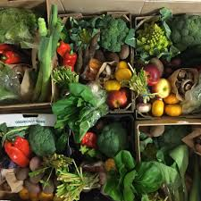


Calderdale Good Food Movement
My Food Community – Wednesday April 27th 2022

Slide 2

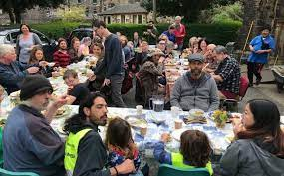
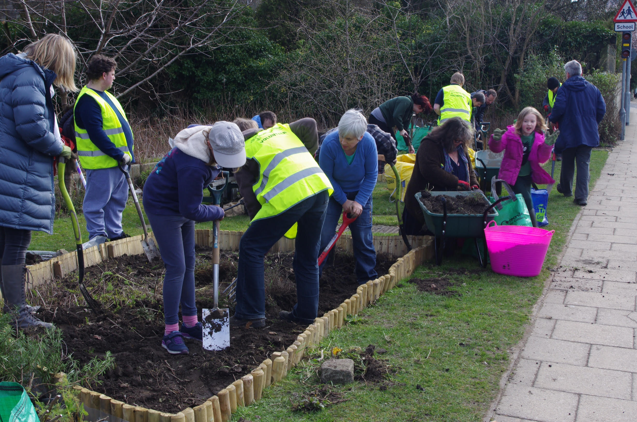

Slide 3

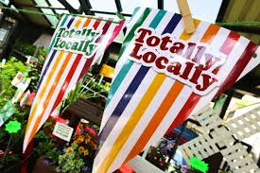

Slide 4

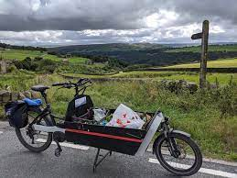

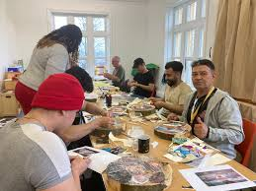
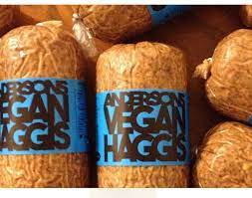

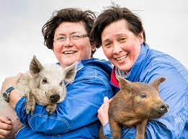
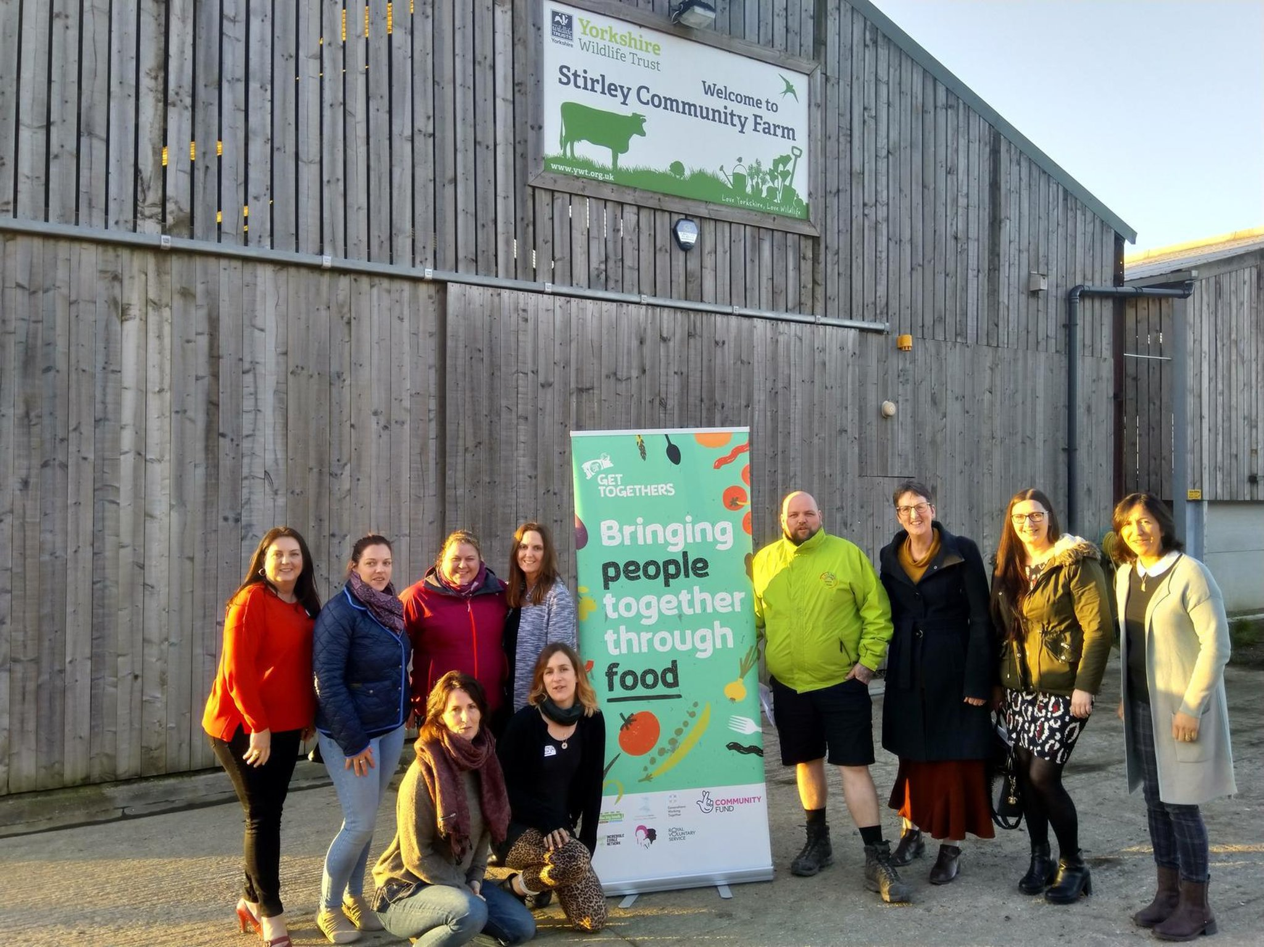

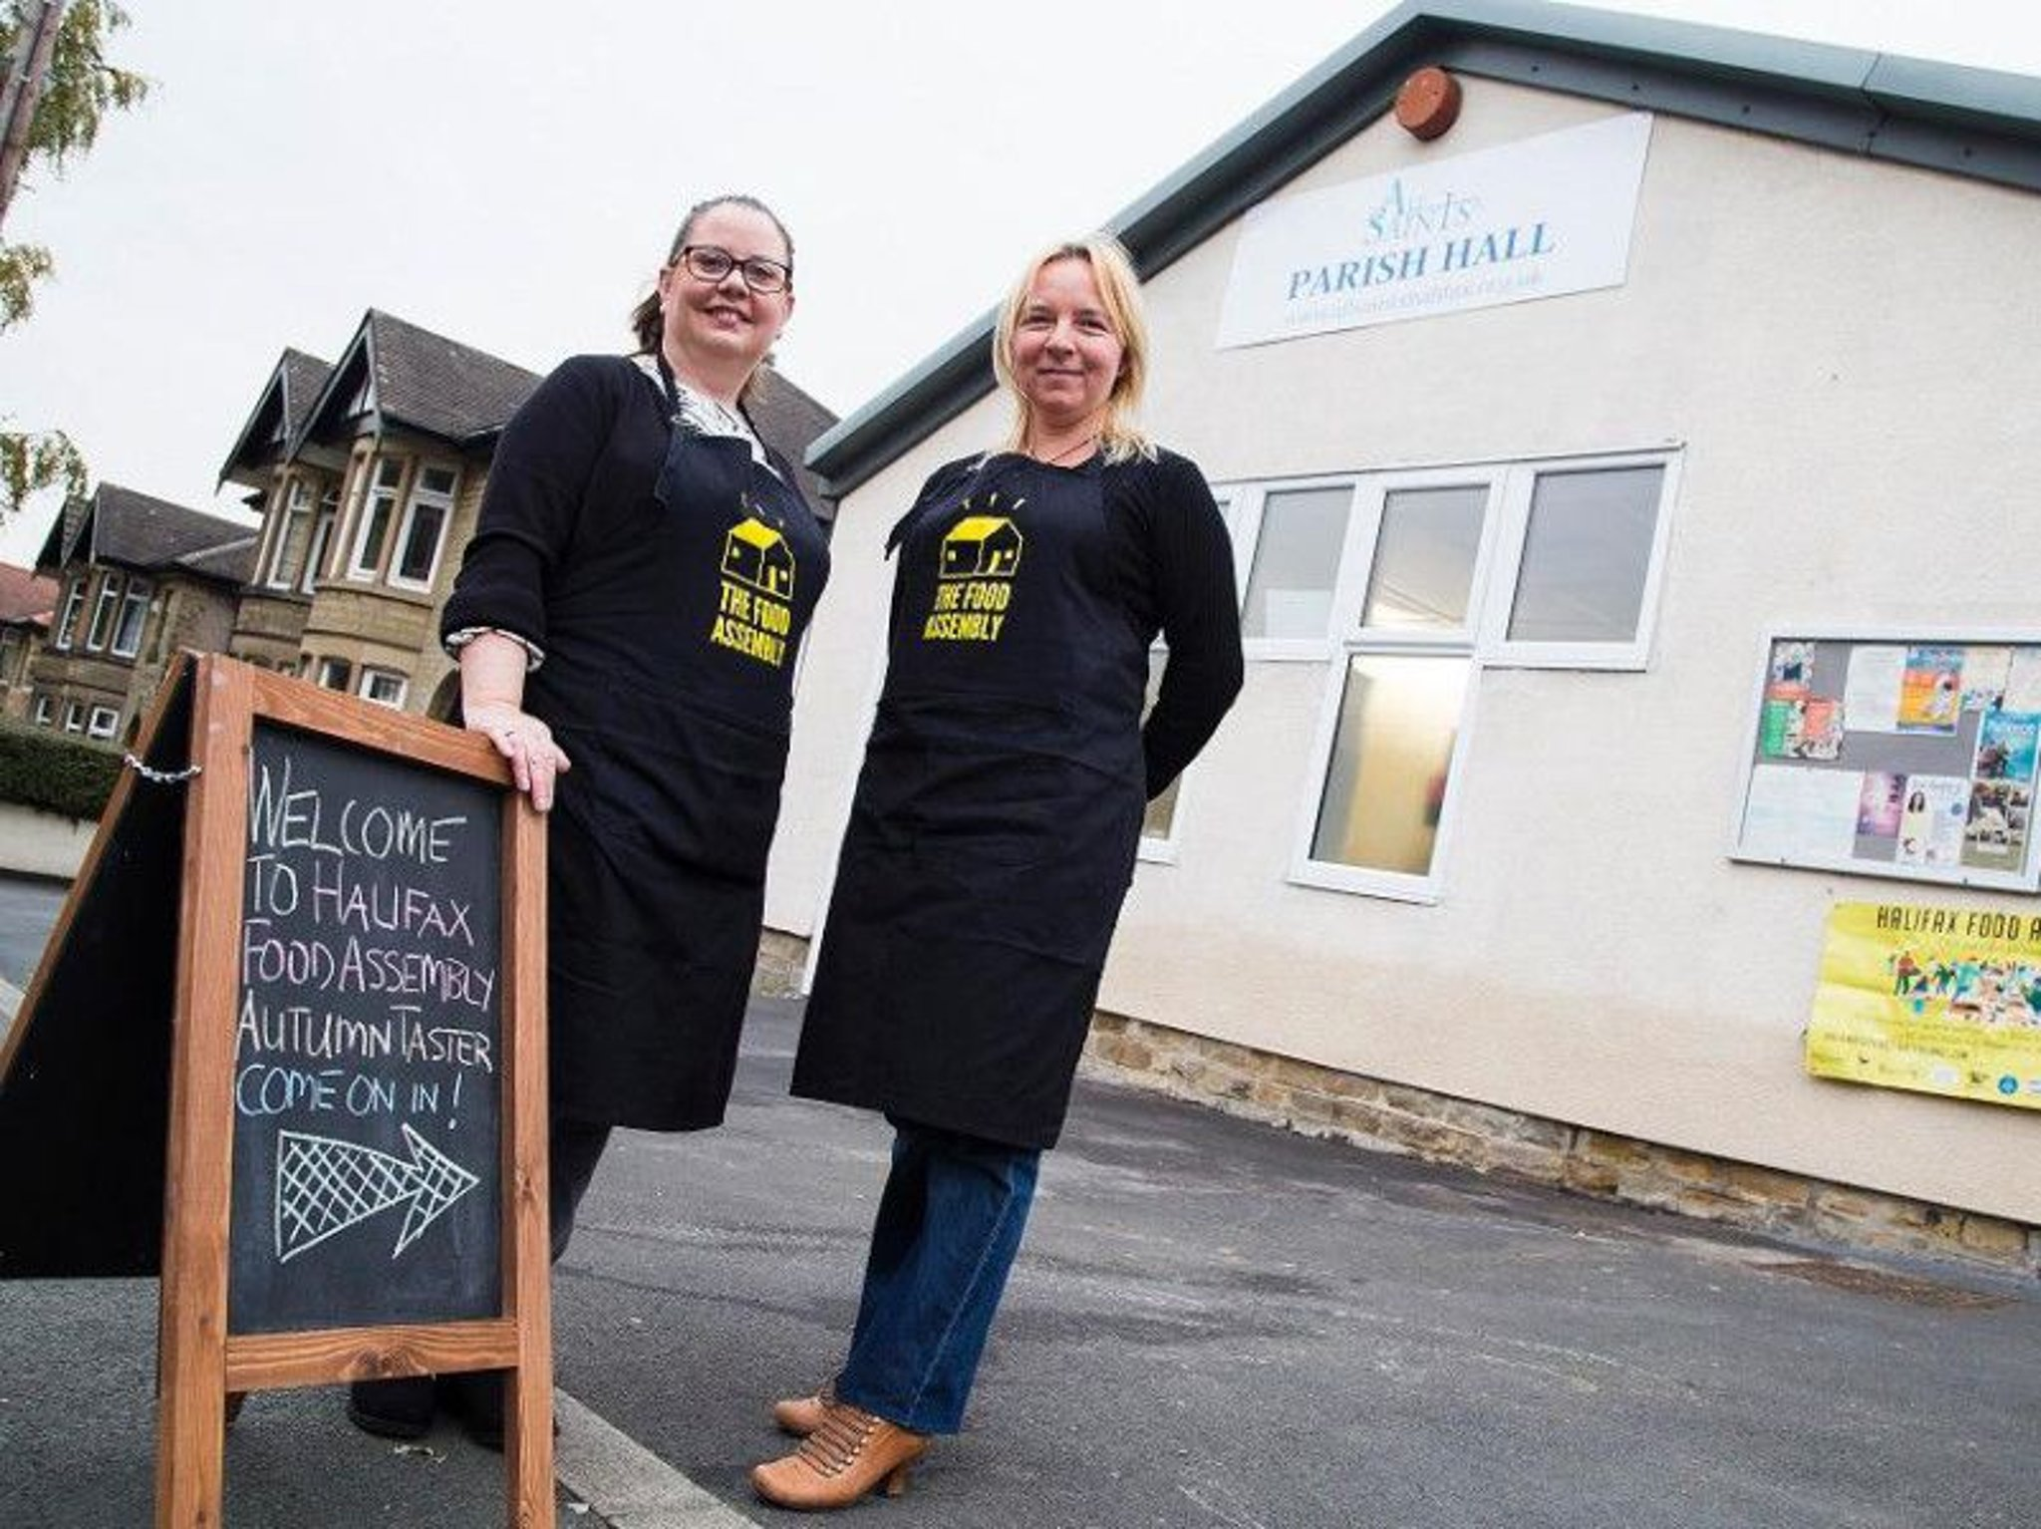


Slide 5


Calderdale – passion, innovation, kindness……
Inequality…….Food Poverty……. Poor nutrition……Climate Emergency

Slide 6
Calderdale Good Food Movement
-3 themes-
Calderdale - Market Garden - peri-urban food production
Calderdale - Resilient, diverse, sustainable food economy
Calderdale - Healthy, affordable, sustainable food -accessible to all
The Calderdale Food Charter, a public facing campaign and call to action, aimed at bringing people together to establish a culture of good food for all and address climate change issues…

Slide 7
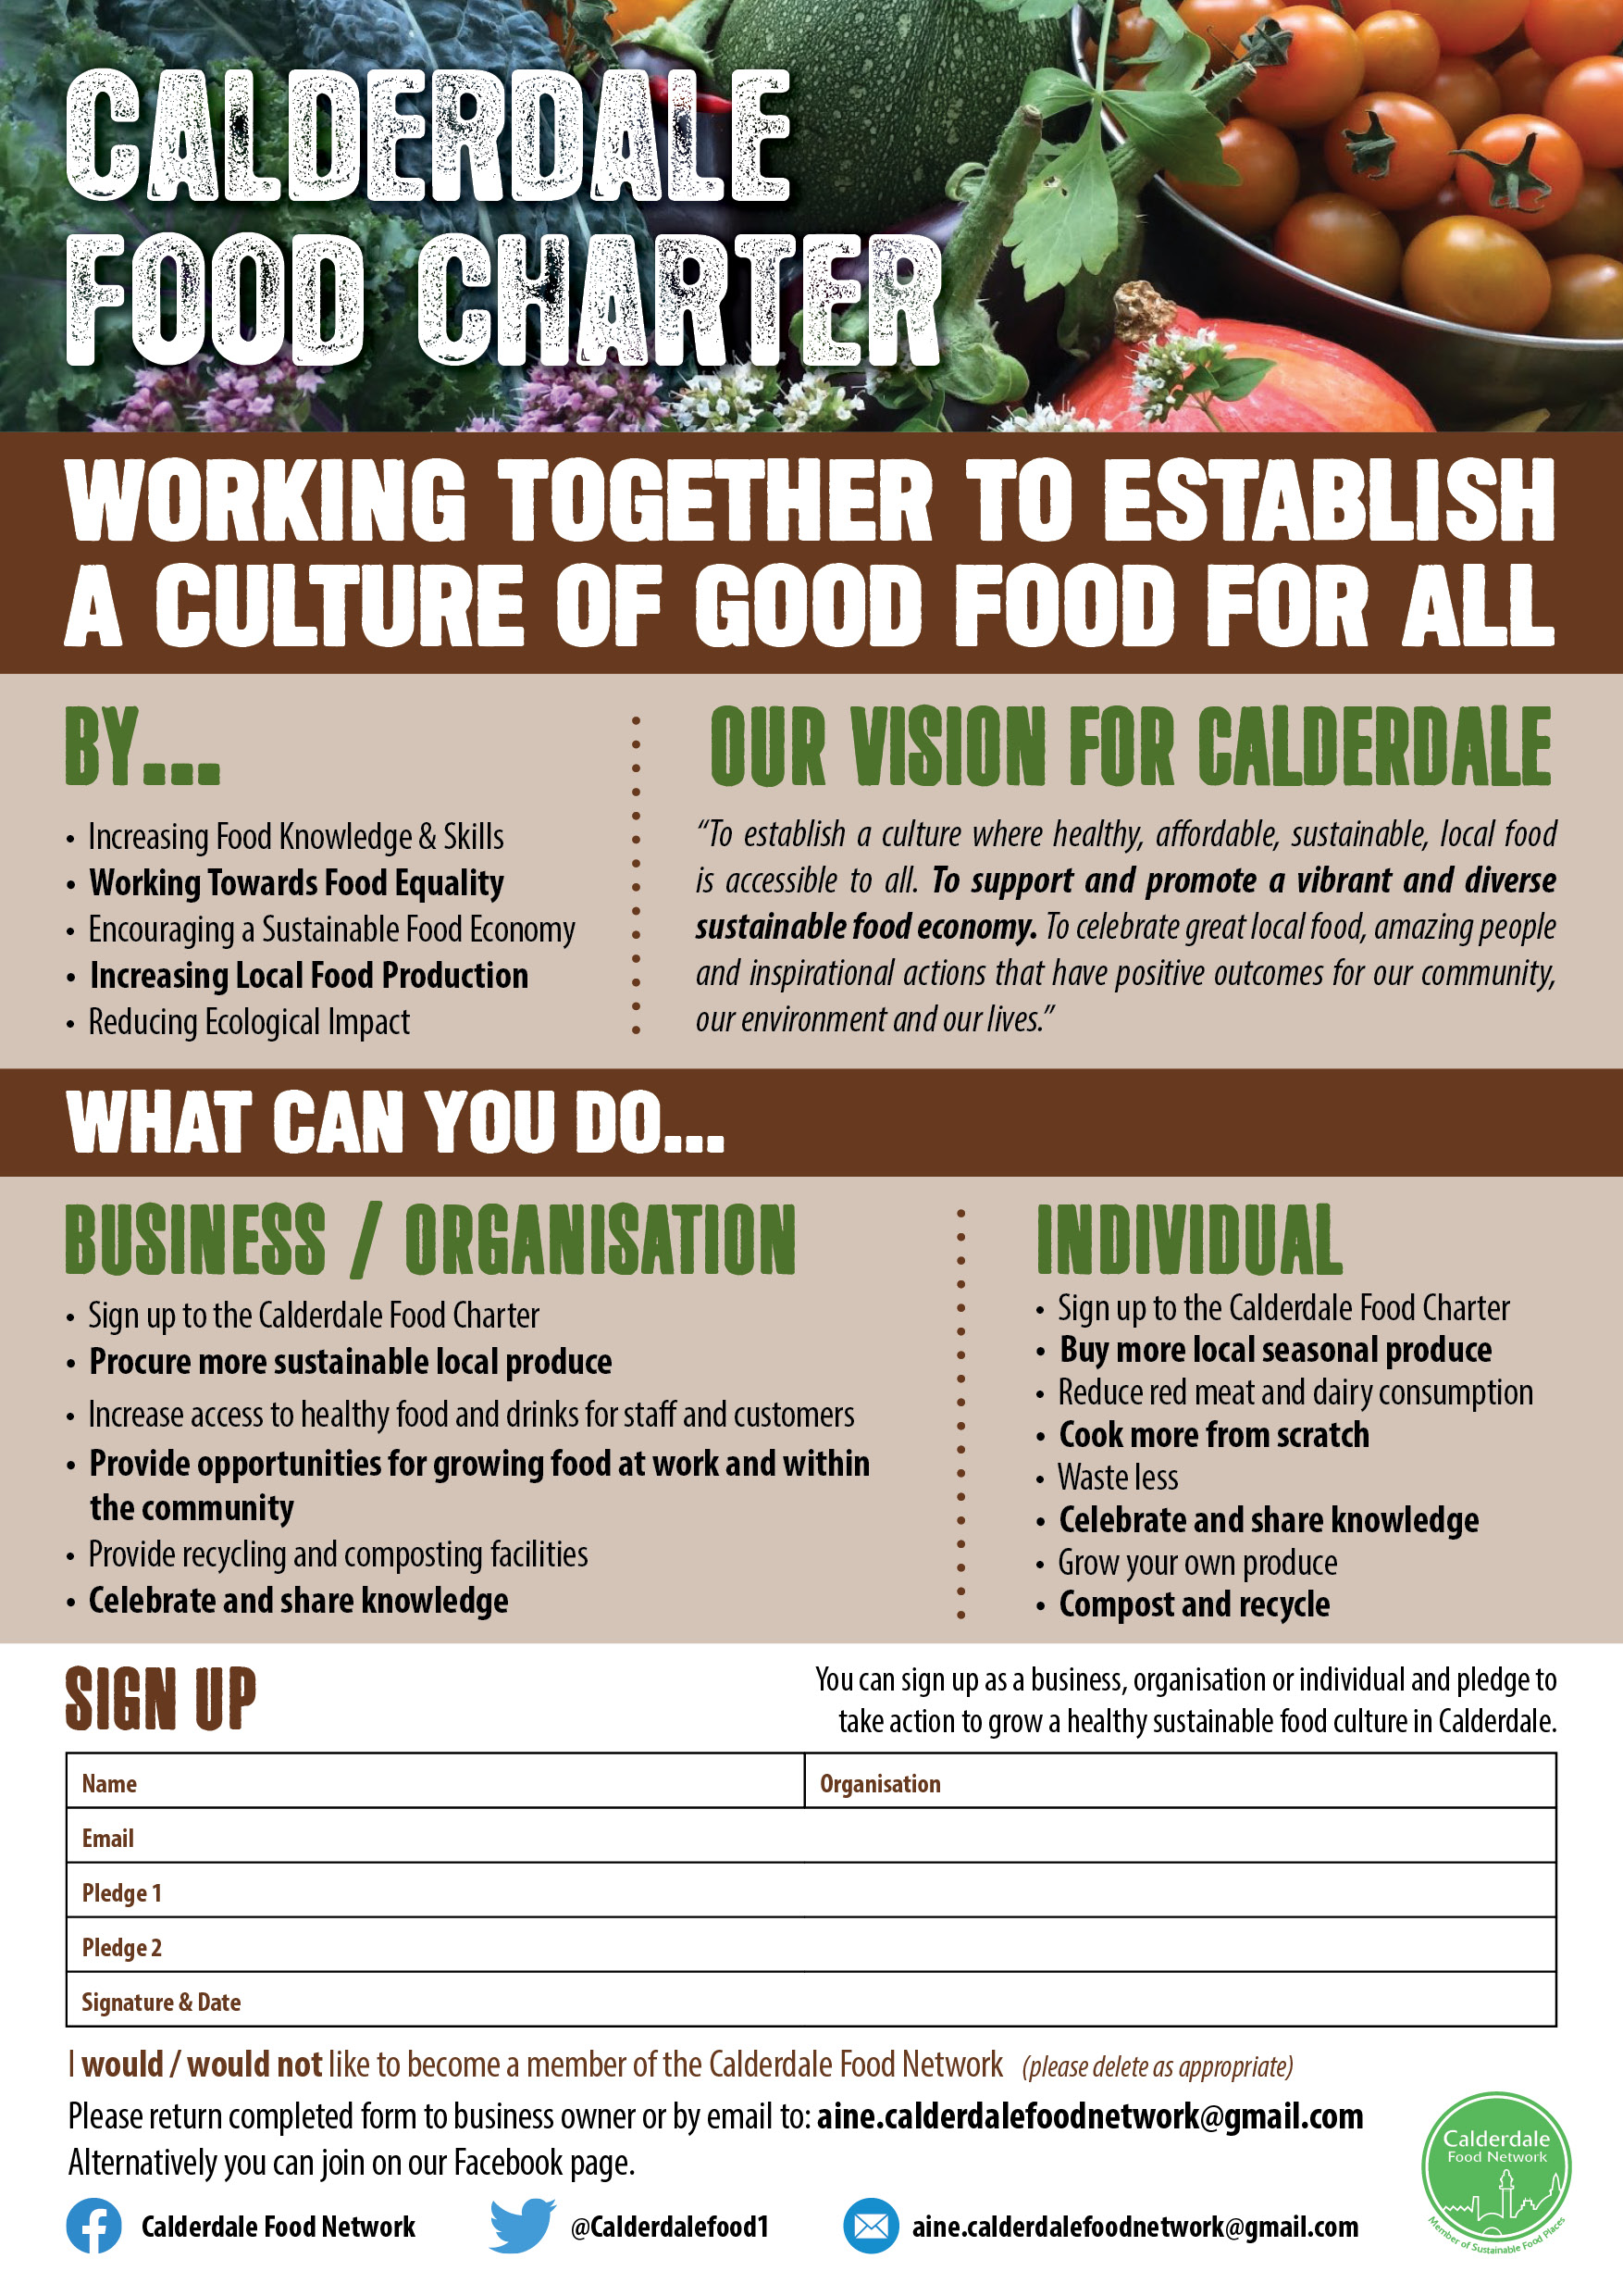
Harness passion and kindness
Encourage Innovation
Collaborate and Integrate
Empower small actions
Simplify the message
Encourage Food Citizens
Create a Good Food Movement

Slide 8

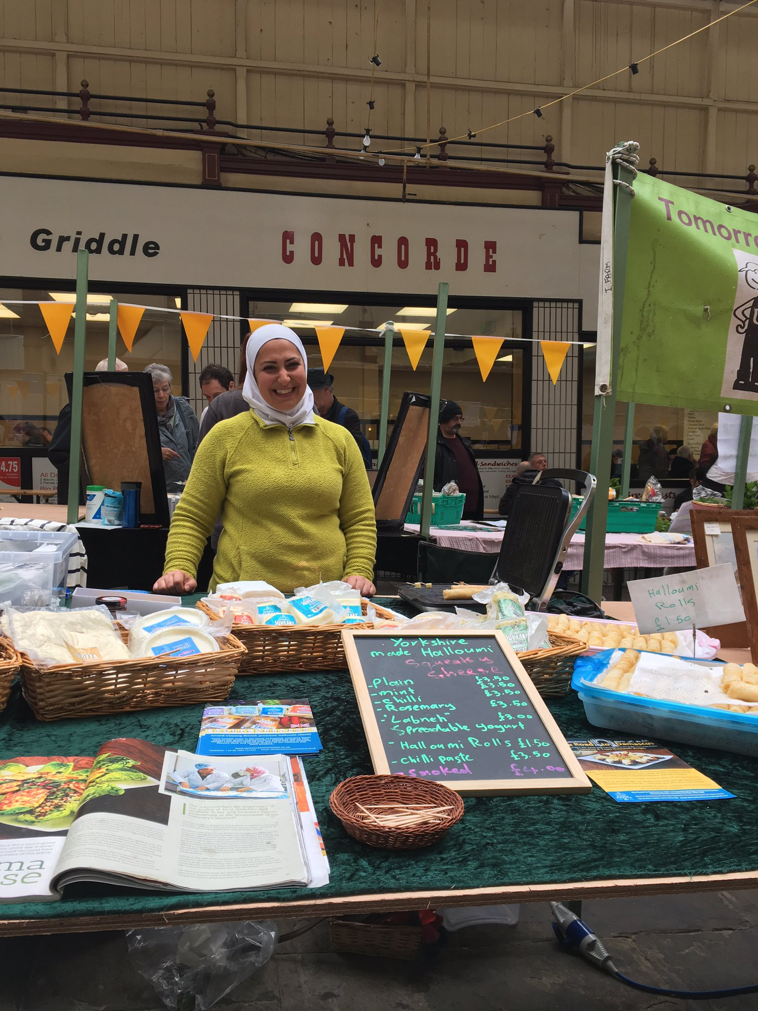
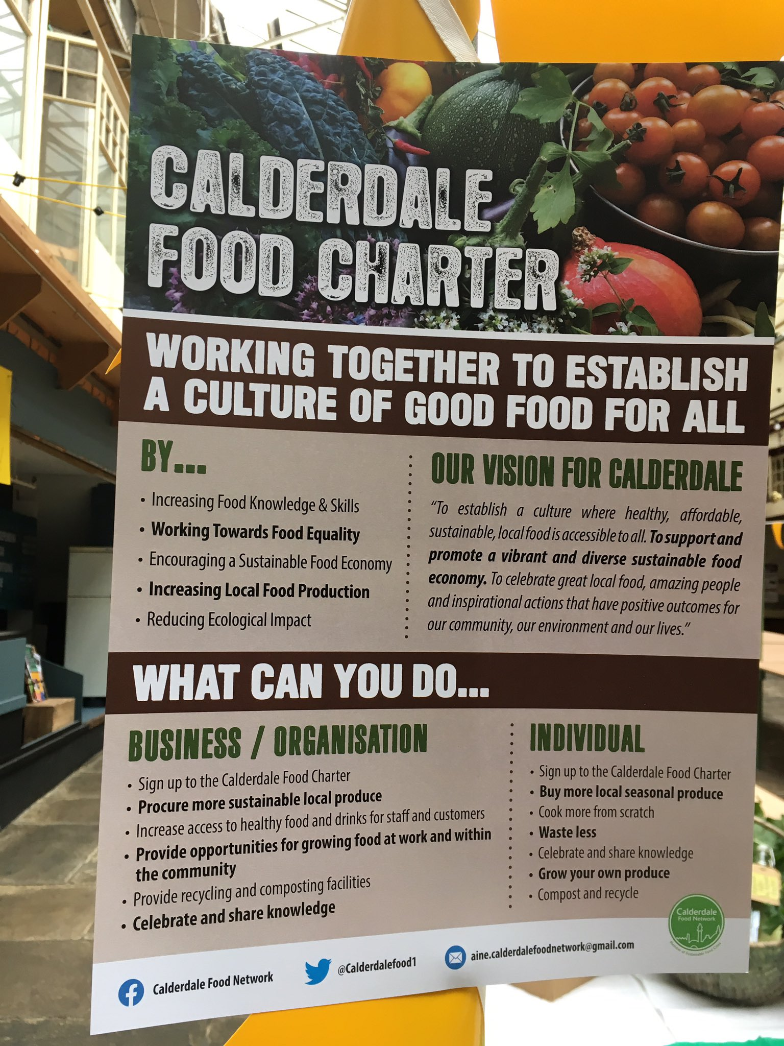

Slide 9
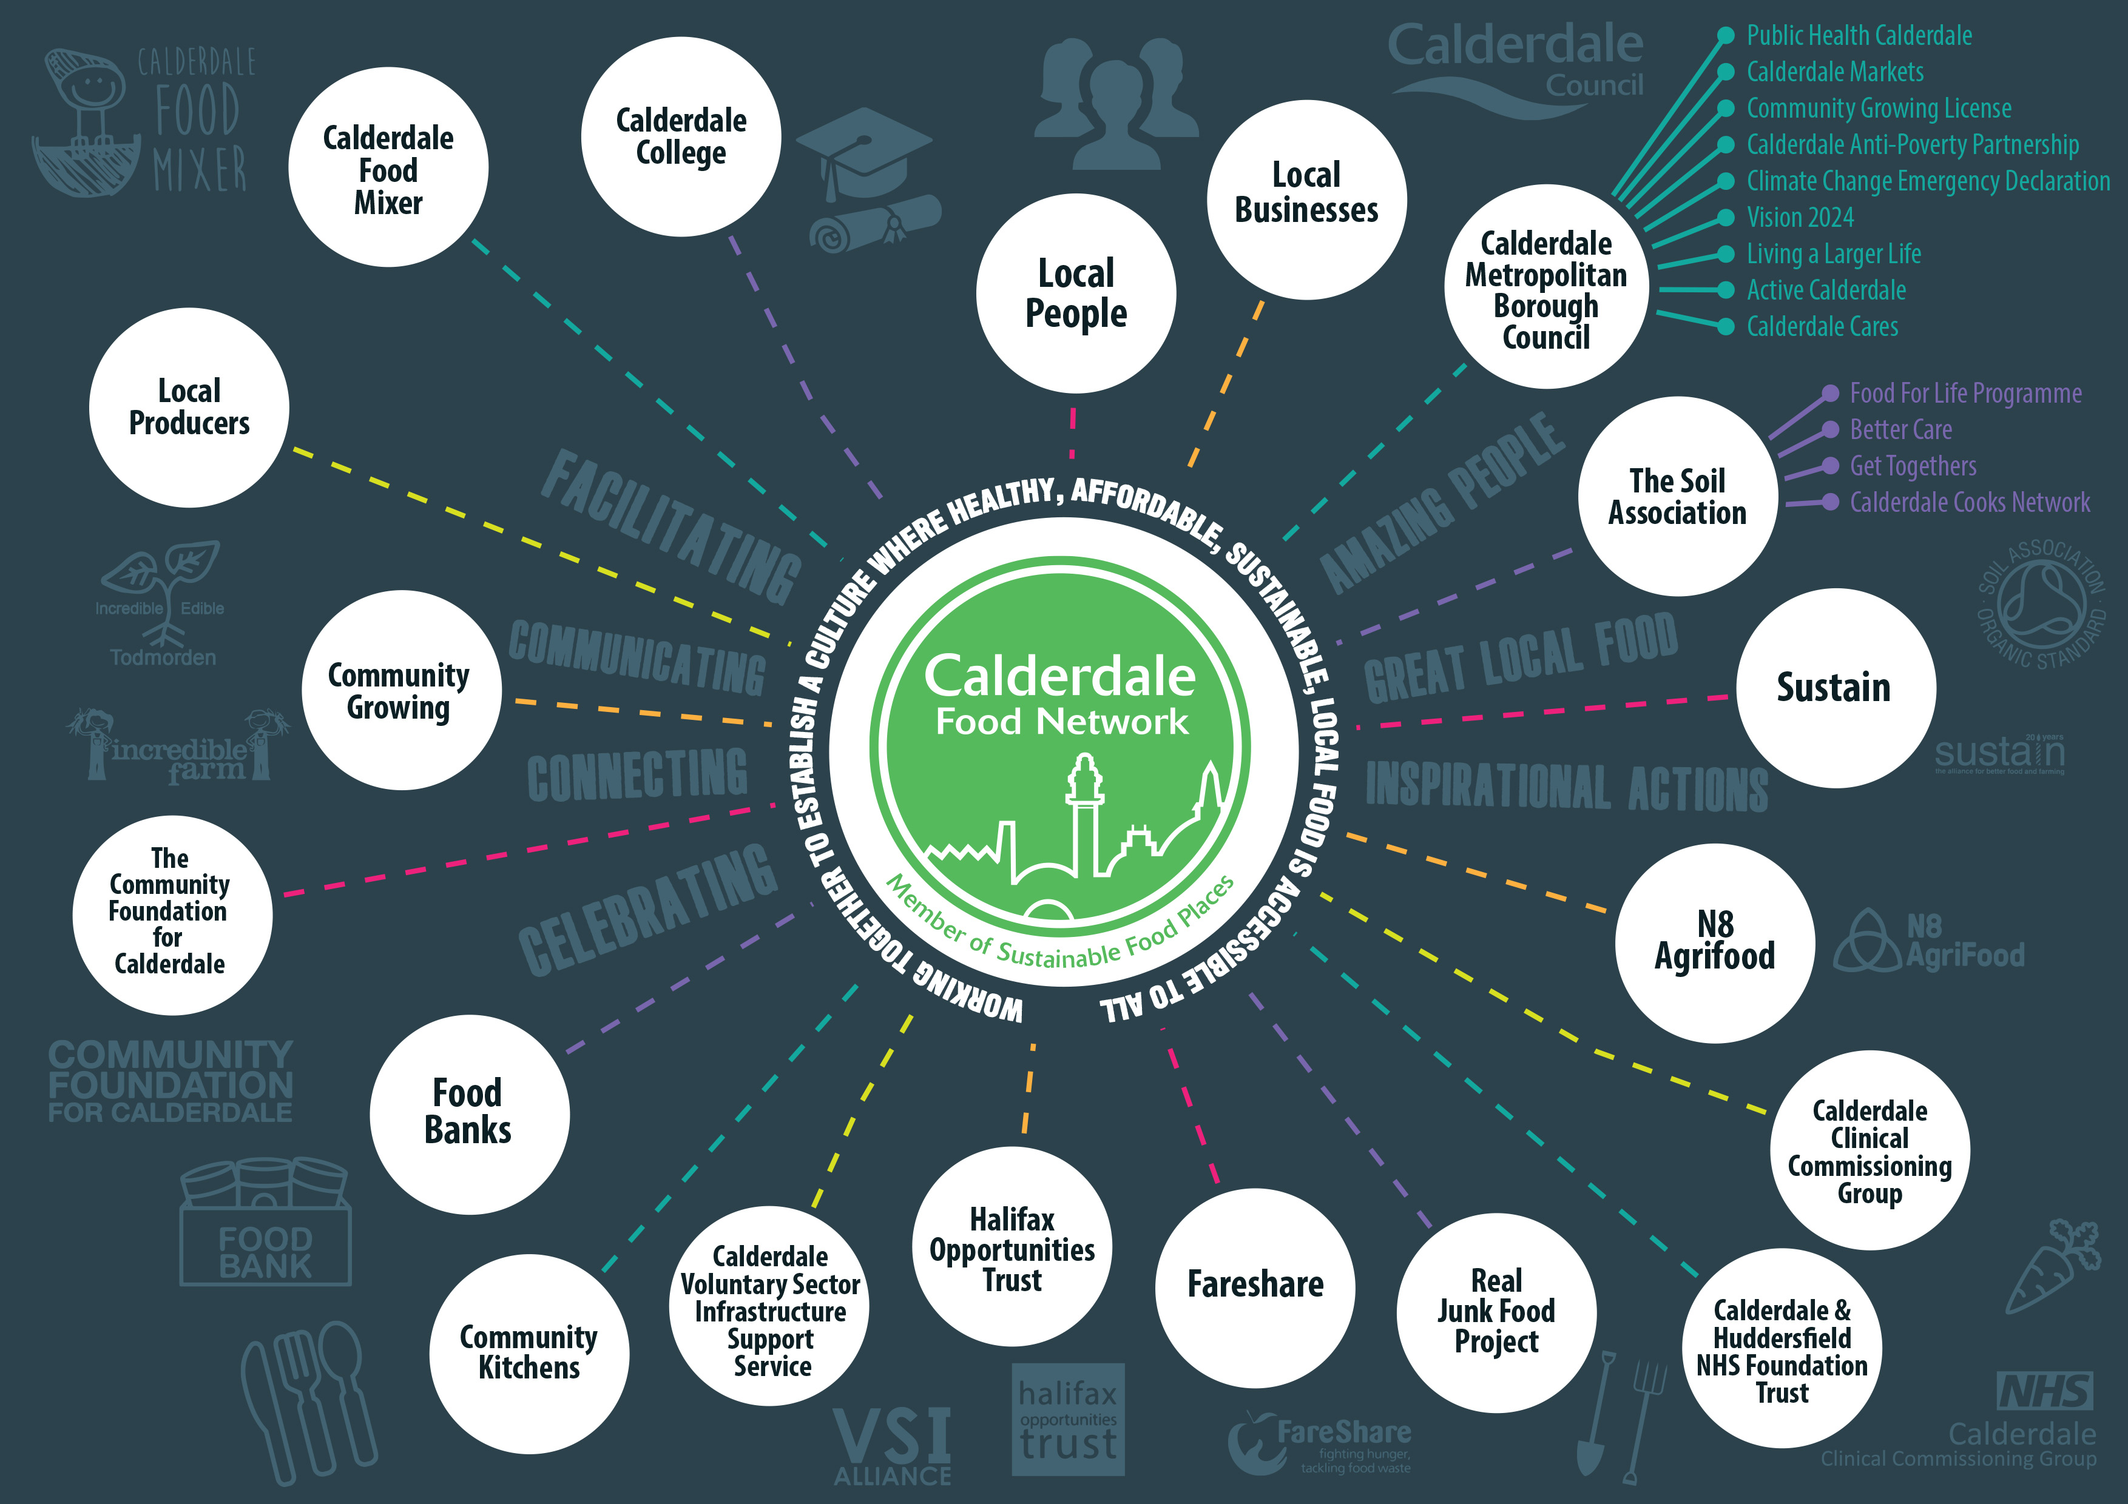
Calderdale Good Food Movement
Communication
Connections
Collaboration
Change

Slide 10


Slide 11
Park Ward - one of the most socio-economically deprived areas in Calderdale. Families face challenges with finances, accommodation, mental health & accessing services. Majority BAME families employed in sectors most affected by job loss /risk of infection, including taxi drivers, those on 0 hours contracts, working in security, care, restaurants, delivery & mail order. A large number of people found themselves needing support for the first time - unfamiliar and uncomfortable ‘asking’ for help and accessing emergency support, ie, social services, foodbanks, etc. The gap between rich and poor is strongly felt, particularly in relation to food and wellbeing - ostracizing children and young people, alongside their families and tight knit community further.

Slide 12

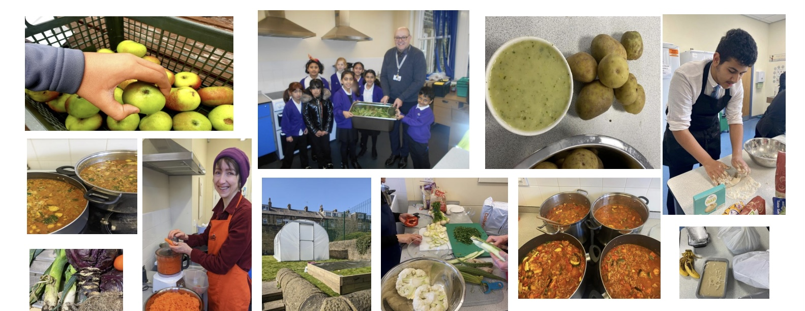

Community Food & Grow
A collaborative initiative bringing together local communities and organisations by harnessing the relationships already existing between school and community to engage with people who are marginalised, economically and socially and giving them the opportunity to play an active role as food citizens in our local food system.

Slide 13
Primary aim - to establish a collaborative working model which will increase access to healthy food for the local community (Park Ward) through the delivery of the following initiatives:
Community Kitchen – working with St. Augustine’s and The Outback to provide healthy hot take-away food, 3 days per week, using produce from Pennine Cropshare, Fareshare, ReThink and The Real Junk Food Project
Voucher scheme pilot to support access to local affordable fresh produce.
Cooking & Growing Workshops – working with members of the local community in friendly, supportive workshops in the grounds of Halifax Academy, supported by local community growing projects.
.

Slide 14

Key to developing a resilient and sustainable food system is having an integrated ‘joined-up’ approach which brings together voices from across the region and is representative of all members of the community

Slide 15
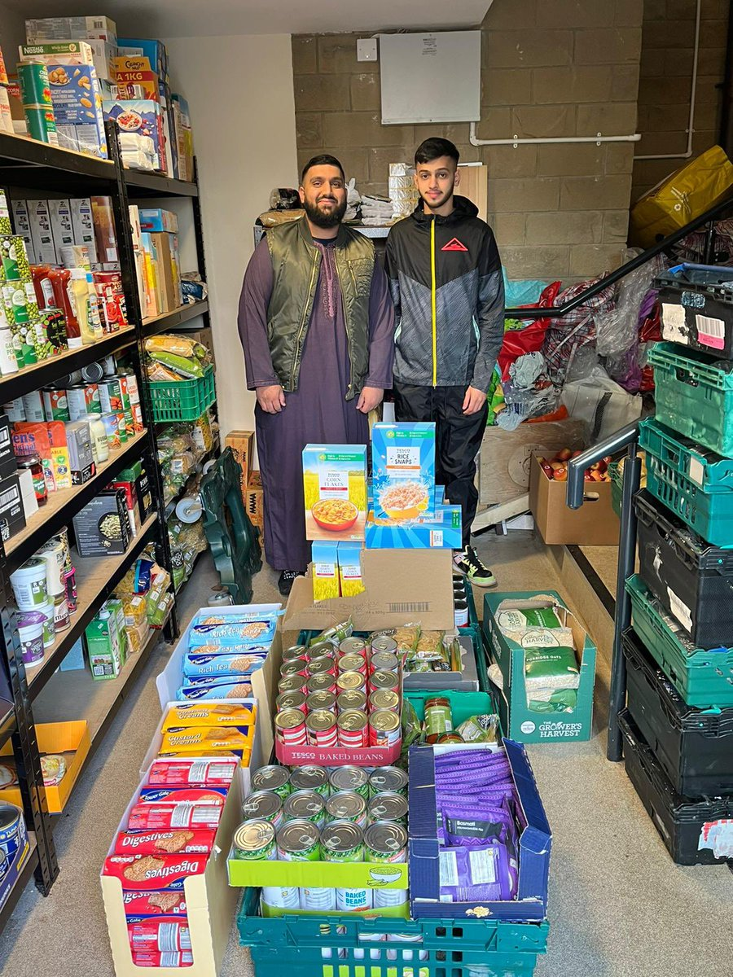
Community voice – Community action
Led and shaped by participants, with a strong emphasis on peer-to-peer learning & embracing the diverse values, cultures and traditions of the community.
Key delivery elements:
Working with local system of providing food support; linking with existing providers and building on to the local offer.
Ensuring support is provided through sign posting and building choice - resilience rather than reliance.
Creating additional/wrap around opportunities that are school and community wide - not only for the duration of this funding.
Seed to plate model.
Local partnerships and strength
Building sustainable and small goals that fit into daily life.
Whole school support- not just targeting one group, but building into school and community ethos.

Slide 16
Outputs & Outcomes The project has been successful in achieving a successful collaborative working model which has delivered the following: Weekly cooking workshops with pupils, using local seasonal and surplus food to create recipes which are taken home and shared Community Kitchen (3 days per week) hosted by Halifax Academy, The Outback and St. Augustine’s, with volunteers supporting the preparation and making of up to 150 meals on a weekly basis. Surplus food from Re-Think as well as vegetables from The Outback are used to produce meat free meals which are available to all primary school families. Cooking and Growing workshops with Year 11 students to learn gardening skills and develop links with the community. The group meet weekly to develop an area of the garden as edible plots. They have visited The Outback and cooked a range of dishes together from the seasonal and surplus ingredients available. The Giving Project with Year 9 students where basic cooking skills are taught on a weekly basis and food is shared and discussed in the context of community and giving.

Slide 17
Outputs & Outcomes (cont……)
Regular opportunities for pupils and community members to come together and form relationships and develop peer support groups, including; ESOL/IT Classes, visits to The Outback, coffee mornings
‘Meet The Street’ and ‘Uniform Reuse and Recycle Point’.
Over 2,500 meals served to the community - all surplus /veggie /vegan
Polytunnel and edible growing sites established installed with pupils ongoing involvement.
Fruit and veg pilot voucher scheme with local retailers and market traders, supported by PH funding.
Walking Bus group for parents and carers – visiting markets, growing sites, community kitchens
Creating a fuel questionnaire to map needs currently then re-visit at the end of the year with Calderdale Citizen's Advice & partnership with New Ground Together Fuel fund.
Building community links and working with local businesses such as McVities to establish new allotments to facilitate growing throughout Park Ward

Slide 18
Outputs and Outcomes (continued……)
‘Bite Back’ Champions group – looking at how we use food throughout school & talking about food-use and cooking after school
Bid for creating our own community fridge submitted
Breakfast club and coffee mornings
Ready Steady Cook classes with pupils and a ‘cook-off’ at the end of term
Summer holiday scheme linking with The Outback, Summerfield Care Home and Spring Hall Health Centre
Our overarching aim is to work with our pupils and community, ensuring sustainability is at the centre of learning, reflected in the home, and to embed a committed individual environmental approach.
We are creating a strategy which will under pin this ethos – Cultivate, Cook, Create.
This will be a live working document which will enable change in small meaningful ways, through food growing and carbon reduction, throughout our classrooms, growing spaces and community.

Slide 19
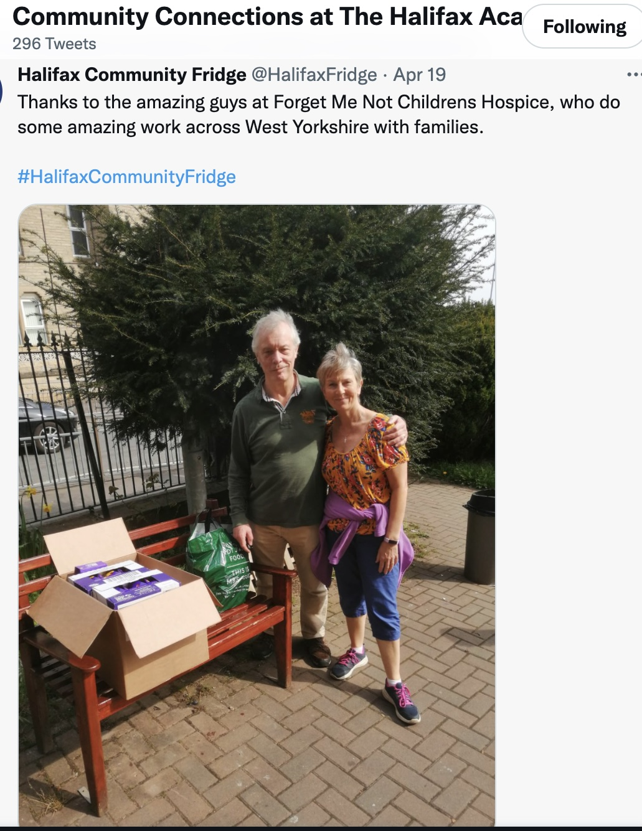
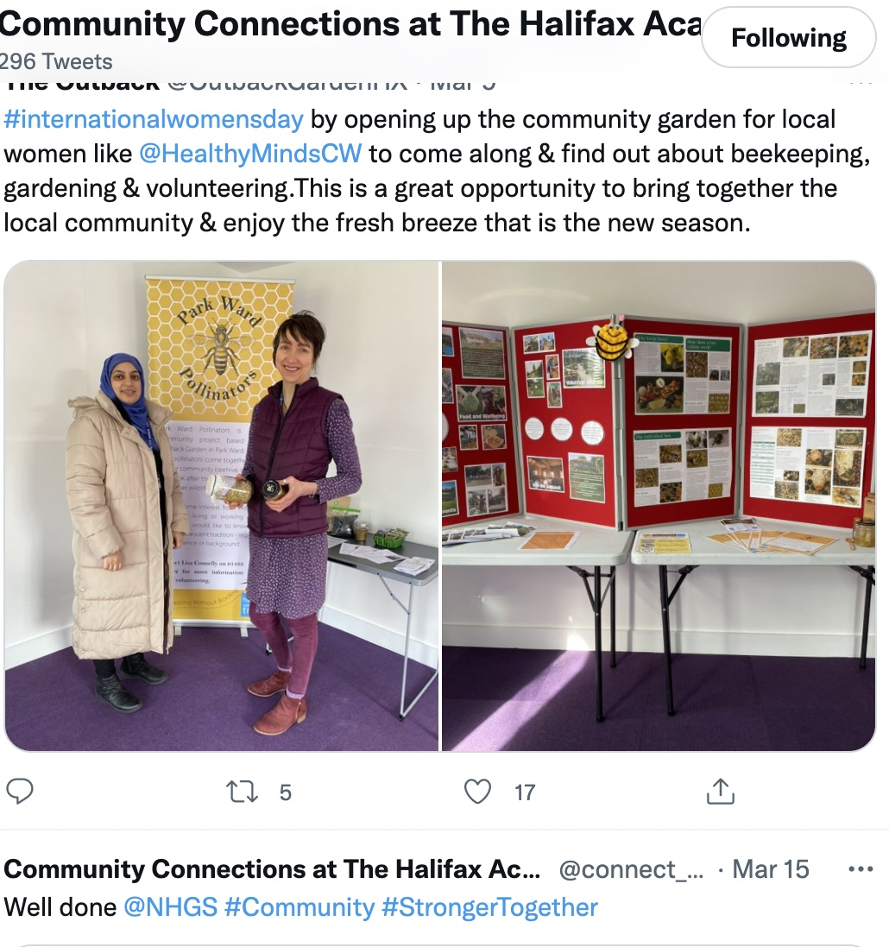
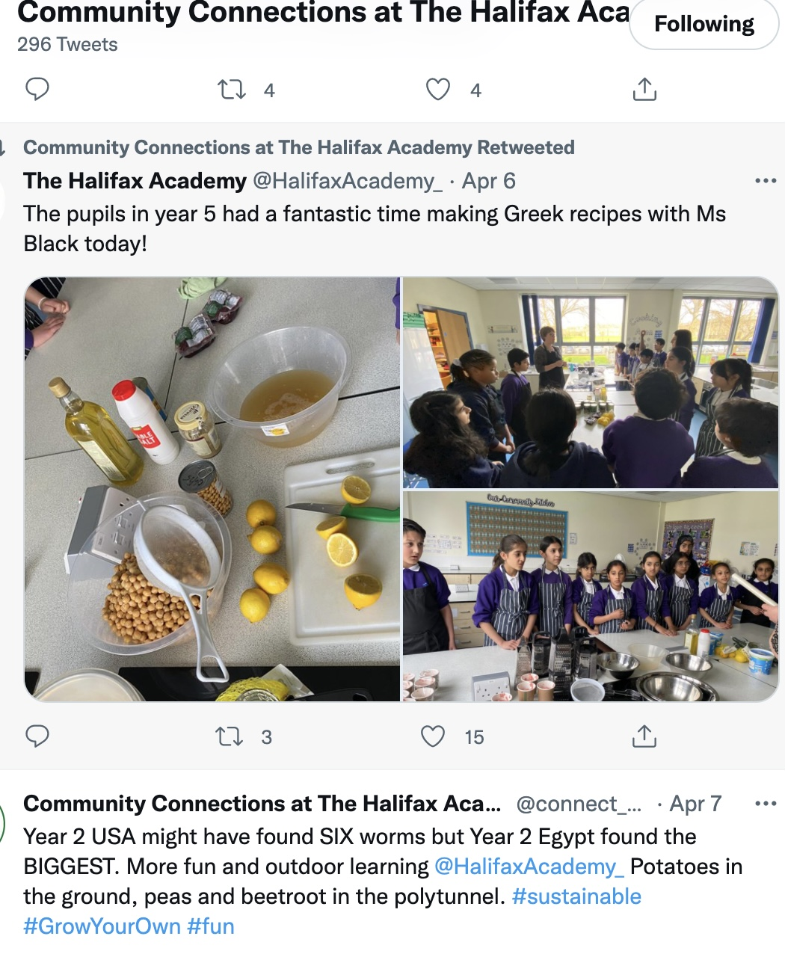
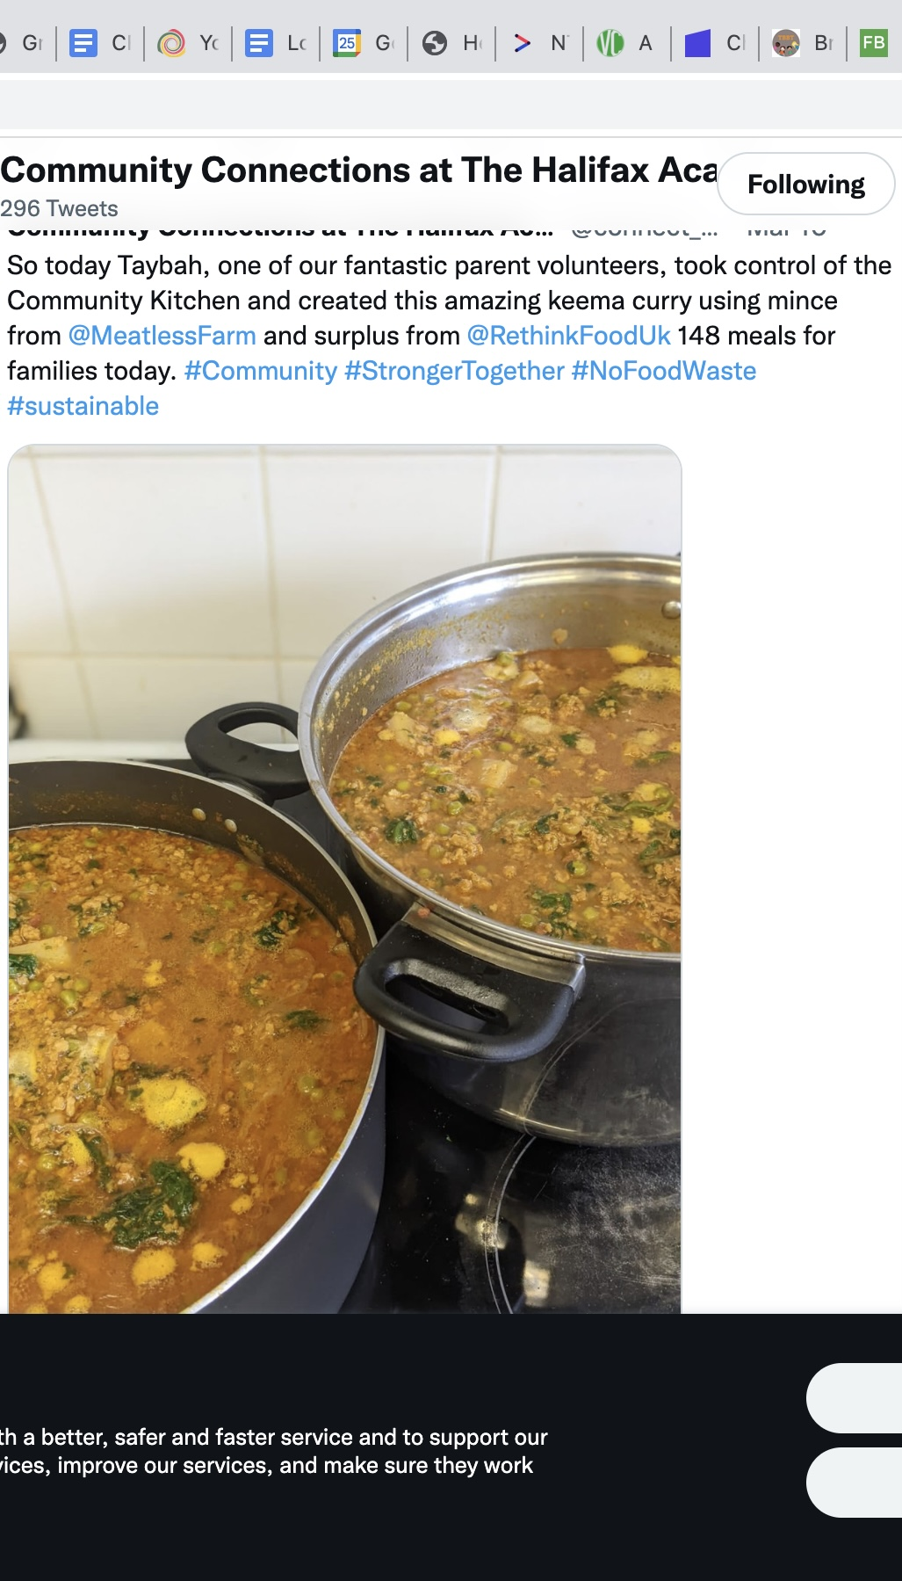
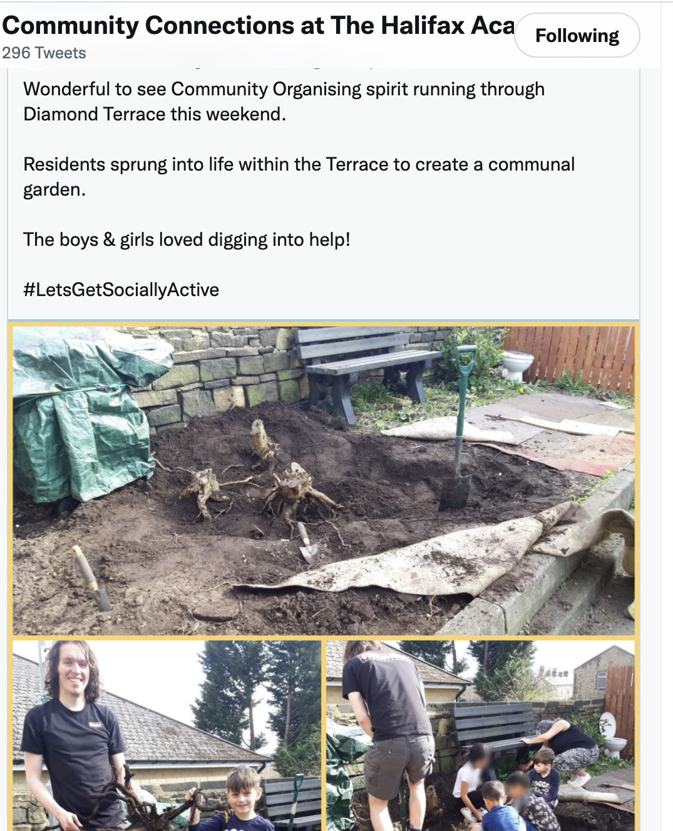
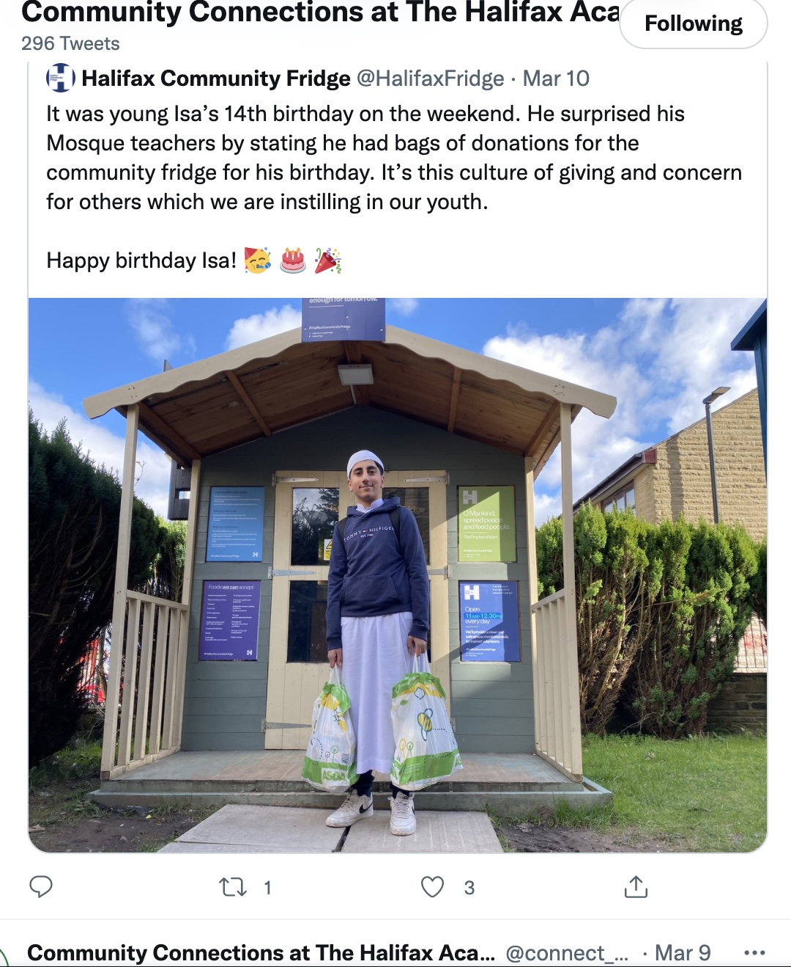

Slide 20
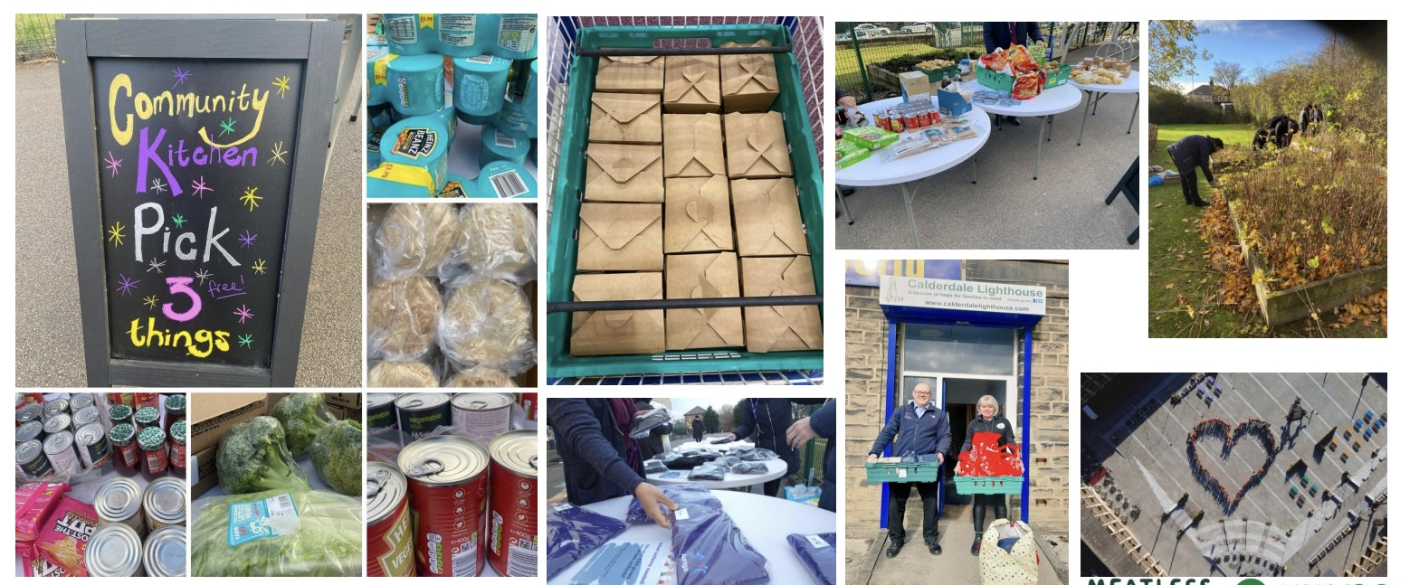
Calderdale Good Food Movement
recognising diversity within our region and the need to connect through collaborative and partnership work to establish an equitable sustainable food culture.
engaging people who are marginalised, economically and socially
giving them the opportunity to play an active role as food citizens in our local food system.
Calderdale Food Network Vision and Principles
‘to establish a culture where healthy affordable sustainable food is accessible to all’
Calderdale Food Charter
-empowering participants to make positive life-long changes to their wellbeing and environment, through food actions

