Slide 1

Local Food Strategy:
Getting Started
Kristin Bash
Consultant in Public Health, OHID, Y&H
Y&H Healthier & Sustainable Food System Network Meeting
09 June 2022

Slide 2
Food – Why do we need a strategy?
How many health and wellbeing problems are connected to food?
  Diet-related poor health
  Childhood obesity
  Food insecurity
  Economic resilience
  Good work
  Environment and sustainability
Food may be at the heart of many big problems our local populations are facing – and that makes it central to the solutions.

Slide 3
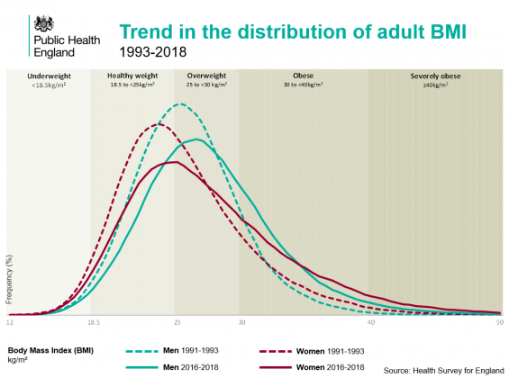
Notes:
https://ukhsa.blog.gov.uk/2021/03/04/patterns-and-trends-in-excess-weight-among-adults-in-england/
Charts by me – data taken from - https://commonslibrary.parliament.uk/research-briefings/sn03336/

Slide 4
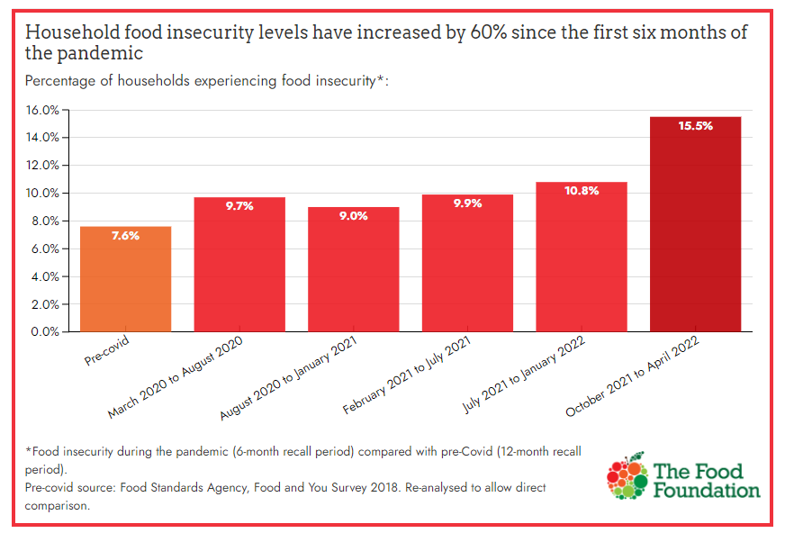
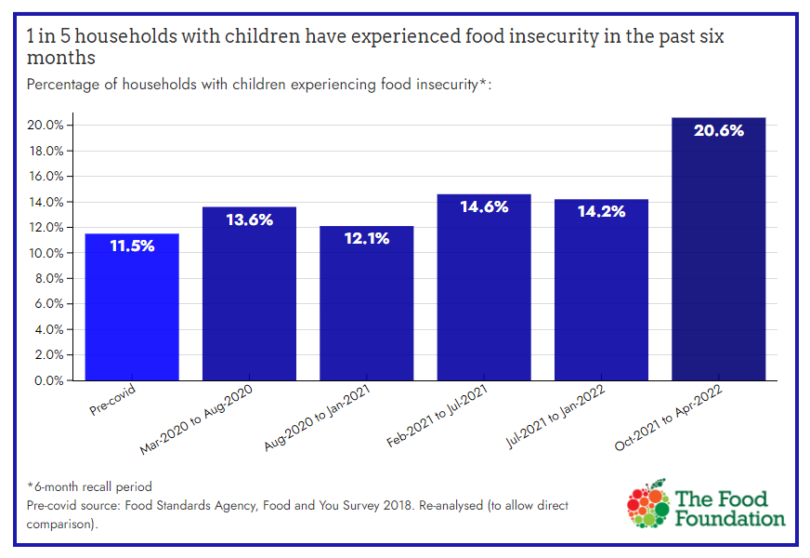

Slide 5
What you’ve said would be useful
The scope of the strategy – as broad as the National food Strategy? Most important elements?
Positioning and Governance of the Strategy
Partners to include at this early developmental stage and further down the line during consultation of the strategy.
Experience and advice on engaging businesses as part of the local strategies
Evaluation measures
Developing local priorities – in a way that doesn’t over promise.
Getting the right stakeholders involved
Managing a diverse range of stakeholder interests – both expectations and practically in a Food Summit situation
Turning the outcomes of a summit into an engaged and well lead food partnership

Slide 6
Scope and Content of Local Food Strategy
The scope of the strategy – what to include and how broad to go?
Developing local priorities in a way that doesn’t over promise.
Developing Local Food Strategy
Getting the right stakeholders involved
  Partners to include at this early developmental stage
  Partners to include further down the line during consultation of the strategy.
Turning the outcomes of a summit into an engaged and well-led food partnership
Engaging Stakeholders in Local Food Strategy
Engaging with businesses as part of the local strategies
Managing a diverse range of stakeholder interests – both expectations and practically in a Food Summit situation
Governance of Local Food Strategy
Positioning and Governance of the Strategy
Using the right evaluation measures
Scope & Content
Development
Engaging Stakeholders
Evaluation methods

Slide 7
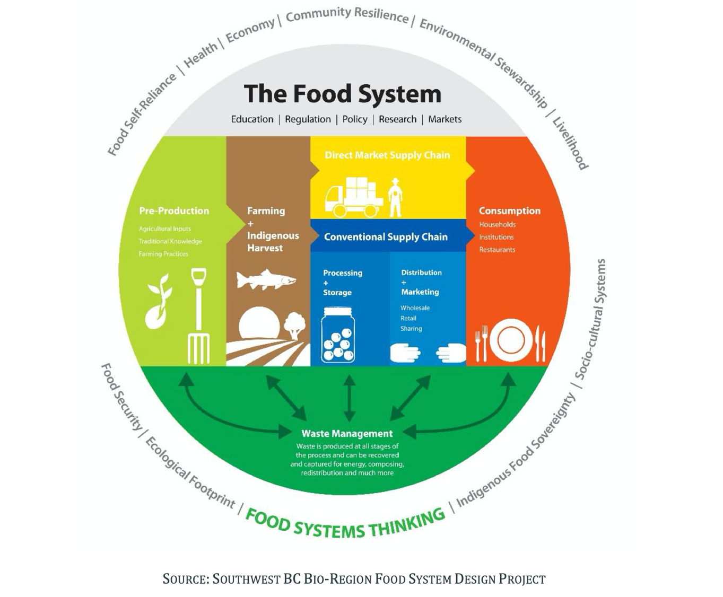
Scope and Content of Local Food Strategy
Two Questions:
  What are the defined strategic objectives in your area for health and wellbeing?
  Where do these overlap with food?
Healthy food environment – local advertising, planning, procurement policies
Sustainability – Net Zero targets – Climate Crisis
Household food security
Farmers and rural population health
Food workers – good work
Local Resilient Economy
Best start in life agenda
Inclusion health groups and food – healthy diet, food insecurity, good jobs
So much more…
Ultimate goal: weave food-related policy options in all major local strategic plans and documents

Slide 8
Developing Local Food Strategy
It is not easy
If it were easy, it would be done already
It is possible – you can get it done
Don’t let good be victim to perfect
It’s important

Slide 9
2. Strategic Food Review
  To inform development of a long term sustainable food strategy that will link in with other key local policies & strategic objectives.
  Identify priority areas to inform development of a food action plan
  Start process of engaging with local stakeholders
    Identify and map key actors in local area
    Informal chats – describe intent to deliver food strategy, collect scoping info
  Map of the system – where is food policy made in your area? Where are existing links?
  How long is a piece of string?
  At the end – Short report describing current state of food system, actors, relationships and gaps in these relationships – and an overview of key findings.
  Share with stakeholders involved in review – keep the engagement going…

Slide 10
2. Assemble Strategy Design Team – working group, committee, etc.
Counsellor support important at this stage – ideally a participant in the design team
Propose and agree framework or methodology – matter of preference and experience
  Logic model approach – work backwards from where you want to be long term
  Borrow existing framework – e.g., Sustainable Food Places framework
  ‘Strawperson strategy’ approach – start with something developed elsewhere and pull it apart, put back together to meet local need
Identify key principles to guide strategy development, implementation and management
  E.g., we adopt a universal proportionalism approach whenever possible; we are evidence-led; etc.
Produce Strategy Design Document (Strategic Intent; Strategy Development Plan…)
  Outline framework chosen and core principles
  Outline process to be used in developing strategy
Then – the really hard work begins… ☺

Slide 11
Sustainable Food Cities Framework
This framework has been used by approximately 50 local food partnerships across the UK to frame their activity when taking a whole food system approach.
This framework focuses on six key areas of action:
Promoting health and sustainable food to the public
Tackling food poverty, diet related ill health and access to healthy food
Building community food knowledge, skills resources and projects
Promoting vibrant and diverse sustainable food economy
Transforming catering and food procurement
Reducing waste and the ecological footprint of the food system.

Slide 12
Stakeholder Engagement
Stakeholder engagement
Key is to start early in the process – even with informal discussions
Develop network – communicate early and often to keep involved
Commit to a Food Summit to kick off the plan
Make the case for paid staff – a Food Team alongside the governance body / advisory board.
Commission the development of a long-term food strategy and 5-year action plan

