Slide 1
MANAGEMENT OF RESPIRATORY INFECTIONS September 2022 Nyari Maliko Health Protection Practitioner Yorkshire & Humber HPT

Slide 2
Overview
Management of common respiratory infections including COVID-19 and other respiratory infections
Symptoms of Common respiratory infections (e.g., Covid, Influenza & Respiratory Syncytial Virus(RSV)
Management of outbreak/incidents & when to contact HPT
Information gathering before contacting local HPT
Infection Prevention Control (IPC) measures
Managing infections and exclusion advice
Vaccination programmes

Slide 3
INTRODUCTION

Slide 4
Background
Respiratory infections are common in children and young people, particularly during winter months.
Symptoms can be caused by several respiratory infections; e.g. common colds, COVID-19 and RSV.
Children and young people with mild symptoms such as a runny nose, sore throat, or slight cough, who are otherwise well, can continue to attend their education setting.
Those unwell , or with high temperature should stay at home and avoid contact with other people.
They can go back to school, or childcare, and resume normal activities when they are afebrile & well enough to attend.

Slide 5
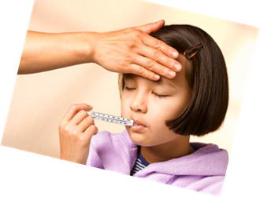
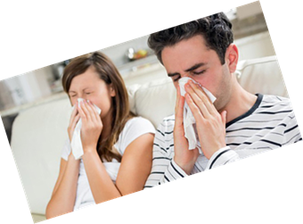
Symptoms of respiratory infections, including COVID-19
continuous cough
high temperature, fever or chills
loss of, or change in, your normal sense of taste or smell
shortness of breath
unexplained tiredness, lack of energy
muscle aches or pains that are not due to exercise
reduced/loss of appetite
headache that is unusual or longer lasting than usual
sore throat, stuffy or runny nose
diarrhoea, nausea & or vomiting

Slide 6
COVID-19
Living with Covid
It is not recommended that children and young people are tested for COVID-19 unless directed to by a health professional.
If a child or young person has a positive COVID-19 test result they should try to stay at home and avoid contact with other people for 3 days after the day they took the test (5days for adults)
After 3 days, if they feel well and do not have a high temperature, the risk of passing the infection on to others is much lower. This is because children and young people tend to be infectious to other people for less time than adults.
Children and young people who usually go to school, college or childcare and who live with someone who has a positive COVID-19 test result should continue to attend as normal
Although many people will no longer be infectious to others after 5 days, some people may be infectious to other people for up to 10 days from the start of their infection. You should avoid meeting people at higher risk of becoming seriously unwell from COVID-19

Slide 7
Respiratory syncytial virus (RSV)
RSV is one of the common viruses that cause coughs and colds in winter.
Transmission; Large droplets from contact with an infected person
Incubation period ; is short, about 3 to 5 days.
When RSV circulates: generally start in October and last for 4 to 5 months, peaking in December
High-risk groups; Under 1 year of age and the elderly are at the greatest risk. infants aged less than 6 months frequently develop the most severe disease such as bronchiolitis and pneumonia, which may result in hospitalisation
Statistics ; Over 60% of children have been infected by their first birthday, and over 80% by 2 years of age
Symptoms; similar to a cold, including rhinitis (runny nose, sneezing or nasal congestion), cough, fever, ear infections and croup
Risks; most common cause of bronchiolitis in infants
Prevention; respiratory &hand hygiene, (washing with soap and warm water, and cleaning of surfaces)

Slide 8
Influenza(Seasonal Flu)
Transmission: Droplet spread.
Incubation period: 1-4 days with average of 2 days
Infectious period: Usually the day before symptoms start, until 5-6 days while symptomatic
Common Symptoms: Headache, fever, sore throat, aching muscles and joints, gastrointestinal symptoms in children
Exclusion period: If symptoms remain then individual is still infectious. Return when no fever and fully recovered.
Prevention : Flu vaccinations now part of the childhood vaccinations in all primary school year groups.
Children at risk: Chronic heart, chest or kidney diseases are offered annual vaccines .
Pregnant staff: Offered flu jab during pregnancy.
Implications for schools: If suspecting an outbreak inform Health Protection Team for advice

Slide 9
Seasonal Flu Outbreak Definition
An outbreak is defined as: the occurrence of 2 or more cases of influenza-like illness and /or confirmed cases, with a shared exposure such as attending the same school group (such as class group), with onset dates within a single 7-day period and with evidence of transmission within school/nursery
Seasonal influenza may transmit rapidly between children of school going age, prompting the occurrence of localised outbreaks within the setting
The end of an outbreak is defined as a single 7-day period following symptom onset of the last outbreak case during which there are no new cases of influenza –like illness and/or confirmed cases within the same school group

Slide 10
Investigation of influenza outbreak
Information required by the health protection team to conduct the risk assessment
size of the school/nursery/class
size of year group (s) affected if illness is limited to specific years (or age groups/rooms for nurseries)
day pupils only, boarders or both?
any pupils with special educational needs or disability (SEND) or any within the mainstream school
main contact person at the school (including their job title and direct contact number)
dates of childhood influenza vaccination and coverage rates in the school
nature of the symptoms
timeline of cases ( ie onset date of the first ,most recent cases according to class/year group )
number of hospitalisations, ICU admissions and deaths associated with the outbreak if known
• any children in clinical risk groups in the school, if known

Slide 11
Management of suspected outbreaks
Response Measures
Raising awareness among parents and guardians that influenza-like illness has been observed in the school/nursery
UKHSA can assist in providing letters which the setting disseminates through their normal route
Exclusion advice – symptomatic children and teachers should be excluded until they are asymptomatic
IPC Measures ; giving clear respiratory & hand hygiene measures within the school/nursery
Closure ;
UKHSA does not make the decision to close setting only in highly exceptional circumstances
Any decision to temporarily close for business continuity reasons such as staff shortages, is a decision for the school/nursery management team and local education authority and should be made clear to parents, guardians and staff that this decision has not been made on public health grounds

Slide 12
Respiratory And Cough Hygiene
Coughs and sneezes spread diseases.
Covering the nose and mouth during sneezing and coughing can reduce the spread of infection.
Spitting should be discouraged

Slide 13
Respiratory Hygiene And Cough Etiquette

Slide 14
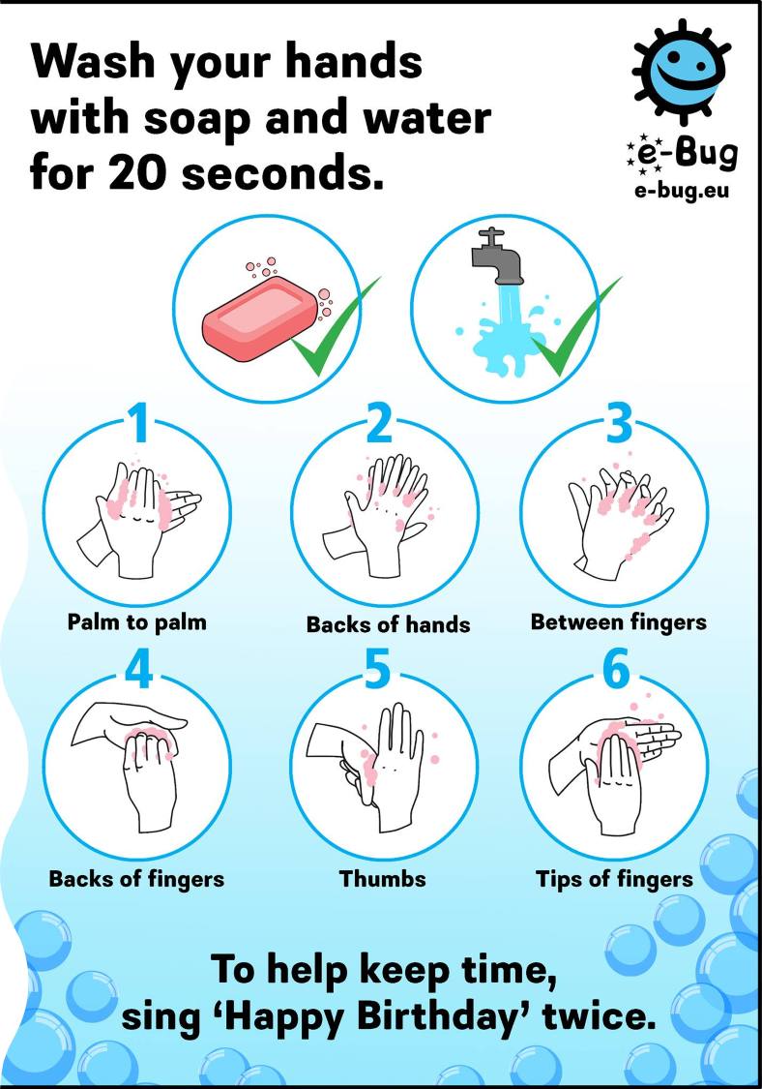
Hand Hygiene
Hand washing is one of the most important ways of controlling the spread of infections, i.e. diarrhoea and/or vomiting and respiratory infections.
Settings should ensure access to liquid soap, warm water and paper towels. Bar soap should not be used.
All staff and pupils should be advised to wash their hands after using the toilet, before eating or handling food & after playtime.
Alcohol hand gel should not replace handwashing

Slide 15
Sanitary facilities
Good hygiene practices depend on adequate facilities.
A hand wash basin with warm running water along with a mild liquid soap, preferably wall mounted with disposable cartridges, should be available.
Disposable paper towels next to basins in wall mounted dispensers & nearby foot-operated wastepaper bin.
Toilet paper should be available in each cubicle.

Slide 16
Keep occupied spaces well ventilated
Ventilation allows fresh air into indoor spaces can help remove air that contains virus particles and prevent the spread of COVID-19 and other respiratory infections
If there are areas of the setting identified that may have poor ventilation, there are several simple things that can be done to improve ventilation.
These include:
partially opening windows and doors to let fresh air in
opening higher level windows to reduce draughts
opening windows for 10 minutes an hour or longer can help increase ventilation – where possible this can happen when the room is empty in between lessons, for example

Slide 17
Vaccination Programme
A table showing when vaccines are offered to children aged 1 to 15
Age | Vaccines
1 year | Hib/MenC (1st dose) MMR (1st dose) Pneumococcal (PCV) vaccine (2nd dose) MenB (3rd dose)
2 to 10 years | Flu vaccine (every year)
3 years and 4 months | MMR (2nd dose) 4-in-1 pre-school booster
12 to 13 years | HPV vaccine
14 years | 3-in-1 teenage booster MenACWY

Slide 18
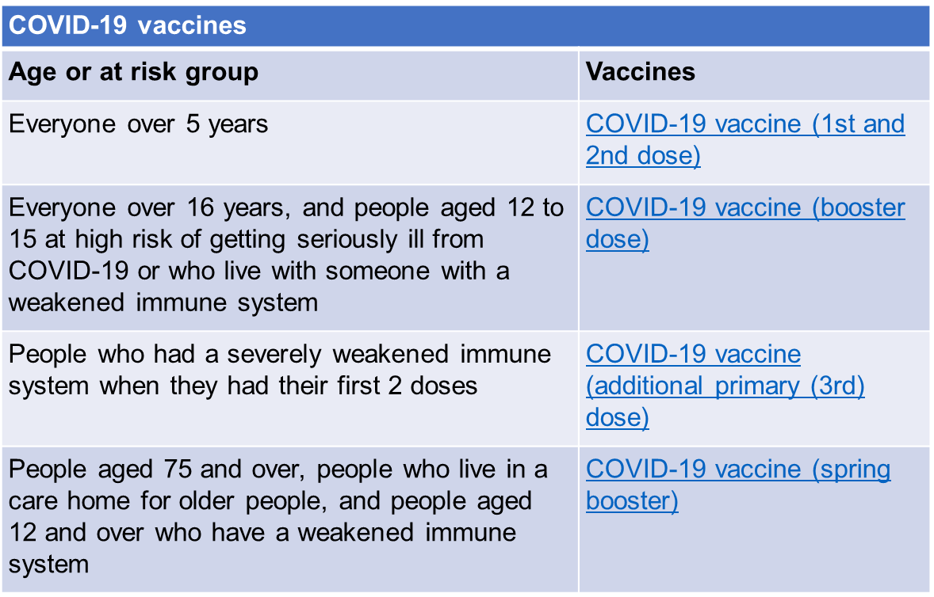
Coronavirus (COVID-19) vaccination

Slide 19
RESOURCES
Health protection in education and childcare settings - GOV.UK (www.gov.uk)
People with symptoms of a respiratory infection including COVID-19 - GOV.UK (www.gov.uk)
People with Symptoms_easyread__130522_v10.pdf (publishing.service.gov.uk)
Chapter 3: public health management of specific infectious diseases - GOV.UK (www.gov.uk)
https://www.hse.gov.uk/coronavirus/hand-sanitiser/choosing-hand-sanitiser-surface-disinfectant.htm
https://www.who.int/teams/integrated-health-services/infection-prevention-control/hand-hygiene/training-tools
Your choices in the NHS - NHS (www.nhs.uk)
https://www.gov.uk/guidance/living-safely-with-respiratory-infections-including-covid-19

