Slide 1
The social and economic value of health
‘The Micawber Principle’, Minding the Gap conference
David Finch
May 2018
@HealthFdn @davidfinchrf

Slide 2
Overview
What makes us healthy?
Health as an asset
Living standards, past and future

Slide 3
What makes us healthy?

Slide 4
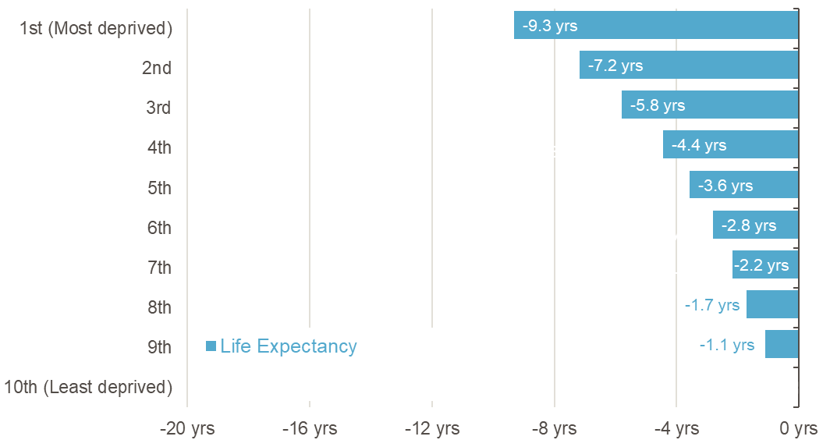
Our backgrounds determine how long we live…
Gap in years of life expectancy at birth by decile of deprivation, males (base=least deprived)
Source: ONS, Health State Life Expectancies, England, 2014-2016

Slide 5
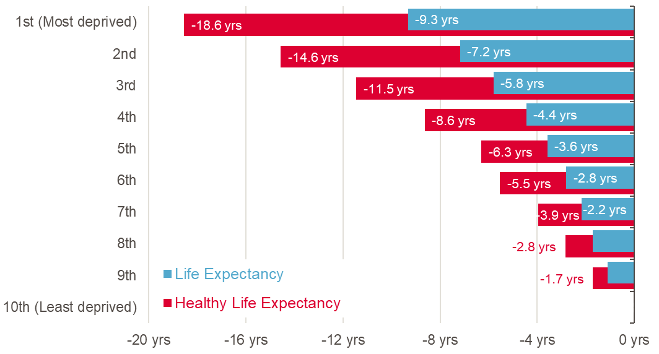
…and how many of those years are healthy
Gap in years of life expectancy at birth by decile of deprivation, males (base=least deprived)
Source: ONS, Health State Life Expectancies, England, 2014-2016

Slide 6
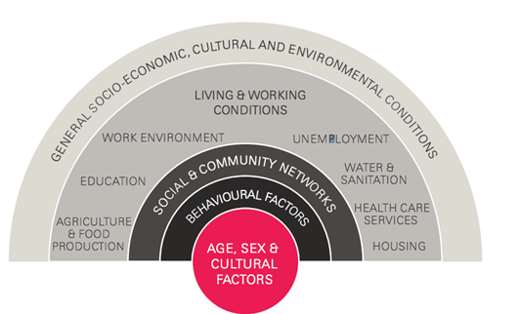
Only a minority of our health is due to healthcare

Slide 7
What makes us healthy?
Education & skills
Money & resources
Good work
Transport
Housing
Family, friends & communities
Our surroundings
The food we eat

Slide 8
Poor diet is now the biggest risk factor for preventable ill health
Healthy food needs to be:
Affordable – it is three times more expensive to get energy we need from healthy food
In greater supply – It is harder to buy healthy foods in deprived parts of the UK
Promoted & valued – 1.2% of food advertising on vegetables versus 22% on confectionery, cakes, biscuits & ice-cream

Slide 9
Transport plays a key role in supporting healthy lives
A healthy and sustainable transport system:
Is accessible and efficient – people on lower income dependent more on bus travel but funding has fallen
Minimises environmental harm – the transport system is the single biggest source of UK air pollution
Enables ‘active’ travel – more people walking and cycling reduces congestion, air pollution and increases health

Slide 10
Poverty damages health and poor health increases the risk of poverty
An inadequate income makes it harder to:
Avoid stress and feel in control: Day-to-day stress in early childhood can damage long-term health
Access experiences and material resources: 30% of families live below the Minimum Income Standard
Feel supported by a financial safety net: 40 per cent of people with unmanageable debt say they are less likely to study or retrain

Slide 11
Health as an asset

Slide 12
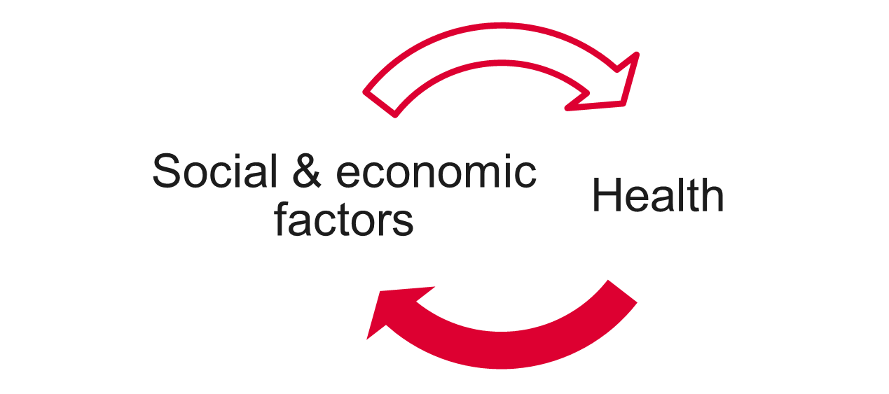
Making health a valued asset

Slide 13
Making health a valued asset

Slide 14
Making health a valued asset

Slide 15
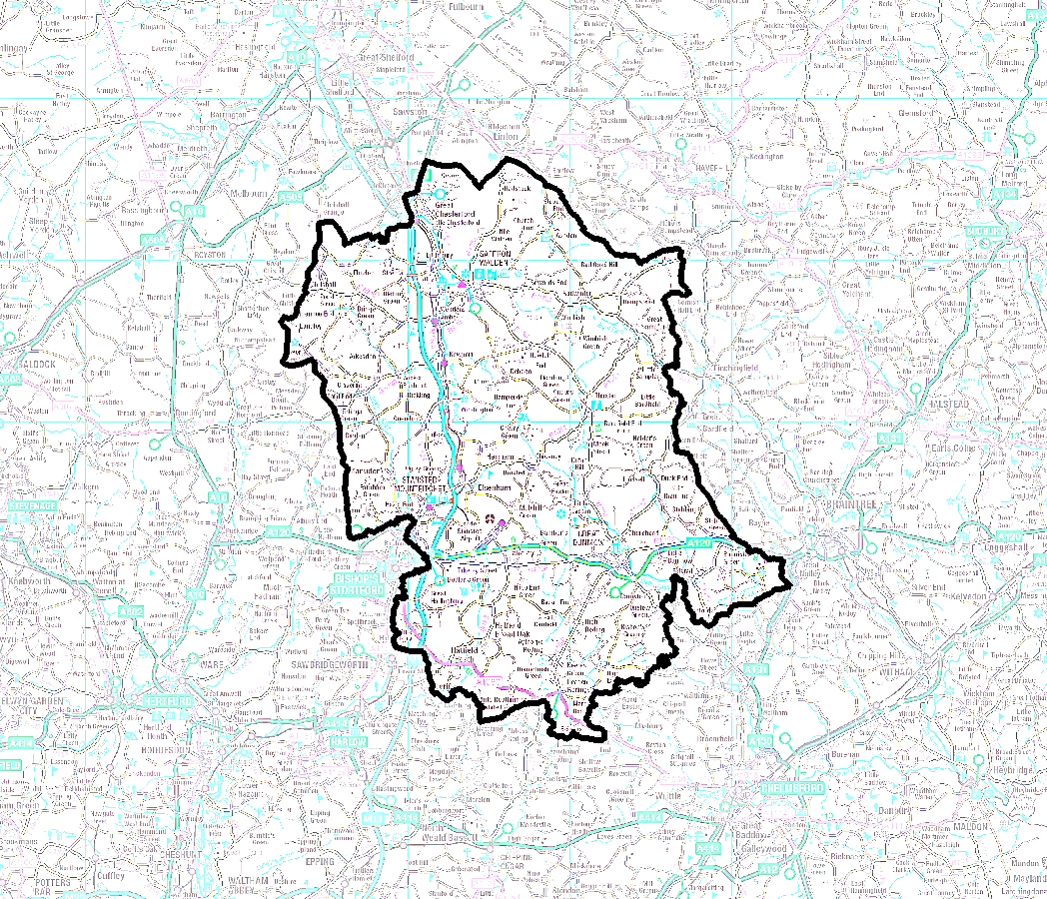
Making health a valued asset

Slide 16
The living standards backdrop

Slide 17
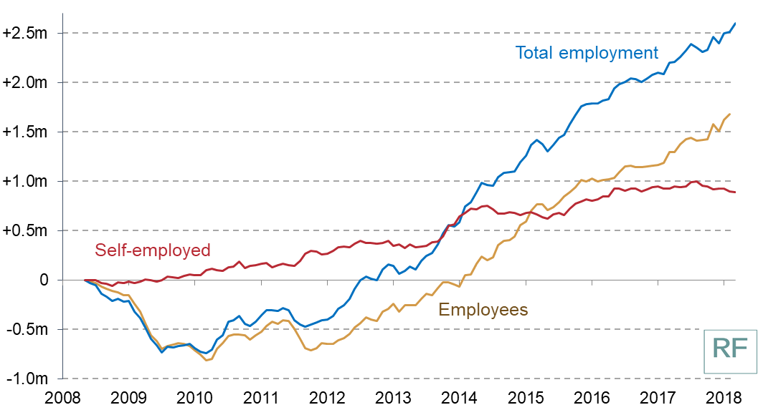
Strong employment growth, but quality matters
Change in employees and self-employment since May 2008
Source: Resolution Foundation analysis, ONS

Slide 18
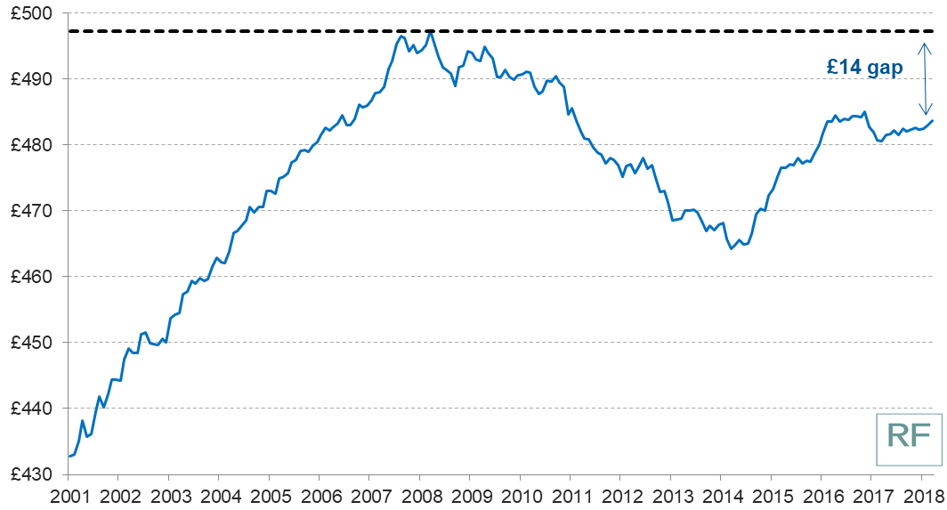
Typical pay remains below its pre-crisis peak
Typical weekly employee earnings, CPIH-adjusted (2017-18 prices)
Source: Resolution Foundation analysis, ONS

Slide 19
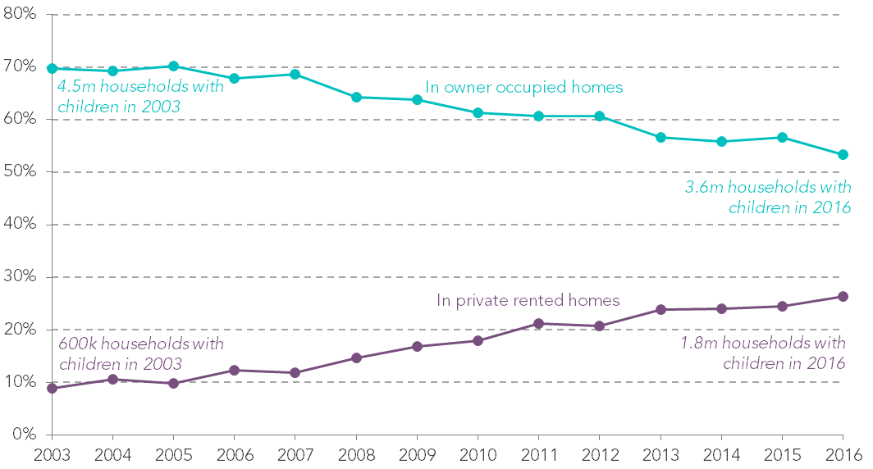
More families with less secure, more costly housing
Proportion of households with children in owner-occupation and the PRS, England
Source: Resolution Foundation analysis, English Housing Survey

Slide 20
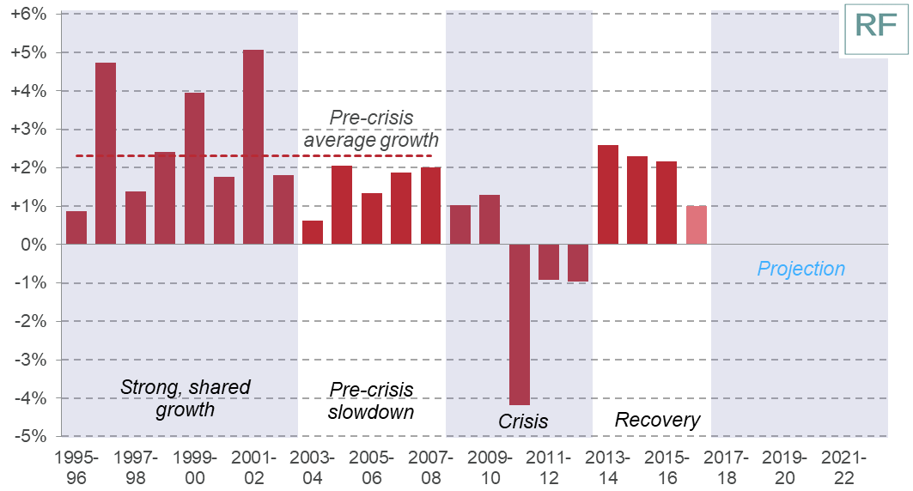
Incomes have recovered in the last four years
Annual growth in real equivalised disposable household incomes, before housing costs, CPI-terms
Source: DWP, Family Resources Survey and RF projections

Slide 21
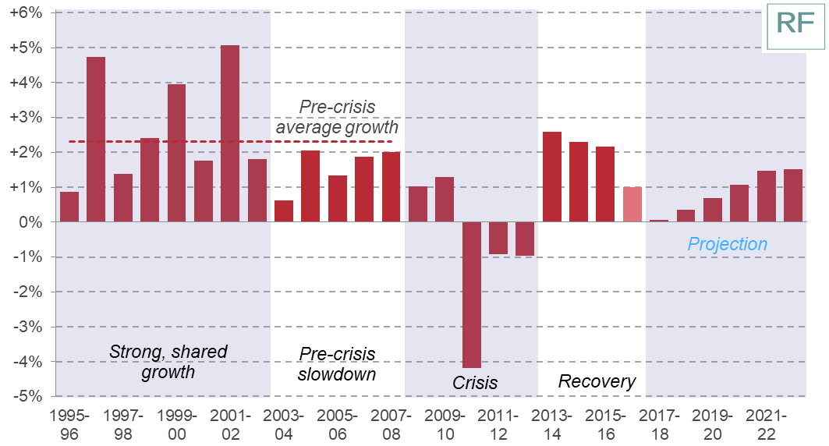
But growth is set to be weak into the next decade
Annual growth in real equivalised disposable household incomes, before housing costs, CPI-terms
Source: DWP, Family Resources Survey and RF projections

Slide 22
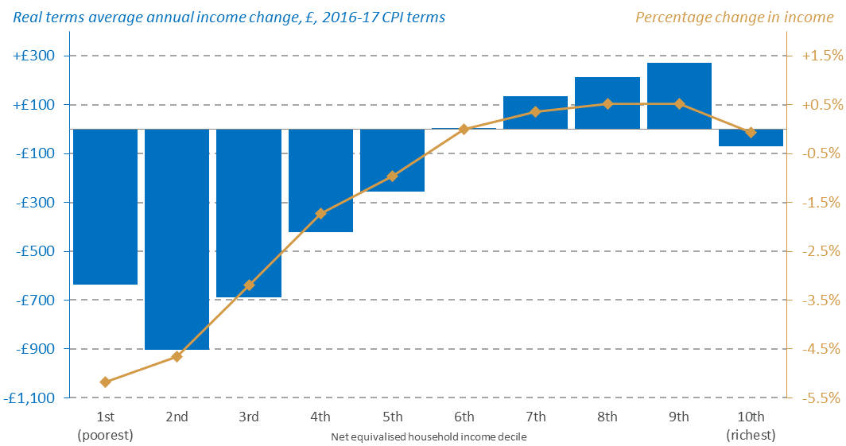
Policy plays a key role in how growth is shared
Distributional impact of tax and benefit policies announced since March 2015: 2022-23
Source: Resolution Foundation analysis using ippr tax-benefit model and OBR, Economic and Fiscal Outlook, March 2018

Slide 23
Conclusion
Growth in living standards set to be weak by historical standards, and outlook grim for the lowest income households
Domestic policy choices play a key role in how growth will be shared
Health inequality and the social determinants should be central to living standards discussion and growth strategies
Leveraging anchor institutions to improve health
Ongoing research will help provide better evidence for policymakers

Slide 24
More information is available at: https://www.health.org.uk/

Slide 25
The social and economic value of health
‘The Micawber Principle’, Minding the Gap conference
David Finch
May 2018
@HealthFdn @davidfinchrf

