Slide 1


Supporting Free School Meal Auto-enrolment in Yorkshire
Professor Maria Bryant, Health Sciences, University of York
Dr Annie Connolly, The Food Foundation

Slide 2
WEBINAR
Free School Meal Autoenrolment:
Learning from Sheffield’s Auto-Award Process
Click here for the link to the recording
Thursday 30th March, 2023
Sarah Cavanagh Free School Meals Lead
School Food Service, Education & Skills, Sheffield City Council
Annabel Hallam Project Manager
Applications Service, BCIS, Sheffield City Council
Myles Bremner Ex-Director of the government’s School Food Plan; Coordinator, School Food
Review Working Group; Director, Bremner Consulting
Maria Bryant Professor of Public Health Nutrition, University of York
Annie Connolly Research & Engagement Lead, The Food Foundation; Visiting Research Fellow,
University of York

Slide 3

Autoenrolment
↑ entitled for FSM nationally (~23%)
25% entitled in Yorkshire
11% of entitled do not apply
  Administrative/technical burden
  Language/literacy barriers
  Access barriers
  Stigma
  Shame

Slide 4


What is the Problem?
1 in ten children not receiving the FSM they are entitled to
  not getting hot healthy dinner
  families not getting financial benefit
Schools not receiving Pupil Premium funding & other associated funding dependent on FSM registration

Slide 5
Aim
To support the set-up of auto-enrolment processes for FSM across Yorkshire and evaluate its implementation and impact
Engage with stakeholders
Learning event / webinar
Implementation support and free resources
Evaluation of implementation and impact
Legacy project
Yorkshire = 1st county to universally deliver auto-enrolment

Slide 6

Today’s webinar
Sarah Cavanagh and Annabel Hallam -
Sheffield’s Auto Award Process
History and background to the introduction of the Auto Award Process
Q&A
Implementation/barriers/technical issues
Q&A
Impact on schools and children/current practices
Q&A
Myles Bremner
National picture
Next steps

Slide 7
Sheffield’s Auto Award Process
Introduction of the Auto Award Process in 2016
Families are identified that have claimed Housing Benefit or Council Tax Support but have not applied for FSM
They are then contacted to ensure that they are claiming everything they are entitled to
Undertaken annually in Aug/Sept (School Census)

Slide 8
Sheffield Case Study
Since 2016:
Additional number of children eligible for FSM:
5,403
Additional Pupil Premium funding available to schools: £3,818,583
*In reality, the total will be greater than £3.8m as this does not include the cumulative, year on year effect of Ever 6. It is estimated that the real total is at least £10m.
No data yet for 2022-23
Data shared with permission from Sheffield City Council

Slide 9
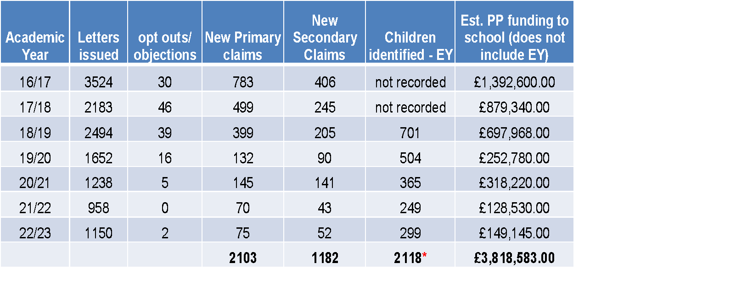
*In reality, the total will be greater than £3.8m as this does not include the cumulative, year on year effect of Ever 6. It is estimated that the real total is at least £10m.
No data yet for 2022-23
Data shared with permission from Sheffield City Council

Slide 10
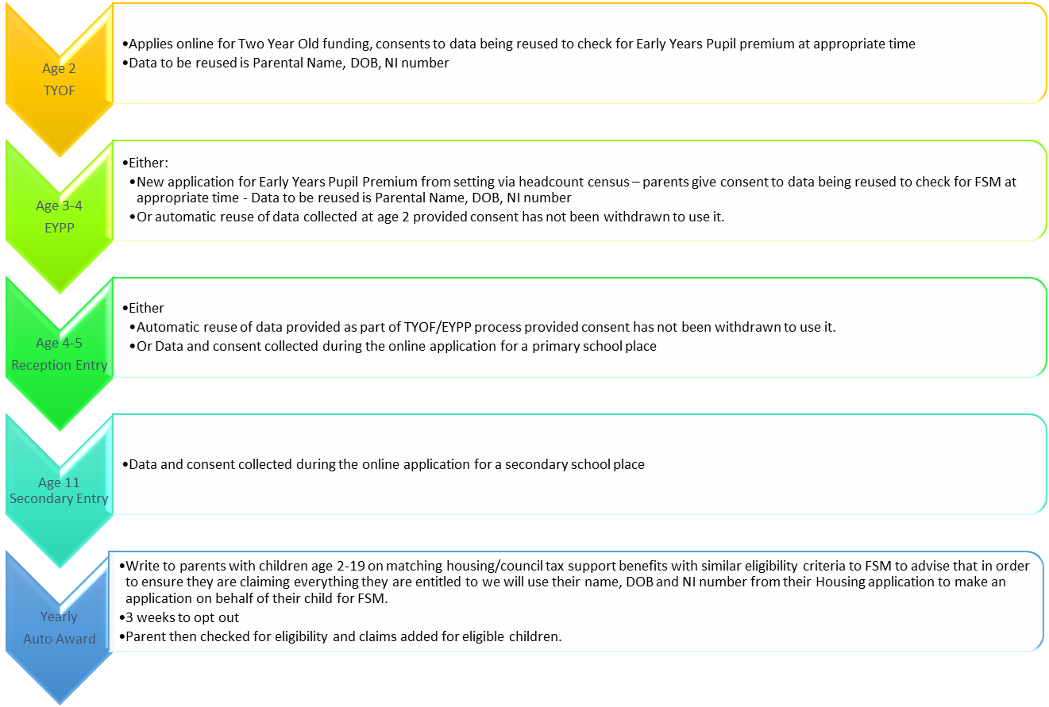
Data Driven Processes Outside of Normal Daily FSM Applications

Slide 11
National Picture
Myles Bremner
CEO of Bremner Consulting,
ex Director of the government’s School Food Plan, coordinator of the national School Food Review Working Group

Slide 12
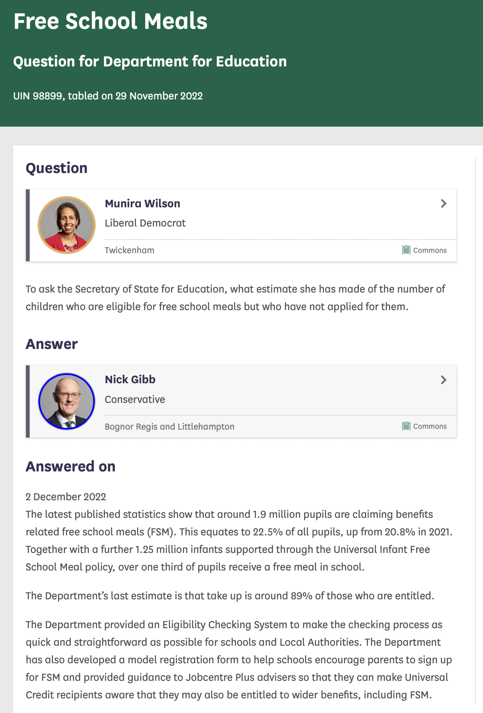
Auto Enrolment - what’s the problem?
DfE still reference 2013 report that states 11% of total eligible pupils not registered for FSM
2022 CPAG analysis in North-East of England also calculated 10% under-registration rate
If this is the case - c.200,000-215,000 pupils missing out
But Dec 2018 report by ‘Datalab’* suggested 1% of total Primary pupils (c.5% of those then FSM registered) figure much lower
IN OTHER WORDS WE DON’T KNOW!
[*] https://ffteducationdatalab.org.uk/2018/12/how-much-pupil-premium-funding-are-primary-schools-missing-out-on/

Slide 13
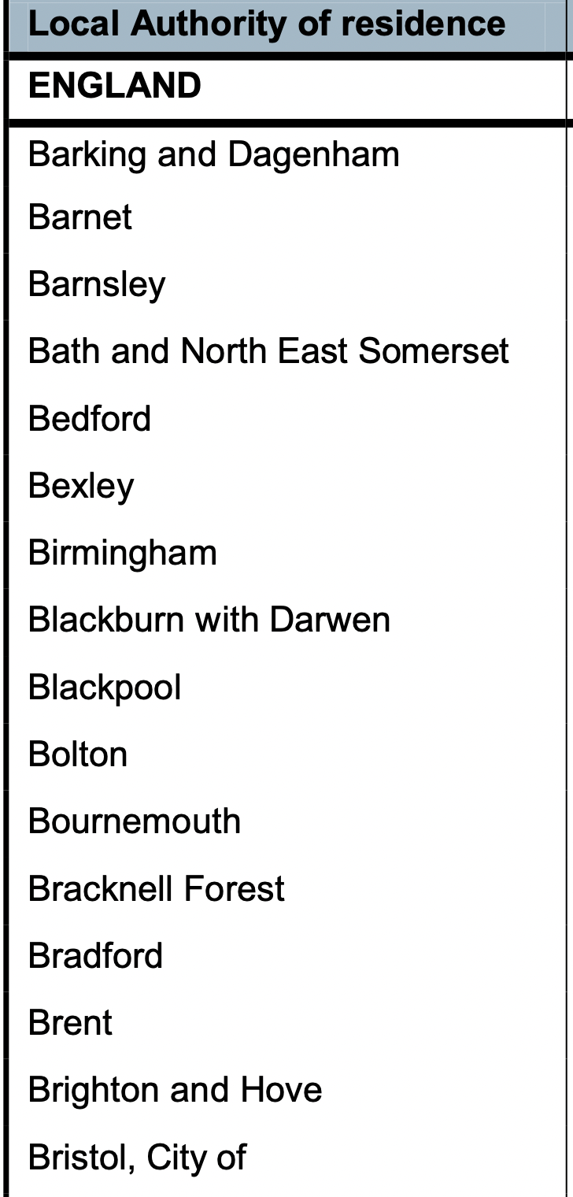
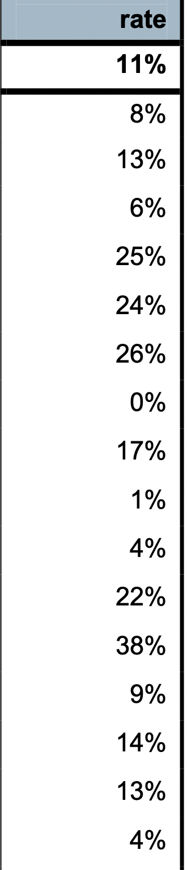
But it’s not an even picture across the country
No standard approaches to how Local Authorities run the Eligibility Checking Service (in place since 2014)
Unitary Authorities seem to have better registration rates – better coordination between required data sets?
Is there a dependency on respective LA education / schools team investment? (number of maintained schools etc?)

Slide 14
What asks of national government?
Get valid (up to date) FSM data so we know scale of problem
Provide clarity and direction to Local Authorities for better automation and ‘opt-out mechanisms’ (don’t shy away from data protection!)
Timeline and process for new national autoenrolment system
“We fully support the idea of changing the current process to one of auto-enrolment and, frankly, it is slightly mystifying why this is not already the case.”
Geoff Barton, General Secretary, ASCL, December 2022

Slide 15
Next steps
In Yorkshire:
We will share information to support LAs in implementing autoenrolment processes
Monitoring and evaluation of impact (Pupil Premium and FSM registration)
More widely:
Dissemination of data on impact
Expressions of interest: annie.connolly@foodfoundation.org.uk

Slide 16




Thank You
maria.bryant@york.ac.uk
annie.connolly@foodfoundation.org.uk
Lisa Collins
Steve Banwart
Ruth Wade
Geisa Reiss
Bob Doherty
Ioan Fazey
Maria Bryant
Sarah Bridle
Katherine Denby
Kate Pickett
Peter Ball
Ulrike Ehgartner
Alana Kluczkovski
Jack Garry
Nicola Nixon
Sam Buckton
Juan Pablo Cordero
Angelina Frankowska
Belinda Morris
Sophie Stewart
Alice Thomas
Chris Yap
Michelle Cain
Adrian Williams
Anna Taylor
Annie Connolly
Zoe McIntyre
Myles Allen

