Slide 1
Food Insecurity Interventions
A review of local food insecurity interventions in the context of the current pressure on cost of living
October 2022
Mella Moylan, OHID North West
mella.moylan@dhsc.gov.uk

Slide 2
Contents
1. Introduction
2. Interventions
3. Useful Resources
Note: In slideshow mode you can click on a heading to take you to that section of the pack. All references are linked, and all links were accessed in October 2022.

Slide 3
1. Introduction
Back to Contents
1.1. Scope of this review
1.2. Food Insecurity Drivers
1.3. Support Structures and Framing Interventions
1.4. Learning from COVID-19
1.5. Problems with Interventions
1.6. Mental Health and Food Insecurity

Slide 4
1.1. Scope of this Review
Back to 1. Introduction
This review focuses on food security interventions that can be delivered locally, including frameworks, considerations, barriers and best practice. Research areas were stimulated by discussions with policy, practice and public health leads. Information reviewed covers academic literature, webinars and materials produced by organisations.
Data on the prevalence of food insecurity is not covered in this review but has been studied as part of the research – multiple sources highlight the North West as being particularly affected by high levels of food insecurity, including:
Greater Manchester Population Survey results
Poverty Monitor 2022: Fuel, utilities and food - Greater Manchester Poverty Action
Southampton research shows regions in the North have higher risk of food insecurity
Local food insecurity data collection is essential to quantify the scale, assess the risk over time and identify support gaps, but currently there is no single reliable measure. Other recommended and reviewed sources of national data include:
Food and You 2 Survey: Wave 4
Consumer Insights tracking survey
Food Banks in the UK
Rising Cost of Living in the UK
CA cost of living data dashboard | Flourish
UK local food insecurity of Adults Jan 2021
Public Health Outcomes Framework - OHID
Data hub | Food Foundation
Family Resources Survey

Slide 5
1.2. Food Insecurity Drivers
Back to 1. Introduction
Access
Healthy, culturally appropriate food within a reasonable distance
Food insecurity needs to be treated systemically – it is more than just affordability. In addition to the causes seen in the diagram on the left, the effects and interdependencies include, but aren’t limited to:
By using a ‘food ladder’ approach we can help those who are food insecure overcome these challenges, build resilience and progress into security.
Cost of transportation
Ability to access and transport food
Transport costs
School holiday provision
Isolation and loneliness
Fuel for cooking
Storage for food
Access to cooking equipment
Cooking skills
Environmental impacts
Internet access
Access to sanitary products
Debt management advice
Welfare advice
Maintaining dignity and independence
Affordability
Cost of buying and cooking healthy, culturally appropriate meals
Capability
Skills and ability to cook healthy, culturally appropriate meals.
Kitchen equipment, recipes, fuel poverty
Food insecurity, its effects and ways to address them | GeoFoodie

Slide 6
1.3. Support Structures and Framing Interventions
A Food Ladder approach considers the associated social and economic implications that comes from food insecurity, alongside a need for food. There are 3 rungs to the ladder:
Catching
Capacity Building
Transforming
doing for
doing with
doing by
Crisis support
(e.g. food banks)
Activities that build food knowledge and independence
(e.g. cooking clubs, food pantries)
Community change
(e.g. activities that advance the local food landscape so that it meets everyone’s needs)
Food
Crisis support
(e.g. mental health)
Community activities that develop social networks
(e.g. social eating)
Community change
(e.g. developed community cohesion and social ties)
Social
Crisis support
(e.g. emergency housing)
Activities that improve financial circumstances
(e.g. employability support)
Community change
(e.g. activities that improve and enhance the local economic landscape)
Economic
Cont.
(PDF) Building Post-COVID Community resilience by moving beyond emergency food support (researchgate.net)

Slide 7
1.3. Support Structures and Framing Interventions
“To be resilient, communities need interventions that build capacity for people to live better within these contexts whilst also seeking to transform those contexts”*
The Food Ladders approach takes an evidence-based, place-specific, holistic approach to food insecurity by addressing the economic foundations and using commensality to harness the social potential of food. Rather than solely responding to the immediate lack of food, Food Ladder support develops local food resilience.
‘Capacity building’ activities start to build resilience by addressing some of the root causes that may have been initially identified by ‘catching’ activities. ‘Transforming’ activity then uses this resilience for advocacy and betterment of the community.
The Food Ladder framework can be used to map the existing support within the locality, identify gaps or duplicate activity, and can help facilitate onward referral to support on the next rung of the ladder.
*Uniting Resilience Research and Practice With an Inequalities Approach 2016 (sagepub.com)
Cont.

Slide 8
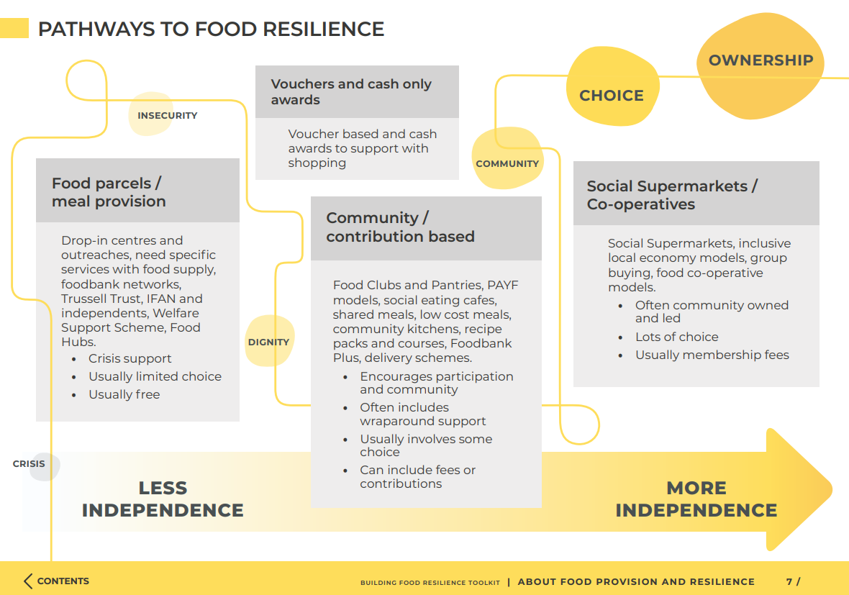
1.3. Support Structures and Framing Interventions
This approach is effectively used in FoodWise Leeds Food Resilience Toolkit:
The toolkit advocates for the Making Every Contact Count approach by utilising the ‘3As’ model (Ask, Advise, Assist) as a conversation guide.
They also encourage the recording of this information through a referral form, so the journey and provision utilisation can be captured.
Cont.

Slide 9
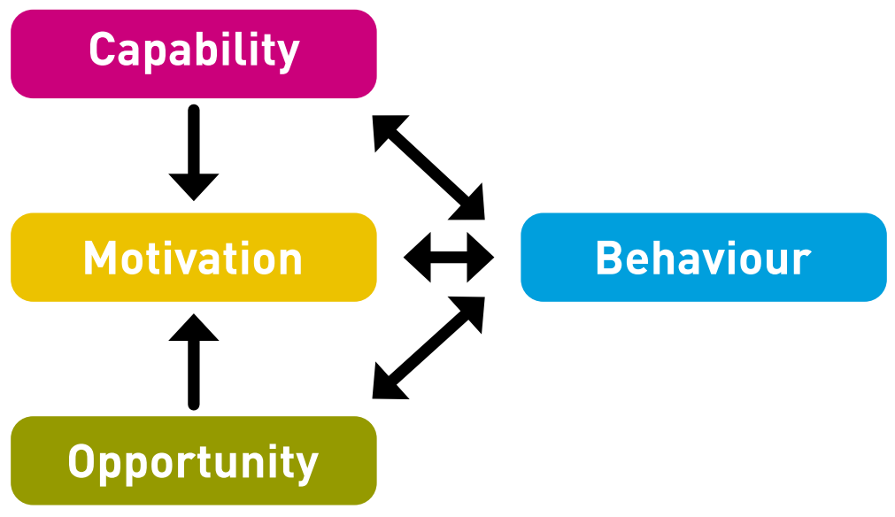
1.3. Support Structures and Framing Interventions
Similarly, Bristol City Council have partnered with Feeding Bristol to develop and co-produce a definition for Food Equality, and create an associated strategy for 2022-32:
“Food equality exists when all people, at all times, have access to nutritious, affordable and appropriate food according to their social, cultural and dietary needs. They are equipped with the resources, skills and knowledge to use and benefit from food, which is sourced from a resilient, fair and environmentally sustainable food system.”
Hertfordshire County Council have produced a range of behavioural science resources to help local authorities identify the groups most at risk of the increased pressure on cost of living and provide evidence-based support.
They advocate using the COM-B model (left) to understand and address behavioural barriers that may prevent people from accessing support services. Their Engage to Understand and Engage to Empower templates are frameworks to help identify barriers, co-design solutions, and monitor and evaluate the delivery.
At a recent Hunger and Health seminar by the LGA, speakers recommended local authorities contact local universities to commission academic research into food insecurity issues and interventions.
Cont.

Slide 10
1.3. Support Structures and Framing Interventions
Back to 1. Introduction
Multiple organisations* describe the principles of good food insecurity interventions as:
User-centred and inclusive to everyone in the community
Healthy, culturally appropriate and social
Communicated effectively to increase knowledge of the available support and reduce stigma
Easy and quick to access, and tailored to need
Promoting dignity, reciprocity and autonomy
Empowering through community participation in design and delivery, and transparent decision making
Having effective monitoring and data recording mechanisms in place
Advocating for change, including the adoption of the real Living Wage
Establishing and utilising a joined-up, multi-agency partnership that includes key organisations and people with lived experience
Taking a whole system approach by facilitating onward referral to broader support.
*Sustainable Food Places, Sustain 1, Sustain 2, Feeding Liverpool, GeoFoodie, Bristol Food Strategy, Food Foundation, SPERI 1, SPERI 2, Behavioural science (hertfordshire.gov.uk)

Slide 11
1.4. Learning from COVID-19
Back to 1. Introduction
Sheffield Political Economy Research Institute’s (SPERI) learnings from the pandemic response echo the summarised principles of good food insecurity interventions, namely the need to take a multi-partnership, whole system approach, including involving stakeholders who hadn’t previously been involved in food issues. They also noted a focus on transforming the local food system, by understanding how local food businesses and producers can be better utilised.
In the Trussell Trust’s Local Lifelines report from October 2020, local authorities reported these changes that they made to their schemes during the COVID-19 crisis:
Wider advertising and promotion of available support
Increasing flexibility in number of applications
Relaxing the rules around evidence and documentation for the application
Supplying internet access through short-term use smartphones
Increasing the crisis award amount, particularly for those who were vulnerable.
Whilst there are benefits to councils promoting community-led action (namely being cost effective and offering localised support), the report also highlighted some of the risks which include:
Concerns around sustainability, capacity and reliance
Lack of data collection which will prevent effective future strategic planning
Challenges around facilitating onward referral and creating wrap-around services.

Slide 12

1.5. Problems with Interventions
In written evidence to parliament in 2019, Exeter Food Bank described some of its challenges despite their best efforts, which are indicative of wider issues with food banks and why they shouldn’t be used long-term.
Parcels were packed with some input from the client and were nutritionally balanced, although they lacked variety. They were supplemented with fresh, redistributed surplus produce from supermarkets which proved extremely logistically challenging; it needed to be collected and redistributed at short notice, but the type and quantity of food couldn’t be predicted, which created further transportation and storage challenges, and it didn’t always meet the requirements of the foodbank.
Whilst the community donated items in line with the Eat Well guide, they were unpopular with the clients who preferred unhealthier, processed or instant foods. Many of the clients had limited access to cooking equipment as they were in temporary or emergency accommodation or were concerned about energy costs (particularly those on energy meters) so preferred food that required minimal preparation over fresh or wholegrain items that take longer to cook.
This often led to long-term dependence on expensive, instant foods, which further exacerbated their financial insecurity.
Cont.

Slide 13
1.5. Problems with Interventions
“Limited resources, continually rising client numbers and the underlying design of the foodbank system make it difficult for them to play an effective new role in supporting development of healthy eating habits… Indeed, it could be argued that reducing food waste is not a viable ethical solution to reducing food poverty; it can legitimise consumption of sub-optimal unwanted items by vulnerable people. The twin challenges of addressing food insecurity and reducing food wastage are sometimes best addressed separately.”
Cont.
https://committees.parliament.uk/writtenevidence/257/html/

Slide 14
1.5. Problems with Interventions
Similarly, in Feeding Britain’s Affordable Food Club Toolkit, Feeding Derbyshire reviewed the COVID-19 food support available to vulnerable and older people, and those who lived in rural areas. Food parcels often included items that were unsuitable or difficult to cook and travel restrictions greatly reduced access to fresh foods which created a further risk of nutritional deprivation.
Studies evaluating food insecurity interventions across high income countries suggest that food banks are unable to prevent people from going hungry:
“charitable food provisioning through food banks is inherently limited in its ability to meet the needs of individuals and households experiencing food insecurity, and at a population level, has done little to impact the widespread problem.”
A study of food bank users in Toronto highlighted that severe food insecurity was persistent despite regular food bank use, and donations were variable and often misaligned to the users needs.
A survey of programmes in New York found that their opening hours and entry requirements were inaccessible, and the type and quantity of food didn’t meet the need.
Studies report food bank users feeling shameful, which can prevent those in need from accessing the service.
Cont.

Slide 15
1.5. Problems with Interventions
Furthermore, in this article on food insecurity and hunger in rich countries, independence is described as a core value in Western society – being unable to access food leads to a loss of self respect, mental wellbeing, dignity and power.
In this study on the user’s experience of Australia’s charitable food services, similar issues with variety, accessibility, shame and unpredictable donations were cited, as well as “the indignity of queuing, the fear of missing out and the desire to socialise and relax over food” and “the significant time and effort required to access three meals per day” which prevented them dealing with other issues associated with their food insecurity. Conversely, Finland was referenced as using their ‘breadline’ queues as an opportunity to build new connections within the community.
The Australian study quotes Salamon’s Theory of Voluntary Failure, which outlines 4 reasons why non-profits can struggle to successfully alleviate issues like food insecurity:
Philanthropic insufficiency, referring to inadequate resources
Philanthropic particularism, when there is a focus on a specific subgroup of the poor
Philanthropic paternalism, when clients’ independence and dignity is undermined
Philanthropic amateurism, referring to a lack of training.
Cont.

Slide 16
1.5. Problems with Interventions
Back to 1. Introduction
In oral evidence to the Select Committee on Food, Poverty, Health and the Environment, public health representatives from Brighton & Hove and Blackpool described some of the barriers to existing initiatives:
In Brighton, there were challenging parameters around eligibility for free food in holiday programmes for children
Both Brighton and Blackpool reported low uptake of Healthy Start and Healthy Vitamins due to the form filling, evidencing, required signature from a health professional, a narrow application window, and problems with the vouchers arriving by post to communal buildings.
Feeding Liverpool also recognised these challenges – 1 in 3 eligible people in Liverpool weren’t claiming Healthy Start. To tackle this they:
Trained volunteers and staff from food programmes into becoming Community Healthy Start Champions, who could promote the initiative and help people sign up
Provided food spaces with Healthy Start booklets and promotional materials
Enabled community spaces to accept Healthy Start cards.
Exeter Food Bank also signpost to Healthy Start and help people complete their application on site.

Slide 17
1.6. Mental Health and Food Insecurity
Back to 1. Introduction
Having touched on the feelings of shame, social isolation and loss of dignity associated with food bank use, it’s clear how mental health is intrinsically linked to food insecurity.
In a webinar for Yorkshire and Humber’s Public Health Network, a consultant dietician described how:
Food insecurity can exacerbate existing mental health conditions and increase the risk of suicide attempts
Food insecure adults are more likely to have a mental illness
There is a significant income gap for people living with a mental illness compared to those without mental illness.
Poor food affordability and access
Poor diet
Poor health outcomes
Inability to source and prepare food
Stress associated with food, social isolation, lack of motivation to cook healthy meals
Depression, low self-esteem, loneliness
Detrimental
food habits
Physical
Health
Mental
Health
Food insecurity, its effects and ways to address them | GeoFoodie

Slide 18
2. Interventions
Back to Contents
2.1. Worldwide
2.2. Partnership Working and Resource Mapping
2.3. Working with the Commercial Sector
2.4. Cash First Approach
2.5. Food Pantries and Clubs
2.6. Subsidies and Voucher Schemes
2.7. Children
2.8. Cooking Clubs
2.9. Community Cohesion and Combatting Isolation
2.10. Effective Communication

Slide 19




2.1. Worldwide
Back to 2. Interventions
Supplemental Nutrition Assistance Programme (SNAP) – USA:
Means tested – money is loaded onto a payment card which can be used to buy eligible foods
Levels of food insecurity are still high within recipients, but evaluations suggest that SNAP could prevent worsening food insecurity.
Universal Child Care Benefit – Canada:
A monthly $100 income supplement for each child under the age of 6
It’s estimated that the benefit reduced food insecurity by 2.4 percentage points.
Australia:
No specific food welfare policies but a focus on market-based solutions, referral to charities and, financial advice, and the voluntary sector redirecting food from landfill
Healthy basic foods are exempt from the Goods and Services Tax.
Norway
Cash first approach – citizens have access universal social services and benefits, but migrants aren’t eligible and are often reliant on charitable services.
Interventions to address household food insecurity in high-income countries (2018)
Food security in welfare capitalism: Comparing social entitlements to food in Australia and Norway - ScienceDirect

Slide 20

2.2. Partnership Working and Resource Mapping
North West DPHs commissioned Food Act!ve to create a partnership to share best practice and lessons learnt across the region.
Blackburn & Darwen’s Food Alliance brings together all VCFS organisations to deliver on their food charter:
1. Good food for all every day
2. Understanding of our whole food chain
3. Create good food places and spaces
4. Zero Tolerance of Food Waste
Manchester council partnered with FareShare Manchester, local food aid providers and The Bread and Butter Thing to enable the local authority to facilitate a food aid triage system – the level of food insecurity is assessed using the USDA’s food insecurity questions and those in need are referred to the organisation best placed to help them. These organisations are supported to provide additional help beyond food provision, and onward-refer to other organisations in the network.
Leeds food aid network coordinates and supports food aid providers and provides data on food insecurity in the area. Their website hosts a map of the available services and information on eligibility and referral, to help direct those in need and create a clear picture of the available provision.
Yorkshire & Humber Healthier and Resilient Food Systems Network is developing a library of ‘local sustainable food system’ case studies from LAs and organisations.
Coventry Council have created a hyper-local interactive map of their food aid network
Bristol was the 2nd city in the UK to receive ‘Gold Sustainable Food City’ status in 2021. Bristol utilises a collaborative, co-produced, ‘One City’ approach to develop, deliver and evaluate its Food Equality strategy, which prioritises the themes: Choice and Security, Skills and Facilities, Sustainable Local Food System, and Food at the Heart of Decision Making. Throughout its delivery they have ongoing engagement with their communities to co-design and evaluate their interventions.
Brighton & Hove Food Partnership brings together a broad range of 100+ organisations, including 30 different council teams, who look at every angle of food, from production to waste, with a focus on food poverty. This reduces silo working. B&H also collaborate with Lidl on Peas Please, a national initiative to increase the amount of vegetables on a plate, championed by the Food Foundation.
Cont.

Slide 21
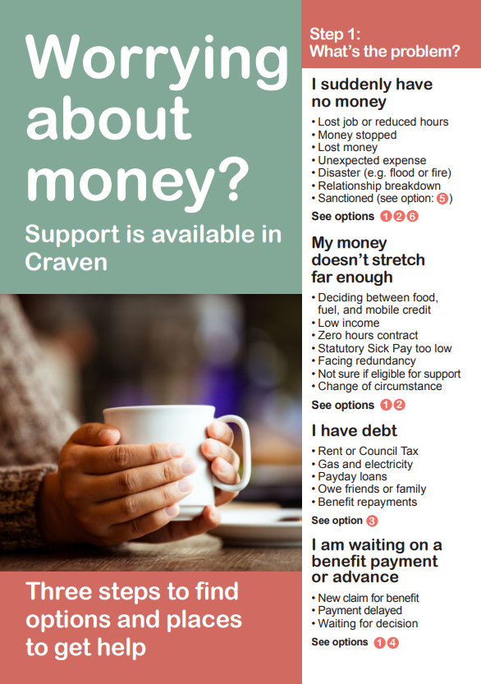
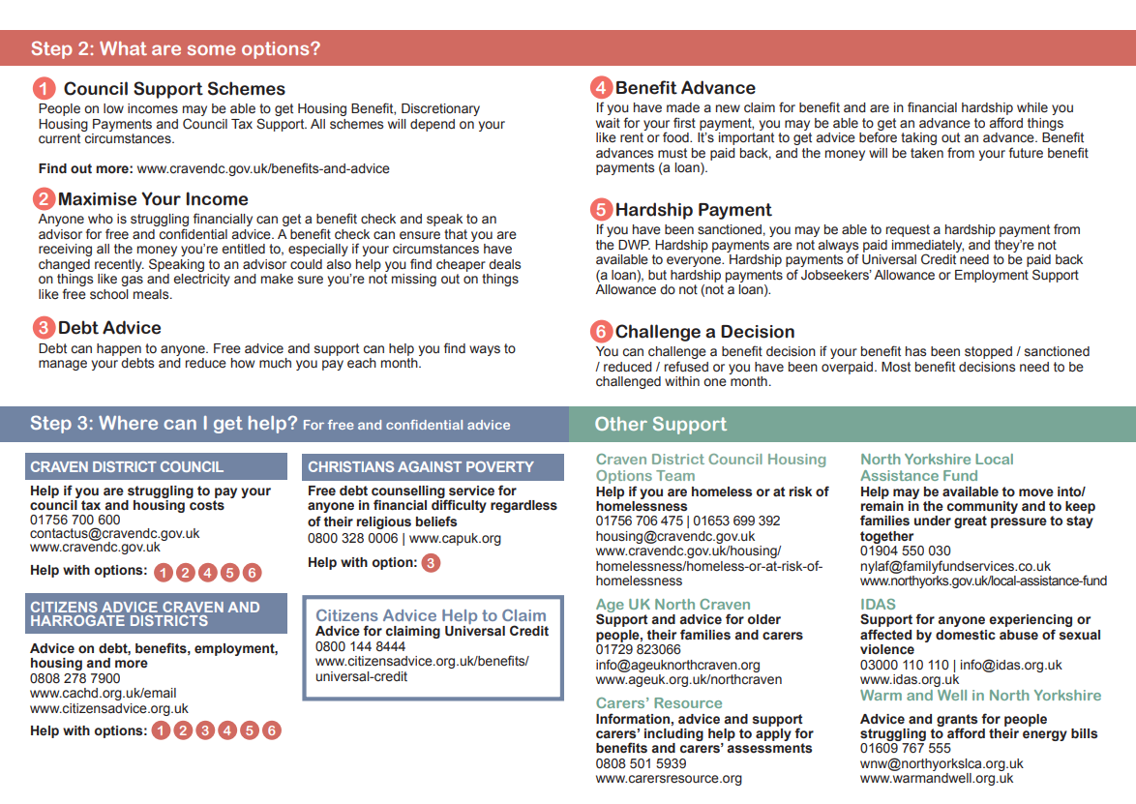
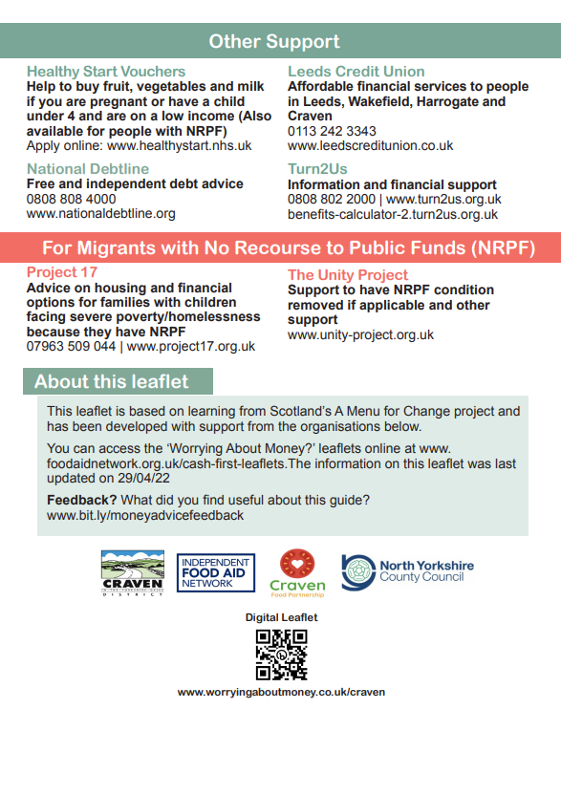
2.2. Partnership Working and Resource Mapping
Craven created a local Cash First Leaflet from the Independent Food Aid Network, which highlights the support available for local residents who are struggling financially.
Cont.

Slide 22
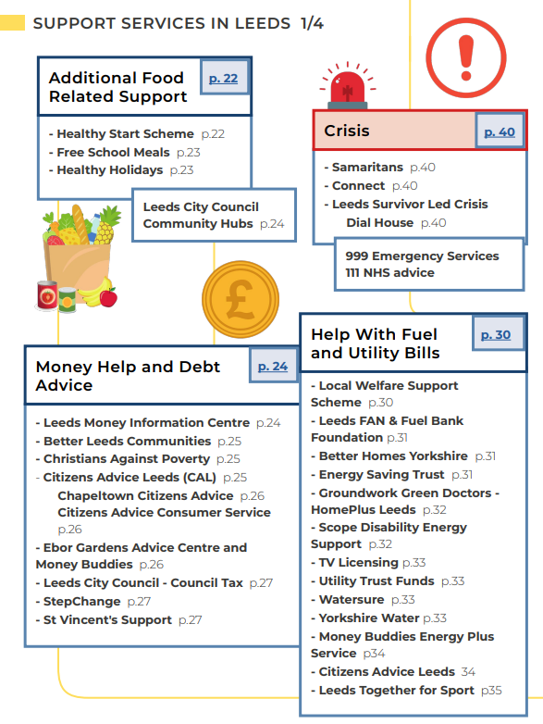
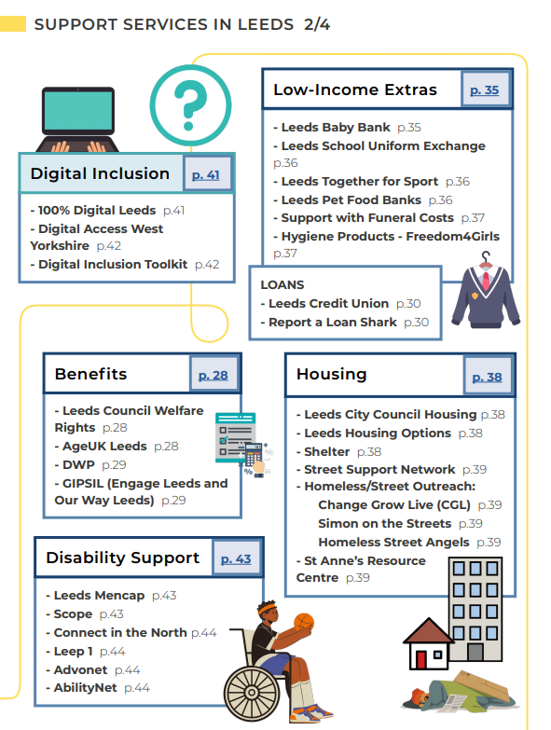
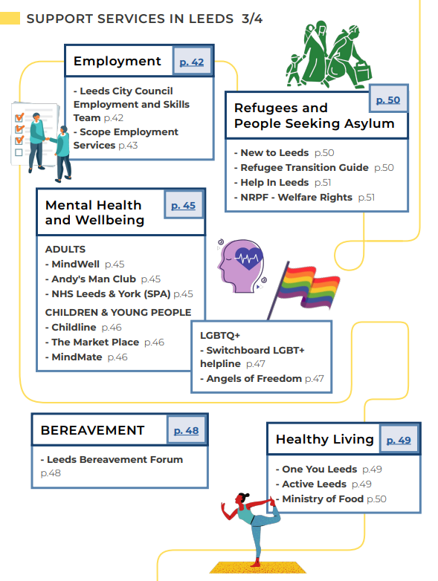
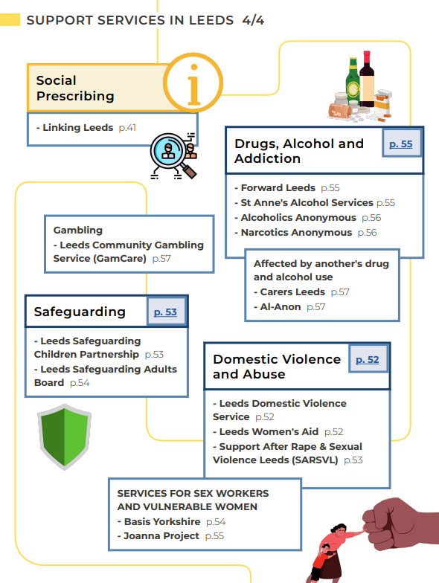
2.2. Partnership Working and Resource Mapping
Back to 2. Interventions
Similarly, FoodWise Leeds Food Resilience Toolkit maps the available support for a range of different issues that are interconnected with food insecurity.

Slide 23
2.3. Working with the Commercial Sector
Back to 2. Interventions
As part of her Food Ladder research and advocacy, Dr Megan Blake recommends that the commercial sector is an active partner in developing the ladder of support – while they may inadvertently be contributing to food insecurity in their local area through their pricing, wages or locations (i.e. creating food deserts), they can actively benefit from an effective local food system.
The Leeds Food Resilience Toolkit recommends speaking to Supermarket Community Champions – staff in major supermarkets who support local food organisations through volunteering, providing funding and redistributing food. Most supermarkets have an established programmes and partnerships, including:
Sainsbury’s, Lidl and Aldi redistribute surplus food to charities through their partnerships with Neighbourly, and Tesco have partnered with FareShare, OLIO and the Trussell Trust
Supermarkets encourage customers to reduce their food waste at home through informative labelling, leftover recipe ideas and campaigns like Waste Less, Save More, Sustain Hub, Changes for the Better, Love Food Hate Waste, Creating Change for Better, Too Good to Go and Helping Everyone Eat Better which tackle food insecurity alongside sustainability and healthy eating
Multiple retailers have partnered with Hubbub, including a Community Fridge partnership with the Co-op, which provides space for people to share food and prevent food waste
Iceland have developed a Food Club Card, which enables customers to spread the cost of their shop without paying interest.

Slide 24
2.4. Cash First Approach
Back to 2. Interventions
In their evaluations of the local response to food insecurity during COVID-19 (March – August 2020 and September 2020-21), SPERI noted that:
Cash first can mean income maximisation, for example through the provision and signposting to support services, or it can be a more literal definition, for example crisis payments, grants and vouchers.
Local responses tended to prioritise cash first interventions over food first interventions (i.e. food parcels)
Many organisations, including the Independent Food Aid Network and Sustain, advocate for this approach
Cash first interventions are prioritised in Scotland as part of their efforts to end the need for food banks
Cash first approaches can have a positive impact on the local economy, for example when vouchers can be redeemed at a wide range of local shops
National research showed that cash was a preferred alternative to free school meal replacements. However, rural areas, for example Argyll and Bute, provided a food first response as cash first was inappropriate due to limited public transport
Moray Council’s cash-first Flexible Food Fund led to a reduction in the use of food banks
Similarly, Greater Manchester Poverty Action believe that a cash first response (namely benefits, grants and local welfare provision) should be prioritised over ‘in kind’ support.

Slide 25

2.5. Food Pantries and Clubs
As described by Feeding Britain, Food Pantries and Affordable Food Clubs:
Are community organisations that offer discounted, nutritional food and essentials, enabling recipients to stretch their budgets further so they have the freedom to shop elsewhere, avoid financial crises and have a dignified shopping experience by preventing the need to use food banks
Provide further support to address the root cause, such as financial advice, and interconnected issues, like offering holiday provisions for children
Often create opportunities to build connections within the community through volunteering, cooking clubs and social meals
“The deep discount is acceptable because the food is identified as surplus, which speaks both to the environmental element, but also to notions of thrift which is a shared British value”*
Freshplace – food pantry in the USA
Members choose their own food, including fresh/perishable items, and are provided with further support from a project manager and referred on to additional services. When compared to people receiving help from a traditional food bank, Freshplace members had a significantly reduced likelihood of severe food insecurity, increased fruit and vegetable consumption and increased self-sufficiency scores.
Cont.
*Releasing social value from surplus food: Impact of British Red Cross funding on FareShare to tackle Loneliness and Isolation.

Slide 26

2.5. Food Pantries and Clubs
The Bread and Butter Thing – food club in the North
Redistributes surplus food to its members through food hubs and partners
Members pay a small fee £7.50 per week for £35 of food, including fresh fruit and vegetables
Founder member of Xcess, a network of 10 redistribution organisations who work with the food industry to prevent food waste.
Deliver a Beyond Best Before campaign to educate the public on how to prevent unnecessary food waste
TBBT also create local packages of support, for example with finances, mental health and housing. They are opening Warm Hubs this winter as part of their weekly shopping service, where this support can be accessed
Healthy Start vouchers accepted at all hubs
Reduced-price period products are offered
Members can volunteer for TBBT, which helps them build connections in their community and gain employment skills.
Their impact report highlighted that the majority of TBBT members:
Are more able to and less worried about providing food for their families
Eat more fruit and vegetables, try new foods and cook healthier meals
Are less likely to use food banks
Feel more involved in their community.
Cont.

Slide 27

2.5. Food Pantries and Clubs
Mustard Tree – Greater Manchester
“We create opportunities for people to help themselves through providing practical support, friendship, connections into work, improvements to health and wellbeing plus new experiences to encourage aspiration.”
A high proportion of Mustard Tree’s clients experience extreme disadvantage, such as poor mental health and disability, homelessness, and seeking asylum
They aim to help clients overcome their barriers by providing holistic, tailored services
Clients have access to their Food Club, where they can buy 10 items, including fresh produce, for £2.50. They also sell discounted furniture, white goods and clothes, and furnish homeless people’s first home for free
They also run the Freedom Project, which provides training, employability skills, work experience and financial advice.
Cont.

Slide 28

2.5. Food Pantries and Clubs
Feeding Britain have created and supported over 100 affordable food clubs (AFCs) and have outlined some lessons learned and best practice in their AFC Toolkit:
Membership frameworks are dependent on the need of the community. In some areas the criteria is strict so that the demand can be managed, but in others there is a universal membership to reduce stigma for those in need. Similarly, annual membership provides stability, but shorter membership can help facilitate referral to other support, creating spaces for others in need
Acceptance of Healthy Start vouchers can further stretch budgets and bring in new members
People can self-refer or be referred by community organisations. Some food banks facilitate referral by providing AFC tokens to customers to use once their crisis has eased
When AFCs have surplus items, they often offer them free of charge or cook them into ready meals that can be taken home, or community meals that can be eaten on site. Similarly, some provide recipes and cooking clubs to encourage and inspire use of in-stock items
The Pathways from Poverty model provides Advice Workers to support members with their wider needs
Feeding Britain have partnered with the Fuel Bank Foundation to set up fuel banks in regions, which provide 2 weeks’ emergency fuel credit to those in need.
Cont.

Slide 29

2.5. Food Pantries and Clubs
As part of Feeding Liverpool’s Good Food Plan, they aim to uncover the scale of food insecurity. They recommend using a 2 question screening tool:
“We worried whether our food would run out before we got money to buy more.” Was that often true, sometimes true, or never true for your household in the last 12 months?
“The food we bought just didn’t last, and we didn’t have money to get more.” Was that often true, sometimes true, or never true for your household in the last 12 months?
A response of “often true” or “sometimes true” to either question indicates food insecurity
Feeding Liverpool have also created a network of over 260 organisations who work together to tackle food insecurity and obesity.
In Feeding Bradford and Keighley, AFCs have partnered with the Credit Union on the Food Savers Initiative - £1 of the weekly membership fee goes into a savings account.
Feeding Birkenhead commissioned an advisor from Involve Northwest to provide specialist, personalised financial advice – over half of the 1500 people in the pilot had their crises resolved immediately whilst others received more intensive, long-term interventions.
Feeding Devon used a former supermarket delivery vehicle to transport food to community buildings in isolated, rural areas. Norfolk also use a food bus to travel to their rural villages, providing food and holistic support.
Cont.

Slide 30
2.5. Food Pantries and Clubs
Back to 2. Interventions
The FoodWise Leeds Food Resilience Toolkit is a fantastic resource that has been mentioned previously for its use of the food ladder, its resource map and advice around working with the commercial sector. The toolkit also offers food aid providers guidance to prevent voluntary failure by:
Planning and delivering a food aid provision that meets the local need
Ensuring the offer is nutritional and culturally appropriate
Using community meals as an opportunity to build relationships and refer to support services
Effectively monitoring and evaluating the project by recording access, referrals and case studies, so that the Leeds Food Aid Network can understand the need across the area.
The toolkit also refers to Nourish Scotland’s Dignity in Practice work, which helps food aid providers understand the perspective of the service user through 5 principles:
A sense of control
Able to take part in community life
Nourished and supported
Involved in decision-making
Valued and able to contribute.

Slide 31

2.6. Subsidies and Voucher Schemes
Back to 2. Interventions
In this review of food insecurity interventions, researchers found that those enrolled on a subsidised fruit and vegetable programme had a lower prevalence of food insecurity than the baseline group. Those who disengaged from the programme experienced a non-significant increase in food insecurity during the follow up period, which may suggest that challenging external circumstances prevented engagement.
In a 2020 study, researchers examined the feasibility, development and impact of Fresh Street, a place-based fruit and vegetable subsidy. All households in the food-insecure area were eligible without the need for referral to prevent the stigma that comes with targeting. Alongside the weekly subsidy, the intervention included a related recipe and nutritional, healthy eating information, to influence and guide behaviour change through incentives and information, whist enabling choice through the expenditure of the vouchers. Additionally, the vouchers could be redeemed at local food vendors, which they hoped would shift the local food landscape by creating a steady demand. Recipients reported buying, eating and trying more fruit and vegetables, cooking from scratch more, and sharing and saving the recipes that were provided.
This intervention was delivered using vouchers from the Alexandra Rose Charity, who provide families eligible for Healthy Start with fruit and vegetable vouchers that are collected from children’s centres and can be redeemed at local markets. In Liverpool, due to a lack of markets they have partnered with a local company who operate mobile fruit and vegetable vans.

Slide 32

2.7. Children
Back to 2. Interventions
In addition to family-focused and Healthy Start-affiliated programmes, there are local interventions, such as Feeding Britain’s Healthy Holidays programmes, which prevent food insecurity during the school holidays by providing nutritious meals and enriching activities to children. However, the primary focus for children is on the provision and uptake of Free School Meals (FSM). The Local Government Association highlighted Sheffield Council who introduced automatic FSM enrolment using Council Tax and Housing Benefit data. This not only significantly increased FSM uptake but it also increased Pupil Premium Funding for children from lower socioeconomic backgrounds.
Blackpool Council introduced a universal free breakfast programme for all state primary school pupils in 2013, the evaluation of which has shown it increases the consumption of healthy breakfast items and children are reported to be happier and more alert. The US has had a federally assisted school breakfast programme since 1975, and Wales first introduced its free breakfast initiative in primary schools in 2004.
This recent article highlights the work and impact of multiple organisations across the UK who teach pupils how to grow and cook their own lunch, including Chefs in Schools, who aim to transform children's health through food education in areas with high eligibility for FSM. In Greenside Primary School in London, children sow and harvest wheat to make their own bread and baked goods, which the children eat and share with local food banks.

Slide 33

2.8. Cooking Clubs
Back to 2. Interventions
Dr Megan Blake notes that food pantries create some opportunities to build community connections, but longer activities like meals and cooking are very effective at building social ties.
A review of studies on community kitchens in high income countries found that they led to an increase in access and intake of healthy foods, an increase in skills and self-reliance, better engagement with services, and improved social skills and confidence. However, the review also noted that some community kitchens had a low uptake due to perceptions around this type of support, transportation barriers, disability, and conflicting priorities. The review also mentions Lobby Restaurants in Germany, which ‘normalise’ social eating by offering a three-course meal with a tiered price structure for the unemployed and employed, who also staff the restaurant. The waiting room offers opportunities for relaxation, relationship building and access to other services like cleaning and health care facilities.
Bags of Taste provide cooking lessons for people who are disadvantaged and in poverty, who are often referred from a wide range of organisations and charities. Together, participants learn to cook healthy, affordable versions of popular takeaway meals and minimise their food waste, and then participants eat together. Later in the programme, they are encouraged to cook a recipe from home, and are guided on how to source the ingredients locally, so they develop the confidence to continue cooking.

Slide 34
2.9. Community Cohesion and Combatting Isolation
Back to 2. Interventions
As explored previously, food insecurity is more than just feeling hunger – it induces feelings of shame, isolation, loneliness and a loss of dignity. Areas where there are high areas of poverty are also inclined to social isolation. This can be countered by harnessing commensality, by dedicating time, creating an appropriate setting, and using it to facilitate relationship building and create community cohesion, for example through shared meals:
“Multi-Denominational Congregation (MDC) in the North of England serves excluded groups. They provide a meal after the church service as a way to connect people with others who have shared experiences. They also offer a free food table, but participants said that the community was why they came. Importantly, access to free food via the food table enabled those attending to have enough money to pay for the transport costs to get to the service. Without free food, participants who do not live nearby would not be able to afford to have these social encounters because there would be no money to spend on transportation.”
Releasing social value from surplus food: Impact of British Red Cross funding on FareShare to tackle Loneliness and Isolation.
Similarly, in this study on the user’s experience of Australia’s charitable food services, long-term food aid recipients spoke longingly of food memories and expressed a desire to participate in ‘normal societal eating’, like sitting down and enjoying a barbeque or a roast dinner.

Slide 35

2.10. Effective Communication
Back to 2. Interventions
The way initiatives are communicated and advertised can encourage those in need to join by normalising the service and promoting dignity and choice. This even applies to naming the organisation. Dr Megan Blake highlights Edlington Community Organisation, which activities for food-insecure families are called Munch Bunch, Family Fun Chill and Chat Club.
Another good example can be seen on the right, from the advertisement leaflet for the Mustard Tree’s Social Supermarket, which highlights that it’s open to everyone and that it will be a normal shopping experience, but members will be able to shop locally, save money and tackle food waste.
Choice of language is also important when referring to participants – words like claimant have a negative preconception, compared to member, guest and customer, which reenforce feelings of autonomy and choice.

Slide 36
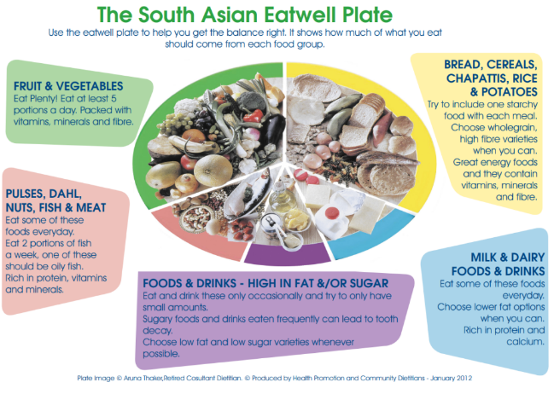
3. Useful Resources
Back to Contents
Healthy, affordable recipes and cooking tips:
cookingwithoutacooker.pdf - Google Drive
Leeds Recipe Hub | FoodWise (foodwiseleeds.org)
Jack Monroe
Non Perishable Food Parcel Meal Ideas - Food Active
Some tips to save money on food - British Nutrition Foundation
Power up the flavour - Cracking Good Food
Other resources:
Mustard Tree | Useful information and resources
Good guides to support discussion about money are available free from the Money Advice Service. Including Difficult Conversations - Talking about Money
Cost of living: Working with partners | Local Government Association

