Slide 1
Population Health
Together We Can
Dr Andy Knox
Director of Population Health
Morecambe Bay Integrated Care Partnership

Slide 2
Some Wisdom from The King’s Fund

Slide 3
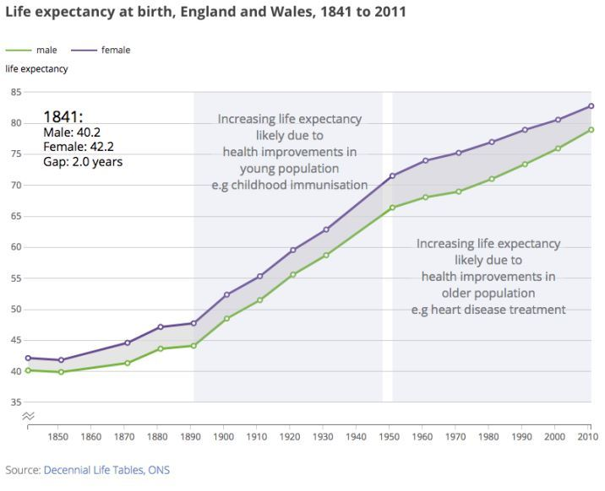
Plenty to Celebrate
‘A Great Escape’ - Prof Sir Angus Deaton

Slide 4
Let’s Face It, We’re Losing
Major Health Inequalities (Healthy Life Expectancy Gap of 18-19 YEARS!)
A North/South Divide
Rise in Early Deaths in North
Mental Health Crisis
Staffing Crisis
Obesity “Epidemic”
Poverty Rates Rising

Slide 5
A Definition of Insanity
“Doing the same thing, over and over again, and expecting different results” - Einstein

Slide 6
Why is this SO Important?
Think GOLDFISH (Prof Sandro Galea - Boston State)
Ubiquitous Factors
Underlines the COMPLEXITY
We must stop trying to oversimplify
55 minutes to save the world - Einstein

Slide 7
4 Pillars (The King’s Fund)
The Wider Determinants of Health
The Places and Communities in Which We Live
Our Health Behaviours and Lifestyles
An Integrated Health and Care System

Slide 8
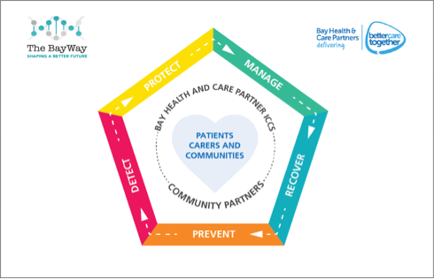
The Pentagon Approach
Morecambe Bay

Slide 9
The Wider Determinants of Health
It is indefensible for government policy NOT to take into account their impact on population health (whether intended or not)
Universal Credit (the ‘safety net’ benefit to guard against poverty) has seen significant growth in Food Bank usage (National Audit Office)
Current absence of high-level goals for nation’s health vs performance, organisation and funding.
Huge Issues - Income, Housing, Environment, Transport, Adverse Childhood Experiences, Education, Work
Making Taxation and Subsidies Work (Alcohol, Sugar, Healthy Foods)
Some encouraging noises at present - perhaps a new commitment?

Slide 10
The Places and Communities We Live In and With
Place has a major impact - housing, education, local planning, advertising, air pollution, transport
49% CUTS in real terms to local government (cannot be covered for by small rise in NHS budget)
Community - positive or negative effects
Poverty Truth Commission
Together WITH
Social Movement

Slide 11
Our Health Behaviours and Lifestyle
Easier for some communities than others
Diet
Smoking
Inactivity
Alcohol
Positive Mental Health
High BP, High BMI, Total Cholesterol, High Blood Sugar

Slide 12
Integrated Health and Care System
Redesigning Care with People who Use the System
Putting Relationships back into the Heart of Everything we Do
Breaking Down Boundaries
Brave Leadership
Culture of Joy and Kindness
Devolution
As the Mayor of Greater Manchester, Andy Burnham, has said:
As Secretary of State for Health, you can have a vision for health services. As Mayor of Greater Manchester, you can have a vision for people’s health. There is a world of difference between the two

Slide 13
Digging Deeper
The Resilience Narrative
Reimagining Politics
Reimagining Economics
Reimagining the Future
Building Step by Step

Slide 14
Despair and Hope
Learning to Sit With and Listen to the Pain
Holding onto Hope
Sober Joy

Slide 15
TogetherWeCan!

