Slide 2
Creating Space for Change
The Pause model and approach.
Pause practice and our experience of delivery, both nationally and locally
What we have learnt.

Slide 3
Notes:
In 2011 a feasibility study was undertaken in Hackney to research the scale of the issue, identify a cohort of woman and examine the prevalence of issues arising for them – Sophie Humphries and Georgina Perry
Numbers of children go up very quickly, with evidence some women have become caught in a cycle of repeated pregnancy and having 3, 4 or more children despite a number of interventions, support from services and repeated proceedings over the years.
We all know those cases don’t we…. People in the room like me who’ve removed baby 4,5,6…. & know that the reality is there’s very little for these women following a Final Hearing/Contact, and particularly when a child has been placed for adoption, because rightly children’s services have generally been focused on children. However, the impact of this is as we know women go on to have further pregnancies, and with the outcome high probability of that child being removed.
These women do not feel heard or understood, they typically do not understand statutory and/or court processes. They are often set up to fail by directions and recommendations which are overwhelming, unclear, poorly sequenced or which require access to resource which is simply unavailable e.g. intensive, lengthy and specialist therapeutic services.
So the first pilot began in Hackney in 2013, aimed at preventing this repeated cycle of children being removed into care and the loss and trauma which accompanies that

Slide 4
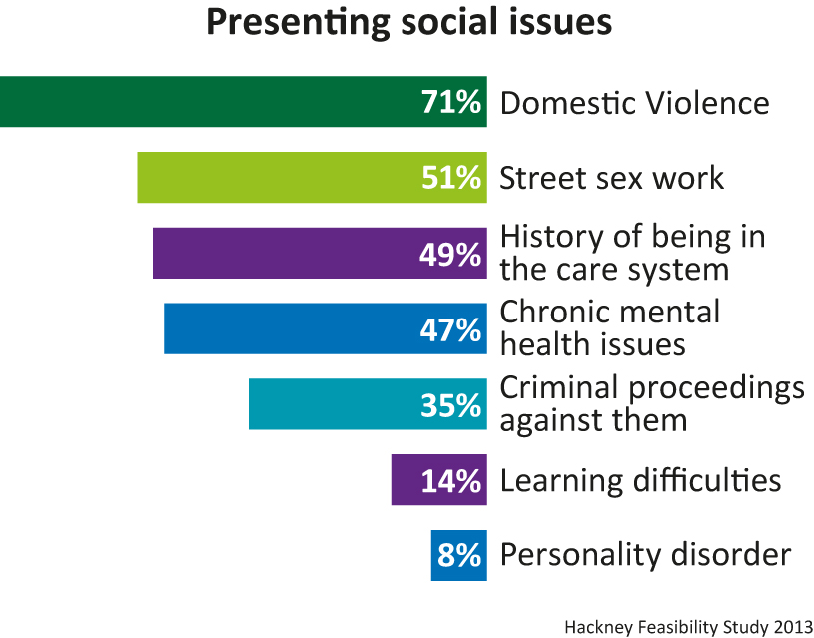
Prevalence Study: Presenting social issues
The social issues identified amongst this cohort of birth mothers should be viewed for most as interchangeable as the likelihood is that women will have experienced at least two or three of these issues over a lifetime.
Number of women and type of presenting social issue
Notes:
Range of complex, often long term issues
Intergenerational nature of a number of them
Possibly under representation of some of these issues as we have learnt from future pilots -= it is what we know when we first meet the women or look at the data but the understanding is often richer from our assessment and knowledge gained
What is known and recorded
Intersecting issues – never one issue just as it is never one reason children are removed or subject to child protection involvement
Long term entrenched issues, take time to make difference

Slide 5
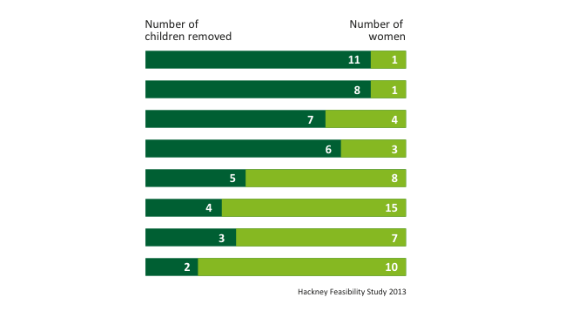
Prevalence study: Number of children removed or in care proceedings
The highest number of children removed from one birth mother was 11
31% (n 15) of the women have had at least four children removed.
Number of children born to number of birth mothers
Hackney Feasibility Study 2013
Notes:
Similar patterns emerging in new pilot areas and other local areas that we speak to
Repeated patterns – impact on women and children being removed
Fairly self explanatory slide

Slide 6
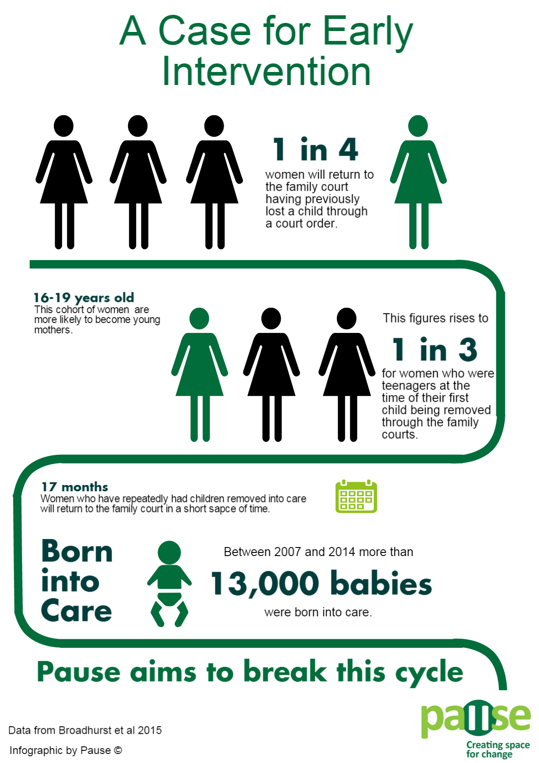
Notes:
Professor Karen Broadhurst from Lancaster University released new research in December 2015 into recurrent care proceedings, the findings of which embody the motivation behind the Pause programme. The study used electronic records held by the Children and Family Court Advisory and Support Service (Cafcass) and findings are based on all care applications made by Local Authorities in England over a seven year period from 2007 to 2014.
24% of women going through care proceedings are associated with repeat episodes of care proceedings This indicates almost 1 in every 4 women is likely to re-appear in a subsequent set of proceedings within 7 years
Younger mothers are most at risk of recurrent proceedings; the probability for girls 16-17 is 32% and 31% for women aged 18-19. For these young women almost 1 in every 3 are likely to reappear in a subsequent set of proceedings within 7 years. In contrast for those aged 30+ this is only 16%.
The risk of a repeat pregnancy is greatest within the first 3 years, although in 38% of cases a new set of proceedings started before the first had concluded.
From median data, in the first repeat episode a new sibling was born 21 months after the older sibling. In second repeat episodes pregnancy intervals were a median of 13 months and intervals tend to become/remain shorter for subsequent pregnancies.
Summary
What she found was that roughly 1 in 4 women is likely to experience repeat care proceedings over 7 year period. With the probability being higher for younger women.
The risk of repeat pregnancy tends to be greatest within the first 3 years and what we see is the gap narrowing with every subsequent child.

Slide 7
The Pause Evolution
Practices open in Derby, Wiltshire, Bristol, NE Lincolnshire, Barking & Dagenham, W Sussex (April – July)
Practices open in Slough, Cumbria, St Helens and Blackpool (August – October)
Practices open in Hull and Doncaster (April), Newham (June)
Practices open in Southwark (September), Greenwich and Islington (October)
Practice opens in Newcastle (September)
Pause pilot begins in Hackney
2015
2016
2017
2013
2016
Department for Education Innovation Fund award
Additional Innovation Fund award
Big Lottery Fund award

Slide 8
Pause in practice
Pause reduces the need to take more children into care by focusing on this problem through the lens of vulnerable women at risk of becoming pregnant and having children removed from their care.
Working with women in a radically different way, addressing everybody in their lives – fathers of their children, family members and friends – as well as professionals
Women agree to take long acting reversible contraception so they have the opportunity to reflect and focus on their own needs often for the first time in their lives.
Helps to set in place strong foundations on which they can build a more positive future for themselves.
Notes:
We use an assertive outreach model and are tenacious, we will go and find the women where they are and keep trying.
There is no motivation for the women to participate other than that they identify it would be positive for them. It’s not part of any assessment or been ordered by court etc. There is a clear focus on them, their individual needs and they are empowered to identify their own outcomes.
Support is developed collaboratively and is about developing her resilience and agency, teaching life skills, looking at how to develop and maintain relationships, giving choice.
All the women we work with have poor self-esteem, which is often compounded by their previous experience of services, repeat failures and messages they receive about themselves. This low self-esteem often results in dependency (whether on services/others/substances) and is a barrier to moving forward and bringing about change.
Encouraging critical reflection - A clear focus on individual needs and ownership of outcomes - choice – Listening – taking time to develop trust
Clarity and checking understanding
A reduced power differential enables pro-social modelling and relationship based working practices. It’s not until the women experience care and respect that they can begin to recognise it.
Teaching life skills and coping strategies, building positive social and support networks
Fun/relaxed activities. The cumulative positive experiences are also valuable and are a real time demonstration that life can be different, things can change and what that might look like.
Access to non-stigmatising locations is very beneficial.
Pause reduces the need to take more children into care by focusing on this problem through the lens of vulnerable women at risk of becoming pregnant and having children removed from their care.
working with them in a radically different way, addressing everybody in their lives – fathers of their children, family members and friends – as well as professionals such as social services, housing, the NHS and the justice system.
Pause never gives up on the women, many of whom have been in care themselves. Nor does Pause label them according their problems such as drug or alcohol addiction, criminal conviction, domestic violence or mental health.
Instead, in local areas across the country it is pioneering a new approach, offering women support they need to pause - delaying further pregnancies - and help them gain better control of their lives.
As a condition of beginning this voluntary programme, women agree to take long acting reversible contraception (LARC) so they have the opportunity to reflect and focus on their own needs often for the first time in their lives.
Pause then offers them an intensive, flexible programme of support, tailored to their individual needs, so they tackle destructive patterns, develop new skills and avoid further trauma. This helps them set in place strong foundations on which they can build a more positive future for themselves.
Pause is an innovative, dynamic and creative approach designed to address the needs of women who have experienced repeat removals of children from their care.
Pause aims to create a space in which women can “take a pause” from the usual periods of chaos, anger, sadness and reaction to removals, in order to be supported to break the cycle, to reflect and develop new skills and responses. Pause intervenes at a point when women have no children in their care.
Pause is a different experience for many women in that it does not define them in relation to any one issue, such as substance misuse or mental health, but instead helps them to focus on themselves to bring about positive change in their lives.
To do this they are required to take LARC during the intervention, thereby creating a space to pause, reflect, learn and aspire.
Importance of delay
Pause not stop
Agree, voluntary, her choice
First time often for focus on her
Lens of woman but no woman an island – systemic approach – why is this important

Slide 9
How ?
Pause draws on ideas from systemic practice, attachment theory, trauma, grief and loss and strength based interventions
Relationship based assertive outreach – We don’t give up on women and we get creative in finding ways to engage them
We have small case loads of 6 – 8 women and are able to provide intensive support
We provide each woman with a bespoke package of 1:1 and group work support over 18 months
We work with women collaboratively to give them agency and choice
We plan for transitions to ensure that women have ongoing support

Slide 10
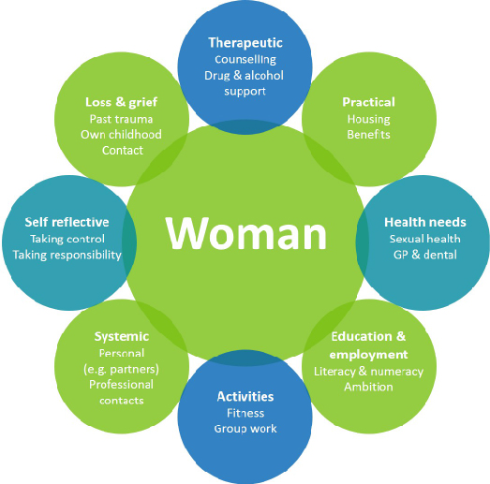

Slide 11
What’s different? What works?
Assertive outreach – practitioners are tenacious and have time, resources and flexibility
Women are supported to reflect, to identify their own needs and develop their own plan
Recognising and celebrating change, whether that be big or small
Building the skills to navigate the everyday, modelling resilience and assertive challenge
The creativity of the practitioner and the use of self to provide a trusted, honest and consistent professional relationship
Having fun!
Notes:
Women identify thier own goals; practitioner enabling not judging
Use of humour and self. Using the relationship to think about woman's approach to other people and how she sees herself in relation to key people
Encouraging Rachel to reflect on repeated behaviours, addictions and life events.
Practitioner role modelling tenacity e.g. managing setbacks not giving up, showing you won't go away
Being Creative; doing something besides the everyday
Leisure and pleasure even when other things are tough
Rachel is finding her Personality Disorder group therapy really hard work. We talk over her apprehension before each session
We celebrated completing a month’s treatment by going Ten Pin bowling - It was a draw!
You might want to make reference to use of the women's resources- how this can help with practical things as well as positive experiences that they may not have had access to,
Creativity of the practitioner and use of self – importance of noting that we do a lot of work ourselves – worker being a therapeutic resource as opposed to referring on to other agencies all the time.
You meet the woman where they are at ( important to say not defining them by any one issue )
Importance of strength based approach
Develop professional, supportive, non-judgemental accepting relationship - Its within these relationships respectful challenges can be made which lead to new learning and enable positive changes to be made.
Attend activities and appointments with my clients ( why’s this important, need to really stress the importance of relationship based approach, doing alongside eg baking, activities, shopping, fun
Time + Resource + Tenacity + Flexibility
Assertive outreach
Support with negotiating pathways and articulating needs
Providing the interface between the women and services, facilitating praticipation and giving emotional support and motivation to enable meaningful engagement
A clear focus on individual needs and ownership of outcomes - choice – Listening – taking time to develop trust
Clarity
A reduced power differential enables pro-social modelling and relationship based working practices. It’s not until the women experience care and respect that they can begin to recognise it.
Teaching life skills and coping strategies, building positive social and support networks
Fun/relaxed activities. The cumulative positive experiences are also valuable and are a real time demonstration that life can be different, things can change and what that might look like.
Access to non-stigmatising locations is very beneficial.

Slide 12
Partnership Working and Pathways
Pause women experience multiple barriers to accessing services, very few are skilled in advocating for themselves and articulating their needs.
They typically become frustrated and challenging, or disengage. They will often continue to present with the same issues and in crisis.
Pause works with partner agencies to smooth pathways which can really benefit the work they are trying to do. Work is undertaken around preparation and support to access services, facilitating attendance and providing motivation to engage consistently.
Multi agency group meetings are held regularly to ensure we can work closely and creatively with partner agencies
Notes:
Many of our women have been put off accessing services due to negative prior experiences, and/or struggle to navigate complex pathways.
A large proportion of the women do not access routine health appointments or engage with early intervention/universal services. This tends to mean that they then only present when issues are acute and there is a high level of need.
It is apparent that for many services this cohort raises a huge amount of anxiety and concern. However they typically do not engage fully or consistently and then present with the same issues again and again.
Many of the women are in need of therapeutic intervention, particularly around bereavement, guilt, grief and loss, but struggle to articulate their needs and are often re-traumatised by having to tell their stories repeatedly and reading them in reports
The majority do not have supportive systems (family, friends, or community) in place or are prevented from accessing them because of the shame they feel.
Many suffer with very low self-esteem, making them even more vulnerable.

Slide 13
Pause Hull
44 women have now completed the Pause programme in Hull
Of those:-
The women average a birth rate of 0.27 per woman, per year
Having long acting reversible contraception in place over the 18 month programme provides at least 27 birth free months for each woman (An estimated 13 pregnancies would cost the local authority more than £1 million)
Pause Hull is now working with a further 20+ women

Slide 14
Outcomes for Hull Pause
Housing
Mental health
Physical health
Sexual Health
Reduction in Criminal Activity and Domestic Violence
Contact with birth children
Education
Employment or placements
Dentists and Opticians
Notes:
Dental From 23% to 90% registration - 80% receiving treatment
(extractions, fillings, and medication to treat infections)
Opticians From 9% to 56% registration - 45% now have glasses
Sexual Health From 0% to 95% screened -15 % treated for STIs,
80% had smears, 5% referred to colposcopy
Mental health From 9% to 77% referred into services
59% attending 4+ sessions at Let’s Talk. Another 10% attended stress control groups
Physical health 63% had known but previously unmet needs
including liver disease, double incontinence and
pain management. All now accessing services
Housing 32% were homeless. 36% of women now have a
permanent council tenancy, 14% are in private rented,
and 50% have a supported tenancy
Criminal Activity: 101 convictions, 18 arrests without conviction, and 139 DV
reports (pre-pause)
By end of programme: 2 convictions, 3 arrests without
conviction, and 48 DV reports
Domestic Violence 7 women left controlling and violent relationships
Contact From 33% to 66% of women now participating in letterbox
Direct contact also improved
Education: 47.5% have accessed courses Maths, English, Confidence
& Motivation, NVQ Level 2 and 3 Hairdressing,
Health & Social care
Employment & placements: From 0 to 29% - with 19% coming off benefits

Slide 15
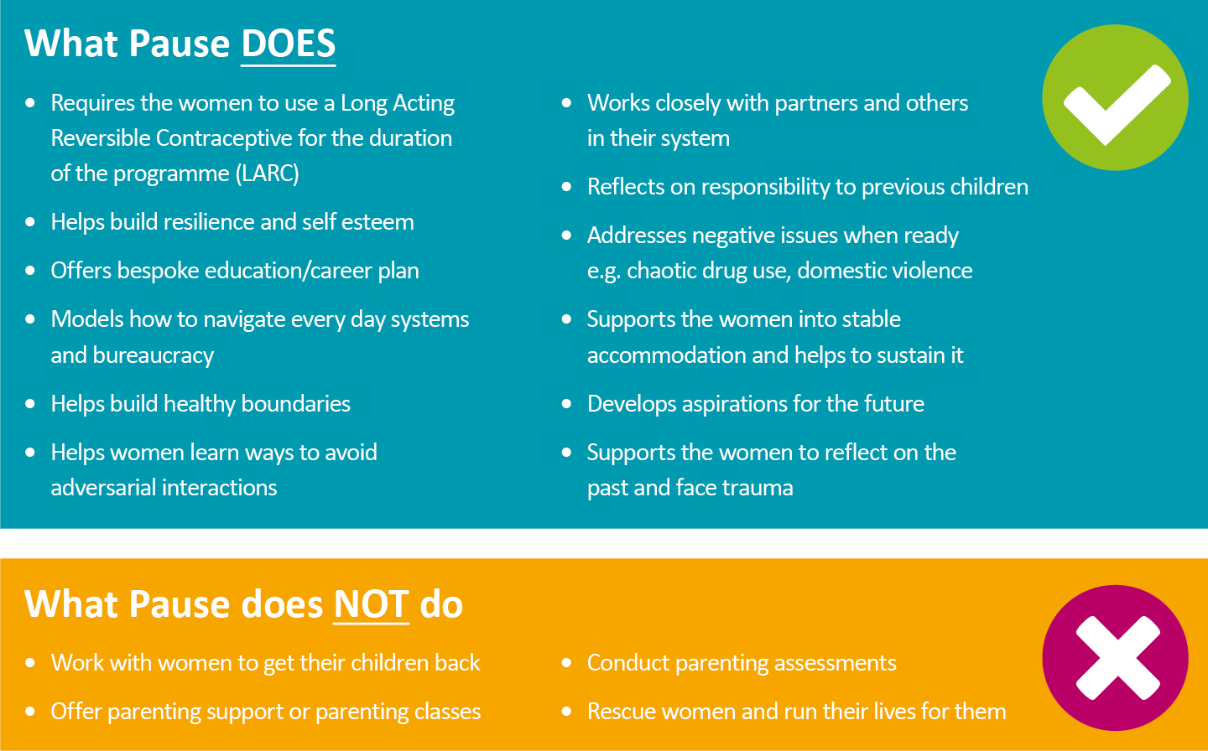
Notes:
Not a parenting programme
Although primary purpose not to get children back, we are beginning to see some positive examples of renewed/improved contact with children – benefits that this then has on child wellbeing, kept in mind, stability. Women may not have the care of their children, but can re-focus on what being a good mother is in whatever their situation is now.
We negotiated for one of our women to restart contact with her youngest child, observed contact and worked with social care to improve the quality of this contact for the child. This has created positive outcomes for the child, mother and the family member with the SGO, and enables the child to maintain relationships with her birth mother.
LARC is a requirement of Pause. This is simply to allow them (like other women) to have a break from repeated pregnancy to allow them to have time to focus on themselves rather than a pregnancy, or a baby and everything that then comes with that. Not really a contentious issue for the woman and something that women use every day in order to plan.
What we found is some women were using LARC already, or saw the need but it either hadn’t been a priority, or there were barriers accessing services. All the pilots have really positive links with health, and named nurses who can provide outreach services, longer appointments, clear explanations to inform choice, all of which ensure that first step on the Pause journey is a positive one. A lot, if not all of our women have struggled to access services and have negative relationships with professionals so it’s really helpful for this to feel different.

Slide 16
Evaluation - Main findings
Positive and significant impact on women engaging with the programme
Access and engagement with services, including health, housing and substance misuse, generally increased and was associated with improved outcomes
Extremely effective in reducing the number of pregnancies
Full cost of delivering Pause is likely to be offset by savings to Local Authorities within two to three years
Notes:
Counterfactual impact analysis demonstrated that Pause was extremely effective reducing the number of pregnancies. While 2 women became pregnant during their time with Pause, it is estimated that between 21 and 36 pregnancies would have occurred, had the cohort of 125 women not been engaged in the programme. Given the women’s histories, these pregnancies would have been likely to have resulted in removals.

Slide 17
Improvements
Women working with Pause saw the following improvements:
For women who reported a drug or alcohol problem, 65% saw improvements.
88% saw improvements who had reported domestic violence issues.
Women with mental health issues saw an improvement of 73%.
Quality contact with children improved for 60% of the women.
73% of women had a more stable housing situation.
Of the women that identified training/education/volunteering/ employment as a goal, 89% achieved this.
Prior to Pause only 19% of women where accessing support from relevant specialist services, this has increased to 67%.

Slide 18
info@pause.org.uk
www.pause.org.uk
@PauseOrg

