Slide 1

Inclusive Wellbeing Economies
Workshop Slides

Slide 2
Agenda and timings
Introductions and context setting (10 – 15 mins)
What are inclusive wellbeing economies? (15 – 30 mins)
Self-assessment (35 – 50 mins)
Developing a visions and shared purpose (35 – 50 mins)
Action planning (20 – 25 mins)
Wrap-up (5 – 10 mins)
Notes:
Check here whether people have done pre-reading

Slide 3
But first some introductions…
Please briefly share with everyone: -
Your name
Your organisation and/or who you’re representing today
Your response to the below check-in question
‘When was the last time you had the feeling “This is why I do this work” or “This is why I get up in the morning”? What led to that feeling?’
Notes:
Check-in – trying to unpick what drives each person and gives them a sense of purpose?

Slide 4
What are inclusive wellbeing economies?

Slide 5
Some definitions for starters
“An economy is the way that we produce and provide for one another. Economies operate at different geographies: global, regional and local. The rules, social norms and stories that underpin our economies were designed by people and that means that they can also be changed by people”
Wellbeing Economy Alliance, 2023
“[An inclusive wellbeing economy is] a more deliberate and socially purposeful economy – measured not just by how fast or aggressive it grows; but also, by how well wealth is created and shared across the whole population and place, and by the social and environmental outcomes it realises for people”
Y&H Public Health Network, 2024
Notes:
Economies are how we relate to each other and how we exchange goods and services. Not inevitable – what we have currently is not the only way of doing this. The economic systems we currently have were developed and iterated over many years and centuries by people. What that means is that we can collectively make the decision to do things differently, if the current way of doing things doesn’t work for us anymore.
People are not subject to economies; economies are subject to people.
Growth is not the end; growth is one potential means to an end. Need to consider whether we need growth to meet our goals and, if so, what kind of growth and where.
https://www.yhphnetwork.co.uk/links-and-resources/adph-priorities/inclusive-wellbeing-economies/

Slide 6
Some definitions for starters
“In a wellbeing economy, economic growth is no longer only seen as an end in itself, but a means to achieving wellbeing… As such, the growth of an economy is only positive as long as it increases what matters to people – that includes basic needs such as housing, nutrition, safety, and health, as well as mental health, psychological wellbeing, and freedom - and is regenerative/or even restores nature… [it] aims to achieve conditions that allow everyone to equally live healthy and happy lives within planetary boundaries, where everyone includes future generations.”
Institute for Public Health & Euro Health Net, 2024
Notes:
https://www.publichealth.ie/sites/default/files/resources/Sustainable%20Wellbeing%20Economy%20report%20final.pdf

Slide 7
And some quotes
“Anyone who believes exponential growth can go on forever in a finite world is either a madman or an economist”
Kenneth Boulding
“The gross national product does not allow for the health of our children, the quality of their education or the joy of their play. It does not include the beauty of our poetry or the strength of our marriages, the intelligence of our public debate or the integrity of our public officials. It measures neither our wit nor our courage, neither our wisdom nor our learning, neither our compassion nor our devotion to our country, it measures everything in short, except that which makes life worthwhile.”
Robert F. Kennedy
“The welfare of a nation can scarcely be inferred from a measure of national income.”
Simon Kuznets
Notes:
GDP (formerly GNP) doesn’t even measure economic output that well (not taking into account more informal parts of the economy, such as caregiving, volunteering, etc) and it was never intended to be used in the way it’s being used now, i.e., as a benchmark figure for a country’s prosperity and success. It doesn’t account for the quality of economic activity or how the benefits of that activity are distributed amongst a population. It also doesn’t account for the wider impacts of that activity, e.g., on health, wellbeing or the natural world.
https://www.weforum.org/stories/2021/12/stakeholder-capitalism-episode-1-a-brief-history-of-gdp/

Slide 8

https://www.youtube.com/watch?v=R8no2wZLKHc&t=174s
Notes:
Brief video from Wellbeing Economies Alliance (WEAll) – ‘A Wellbeing Economy is Possible’

Slide 9
How does IWE differ from BAU?
Business as usual Inclusive wellbeing economies
Focus on economic growth, e.g., GDP Focus on wellbeing and thriving populations
Growth is the end goal / measure of success Growth is a means to an end
Grows regardless of whether people thrive People thrive regardless of whether it grows
Extracts wealth and resources Circulates wealth and resources
Wealth and resources distributed inequitably Wealth and resources shared equitably
Not working within planetary boundaries Working within planetary boundaries
Complicated but linear Complex system
Primacy of the market Embedded economy
Markets are self-regulating Markets should be regulated
People serve the economy Economy serves the people
Notes:
IWE = inclusive wellbeing economies. BAU = business as usual.
Embedded economy – recognises the importance of the state, commons and household and places it within the living world. Recognises the value of ‘non-economic’ activities to the economy. Much of this comes from Kate Raworth’s Doughnut Economic - https://doughnuteconomics.org/about-doughnut-economics.

Slide 10
Economic growth – a more nuanced view
As you will have gathered from the previous slides, inclusive wellbeing economies contest the ‘economic growth at all costs’ narrative that is often dominant.
However, this does not mean that economic growth is bad in all circumstances. Rather it is the type of growth that matters in inclusive wellbeing economies.
For example, what kind of growth is it, where is it happening and who stands to benefit from it? Is it growth at all costs or growth for a purpose?
Economic growth focused in those places and for those communities where there are significant inequalities could help narrow the gap and ‘level up’.
BUT this depends on how this growth is achieved, what characteristics it has and who benefits from it. This is where IWE principles come in.
E.g., use of local suppliers and supply chains, employment opportunities for local people, development of local assets.

Slide 11
What do inclusive wellbeing economies look like in practice?

Slide 12
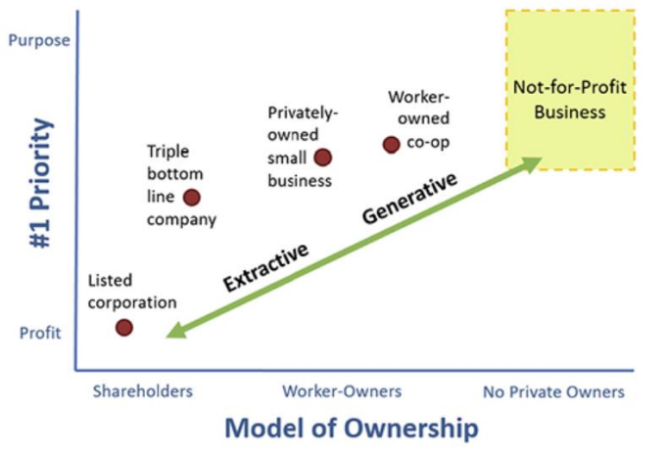
More circular local economies
Source: Jones F and Bettany V. Introduction to community wealth building. Centre for Local Economic Strategies. Available online at https://www.cles.org.uk/wp-content/uploads/2019/09/Introduction-to-CWB-29082019.pdf.
Notes:
To truly thrive and support local people to thrive, local economies needs lots of generative organisations, including: -
worker-owned businesses
community organisations
charities
social enterprises
locally rooted SMEs
municipal enterprises
All these types of organisations allow the wealth they create to circulate around their local economies.
-
In addition to this, organisations with shared ownership structures have the added advantage of widening ownership of wealth even further, by passing profits directly on to workers, consumers or citizens.
Examples of this include: -
worker-owned co-operatives
mutuals
community businesses
By baking all of these elements and the following ones into our economies as early on as possible, we can mitigate the need for ‘failure demand’, e.g., spending a lot of money to fix problems created by inequality.

Slide 13
Components of an inclusive wellbeing economy
There are many different ingredients that can help to support inclusive wellbeing economies. Which ones you focus on will depend on your local context.
Strong anchor institutions and networks
Community wealth building
Community banking
Community safety
Diverse range of local institutions, organisations and businesses
Fair work schemes to support ‘good work’
Offers to support good workplace wellbeing
Focus on education and skills
Valuing and supporting volunteering
Notes:
Anchor institutions and networks - https://www.kingsfund.org.uk/insight-and-analysis/long-reads/anchor-institutions-and-peoples-health
Community wealth building - https://cles.org.uk/community-wealth-building/what-is-community-wealth-building/
Community banking - https://cles.org.uk/what-is-community-wealth-building/the-principles-of-community-wealth-building/making-financial-power-work-for-local-places/mutuals-and-community-banks/
Good work - https://www.local.gov.uk/topics/employment-and-skills/good-work-project

Slide 14
Inclusive wellbeing economies in practice - a case study
Your pre-reading will have involved a case study from Preston, where the Centre for Local Economic Strategies has been working with Preston City Council since 2015 to build a programme of community wealth building (CWB) in the city.
Aimed to address failings of traditional regeneration and a reliance on ‘trickle-down economics’.
Focus on working with anchor organisations to unlock the power of procurement, influence local spend and grow local businesses and cooperatives.
Range of impacts, including retaining money in the local economy, increase in social mobility, reduction in deprivation, lower unemployment better jobs and higher skills.
Notes:
The UK is the fifth largest economy in the World, yet many of its local areas experience economic stagnation, falling wages, rising levels of poverty, and public sector austerity. The economy is not working for all; inequality is now entrenched with 10% of households owning 45% of the nation’s wealth.
The traditional model of economic development does little to address this wealth problem. Instead it focuses heavily on attracting inward investment, assuming that the wealth created will trickle down to local communities.
On one level it’s a familiar story. At the start of the decade Preston, Lancashire, was a city with economic and social issues but also unrealised opportunities. The decline of industry in the 1970s had contributed to rising rates of poverty.
By the early 2010s these issues were being compounded: firstly, by public sector austerity and the post-financial crash recession and; secondly, the stalling and then eventual abandonment of the £700 million Tithebarn regeneration project, which had been expected to provide the inward investment necessary to transform the city centre.
This identified that of the collective £750m spent by those institutions procuring goods and services, 5% was spent with organisations based in the Preston boundary, with 39% spent with organisations based in wider Lancashire (including Preston). Over £458m was leaking out of the Lancashire economy.
The impact of this work has been significant, with the most recent anchor institution spend analysis finding that the procurement spend retained within Preston was £112.3m, a rise of £74m from 2012/13. Within the wider Lancashire economy (including Preston) £488.7mof spend had been retained, a rise of £200million from the baseline analysis.

Slide 15
Inclusive wellbeing economies in practice - a case study
Community wealth building…
Is the work of many hands
Must be unique to place
Involves public service
Means having a diversity of suppliers
Tells a story people that want to hear
Is an inspiration rather than a model
Is both a policy approach and a way of working
https://cles.org.uk/publications/how-we-built-community-wealth-in-preston-achievements-and-lessons/
Notes:
Lessons learnt.

Slide 16
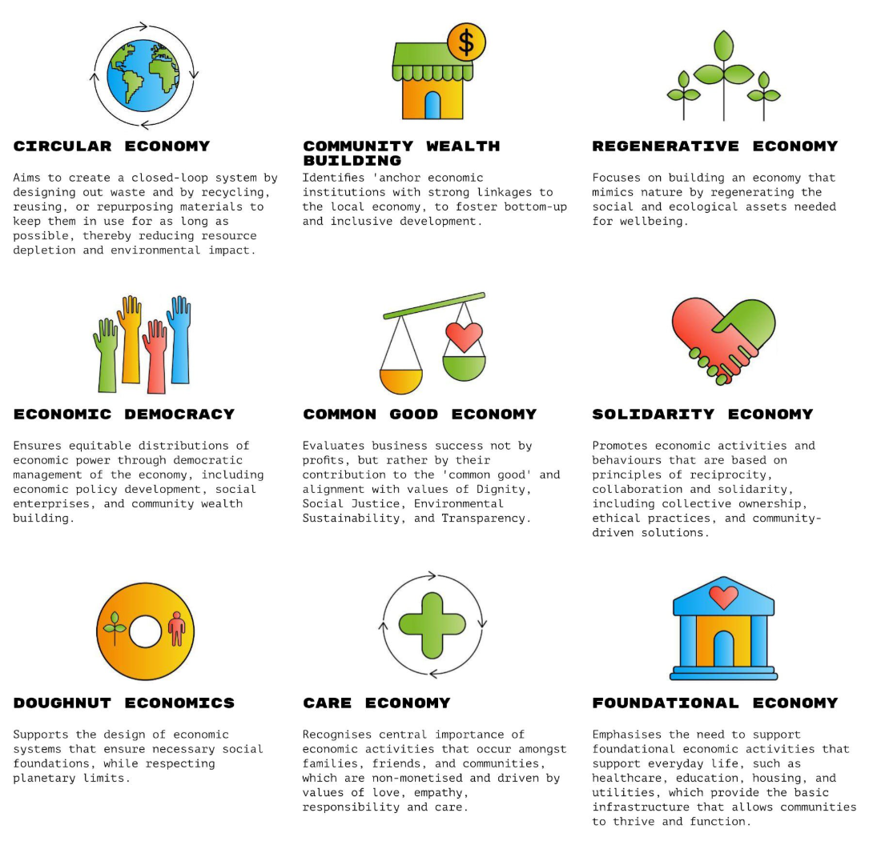
Different models, same principles
Notes:
There are a multitude of different concepts and models that align with or are utilised by inclusive wellbeing economies.
This may seem confusing at first, but all of these models are largely complementary in terms of their values and there is significant overlap between them.
They are essentially slightly different ways of thinking about the same kinds of things.
BUT despite this, there are some important distinctions between models too (in terms of emphasis, scope, etc) and places should consider which model(s) are right for them and their local places, based on which ones most resonate and align with their values and priorities and those of local communities, as well as which ones are more likely to generate traction and shared purpose amongst a range of key partners and stakeholders.
Where more than one model is adopted (a ‘pick and mix’ approach), places will need to be mindful of to what extent these models are compatible and how any tensions or necessary trade-offs will be resolved.

Slide 17
Why do inclusive wellbeing economies matter?

Slide 18
Why does it matter? So what?
Our current economic systems distribute wealth and resources unequally, and this leads to significant inequalities in wealth.
They are also placing unsustainable strain on the natural world, which is exacerbating climate change.
All of this then has considerable impacts on the health and wellbeing of our local populations and leads to substantial health inequalities.
Whichever way you look at it (e.g., from a climate, health or social justice perspective), the current system is not working well for us as a collective.
Working towards inclusive wellbeing economies allow us to rebalance how our economies work, to prevent these negative impacts and to escape the trap of spending money to fix them after they occur.

Slide 19
Why does it matter? So what?
We are increasingly seeing the impacts of this in all of our daily lives and work, for example: -
Work increasingly treats employees as on demand, disposable inputs and a cost to be minimised (rather than assets to be supported and nurtured).
This is leading to more people being unwell, reflected in the growing number of people of working age who are economically inactive due to long term illness.
Local economies are losing their workforce to ill health at a time when there are labour shortages, resulting in less wealth when more is needed.
All of this exacerbates existing inequalities, stifles local economies and disempowers local communities.

Slide 20
Why does it matter? So what?
“I’m working in public health, why should I care?”
Shifting towards an IWE will allow us distribute wealth and resources more equitably and so tackle health inequalities, by addressing wider determinants of health.
“I’m working in economic regen or economic policy, why should I care?”
Shifting towards an IWE will allow you to ‘level up’ across your local place and help boost prosperity in left behind places and communities.
“I’m an elected member, why should I care?”
Shifting towards an IWE will lead to more inclusive and prosperous local economies, where all local people have the best opportunity to thrive.
Notes:
More work to do around comms and framing – this is just a starter.

Slide 21
Why does it matter? So what?
“I’m working in public health, why should I care?”
Shifting towards an IWE will allow us distribute wealth and resources more equitably and so tackle health inequalities, by addressing wider determinants of health.
“I’m a local resident, why should I care?”
Shifting towards an IWE will allow for wealth and resources to be shared more equally and give you the best opportunity to participate in your local economy and thrive.
“I’m working in economic regen or economic policy, why should I care?”
Shifting towards an IWE will allow you to ‘level up’ across your local place and help boost prosperity in left behind places and communities.
Notes:
More work to do around comms and framing – this is just a starter.

Slide 22
Why does it matter? So what?
“I’m a local business, why should I care?”
Shifting towards an IWE will allow more wealth and resources to be retained and spent within local places, benefitting local businesses.
“I’m a local resident, why should I care?”
Shifting towards an IWE will allow for wealth and resources to be shared more equally and give you the best opportunity to participate in your local economy and thrive.

Slide 23
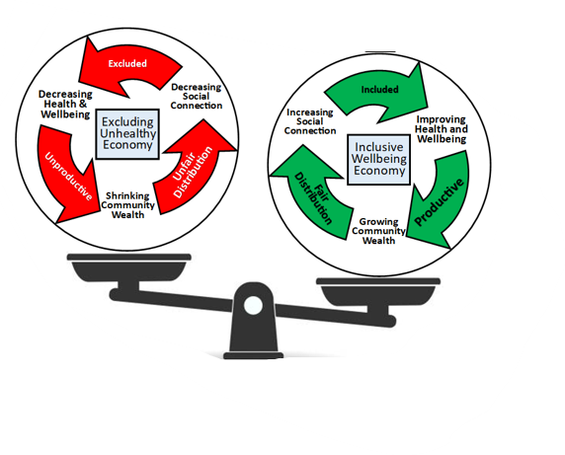
A vicious cycle or a virtuous cycle?

Slide 24
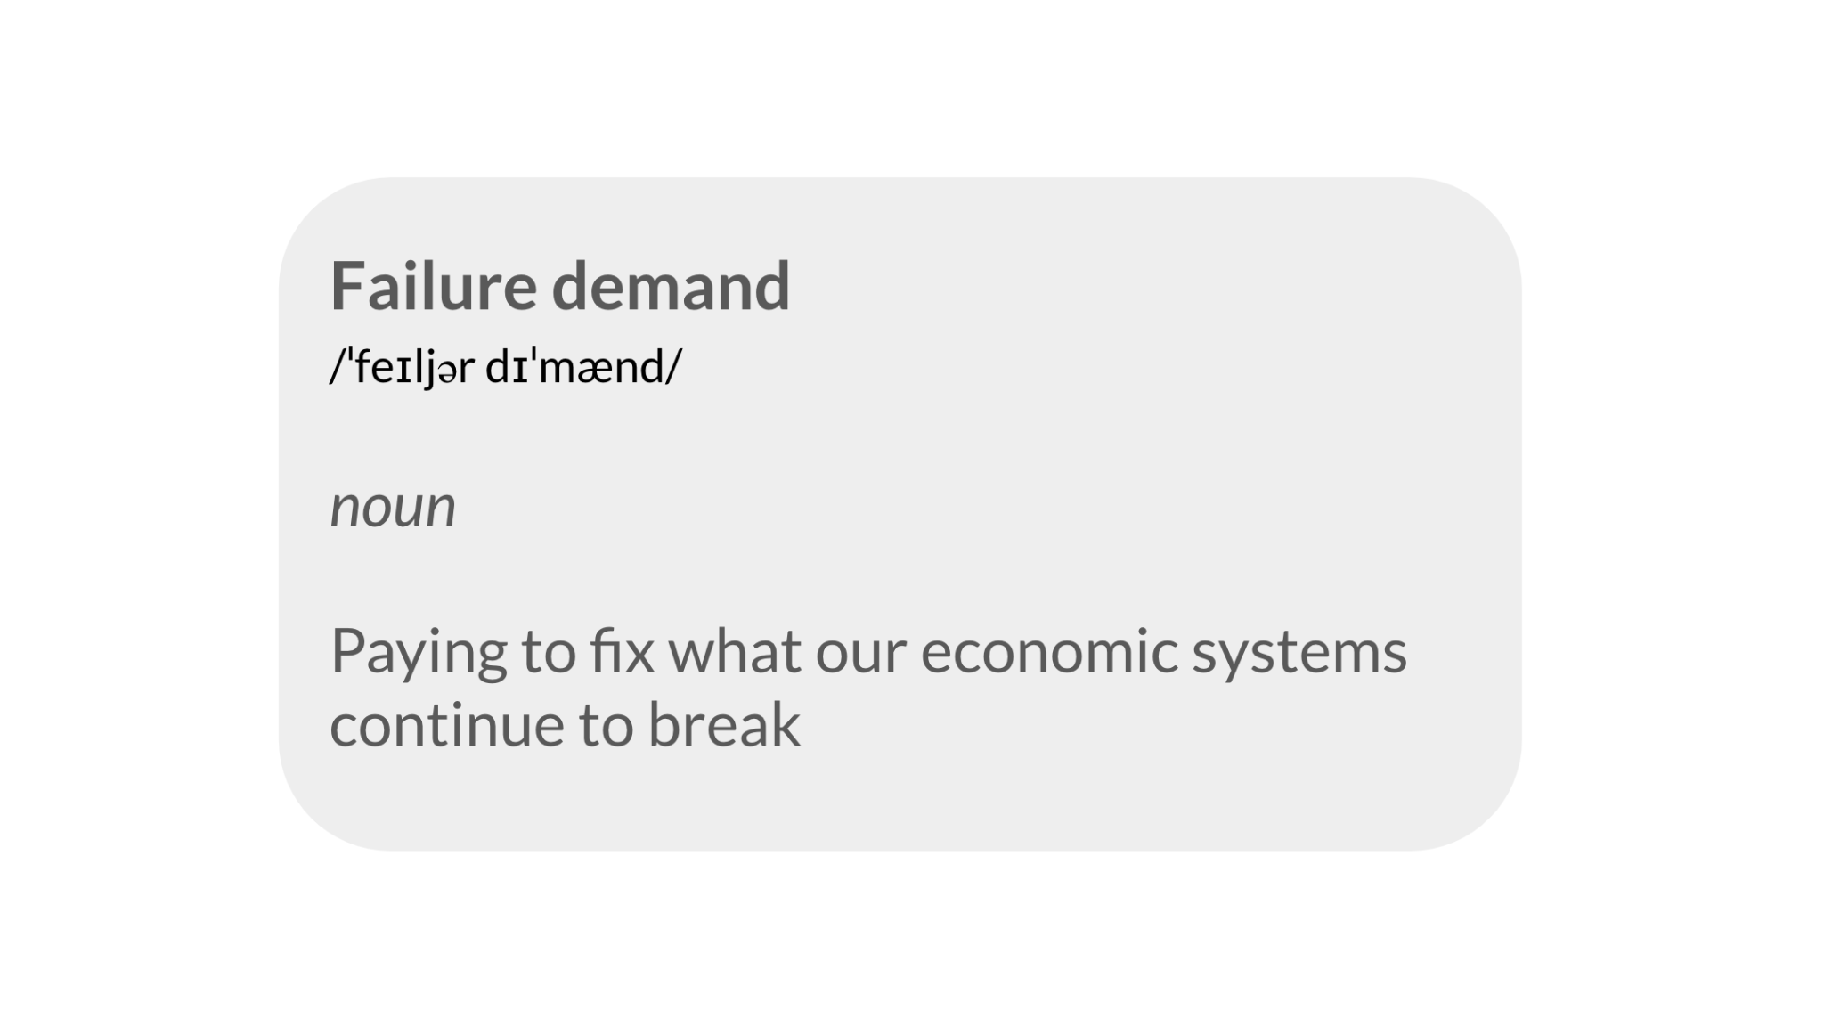
‘Failure demand’ and the importance of acting early
Notes:
A narrow focus on economic growth at all costs is causing harm to people and the planet, requiring governments to spend money (re-distribution) to respond to these harms.
For example, huge amounts of money are spent annually to tend to the impacts of poverty and precariousness, housing insecurity and homelessness, and of the environmental destruction generated by our current economic systems.
By transforming our economies to be more inclusive and to enable population health and wellbeing as early on as possible (pre-distribution), we can mitigate the potential for ‘failure demand’, i.e., being caught up in a cycle of paying to fix what our current economic systems continue to break.
https://weall.org/failure-demand-counting-the-true-costs-of-an-unjust-and-unsustainable-economic-system

Slide 25
How can you get started with inclusive wellbeing economies?

Slide 26
Getting started
Moving to a more inclusive wellbeing economy involves changing from one way of thinking about and doing things to another. We can approach this in a couple of different ways.
Looking at the wider systems and ways of doing things that underpin our local economies can bring change at a more systemic level. BUT it’s sometimes harder at a local level to influence the kind of things that will bring about this wider change.
Looking at smaller, locally-oriented actions allows us to focus down on those things that are practical and achievable at a local level. BUT scope and impact may sometimes be limited by wider factors that are out of our control.
In practice, you probably need some of both and where you start from will depend on your local context and where the interest and energy among your partners takes you.
You could start by looking at wider systems and then use that to focus down on particular actions that are needed OR start with what’s doable at a small scale and use the energy and momentum generated by that to make the case for wider change.

Slide 27
Starting big - thinking about systems change
There are multiple different models that can be used to think about systems change. These next few slides will briefly describe a couple that have already been applied to the shift to more inclusive wellbeing economies and that you can use to help explore what this might look like for you at a local level.
These are: -
Two Loops Model (originally described by Wheatley and Frieze)
Four P’s Model (described by Trebeck and used by WeAll)
Notes:
https://www.sfu.ca/complex-systems-frameworks/frameworks/strategies/two-loop-model.html
https://weall.org/what-is-wellbeing-economy#b3

Slide 28
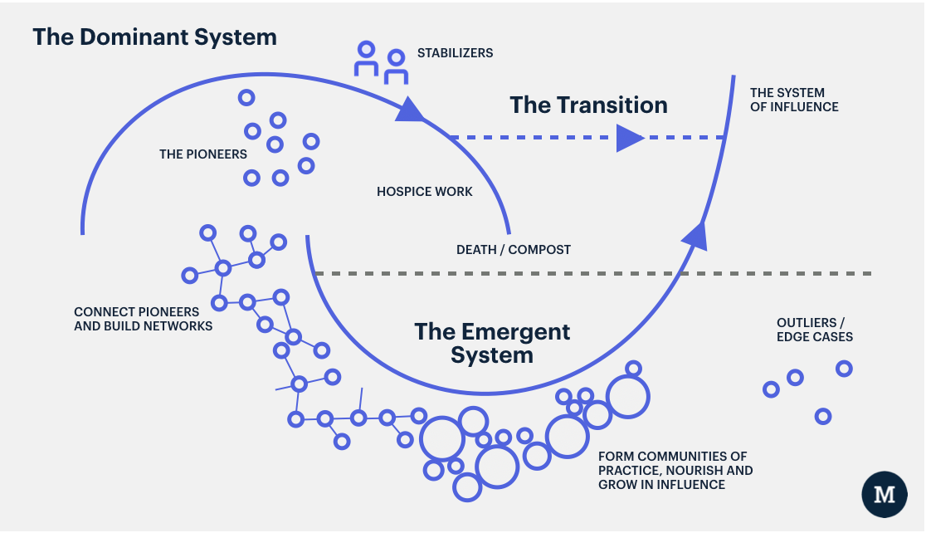
Two Loops Model
Notes:
This framework can be used to talk about both ‘what we need less’ (the hospicing of a dominant system that no longer works for us) as well as ‘what we need more of’ (supporting a new inclusive wellbeing economy system).
Potential questions for exploration might be: -
The dominant system:
What challenges are we facing that our existing economic system struggles to address?
What are the practices, structures, or policies in our organisation that keep the current economic system in place?
How can these practices, structures, or policies be replaced with ones that are better aligned with our goals of becoming an inclusive wellbeing economy.
Who will this transition be hard for? How can they be acknowledged and supported?
The emerging system:
What new ideas or practices are starting to emerge within our organisation or sector that symbolise an emerging wellbeing economy system?
What examples of such activities and processes already exist in the local context and embody the desired ways of working and outcomes?
How can these (emerging) initiatives be nurtured, supported and scaled up?
Credit to Margreet Freeling, Wellbeing Economies Alliance, for this content.

Slide 29
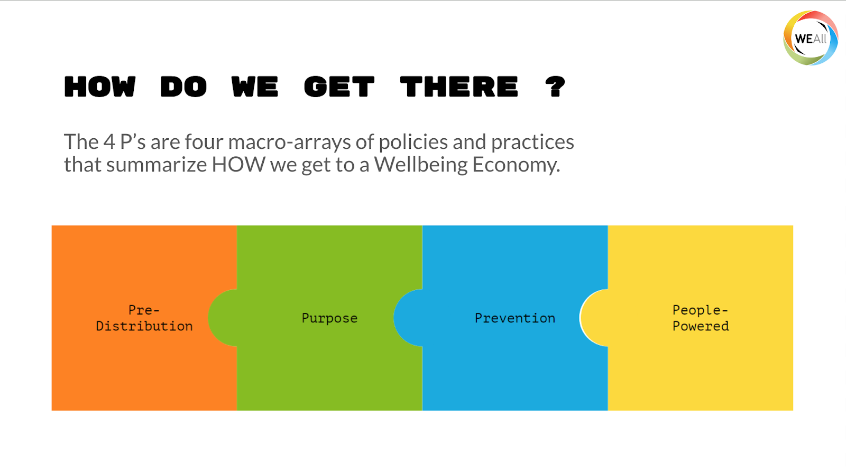
Four P’s Model
Notes:
Pre-distribution: We don’t leave it to people to fend for themselves or rely on limited redistributive mechanisms, but predistribute power, wealth, time, and income so that the heavy lifting is done by the economy itself. Example: social enterprises and businesses owned by their workers, community wealth building and living wages.
Purpose: The purpose of the economy becomes exclusively to deliver human and ecological wellbeing. Example: adopting a wider suite of success measures Beyond GDP, and visionary national development plans.
Prevention: Rather than being content just fixing the harm we do to nature and people, we adopt preventive measures that stop harm from happening in the first place. Example: Outcome budgeting and circular production and consumption.
People-powered: Economic decisions are powered by the people, who become directly involved in decision making and agenda setting. Example: Citizen assemblies and participatory budgeting.
Credit to Margreet Freeling, Wellbeing Economies Alliance, for this content.

Slide 30
Starting small – opportunities for action
There are a wide range of potential opportunities for action at a local level that will help you build and work towards a more inclusive wellbeing economy.
We can’t cover the full range of these here but they can largely be divided into four main categories, although these are not necessarily exhaustive.
Work and health
Circular economies
Community wealth building
Anchor organisations
There is much more on each of these categories, including specific actions that can be considered in Narrative to Action – Moving towards inclusive wellbeing economies in Yorkshire and the Humber.
Notes:
Work and health – building a fairer and more inclusive labour market that supports good work and better population health and wellbeing
Circular economies – reducing the environmental impact of the way in which our economies use and dispose of resources
Community wealth building – increasing the amount of wealth and resources that are retained in and that benefit local people and communities
Anchor organisations – increasing the capacity of large organisations embedded in our local places to use their assets and resources for social good

Slide 31
Laying the groundwork – preparation is key
Whether you’re starting with wider systems or smaller actions, the inclusive and wellbeing economies narrative developed as part of this fellowship describes some factors that will help make it easier to take action: -
Understand what strategic levers you have at your disposal and use them.
Know your local population(s) and use community-centred approaches.
Understand and be prepared to make the best use of local assets at your disposal.
As far as possible, link your local economy to your local place.
Understand the impacts of what you do on future generations.
There is further guidance on this for people working at a local, sub-regional and regional level in the narrative.

Slide 32
Getting started - some potential first steps
Engage with stakeholders and local communities to understand local needs and aspirations, and to inform your vision.
Build and invest in relationships and ways of working that will help you to collaboratively work towards your vision.
Think about the assets and levers that you have and that can be built upon in your local place, e.g., anchors, voluntary sector.
Think about getting community wealth building started, to anchor more money to local places and communities.
Pick a series of indicators that will allow you to measure what good looks like for your local area.
Look into some of the resources listed at the end of these slides.

Slide 33
Some common concerns and misconceptions

Slide 34
Isn’t our wellbeing dependent on economic growth?
Many people still assume that there’s a link between economic growth and population wellbeing. Implicit in our political and public discourse is a belief that economic growth will increase wellbeing for all.
However: -
GDP is not a good measure of societal wellbeing.
A rising tide does not lift all boats equally.
More is not always better.
The current growth model is detrimental to wellbeing.
Notes:
GDP is not a good measure of societal wellbeing
GDP is a useful indicator to measure the extent of economic activities in a country, but it is not a good measure of human wellbeing or societal progress. This is a fact that was already understood by Simon Kuznets, one of the intellectual fathers of the metric.
GDP fails to accurately capture wellbeing, as it disregards important aspects of wellbeing such as social inequalities, environmental sustainability, as well as non-monetary exchanges and unpaid work, such as care work.
GDP measures the quantity, not the quality, of economic activity. Expenditures that increase GDP, such as the cost of cleaning up environmental damage or increased health expenditures due to accidents and disease, do not necessarily reflect positive economic development.
The disconnect between wellbeing and economic growth is further supported by research on alternative metrics of societal wellbeing and progress. While global GDP per capita has been rising since the 1980s, the Genuine Progress Indicator has decreased in the same time period.
A rising tide does not lift all boats equally
The socioeconomic benefits related to a growing economy are often very unequally distributed in society as well as between societies. In 2021, the richest 10% of the global population received 52% of total income and owned 76% of all wealth, respectively. At the same time, the poorer half of the global population only earned 8,5% of total income and owned 2% of global wealth.
Since the 1980s, the share of GDP going to labour in the form of wages has been declining in comparison with the share of GDP that goes to owners of capital.
These trends point towards the fact that workers benefit less from economic growth when compared to owners of capital, an issue that raises concerns of social justice and fairness.
High levels of inequalities are problematic for wellbeing, even in a growing economy. Evidence suggests that countries with higher inequalities perform worse in a wide range of domains crucial for wellbeing, including physical and mental health, education, trust, as well as violence and crime. Similarly, global inequalities exacerbate environmental challenges and hamper collective efforts to address these.
More is not always better
Empirically, economic growth and associated increases in income are not linked to happiness in the long-term, especially in high-income countries. This has become known as the Easterlin paradox.
Consumerism as a central pillar of current economic growth has negative effects on wellbeing due to its close association with materialist values. Psychological research shows that people whose values centre around materialism experience lower wellbeing, reflected in lower life satisfaction, worse physical health, poorer quality social relations, as well as higher susceptibility to depression and anxiety.
Instead, findings from the world’s longest scientific study of happiness, the Harvard Study of Adult Development, show that rather than money or material things, it is the quality of our relationships with others that is the most important in influencing people’s happiness.

Slide 35
Don’t we need economic growth to fund essential public services?
Often, economic growth is presented as a pre-requisite to financing the delivery and improvement of essential public services (including the transition towards inclusive wellbeing economies). More immediate demands on government budgets are sometimes used to argue that ‘we can’t afford to focus on wellbeing’.
However, this argument only holds true if we take the government’s current fiscal architectures as a given. There are, in fact, several reasons why economic growth is not an inherently necessary condition for financing essential state functions: -
The composition of government revenues matters
Strategic public investment is key
A wellbeing economy will save the government money in the long-term
Notes:
The composition of government revenues matters
Many governments generate a substantial part of their revenues via taxes on labour or consumption. For example, in the United States as well as in the European Union, more than half of all tax revenues come from employment. Employment-related taxes also make up a substantial portion of the total tax revenue in many Latin-American and Asian nations. African countries tend to rely more on consumption taxes, including Value-Added Tax (VAT). In the Middle East and North Africa (MENA region) Value-Added Tax are also an important source of government revenue, as is revenue from natural sources like oil and gas.
Since employment, consumption, and oil and gas production are so closely linked to – and indeed often driven by – economic growth, an expansion of economic activities is often seen as essential to maintain stable government revenues. The composition of government revenues is, however, not set in stone. Decreasing the reliance on labour taxes, consumption, and oil and gas production and diversifying government revenues can enable societies to effectively fund the transition towards a wellbeing economy, even in the absence of economic growth.
Strategic public investment is key
Currently, governments are spending a lot of money and resources on fixing the harm done by our profit-driven economic systems. The associated costs - often called ‘failure demand’ - are very large.
For example, governments still heavily subsidise fossil fuel industries, despite their exceedingly harmful impacts on the natural environment and human health. In 2022, worldwide fossil fuel subsidies reached $7 trillion, approximately 7.1 percent of global GDP.
At the same time, governments are spending hundreds of billions a year dealing with the impacts of extreme weather events that are caused by greenhouse gas emissions, with the drain on public expenditure likely to increase as those weather events get more extreme and frequent.
There exists great potential in redirecting government expenditures towards environmentally and socially meaningful purposes, such as climate investments and social policies.
A wellbeing economy will save government money in the long-term
In the current economic system, the welfare state largely focuses on relieving socio-economic harms such as poverty and unemployment.
In a wellbeing economy, the need for the welfare state to repair socio-economic harms can be significantly reduced, as the focus shifts to preventing these harms from occurring in the first place.

Slide 36
Will a wellbeing economy jeopardise a healthy business environment?
A third common concern is that moving to an inclusive wellbeing economy may ‘hurt’ healthy business environments, which could in turn lead to unemployment, putting other wellbeing outcomes at risk.
However: -
Businesses are fundamental for a wellbeing economy, especially foundational business sectors (e.g., food, housing, health & care, transport, energy, etc).
It is how businesses operate, what their overarching goals are, and how they are designed to pursue those goals that will require fundamental shifts.
Inclusive wellbeing economies are around changing government rules and incentives for businesses, not adding bureaucracy.
Many businesses are already taking steps to become more ecologically and socially responsible and are calling for government actions to enable broader action.
Notes:
Businesses play a crucial role in a wellbeing economy
A wellbeing economy is about recognising that there is more to the economy than ‘markets’ and rebalancing and revaluing the roles that the market, the state, the commons and households play in how we care and provide for one another.
That does not mean that a wellbeing economy is anti-business. Businesses play a crucial role in building a wellbeing economy, by extending their goals beyond the pursuit of short-term profit to include care for their workers, wider stakeholders and the environment.
Governments, in turn, can help shape markets so that they enable regenerative and redistributive businesses to thrive, as well as shaping the deep design of businesses so they are better able to pursue social and ecological goals.
It is about changing government rules and incentives for businesses, not adding bureaucracy
Governments already guide business priorities in many ways, based on existing (dis)incentives and rules. A wellbeing economy approach would reorient existing rules and (dis)incentives, so that business success is redefined from being 'the best in the world' to being 'the best for the world’.
At present, businesses with a social or environmental purpose are often given a harder route to success than destructive, selfish businesses. That needs to change. This does not mean more bureaucracy that hinders innovation. There is good evidence that companies with a purpose outperform their peers, especially when sustainability principles are embedded in the deep design of businesses.
Many businesses are calling for government actions to enable a broader transformation
An increasing number of companies are taking actions to become more ecologically and socially responsible. Many businesses recognise that they can’t do this alone and need government support in order to level the playing field for their businesses to prosper in the long-term. For example, in 2023, more than 1,400 companies spanning 70 countries with a total revenue of US$ 7 trillion called on their governments to adopt policies now to reverse nature loss in this decade.

Slide 37
Self assessment

Slide 38
Self assessment exercise
It’s time to get a sense of where you think you are as a place in terms of inclusive wellbeing economies.
Work through the maturity matrices that you’ve been given and score yourself as a place against the various statements.
It will be helpful to reflect on where you are overall and draw on a range of perspectives to help inform your decisions.
Give your rationale for each decision in the notes section. If you’re not sure, then say so – there will be time to discuss and confer all together at the end.

Slide 39
Visioning

Slide 40
Visioning exercise (1)
Now that you have a sense of where you currently are as a place, it’s time to think about where you’d like to be in the future.
Vision – Try to think of a vision (one to two sentences) that sum up what a place that embraces inclusive wellbeing economies would look like for you. What does good look like? Take time to consider a range of aspects of and perspectives on this.
Goals – What do you need to do to achieve your vision? What needs to change and what does this change look like? What needs to happen in the short (next year), medium (next two years) and long term (next five years)?
Notes:
Those section to be accompanied by a handout.

Slide 41
Visioning exercise (2)
Partners - Who needs to be involved for this vision to happen? Are they all in the room now or do you need to bring others in? When and how will you engage them? Are they likely to be supportive or not and how will you manage this?
Assets - What assets do you have at your disposal at a local level? Are there assets you can draw upon from a wider level, e.g., regional, national? Consider the full range of both tangible and relational, e.g., organisations, people, resources, relationships, structures.
Notes:
Those section to be accompanied by a handout.

Slide 42
Visioning exercise (3)
It may be helpful to use the Four P’s Model to frame your thinking: –
Pre-distribution
We don’t leave it to people to fend for themselves or rely on limited redistributive mechanisms, but pre-distribute power, wealth, time, and income so that the heavy lifting is done by the economy itself.
Examples: social enterprises and businesses owned by their workers, community wealth building and living wages.
Purpose
The purpose of the economy becomes exclusively to deliver human and ecological wellbeing.
Example: adopting a wider suite of success measures Beyond GDP, and visionary strategies and development plans.
Notes:
Those section to be accompanied by a handout.

Slide 43
Visioning exercise (4)
Prevention
Rather than being content just fixing the harm we do to nature and people, we adopt preventive measures that stop harm from happening in the first place.
Example: Outcome budgeting and circular production and consumption.
People-powered
Economic decisions are powered by the people, who become directly involved in decision making and agenda setting.
Example: Citizen assemblies and participatory budgeting.
Notes:
Those section to be accompanied by a handout.

Slide 44
Visioning exercise (5)
Coming back together, share your visions and goals with each other.
Take the time to question and understand each other’s thoughts and perspectives.
To what extent do they line up? To what extent to they differ?
Can you come to a consensus and agree on a shared vision and purpose?
Is it clear what the goals should be to achieve that shared vision and purpose?
Notes:
Those section to be accompanied by a handout.

Slide 45
Action planning

Slide 46
Action planning exercise
Now that you have a shared vision, purpose and goals, it’s time to consider what your next steps are needed to start moving towards this as a place.
Try to think about some next steps that are tangible, actionable and realistic, and which you are happy to be collectively held to account to.
Also think about what structures, governance and support are needed to ensure this accountability and to keep forward momentum, e.g., steering group.
Notes:
Make reference to the Two Loops model here.

Slide 47
Thanks
Thanks for your participation today. We hope you found this useful, and that it’s the start of a lot more conversations and work to come.
There are evaluation forms on your tables. Please prioritise completing this before you leave if possible. These sessions are being run as pilots and your feedback will be vital for us in terms of tailoring and improving them for the future.
tom.mapplethorpeapf@kirklees.gov.uk

Slide 48
Resources on inclusive wellbeing economies

Slide 49
To get you started
Yorkshire & Humber Public Health Network – Inclusive Wellbeing Economies
This website is run by the Yorkshire & Humber Association of Directors of Public Health and includes resource hubs for all three of their priority ambitions, including inclusive wellbeing economies.
Future NHS NEY Anchor Organisations Network – Inclusive Wellbeing Economies
This webpage is run by the NEY Anchor Organisations Network and has a resource hub for inclusive wellbeing economies. Membership of Future NHS is required to access this, but it’s free to sign up.

Slide 50
Exploring a bit deeper
UK national and English regional policy and advocacy
Yorkshire & Humber Academic Health Sciences Network - Levelling Up Yorkshire and Humber: health as the new wealth post-COVID
Health Innovation Yorkshire & Humber - Empowering local places for health and prosperity: new perspectives from Yorkshire and the Humber
Northern Health Science Alliance - Health for Wealth: Building a Healthier Northern Powerhouse for UK Productivity
Health Foundation – Using economic development to improve health and reduce health inequalities
Centre for Local Economic Strategy - The Manifesto for Local Economies

Slide 51
Exploring a bit deeper
Policy and advocacy from devolved nations and other countries
Ireland – Creating an impactful and sustainable Wellbeing Economy for better public health
Scotland – Wellbeing Economies
Wales – Wellbeing of Future Generations Act
World Health Organisation – Health for All: Transforming economies to deliver what matters

Slide 52
Exploring a bit deeper
Designing and influencing policy
Wellbeing Economy Alliance – Designing Public Policy
Wellbeing Economy Alliance – Wellbeing Economy Policy Design Course
Scottish Government - Wellbeing economy toolkit: supporting place based economic strategy and policy development
SIPHER Consortium – Inclusive Economies: Supporting Policy Development
Support with implementation
Public Health England – Inclusive and sustainable economies: leaving no-one behind
Local Government Association - Inclusive economies and healthy futures: Supporting place-based action to reduce health inequalities

Slide 53
Exploring a bit deeper
Community wealth building
Centre for Local Economic Strategies – What is community wealth building?
Power to Change – Getting it right: Introducing a community right to buy
Centre for Local Economic Strategies – How we built community wealth in Preston: Achievements and lession
Anchor institutions and networks
Centre for Local Economic Strategies – How to build and anchor network: Learning from the West Midlands
NHS Confederation - Unlocking the NHS’s social and economic potential: Supporting integrated care systems to develop more productive systems
NHS Confederation – Unleashing health and prosperity throughout Britain: Supporting health systems to unlock social and economic development

Slide 54
Exploring a bit deeper
Work and health
Local Government Association – Good Work Project
Health Innovation Yorkshire and Humber – Health and work
Health Foundation – Towards a healthier workforce: Interim report of the Commission for Healthier Working Lives
NHS Confederation – Improving Our Nation’s Health: a whole of government approach to tackling the causes of long-term sickness and economic inactivity
Royal Society for Public Health – A better way of doing business: Securing the right to a healthy workforce

Slide 55
Exploring a bit deeper
Community centred approaches
Public Health England - A guide to community-centred approaches for health and wellbeing
Young Foundation – Rewriting the rulebook: A plan for greener, fairer, community-powered growth across the UK

Slide 56
Exploring a bit deeper
Research and academic literature
Crisp R, Waite D, Pike A. ‘Beyond GDP’ in cities: Assessing alternative approaches to urban economic development. Urban Political Ecology 2023; 61: 7.
Erickson E, Atfield G, et al. Building a business case for good jobs: The links between Good Work and innovation, productivity and employee health/wellbeing (ReWAGE Evidence Paper). 2024
Jansen A, Wang R, et al. Beyond GDP: a review and conceptual framework for measuring sustainable and inclusive wellbeing. Lancet Planetary Health 2024; 8: 9: 695-705.

Slide 57
Exploring a bit deeper
Research and academic literature
Mazzucato M, Ghebreyesus TA. Advancing the economics of health for all. Lancet 2024; 404: 10457: 998-1000.
Pugh, A 2024, Inclusive and Sustainable Local Economic Performance Evidence Review. The Local Policy Innovation Partnership Hub
Shipton D, Sarica S, Craig N, et al. Knowing the goal: an inclusive economy that can address the public health challenges of our time. J Epidemiol Community Health 2021;75:1129-1132

Slide 58
Exploring a bit deeper
Blogs and short reads
The Health Foundation (Y Naik) - Creating wealth and health
Public Healthy (A Turner) – Addressing the causes of the causes through a wellbeing economy
Some datasets and indicators that may be of interest
Wellbeing Economy Alliance – Measuring the wellbeing economy: How to go beyond GDP
Australian Government – Measuring What Matters
Leeds – Leeds Social Progress Index

Slide 59
Exploring a bit deeper
Some local examples of good practice
Barnsley – Pathways to Work Commission
Clackmannanshire – Community wealth building in Clackmannanshire
Greater Manchester – Good Employment Charter
Leeds – Leeds Inclusive Growth and The Leeds Doughnut
Preston – The Preston Model

Slide 60
Some organisations to keep an eye on
Centre for Local Economic Studies (CLES)
Doughnut Economics Action Lab (DEAL)
Ellen MacArthur Foundation
Finance Watch
Green Economy Coalition
Health Anchors Learning Network (HALN)
Institute for Progressive Policy Research (IPPR)
Local Futures
New Economics Foundation (NEF)
Population Health Improvement UK (PHI UK)
Post Growth Institute
Rethinking Economics
Systems Science in Public Health & Health Economic Research (SIPHER)
Wellbeing Economy Alliance (WEAll)

