Slide 1


Inclusion health briefing pack:
Driving action in a new system landscape
V1 May 2026
In collaboration with:

Slide 2
Acknowledgements
This resource has been developed collaboratively across NHS England (NHSE), Department of Health and Social Care (DHSC) including regional leads for Office for Health Improvement and Disparities (OHID), and the UK Health Security Agency (UKHSA), with valued contributions from local authorities (LAs), integrated care boards (ICBs) and the voluntary community and social enterprise (VCSE) sector.
For further information contact:
DHSC & OHID: NorthBOT@dhsc.gov.uk
NHSE: england.healthinequalities@nhs.net
UKHSA: healthequityinclusionhealth@ukhsa.gov.uk
With thanks to the following local organisations: North East Lincolnshire Council, Humber and North Yorkshire ICB, Calderdale Council, City of York Council and South Yorkshire Strategic Authority.

Slide 3
Purpose of pack
This slide set is designed to be used and adapted for a range of audiences to support the identification of opportunities for inclusion health within the system landscape, whilst also helping to anticipate and mitigate potential risks.
The intended audience includes integrated care boards (ICBs), NHS providers, strategic authorities, local authorities, and voluntary, community and social enterprise (VCSE) organisations.
This is not an official publication. It is intended to stimulate discussion at local level and to support strategic decision‑making, programme planning, commissioning decisions and resource allocation. It will be regularly updated on the NHS Futures site so please use the most recent version.
While the slide set can be read in full, stakeholders may also choose to focus on the sections most relevant to their role or area of work.

Slide 4
Contents
About inclusion health
10 Year Health Plan and inclusion health
Wider policy levers
The economic case for change
What’s best practice?
Driving data quality
Current context: Organisational roles and call to action
Neighbourhood health and inclusion health
Resources to support action
Practice examples
Further resources
Acronyms

Slide 5
1. About inclusion health
Inclusion health is an umbrella term used to describe an approach to supporting people who face extreme health inequalities, and who typically experience multiple disadvantage and common multiple interacting risk factors for poor health, such as social exclusion, stigma, discrimination, poverty, violence, and complex trauma.
These groups have significantly worse health, quality of life and live shorter lives than the general population ^{(1, 2, 3)} Despite making up a small proportion of the population, 12% of all-cause premature deaths are attributable to the circumstances of people in some key inclusion health groups.
The multiple interacting causes of social exclusion and ill health in inclusion health groups requires cross-sector, interagency working and a whole systems approach, underpinned by coproduction with people with lived experience. It requires system partners holding collective responsibility, including the NHS, LAs, VCSEs, welfare organisations, the police and other community partners.
Whilst numbers may be small, the cost is high to individuals and systems. A proportionate universalism approach is required to ensure resources are allocated appropriate to need to reduce pressure on the system, save lives and improve healthy life expectancy.
The NHS has a legal duty to have regard to reducing inequalities associated with access to, and outcomes from NHS services. This can only be met if the needs of those experiencing the most extreme inequalities are met.

Slide 6
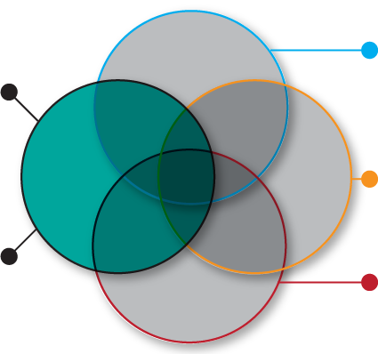
1. About inclusion health
Inclusion health describes an approach to prevent and address extreme health inequities.
Populations are diverse but can share common experiences such as social exclusion, extremely poor health, and barriers in accessing services.
They are largely absent in electronic systems meaning their needs can be overlooked.
Impact of wider determinants such as education, income, employment and housing
Socio-economic
Area you live: Population composition, built and natural environment, levels of social connectedness, and features of specific geographies such as access to green spaces and transport
Inclusion health
Geography
Inclusion health groups include:
People experiencing homelessness
Gypsy, Roma and Traveller communities
Sex workers
Migrants in vulnerable circumstances
People subject to modern slavery
People in contact with the justice system
People experiencing drug and/or alcohol dependence
Among others e.g. people with experience of the care system
Personal attributes: Age, disability, gender reassignment, marriage and civil partnership, pregnancy and maternity, race, religion or belief, sex, sexual orientation
Protected characteristics
The health inequalities experienced by belonging to inclusion health groups can be exacerbated if individuals also experience other domains of inequality above

Slide 7
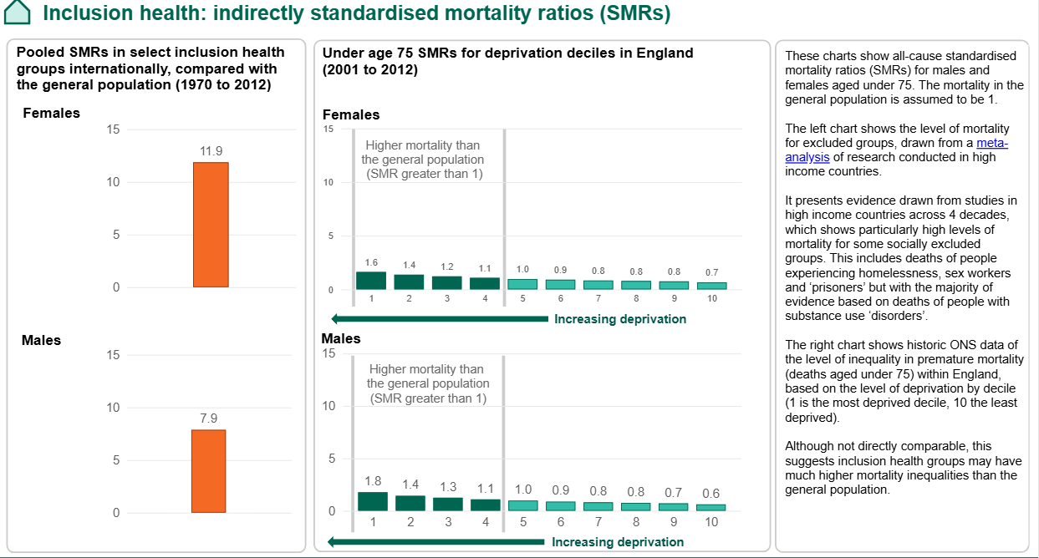
1. About inclusion health
Meta-analysis reference: Morbidity and mortality in homeless individuals, prisoners, sex workers, and individuals with substance use disorders in high-income countries: a systematic review and meta-analysis - The Lancet

Slide 8



2. 10 Year Health Plan and inclusion health
The 10 Year Health Plan committed the NHS to being ‘a service equipped to narrow health inequalities’ and ‘give everyone, no matter who they are or where they come from, the means to engage with the NHS on their own terms.’
It highlights that inclusion health groups - such as people who experience homelessness or people who experience domestic violence - are more likely to die younger and experience poorer access, experience and outcomes in the NHS.
Action on the three key shifts will be central to narrowing health inequalities, through designing community models of care that are accessible to all; ensuring digital inclusion is hard-wired into digital advances; and in the shift to prevention utilising population health approaches to tailor interventions for those experiencing inequalities.
How do the three shifts support inclusion health?
Hospital to community
Neighbourhood health centres in every community.
Multi-disciplinary teams and co-location of services encompassing welfare, debt advice, housing, social care, work and health.
Scaling new roles, including community health and wellbeing workers and peer support workers.
Focus on people who frequently attend A&E, offering proactive targeted support, including 24/7 mental health hubs and outreach models.
Analogue to digital
Single patient record to support personalised, coordinated and
predictive care.
Social risk assessments capturing non-clinical risk factors.
‘Inclusion designed into NHS App by default’ to deliver more choice, different access, more convenience and accessible knowledge. Proactively identifying lower digital literacy.
Sickness to prevention
Ambition to halve the gap in healthy life expectancy (HLE) between the richest and poorest regions.
Scaling of Individual Placement and Support schemes to support people with severe mental illness or drug and alcohol dependence find work.
Increase access and uptake of screening services.
Roll out of Prevention Accelerators and Health and Growth Accelerators.

Slide 9
3. Wider policy levers
Health and Care Act 22
NHSE and ICBs have a legal duty to have regard to reducing inequalities. NHSE’s joint reference document outlines the statutory equality and health inequalities duties that apply to commissioners and providers. The Medium-Term Planning Framework
for 26/27-28/29 asks ICBs to demonstrate how they will reduce health inequalities in the exercise of their functions.
10 Year Health Plan
The 10 Year Health Plan sets out the government’s plan to drive three fundamental shifts in how the NHS works and commits to the NHS to being a service equipped to narrow health inequalities and tackle injustice. It also restated the commitment to half the HLE between the poorest and richest regions of England.
Core20PLUS5
Core20PLUS5 is the national NHS England approach to support the reduction of health inequalities at both national and system level. Inclusion health groups can be prioritised locally as a PLUS group.
Inclusion health framework
The Inclusion health framework supports NHS organisations and wider system partners to plan, develop and improve health services to meet the needs of people in inclusion health groups – focused on five key principles for action.
Changing Futures
Changing Futures aims to improve outcomes for adults experiencing multiple disadvantage.
The first programme ended in March 2026, and the second one is now in place until 2029.
Local Government Outcomes Framework
The Local Government Outcomes Framework guides local authority prioritisation and commissioning. It includes homelessness & rough sleeping, health and wellbeing, multiple disadvantage, neighbourhoods and child poverty.

Slide 10
3. Wider policy levers
Strategic commissioning
The Strategic commissioning framework sets the expectation ICBs should, in line with Core20PLUS5, understand how cohorts (such as inclusion health groups) have inequalities in access, experiences and outcomes, and how population health improvement plans will
address this.
Statement on information
NHSE’s Statement on information on health inequalities supports NHS bodies to meet their legal duties and provides guidance on collecting, analysing and publishing information. It sets the expectation NHS bodies focus on inclusion health groups as a Core20PLUS5 cohort and collect housing status to increase visibility in health data.
Ethnicity recording improvement plan
This Ethnicity recording improvement plan sets out targeted actions to strengthen the quality, consistency and completeness of ethnicity data – including for Gypsy, Roma and Travellers, who are often invisible in datasets
Neighbourhood health
The Neighbourhood Health Framework provides guidance on the delivery of neighbourhood health. The priority for 26/27 should be supporting priority cohorts with complex health and social care needs who are at the highest risk of hospital admission. Inclusion health groups can be considered as a key cohort.
CMO Reports
The CMO review into the health of the criminal justice system emphasises people on probation as a key Core20PLUS5 group, championing the key role of the health and justice workforce in meeting inclusion health needs. The CMO’s annual report into infections also has an explicit focus on vulnerable populations.
A National Plan to End Homelessness
The National Plan to End Homelessness is a comprehensive strategy to tackle the rising homelessness crisis, emphasising collaboration across government departments and local partners to deliver the vision, key actions include a commitment to end hospital discharge to the street.

Slide 11
4. The economic case for change – the challenge
The unmet needs of inclusion health groups often results in disproportionally high rates of access to costly emergency
and crisis care.
Housing precarity and homelessness is a common experience across inclusion health groups.
In addition to the moral imperative to address homelessness, there is an economic benefit too. It is estimated the total public sector cost of a person experiencing homelessness to be as much as £38,736 per year in England. This includes costs for the NHS as well as other sectors.
On average, it was estimated that preventing homelessness for one year would reduce the public expenditure by approximately £10,000 per person.
Failing to address inclusion health costs the NHS and society at large. For example,
Meeting the needs of people in severe and multiple disadvantaged groups costs society an estimated £10.1 billion per year.
The frequency of unplanned emergency care has a significant impact on the health system, putting greater strain on the service and costing the NHS £2.5 billion a year.
Faced with significant barriers to accessing primary and community care, and early or preventative interventions, people in inclusion health groups often have to rely on costly acute services to access care. For example, people experiencing homelessness attend emergency departments six times as often as housed people, are admitted four times as often and stay on average twice as long.

Slide 12
4. The economic case for change – the challenge
Most people experiencing homelessness or in need of
drug treatment services are aged between 25 and 55. However, their NHS costs are equivalent to people much older.
Average NHS costs of a single homeless person = costs of someone age 85
Average NHS costs of a person needing but not receiving drug treatment services = costs of someone age 78
Average NHS costs of a person in drug treatment services = costs of someone age 65
Key references:
OBR - Fiscal sustainability and public spending on health 2016
PHE - An evidence review of the outcomes that can be expected of drug misuse treatment in England. 2017
Crisis - Better than Cure – Testing the case for preventing single homelessness in England. 2017

Slide 13
4. The economic case for change – what works?
Evidence shows that implementing bespoke solutions for inclusion health - such as targeted health and social care pathways and providing accessible effective services - benefits patients and reduces the costs of public services.
Commissioned by Pathway from Alma Economics, a cost-benefit analysis shows the positive return on investment of a proposed nationwide initiative to expand specialist intermediate care for people experiencing homelessness, with an estimated financial benefit of £1.20 and societal benefit of £4.30 for every £1 spent.
An economic analysis investigating the cost-effectiveness of three different ‘in patient care coordination and discharge planning’ configurations for adults experiencing homelessness, highlighted that specialist Homeless Hospital Discharge care is more cost-effective than standard care, resulted in fewer bed days per year and presented better quality-adjusted life year (QALY) outcomes.
A realist evaluation found specialist homeless hospital discharge schemes employing multidisciplinary co-ordination and ‘step-down’ intermediate care reduced delayed transfers of care and reduced A&E visits by 18%.
A cost-benefit analysis based on current experiences of Gypsy, Roma and Traveller families showed that an improved dementia and carer pathway was estimated at less than half the cost of the current pathway, from £20,298 down to £8,884. The analysis also highlighted that up-front investment, for example in appropriate social work engagement, or in GP outreach work, can pay for itself many times over in the longer term.

Slide 14
4. The economic case for change – what works?
Housing first pilots which take a multidisciplinary approach targeted at entrenched homelessness with complex needs in Liverpool show an average saving of £35,000 for each (range £27,000-£66,000) in prisons and drug treatment services is highly cost effective.
The Groundswell homeless peer advocacy programme has been found to reduce missed health appointments by 68% with an average return on investment of £2.43 for every £1 spent.
Peer supported hepatitis C screening in people experiencing homelessness improve testing and treatment uptake amongst marginalised groups has been found to be highly cost effective and cost saving, with an incremental cost effectiveness ratio of £9,408 per QALY (quality-adjusted life year) which is cost-effective at the UK willingness-to-pay threshold of £20,000 per QALY.
Outreached tuberculosis screening and supported case management of people experiencing homelessness is highly cost effective.
Needle and syringe programmes are highly cost effective and potentially cost saving even when only considering their impact on reducing hepatitis C transmission.
Opioid substitution therapy is highly cost effective from an NHS perspective and cost saving from a societal perspective, incremental cost effectiveness ratios ranged from £13,923 - £14,206 per QALY.

Slide 15
5. What’s best practice?
NICE guideline NG214: Integrated health and social care for people experiencing homelessness
The NICE guideline 214 provides guidance on developing models of service provision that are specific to people experiencing homelessness, as well as improving how to improve access and engagement within mainstream services.
The needs of the homeless population overlap considerably with other inclusion health groups, and housing precarity is a common experience amongst inclusion health groups.
NICE guideline NG214 should therefore be used to inform best practice for integrating services to improve outcomes for people experiencing homelessness and inclusion health groups more generally.
Recommendations include:
1.1 General principles
1.2 Planning and commissioning
1.3 Models of multidisciplinary service provision
1.4 The role of peers
1.5 Improving access to and engagement with health and social care
1.6 Assessing individual needs
1.7 Intermediate care
1.8 Transitions between different settings
1.9 Housing with health and social care support
1.10 Safeguarding
1.11 Long-term support
1.12 Staff support and development

Slide 16
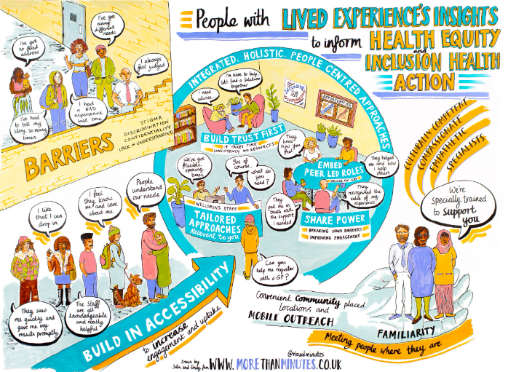
5. What’s best practice?
Co-produced principles for inclusive healthcare
UKHSA commissioned 10 VCSEs¹ to engage with over 200 people with diverse experiences of social exclusion to co-produce key principles for inclusive approaches to health protection.
The co-produced principles are also highly relevant to broader healthcare access and can help inform action at national, regional and local level to build more inclusive approaches and better meet the needs of people in inclusion health groups.
Inclusive Health Care Principles (2025)
Build trust first
Provide integrated, holistic, people-centred approaches
Build in accessibility to increase engagement and uptake
Tailor approaches to increase relevance
Embed peer roles

Slide 17
6. Driving data quality
Inclusion health groups are not consistently recorded in electronic health datasets and face barriers to disclosing their inclusion health status when interacting with health services. This means they can be effectively invisible in data used for service design and evaluation, and so services are not configured to meet their needs.
Three key challenges for
data availability and quality:
  A lack of consistency of data recording and coding practices for inclusion health groups
  Barriers to people sharing and disclosing of inclusion health status due to risks of stigma and discrimination and fear of wider consequences
  Healthcare providers may not have training, experience and expertise on how to inclusively ask about inclusion health status
The impact of lack of data results in:
  Inclusion health needs are not identified when commissioners are carrying out needs assessments and planning services
  Inclusion health groups are invisible to national decision makers when making policy
  There are challenges in holding services to account for improving outcomes for inclusion health groups

Slide 18
6. Driving data quality
Housing precarity is disproportionality experienced within inclusion health groups; therefore, housing status can act as a proxy for identifying inclusion health groups in datasets
Recording housing status:
As championed by Pathway, recording housing status is equitable, because it can be applied to everyone.
It identifies most people in inclusion health groups by proxy, as housing precarity cuts across all of these groups.
It also enables understanding of wider public health issues, particularly how housing status affects health outcomes and health inequalities in general.
Academic research estimates that there are five times as many hospital admissions for people experiencing homelessness than observed directly in datasets.
Policy drivers: Key national policy documents have set the expectation that NHS bodies should make demonstrable improvements in the completeness and accuracy of coding and recording of housing status, using relevant SNOMED codes.
NHS England’s Elective Care Reform Plan
NHSE Statement on information on health inequalities
Guidance: Guidance on i) Accommodation status and why it’s important to ask about it ii) How to ask about accommodation status iii) How to collect and record accommodation status data
Accommodation status (homelessness and rough sleeping) - NHS England Digital
Recommended codes: Pathway have identified a set of recommended housing fields within the SNOMED CT system which it is suggested for health care services to use.
Recommended Housing Fields within SNOMED CT – Pathway

Slide 19
6. Driving data quality
High‑quality, complete ethnicity data is also essential to addressing inequalities.
This is particularly important for communities such as Gypsy, Roma and Traveller groups, who are poorly captured in current healthcare data yet are known to experience significant inequalities in access, experience and outcomes. The Ethnicity Recording Improvement Plan sets out actions organisations can take to improve the quality of ethnicity data, structured across five key domains for improvement.
Domain
Measure
ICBs can…
Providers can…
Improving how ethnicity is requested from patients
% records with ‘not known’ ethnic code
Embed protected characteristics recording into system-wide training and education efforts. Share good practice.
Raise awareness of the importance of ethnicity data quality and work with staff to build confidence and skill and understand patients’ expectations.
Improving trust and confidence among patients to share ethnicity
% records with ‘not stated’ ethnic code
Support codesign and engagement efforts across the population and act on the insights to build trust. Share learning with providers
Prepare and share patient facing information in a variety of languages and formats for people to understand at a glance why it is asked
Improving how data is recorded in systems
% incomplete/blank codes
Monitor quality of ethnicity data and look across records where possible to identify inconsistency, scale good practice, advocate for local improvements
Monitor completeness and consistency and work with services to improve low completion rates
Improving how ethnicity data is processed
% records matching across datasets
Embed analysis of ethnic health inequalities and use linked data to impute gaps
Use gaps in data quality to target outreach. Link datasets to fill in gaps between services.
Improving analysis and use of ethnicity data to reduce inequalities
% metrics reported
by ethnicity
Embed analysis of ethnic health inequalities in access, experience and outcomes into routine reporting, assurance and strategic commissioning
Embed analysis of ethnic health inequalities in service evaluation, quality improvement and performance reporting

Slide 20
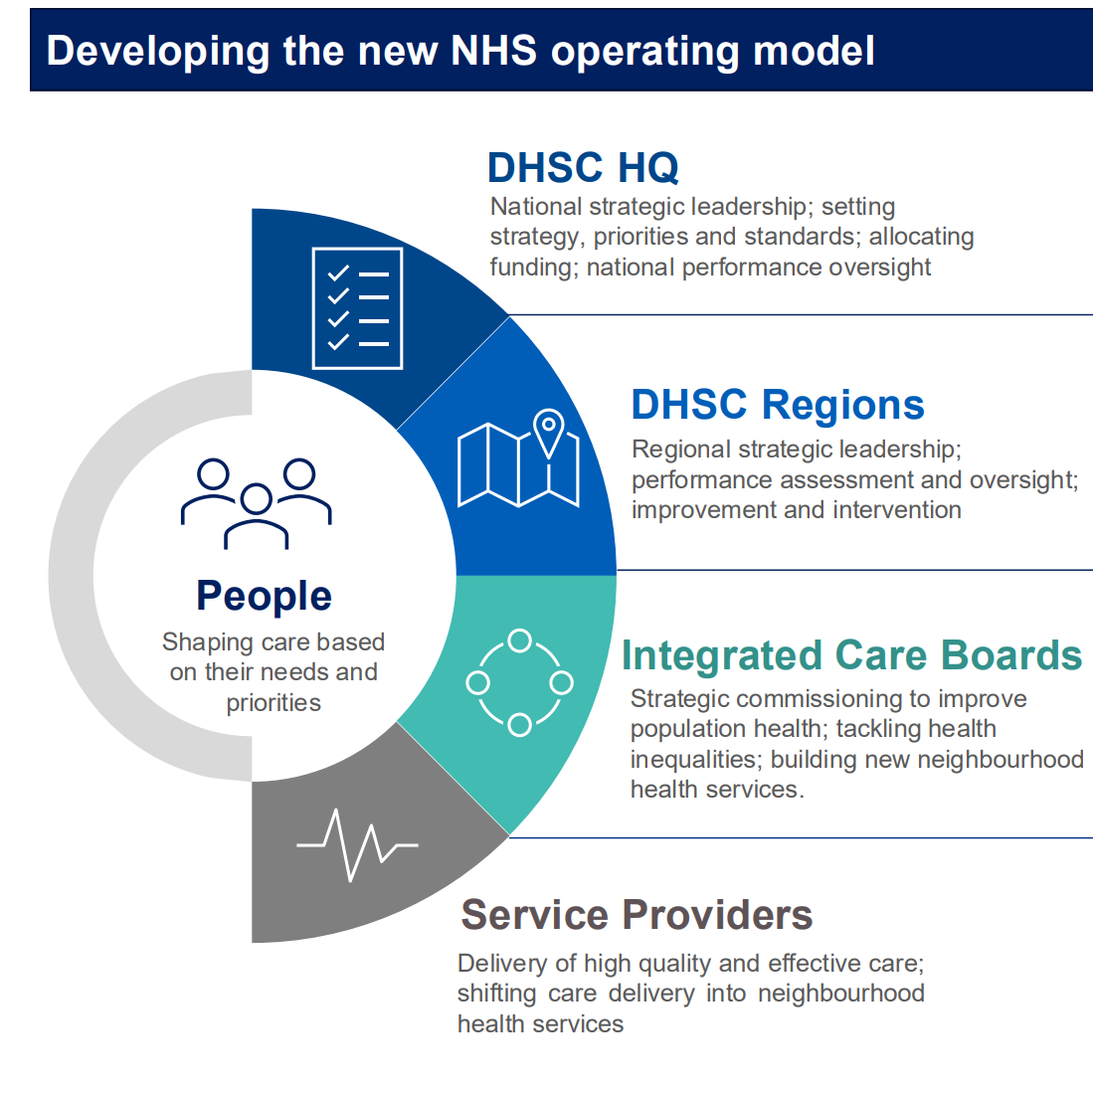
7. Current context: Organisational roles and call to action
The new NHS operating model aims to increase clarity in the system about role and purpose of local leaders to improve population health outcomes.
National partners, regions, commissioners and service providers all have a key role to play in supporting inclusion health groups and addressing the systematic health inequalities they face.
However, cross-sector collaboration across health, local government, social care providers and the VCSE sector is key to meet the needs of inclusion health groups.
Partnership arrangements will differ across local areas, but the following slides aim to provide an overview of role and responsibilities across the NHS system architecture and wider, and key actions to consider.

Slide 21
National
Key actions for inclusion health:
NHSE and DHSC are integrating into a new DHSC. Whilst the new operating model is still being established, partnership work is continuing across the organisations to address inclusion health.
The key actions are:
Delivering the commitments in the 10 Year Health Plan
Operationalising the Government commitment to halve the healthy life expectancy gap between the richest and the poorest regions.
Supporting cross-Government policy drivers such as the Changing Futures Programme, the National Plan to End Homelessness and the Child Poverty Strategy.
Working with the Home Office to oversee the priorities of the National Partnership Agreement to support the health and wellbeing needs of people seeking asylum.
Collaborating to produce resources for stakeholders to support work on inclusion health at a local level.
DHSC sets strategic leadership, priorities and standards, and allocation of funding.
OHID is embedded within DHSC and is focused on preventing ill health, in particular in the places and communities where there are the most significant disparities. OHID brings together expert advice, analysis and evidence with policy development and implementation to shape and drive health improvement and equalities priorities for government.
NHSE lead the NHS to deliver high-quality services for all. This includes work on ensuring the NHS delivers equitable access, optimal outcomes and excellent experience for all. The key delivery framework is Core20PLUS5 - inclusion health groups are considered a key PLUS group who should be prioritised locally. NHSE works alongside DHSC to drive policy and strategy implementation across the NHS.
UKHSA prevents, prepares for and responds to infectious diseases and environmental hazards, including providing health protection expertise, guidance and coordination of incident response. This includes work to improve the identification of and support to population groups who face the greatest risk of health hazards.

Slide 22
Regions
Overview: The Model Regional Blueprint sets out that the seven regions will be the leadership interface between the centre and local health systems, overseeing strategy, managing performance and coordinating improvement and intervention. The model also describes how regions will integrate their wider social care and public health functions for example, describing the interface with local, strategic and combined authorities at regional level on public health and social care issues, overseeing public health performance and assuring use of the Public Health Grant.
Core functions:
Regional strategic leadership: To support delivery of reform, overseeing planning, investment and reconfiguration, supporting innovation and effective regional leadership strategy.
Performance management: Holistic oversight of performance in line with national frameworks, including understanding board and leadership capability, identifying ‘early warning’ systems and managing risk
Improvement and intervention: Regional approach to improvement, support and intervention to ensure high quality and sustainable care, developing capability, addressing underperformance and overseeing regulatory interventions as required.
Key actions for inclusion health:
Oversee service reconfigurations to ensure provision for inclusion health groups is not compromised during ICB and provider reforms.
Ensure strategic plans pay due attention to public health priorities including future health and care needs for inclusion health groups, tackling inequalities, shifting to prevention and improving population health.
Support strategic partnerships at a regional level, including NHS leaders, LA leaders, SA mayors and VCSE leaders.
Facilitate regional inclusion health networks focused on fostering peer learning.
Work with ICBs to provide strategic oversight of the development of neighbourhood health plans and delivery models, ensuring these have considered how these will support equitable access for inclusion health groups.
Ensure that digital strategies and innovation have due regard to reducing inequalities, proactively addressing data poverty and digital exclusion concerns.

Slide 23
ICBs
Key actions for inclusion health:
Work with local authorities to develop needs assessments that draw on quantitative data, qualitative insight and lived experience, reflecting the needs of inclusion health groups.
Work with Health and Wellbeing Boards to ensure neighbourhood health planning addresses inclusion health.
Undertake a self‑assessment and map inclusion health service provision to understand how needs are currently being met.
Use strategic commissioning levers to drive improvements in data quality, availability and use.
Appoint a named executive lead with overall accountability for inclusion health and embed explicit inclusion health priorities within population health improvement plans.
Use payment mechanisms to shift towards outcome‑based service specifications and equitable payment models. Leverage multi‑neighbourhood provider contracts and provider collaboratives to achieve efficiencies of scale.
Strengthen the local evidence base through cost‑benefit analyses and robust service evaluations, informed by people with lived experience.
Overview: The Model ICB Blueprint sets out that, as strategic commissioners, ICBs will be responsible for improving population health, reducing inequalities and ensure access to consistently high quality, efficient care. The Strategic commissioning framework emphasises that ICBs should understand how different population groups (such as inclusion health groups) access services, experience care and how outcomes vary - and consequently how gaps will be narrowed through the ICB strategy and planning.
Core functions:
Understanding local context: Assessing population needs now and in the future, identifying underserved communities and assessing quality, performance and productivity of existing provision
Developing long-term population health strategy: Long-term population health planning and strategy and care pathway re-design to maximise value based on evidence
Delivering the strategy through payer functions and resource allocations: Oversight and assurance of what is purchased and whether it delivers outcomes required
Evaluating impact: Day-to-day oversight of healthcare usage, user feedback and evaluation to ensure optimal, value-based resource use and improved outcomes

Slide 24
Trusts & foundation trusts
Key actions for inclusion health:
Focus on driving data quality through systematically improving methods of routine data collection and coding, such as recording housing status, and link data sets across system partners to identify inclusion health needs.
Engage with inclusion health groups and harness lived experience to drive continuous improvement approaches.
Ensure training on inclusion health is accessible to all staff, and that specialist workforce and street outreach teams are integrated into multidisciplinary working.
Develop robust discharge planning and intermediate care provision with LA and housing partners, ensuring compliance with the ‘Duty to refer’, ‘Duty to collaborate’ and NICE 214.
Co-locate services and embed peer support workers and care coordinators who can support individuals strengthen links to wider community pathways, such as drug and alcohol treatment, housing or welfare services.
Use the HEAT tool to systematically assess how services can address health inequalities and set up mechanisms for co-designing whole pathway services and preventative interventions with inclusion health groups.
Overview: Trusts and foundation trusts - whether for acute, community, ambulance or neighbourhood services - will focus on the delivery of high quality and effective care.
Core functions:
Delivery of high quality and effective care: A focus on universalising high-quality care to drive up standards for everyone.
Shifting care into neighbourhood services: Trusts and foundation trusts will have a key role in the development and operationalising of neighbourhood health approaches, supporting coordinated, multi-disciplinary care across pathways.
A focus on performance to enable earned autonomy: Foundation trusts will be able to use freedoms and flexibilities to improve population health, not just increase activity. Integrated Health Organisations (IHOs) will also have the opportunity to hold the whole health budget for a local population, with the requirement to support integration, shift resources from hospital to community, focus on population health and tackle inequalities.
Improving data and insight: Providers should ensure that information on health inequalities is used as part of trust-wide improvement approaches. This includes engaging with those who are seldom heard, such as people from inclusion health groups, and working with local partners to collate a range of data sources to understand the drivers behind inequalities in access, experience and outcomes.

Slide 25
Primary care
Key actions for inclusion health:
Support flexible access models, including longer appointments, walk‑in provision, outreach, and registration without proof of address or ID.
Explore specialised contracts, such as enhanced services and inclusion health clinics, either as stand-alone or embedded within mainstream practices, to help to meet the complex needs of patients in inclusion health groups.
Improve visibility of inclusion health populations through improved data recording (e.g. inclusion health indicators or flags).
Develop workforce capacity and speciality (e.g. Deep End approaches), developing skills and training focused on trauma-informed care and deprivation medicine.
Inform commissioning and service design through insight into unmet need and barriers to access.
Champion inclusion health priorities within PCNs, neighbourhoods and ICBs.
Overview: Primary care and GPs play a critical role in reducing health inequalities for inclusion health groups through their position as the first point of contact, trusted community presence, and coordinators of care.
Core functions:
Improving access and continuity: Act as an accessible entry point to the NHS. Provide continuity of care for people with complex needs, multimorbidity and high service use.
Proactive identification: Maintain high-quality data collection and coding and use population health management approaches to proactively reach people who are underserved or disengaged from care. Support early intervention and prevention, including vaccinations, screening and long‑term condition management.
Holistic, person‑centred care: Deliver trauma‑informed, culturally competent care that recognises the impact of social exclusion, poverty and adverse experiences. Address wider determinants of health through social prescribing, care coordination and links to local support.
Integration and partnership working: Work closely with PCNs, community services, local authorities, VCSE organisations and inclusion health specialist services. Contribute to neighbourhood health models and multidisciplinary teams supporting people with complex social and health needs. Support transitions between primary, community, mental health and secondary care.

Slide 26
Local authorities
Key actions for inclusion health:
Ensure inclusion health populations are included in JSNAs.
Advocate for neighbourhood health planning to address the needs of inclusion health populations. This can be done by making sure both national local data and intelligence is used as well as lived experience insight to support commissioning and service development.
Public health teams are well placed to facilitate collaboration and involvement across departments in addressing the needs of inclusion health groups. Encourage departments to take account of the health and wellbeing needs of those facing the most extreme inequalities in their programmes and plans.
With system oversight, LA public health teams can help facilitate wider collaboration across sectors to meet the needs of inclusion health groups, for example to support access to work and take advantage of activities that support wellbeing and good health.
Overview: As commissioners of public health services, local authorities (LAs) are key to driving the ‘sickness to prevention’ and ‘hospital to community’ shifts.
Core functions:
Neighbourhood health planning: Take a leading role in development of neighbourhood health plans and utilise health and wellbeing boards to oversee their execution and alignment.
Addressing social determinants: LAs are vital partners in addressing the wider social determinants of health - such as housing, employment, and environment - by working closely with public health, social care, and children’s services. This includes specific policies like using local planning controls for fast-food establishments to tackle obesity.
Connecting wider services: LAs facilitate the connection of people accessing health and care to wider public services and third-sector support, including social care, public health, and other local government services.

Slide 27
Strategic authorities
Key actions for inclusion health:
Embed an approach to ensure health is in included in all policies.
Play a direct leadership role, convening ICBs, LAs and other partners to ensure health is prioritised across the entire regional system.
Use devolved funding to design targeted training and job programmes for inclusion health groups, improving income and financial security.
Use planning powers to ensure the delivery of high-quality, safe, and affordable housing, which prevents illnesses related to poor housing conditions (e.g., damp and mould).
Invest in public transport to improve access to jobs, education, and healthcare facilities for inclusion health groups, reducing barriers to essential services.
Overview: Strategic authorities (SAs) have devolved powers from government and provide a layer of regional government for strategic planning and economic growth. They are now in place across many parts of England.
Core functions:
Health improvement: Under the English Devolution and Community Empowerment Bill​ (July 2025), SAs have a statutory duty to have regard to improve health and reduce health inequalities when exercising any of their functions. These ‘areas of competence’ allow SAs to perform functions at scale allowing them to position health equity and more specifically inclusion health as a central objective across the wider determinants of health. This would include transport and local infrastructure, skills and employment support, housing and strategic planning, public safety and health and wellbeing.
Regional policy: The Bill expands SAs’ ability to act, convene, and collaborate within these defined policy areas so they have a key role in creating healthier places and can use their oversight over regional policy to proactively tackle the social and economic disparities that result in unfair and avoidable differences in health outcomes.

Slide 28
VCSE
Key actions for inclusion health:
Support and facilitate the involvement of those with lived experience of inclusion health to be heard, support people from inclusion health groups to engage with statutory services and ensure their voices are central to the design, delivery and evaluation of services.
Lead and support peer‑support and lived‑experience networks, enabling meaningful power‑sharing and participation in decision‑making.
Advocate for inclusion health populations within policy, promoting tailored, flexible models of care that respond to people’s needs.
Contribute to strengthening the evidence base by leading research and insight work to address data gaps affecting inclusion health groups.
Use the VCSE Inclusion Health Audit Tool to understand how effectively your organisation is engaging with service users and trusted community partners.
Overview: The VCSE sector have a key role to play in designing and delivering specialist inclusion health services, and in brokering trusted relationships with communities. To fulfil this role effectively and sustainably, VCSE involvement must be properly resourced, recognising that building trust, supporting lived experience and delivering high quality insight cannot be done on a voluntary basis.
Core functions:
Trusted community partners: VCSEs are well placed to understand and articulate need, drawing on long standing relationships, lived experience, and up to date knowledge of community challenges. They can also facilitate lived experience and peer support networks, supporting communities to engage meaningfully and share power in decision making.
Front-line delivery: VCSEs provide culturally competent, trauma informed and person-centred services that address both health needs and the wider social determinants of health. This includes practical support such as benefits and debt advice, advocacy around housing, education and access to care, and provision of essential items - often preventing escalation of need and reducing pressure on statutory services.
Strategic partners: Strategically, they contribute to co-designing services, shaping commissioning priorities and embedding design principles informed by lived experience. They can provide rapid insight as well as sustained, in-depth engagement with local communities.

Slide 29
Embedding lived experience
Key system actions for embedding inclusion health lived experience:
Share power and decision‑making with people with lived experience as equal partners.
Design flexible terms of reference for engagement that enables lived experience to meaningfully influence decisions.
Work in partnership with inclusion health VCSE organisations to embed lived experience expertise and peer‑led approaches.
Embed peer‑led roles across service design, delivery and evaluation to improve acceptability, relevance and quality
for inclusion health groups.
Resource and support peer roles appropriately, with clear supervision, development and progression pathways.
Apply inclusive recruitment principles that are proportionate and adaptable to peer‑led roles.
Treat the health and care workforce equitably and without discrimination, recognising that people from inclusion health groups are also employed within systems.
Overview: People with lived experience can provide vital insights to support the design of services, as well as taking on more active peer-led roles to help address extreme health inequalities faced by their communities.
Core functions:
UKHSA’s research with people with lived experience identified five common components of inclusive approaches to care:
Build trust first
Provide integrated, holistic, people-centred approaches
Build in accessibility to increase engagement and uptake
Tailor approaches to increase relevance
Embed peer roles
The research also identified a range of possible core functions for inclusion health peer-led roles:
Support with initial healthcare engagement and accessing and navigating health and care services. Support with long-term conditions including those lost to follow up.
Delivering care with appropriate training and governance.
Supporting access to wrap around care e.g. housing, financial support, phones and counselling.
Health promotion, disease surveillance e.g. survey delivery and data collection.
Training non-lived experienced staff.

Slide 30
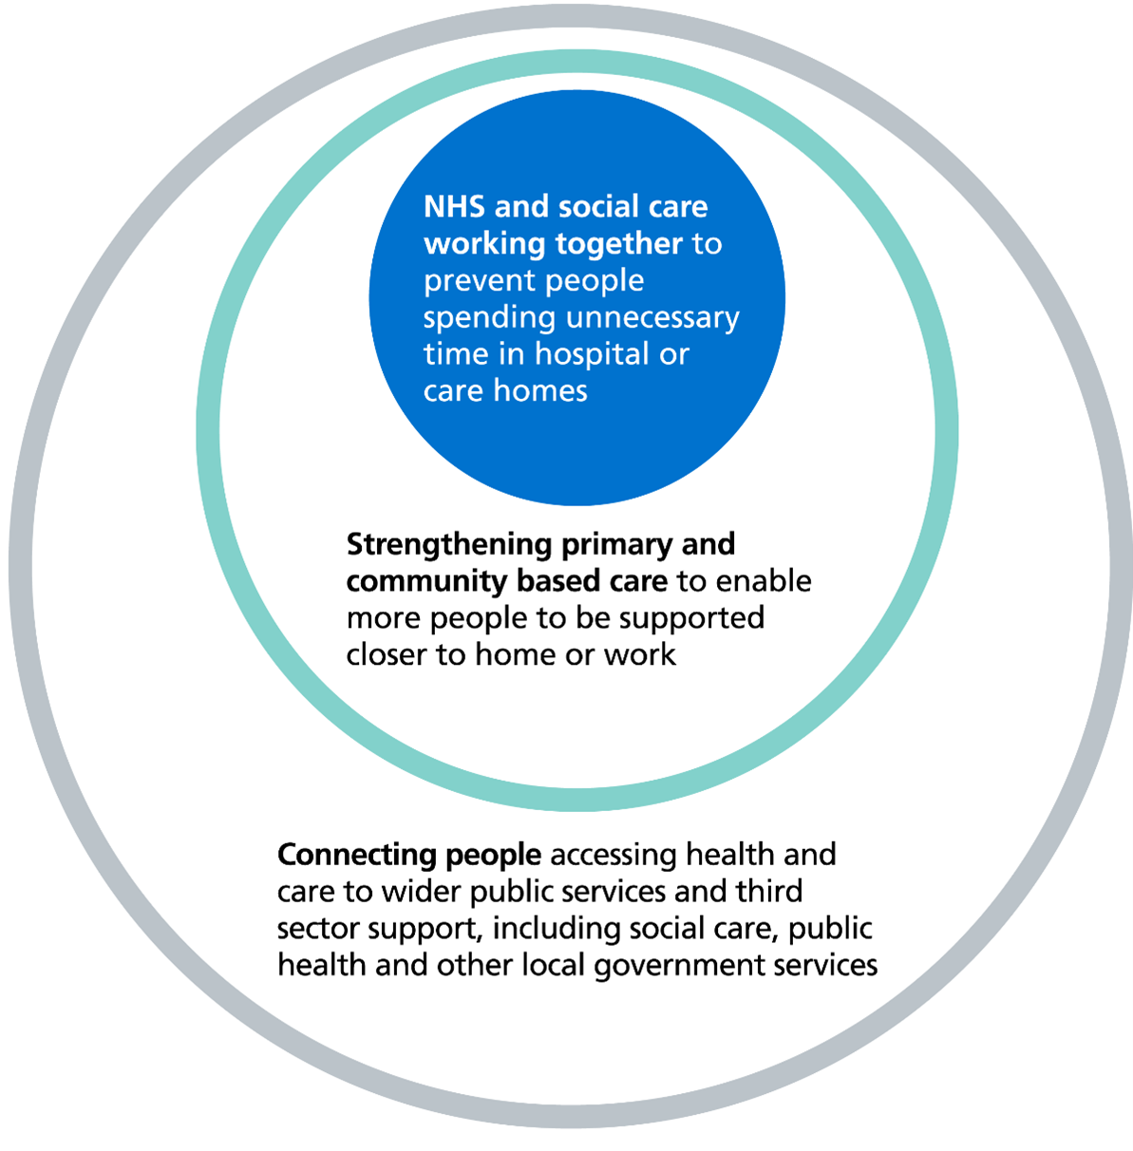
8. Neighbourhood health & inclusion health
Neighbourhood health services will bring care into local communities; convene professionals into patient-centred teams; end fragmentation and shift away from the NHS default of ‘one size fits all’ care.
The focus in 2026/27 should be supporting priority cohorts with complex health and social care needs who are at the highest risk of hospital admission.
This focus on people with the greatest need means specific consideration of inclusion health groups is essential when planning and delivering neighbourhood health services.
Local areas are being asked to:
improve and tackle unwarranted variation in GP access
reduce non-elective admissions and bed days
support people with complex needs and moderate to severe frailty.
This includes developing integrated neighbourhood teams (INTs) for high priority cohorts and tailoring services to local areas. This is part of delivering on the ambition of neighbourhood health to bring care into local communities and make it easier for people to get the right support.
Neighbourhood health is well placed to offer an integrated people-centred approach that goes beyond healthcare.

Slide 31
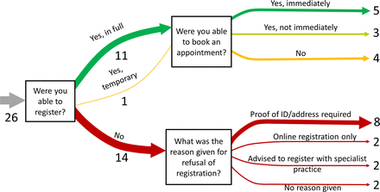
Neighbourhood health
A focus on inclusion health populations will help meet the national objectives of neighbourhood health.
How does a focus on inclusion health meet neighbourhood health priorities?
1. Improving access to core GP services:
A mixed-methods study exploring access to GP care for inclusion health groups found only 31% of visits resulted in a GP appointment or registration – with many refused due to lack of ID or proof of address. (See graph)
A report by Friends, Families and Travellers also found that when 50 GPs had ‘mystery shoppers’ who identified as Romany with no fixed address, over 50% refused registration - despite no regulatory requirement to provide proof of address or identification in order to register.
The Unhealthy State of Homelessness found that primary care is still falling short in delivering healthcare to meet people's needs, and a scoping review evidenced that where interventions do take place, these are rarely evaluated to understand effectiveness.
GP access for inclusion health groups: perspectives and recommendations | BJGP Open

Slide 32
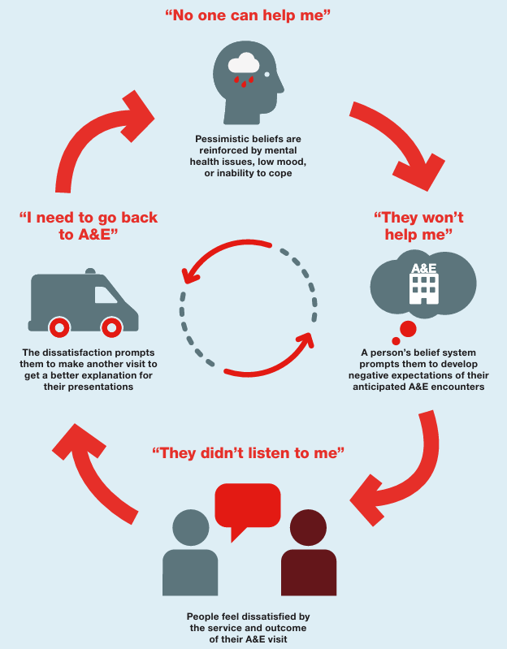
Neighbourhood health
How does a focus on inclusion health meet
neighbourhood health priorities?
2. Reducing unnecessary non-elective admissions:
British Red Cross research shows people who frequently attend A&E make up less than 1% of England’s population but more than 16% of A&E attendances, 29% of ambulance journeys, and 26% of hospital admissions.
Deprivation, housing insecurity, homelessness, loneliness, and mental health issues are common factors.
Inclusion health groups consistently use emergency services at higher rates, often facing repeated visits and early self-discharge.
High Intensity Use (HIU) services run by the British Red Cross - and other organisations - have been able to reduce frequent A&E attendance by as much as 84%. Neighbourhood health models can incorporate learning from HIU services that have successfully used a person-centred, integrated and holistic approach to improve outcomes for service users and reduce pressures on hospitals.’
Exploring high-intensity use of Accident and Emergency

Slide 33
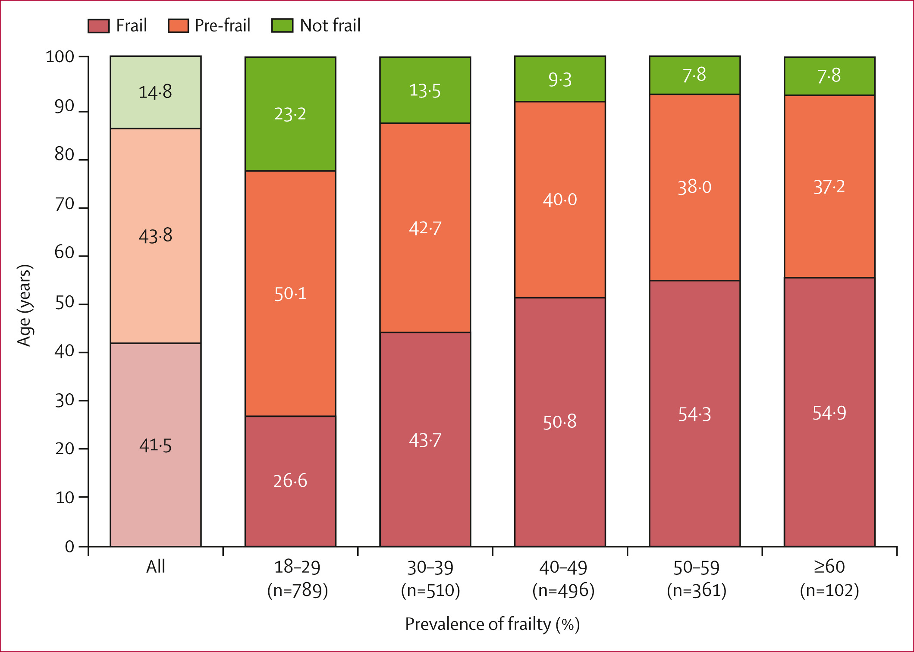
Neighbourhood health
How does a focus on inclusion health meet
neighbourhood health priorities?
3. Supporting people with complex needs and moderate-severe frailty:
Inclusion health groups, and people experiencing homelessness particularly, have frailty levels equivalent to people who are decades older.
A cross-sectional secondary analysis evidenced frailty was prevalent in 41.5% of people experiencing homelessness aged 18-29, and pre-frailty in 50.1%. (See graph).
Most of those studied (73%) were men but women experiencing homelessness were 2.3 times as likely to be frail as men experiencing homelessness.
A cross-sectional observational study also showed people in a London hostel with a mean age of 55.7 were as frail as 89-year-olds in the general population.
Prevalence of frailty and associated socioeconomic factors in people experiencing homelessness in England: cross-sectional secondary analysis of health needs survey data - The Lancet Healthy Longevity

Slide 34
Neighbourhood health – principles for action
The 5 principles in NHS England’s National framework for NHS – action on inclusion health can be used as a template to consider how NHS organisations and system partners can embed inclusion health considerations within neighbourhood models.
 | 1. Commit to action on inclusion health | Ensure ICBs and local authorities include inclusion health groups as a key cohort within neighbourhood health plans, with a named lead for inclusion health at system or place level to ensure plans to tackle inequalities of access, experience and outcomes for people in inclusion health groups deliver impact.
 | 2. Understand the characteristics and needs of people in inclusion health groups | Proactively improve data visibility of inclusion health groups by driving GP registration and improving recording practice for social risk factors e.g. housing status. Develop person-level longitudinal linked datasets and pool insights across sectors including housing, criminal justice and employment, underpinned by data sharing agreements.
 | 3. Develop the workforce for inclusion health | Ensure integrated neighbourhood teams understand inclusion health and trauma-informed practice. Develop specialist roles that can operate across multiple neighbourhood boundaries. Support employment of people in inclusion groups into local anchor organisations and develop peer-support roles.
 | 4. Deliver integrated and accessible services for inclusion health | Strategically commission and co-design neighbourhood services that support inclusion health needs e.g. specialist immediate care, mental health and housing pathways, and integrated substance misuse support. Mitigate for digital exclusion and health literacy barriers. Use alternative co-located settings such as mobile clinics, outreach, community hubs and drop-in without appointments to reduce access barriers – work across organisational boundaries, including non-health services and VCSEs in line
 | 5. Demonstrate impact and improvement through action on inclusion health | Evaluate the impact of changes made. Ensure people with lived experience inform service improvement and evaluation, and identify accountability levers to ensure that inclusion health are meaningfully included in neighbourhood plans.

Slide 35
9. Resources to support action
To support implementation of the national Inclusion Health Framework and improve access, experience and outcomes for these communities, DHSC, OHID, NHSE and UKHSA have developed a national suite of resources to support system leaders drive action.
Inclusion Health Data and Intelligence Dashboard
Inclusion Health Self-Assessment Tool
Inclusion Health Safeguarding Self-Assessment Tool
Inclusion Health Services Mapping Tool
Health Equity Assessment Tool (HEAT)
These resources are all hosted on the Inclusion Health page within the Healthcare Inequalities Improvement Programme Futures space.

Slide 36
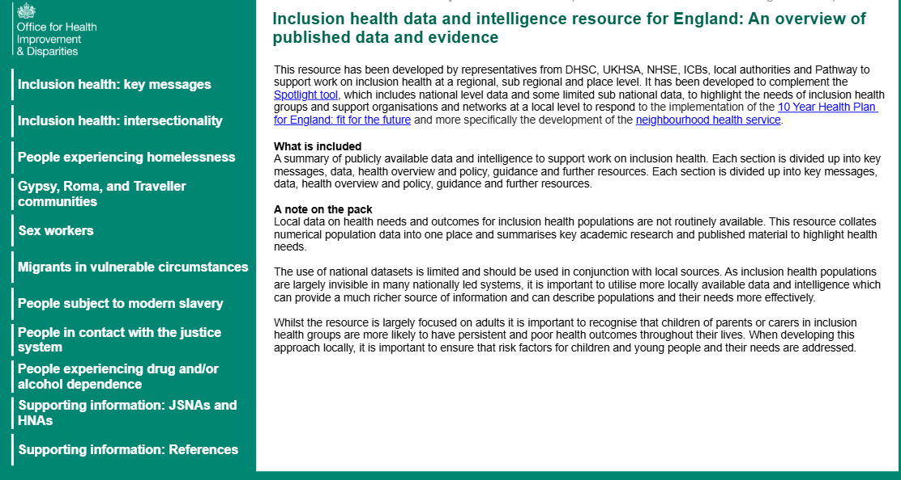
Inclusion Health Data and Intelligence Resource
About:
The Inclusion Health Data and Intelligence Resource for England is an interactive resource which has been a collaborative project between DHSC OHID, UKHSA, NHSE with representatives from local government, ICB and VCSE to support work on inclusion health at a local level.
Its purpose is to support informed decision-making and develop tailored solutions to the specific challenges these groups encounter.
It contains a summary of statistics already in the public domain and brings these together into one place with accompanying narrative to highlight the importance of addressing the needs of inclusion health groups across different organisations, sectors, and programmes of work.
Audience:
The target audience is the professional workforce across health and care, including:
LA public health and other departments
NHS commissioners and providers
Police
Probation
VCSEs as well as local networks.

Slide 37
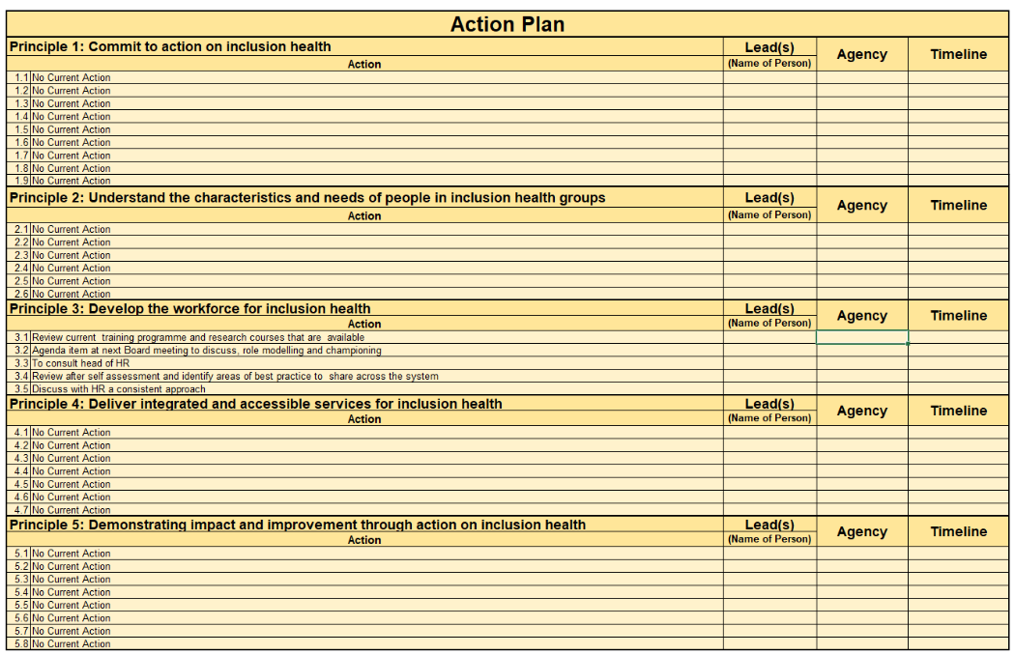
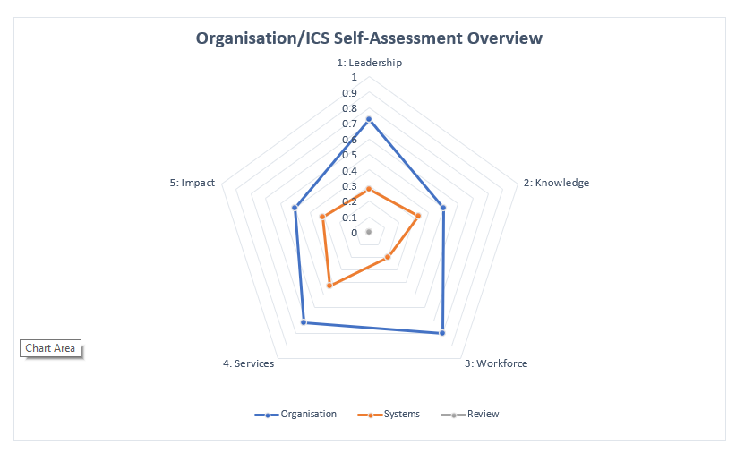
Inclusion Health Self-Assessment Tool
About:
The Inclusion Health Self-Assessment tool is primarily an engagement tool designed to help ICBs, and wider system partners, understand their achievements to date, review their actions and explore their readiness to implement the national inclusion health framework.
The tool is based on the five key principles in the inclusion health framework. While the framework calls for NHS action, the self-assessment tool is aimed at a broader audience. It allows systems to review themselves now, plan action for the future, and provides an opportunity to revisit and evaluate progress.
It was developed and piloted by the OHID South East Team, in response to requests for support in implementing the national framework.
Audience:
ICBs and other NHS organisations to support the implementation of the NHS inclusion health framework
LA, VCSE organisations and other system partners.

Slide 38
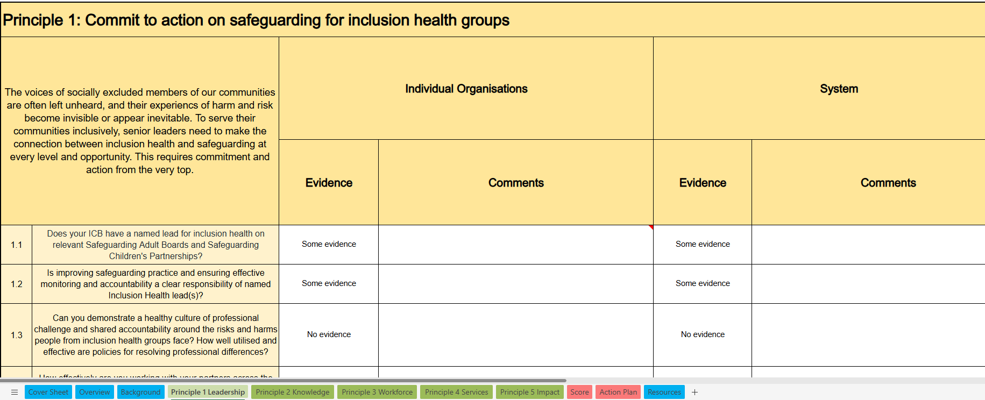
Inclusion Health Safeguarding Self-Assessment Tool
About:
People in inclusion health groups face the same safeguarding risks as everyone else but they may also have discrete risks related to their circumstances and identities.
The Inclusion Health Safeguarding tool is intended to help local areas and systems to understand their safeguarding activity around inclusion health, evidencing achievements, reviewing actions arising from serious incidents and exploring their readiness to implement safeguarding elements from the national framework.
It is orientated around the five principles for action relating to safeguarding and was developed on behalf of Transformation Partners in Health and Care, in collaboration with Pathway, NHSE London, London region ICBs and OHID.
Audience:
ICBs and other NHS partners to support the implementation of the NHS Inclusion Health Framework
LAs, VCSE organisations and other system partners.

Slide 39
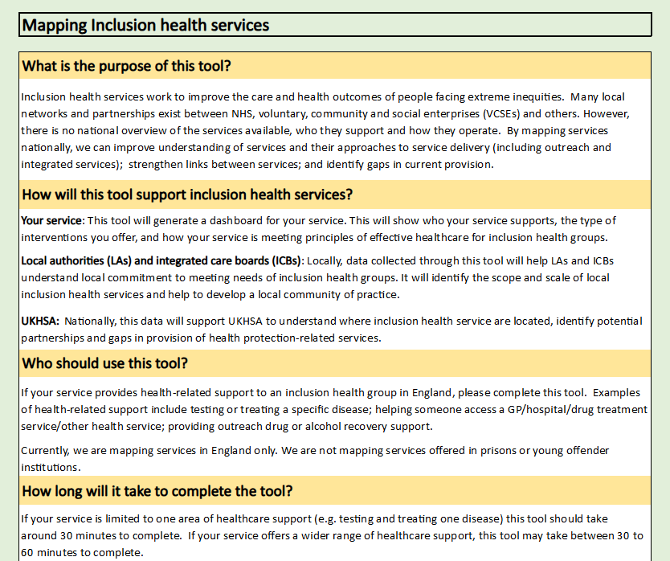
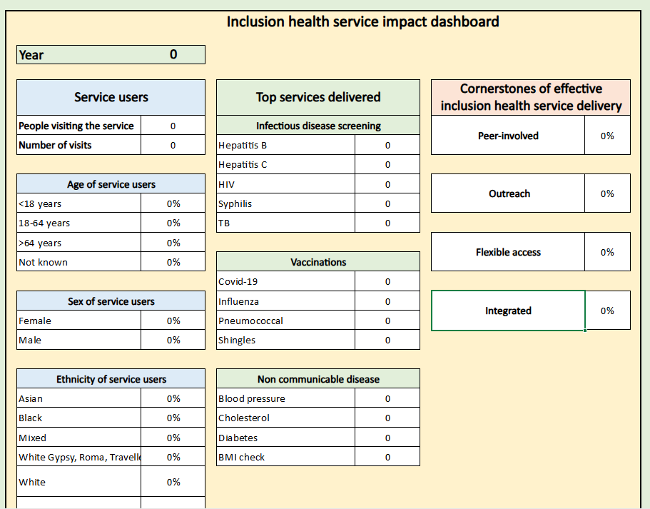
Inclusion Health Services Mapping Tool
About:
Inclusion health services work to improve the care and health outcomes of people facing extreme inequities.
Many local networks and partnerships exist between statutory, NHS, VCSEs and others.
There is no national, or very often local, overview of the services available, who they support and how they operate.
Developed by Find&Treat University College London Hospitals and UKHSA, this tool is designed for use by local planners and commissioners of Inclusion Health services to improve understanding of services and their approaches to service delivery (including outreach and integrated services); strengthen links between services; and identify gaps in current provision.
Audience:
Services explicitly providing health-related support to inclusion health groups in England.
Health-related services includes testing or treating a specific disease, non-communicable diseases, reproductive health, health promotion and harm reduction.

Slide 40
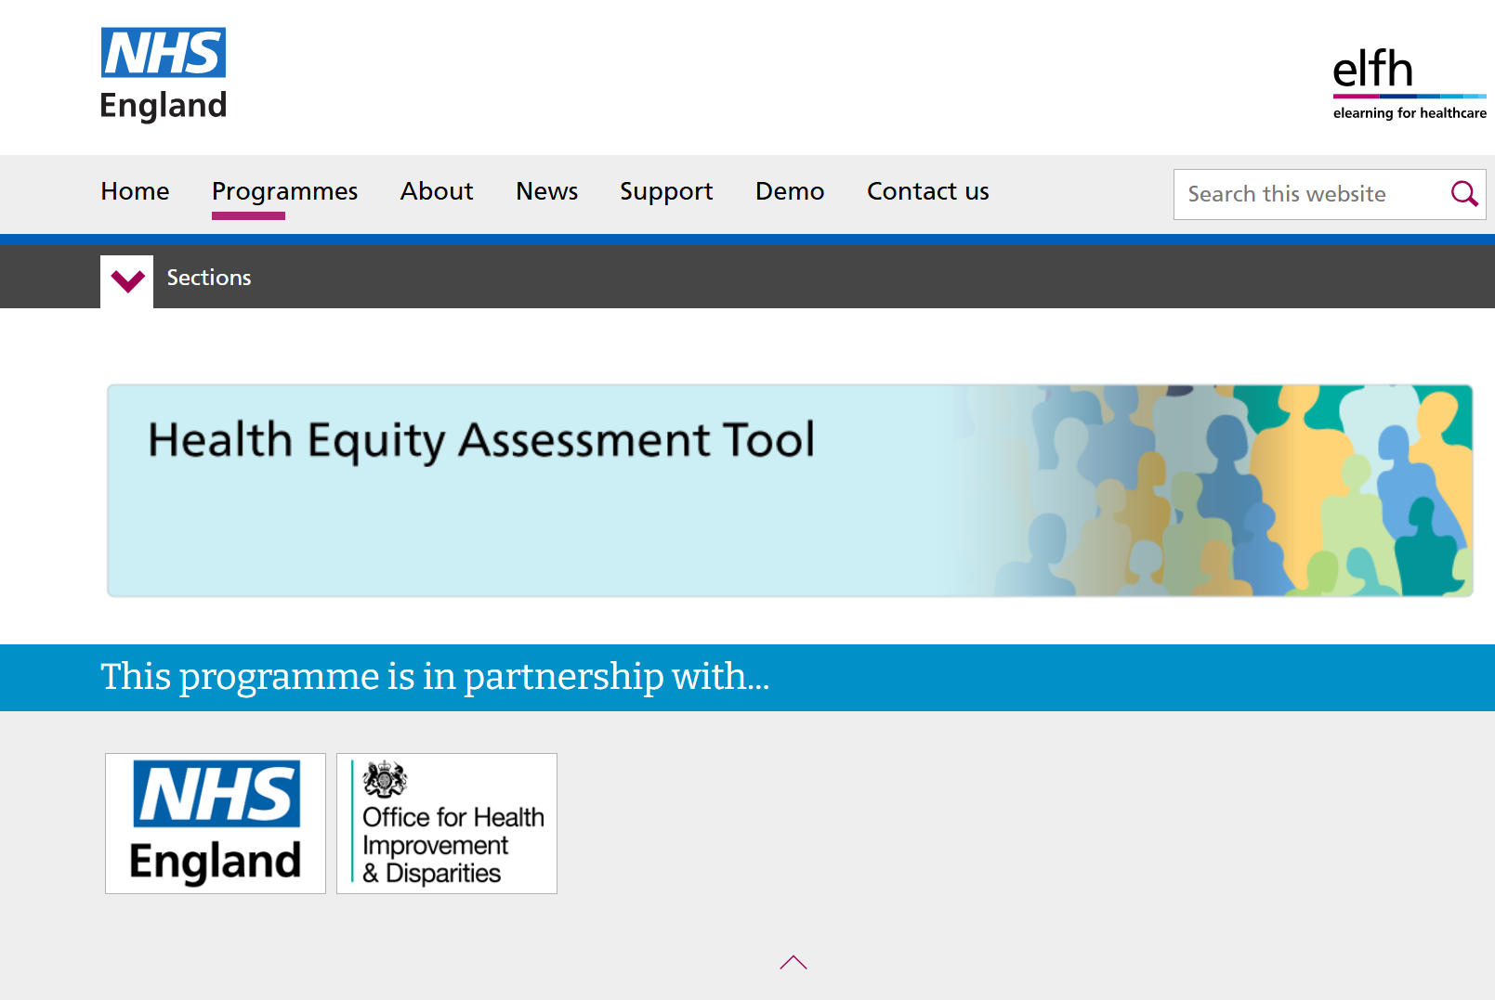
Health Equity Assessment Tool
About:
The HEAT tool is a practical framework that enables multiple audiences to systematically identify and embed action on health inequity and equity in their work programme or service.
It consists of a series of questions and prompts designed to help assess impact on health inequalities and identify steps that can be taken to help reduce this. Considering the following:
Equity issues in planning stages of programme or service development
Equality Act 2010 requirements and demonstrate compliance with the public sector equality duty (PSED)
HEAT was originally published in 2020, and updated 2024. It is supplemented by an e-learning module on the NHS Learning Hub.
Audience:
The intended audience includes a wide range of professionals working at national and local level in public health, health and social care and other public sector duties such as housing and education, in service delivery as well as strategy and commissioning. The tool can also be of benefit to managers of VCSEs.

Slide 41
10. Practice examples: North Tyneside - Working Well
Context and challenge
Action
Learning
Working Well North Tyneside (WWNT) was launched as part of North Tyneside’s Health and Wellbeing Inequalities Strategy: Equally Well. It’s a partnership between North Tyneside Council, the NHS, Department for Work and Pensions (DWP), and a wide range of VCSEs . Its core aim is to reduce health-related inactivity by bringing together health, wellbeing, and employment support under one accessible, community-based model.
The service supports all residents through an inclusive, universal offer, with targeted provision for those facing additional barriers, including: Individuals furthest from the labour market, people with health barriers, including substance dependency and neurodivergence, Refugees and asylum seekers, social housing tenants, carers, lone parents and young people.
Working Well North Tyneside Hubs are high-street based centres that make work, health, and wellbeing support visible and accessible. They aim to reduce social isolation, build confidence, and connect employers with motivated local candidates, creating stronger, healthier, and more inclusive communities.
The Working Well Hubs operate as a one-stop shop, by co-locating multiple partners in one space, the model ensures residents receive joined-up, person-centred support. Key features include:
Triage and Navigation: Dedicated advisors ensure residents are quickly connected to the most appropriate service or intervention.
Employment Support: Access to employability advisors, job search support and direct links to local employers.
Health and Wellbeing Services: Access to community services, addiction recovery, and lifestyle support.
Financial and Welfare Advice: Regular sessions with Citizens Advice and partner organisations providing benefits, debt, and cost-of-living support.
Community Engagement: Informal drop-in space encouraging connection and reducing isolation.
Employer Engagement: Events and workshops that promote inclusive employment and provide direct employer connections for residents.
Collaborative Working: Residents can now access multiple types of support in a single visit – e.g. employment advice alongside mental health or welfare support.
Since opening, the WWNT Hubs have welcomed over 22,000 visitors, many of whom were previously disengaged from traditional services such as Jobcentre Plus. Evaluation shows:
Co-location drives collaboration. Housing multiple partners under one roof ensures that joint working happens organically and daily.
Design matters. The physical layout and atmosphere of the hubs - bright, informal, and welcoming - influences engagement and retention.
Neutral, partnership-led branding increases community trust and reduces perceived stigma associated with statutory services.
Simplify access. A clear triage process ensures that people reach the right service first time, reducing frustration and drop-off rates.
Tell the story. Sharing success stories and case studies reinforces the value of the model and builds momentum with partners and funders.
Build employer relationships early. Employer-facing events not only promote inclusive hiring but also create tangible job opportunities for residents.
Embed continuous learning. Feedback loops between partners and residents refine delivery and sustain innovation.

Slide 42
10. Practice examples: West Yorkshire - Inclusion Health Framework
Context and challenge
Action
Learning
Frontline staff across health and care report feeling ill-equipped to support people with complex, overlapping needs, and traditional models of care frequently fail to meet people where they are.
When services are not trauma-informed or culturally competent, many avoid healthcare altogether - widening inequalities further.
Despite the scale of need, inclusion health has historically been viewed as a niche specialism rather than a core part of everyday NHS practice.
A lack of consistent training, variation in practice, and absence of a national inclusion health training framework has created a gap in workforce capability, confidence, and consistency.
To address these challenges, West Yorkshire ICB developed the Inclusion Health Workforce Training Framework, created through an evidence-based, trauma-informed and co-produced approach.
It was co-designed with colleagues, system partners, and, crucially with insights from people with lived experience.
The framework introduces a tiered learning model:
  Foundation Level: Essential awareness for all staff.
  Intermediate Level: For staff working more closely with inclusion health groups.
  Advanced Level: For leaders and specialists driving system change.
The goal is to embed a consistent, culturally competent, trauma-informed standard of care across the entire workforce.
Workforce capability in inclusion health must be mainstreamed - it is core NHS business.
Trauma-informed and culturally competent practice significantly improves access, trust, and outcomes.
A tiered approach avoids one-size-fits-all training and aligns learning with responsibility.
Lived experience must shape system design to ensure relevance and impact.
The framework fills a national gap, offering a pioneering and replicable approach.
To access the framework, you need to have a Futures account. Sign up to Joined up care West Yorkshire - Futures then search for the Inclusion Health training directory.

Slide 43
10. Practice examples: Wakefield - Neighbourhood provider collaborative
Context and challenge
Action
Learning
System integration and collaboration: Aligning NHS, LA, partner and VCSE efforts around inclusion health. Overcoming siloed working, fragmented commissioning and conflicting priorities.
Data and intelligence: Incomplete or inconsistent data on inclusion health and difficulty in applying PHM tools to transient or hidden populations.
Workforce and leadership: Limited inclusion health expertise across neighbourhood teams.
Sustainable funding: Short-term pilots vs. long-term investment in outreach and specialist services. Ensuring inclusion health is embedded in core budgets, not just discretionary spend.
Community engagement and co-design: Building trust with marginalised groups. Moving from consultation to co-production.
Measuring Impact: Developing meaningful metrics for inclusion health outcomes and capturing improvements in access, experience, and wellbeing.
Place-based provider collaborative model:
Established a network of providers covering primary, secondary, LA, housing and VCSE that can focus on driving neighbourhood health approaches for inclusion health groups across Wakefield’s 6 neighbourhoods.
Agreed shared strategic vision across the district for inclusion health with a joint delivery model and co-funded roles.
Multi-disciplinary workforce:
Embedded specialist inclusion health workforce within neighbourhood MDTs to provide expertise in community settings.
Piloted dedicated physical and mental health liaison workers in the Housing Needs Team.
Expanded outreach and mobile services – delivering primary care, screening, vaccinations, and chronic disease management in shelters, hostels, community centres, and Gypsy, Roma and Traveller sites.
Inclusion health approaches require an ‘additionality’ approach – rather than expecting mainstream services to meet the needs of inclusion health groups.
Do it once and do it well - develop inclusion health place lead that can utilise local intelligence across neighbourhoods.
Just because inclusion health groups are invisible in NHS datasets, doesn’t mean they’re not visible in datasets for other services e.g. probation.
Ensure primary care are a key player in designing neighbourhood models.
Address complex biopsychosocial needs of people experiencing homelessness, substance misuse, migration challenges, and other inclusion health issues.

Slide 44
10. Practice examples: East Riding - Inclusion Health Needs Assessment
Context and challenge
Action
Learning
Current health and care systems do not consistently meet the needs of people experiencing social exclusion.
Evidence that inclusion health populations are insufficiently visible within local intelligence and service design, limiting the system’s ability to plan proactively and address unmet need.
Ongoing concerns about fragmented pathways, inconsistent access and poor transitions.
Acknowledged requirement to strengthen workforce capability and shared culture, embedding trauma‑informed, relational and culturally competent practice across services.
Disconnection from people with lived experience and community-embedded professionals.
Inclusion Health Needs Assessment (IHNA) conducted in 2024 – review of all available quantitative data, giving universal and targeted recommendations
IHNA II - Lived Experience Engagement and Insights Report – built connections with professionals across ERY to support them to gather insights from people with lived experience, as well as their own, creating case studies highlighting intersectional inclusion health needs.
Themes focused on connections, engagement, and barriers.
Using the insights from both reports, recommendations have been developed into universal, system level workstreams and targeted actions.
Relationships, trust and continuity are key drivers of engagement.
Consistent, trauma‑informed relationships appear more influential than service type or volume in enabling access, re‑engagement and recovery.
System design / access models actively drive exclusion, e.g., rigid, digital‑first, appointment‑led and fragmented systems.
Fragmentation /poor transitions undermine trust and outcomes.
In the absence of coordinated pathways, continuity is often sustained only through individual advocacy rather than embedded system processes.
Inclusion health needs and experiences remain unevenly visible across the system.

Slide 45
10. Practice examples: Humber and North Yorkshire - LES
Context and challenge
Action
Learning
Persistent inequities and limited flexibility within primary care in meeting the needs of inclusion health populations.
Limited visibility of inclusion health groups and the need to strengthen equity, visibility and access through proactive, trauma-informed, data-led primary care approaches.
Recognised requirement to build workforce capability and culture, including enhanced trauma-informed & culturally competent training.
Marked inconsistency in service models and funding distribution across Places.
ICB developed a Locally Enhanced Service (LES) to strengthen inclusion health within general practice.
Established a SNOMED-coded register to enhance visibility, data quality, and consistency.
Developed Fairer Practice plans with reference to the Fairer Practice Toolkit for Primary Care.
Implemented mandatory training to ensure the workforce is prepared and competent to deliver.
Requirement that LES delivery provides flexible access, comprehensive health assessments and coordinated care with system partners.
Improvement plans led jointly by a care navigator and clinical lead.
Build the investment case by quantifying unmet need, system costs and potential return on investment (e.g. reductions in unplanned admissions and repeat ED attendance).
Establish shared expectations by collaborating with Place leads and system partners to align priorities and ensure centralised approaches are responsive to local needs.
Tackle digital exclusion and low health literacy by recognising digital barriers and offering alternatives to online access, supporting with form completion and clearer comms.
Prepare for system change by safeguarding inclusion health during organisational transitions (e.g. ICB restructuring) through robust contingency planning.

Slide 46
10. Practice examples: Humber and North Yorkshire - Champions
Context and challenge
Action
Learning
Barriers to access, experience and outcomes were identified for Inclusion Health Groups in the East Riding of Yorkshire. The project was developed with partners from the East Riding Health & Care Committee’s Inclusion Groups Programme.
Inclusion health knowledge and confidence varied across the workforce, with many staff wanting to ‘do things differently’ but unsure how.
Inclusion health activity relied on a small number of specialists, rather than being embedded in everyday practice.
Opportunities to learn from lived experience and collaborate across sectors were inconsistent and often informal.
There was a need to think about how learning could be acted upon across Humber and North Yorkshire ICB.
Introduced Inclusion Health Champion role across East Riding, later expanding to cover Humber and North Yorkshire ICB.
Champions focus on embedding inclusion health into everyday conversations and behaviours rather than creating additional workload. They share learning, offer signposting and role‑model inclusive and positive practice.
Supported champions through light‑touch infrastructure: induction training, bi‑monthly network meetings, shared resources and peer support.
Enabled champions to positively challenge stigma and advocate for lived‑experience insights within their workplaces.
Culture change is sustainable when led by peers. Senior buy-in was essential to promote the scheme initially.
The network approach reduces isolation, builds confidence and creates momentum for change.
Inclusion health becomes everyone’s responsibility when it is normalised through everyday conversations and behaviours.
Supporting champions with light‑touch structure and recognition unlocks system‑wide impact without significant resource.
Evidencing impact is key; work is ongoing mapping connections champions have made.

Slide 47
10. Practice examples: York - Inclusion health coding in GPs
Context and challenge
Action
Learning
ICB developed specification to commission practices to record ‘PLUS group’ patients.
Practices were offered payment for all new patients registered with supplements for newly coded patients over a two-month pilot period (Feb-March 2025).
ICB developed SystemOne template for the new inclusion health register.
Providers required to apply identified SNOMED coding to patient’s records based on their inclusion in York’s ‘PLUS’ group cohorts.
Lack of visibility: Inclusion health populations lack visibility in general practice data systems.
Pilot initiative: Humber and North Yorkshire ICB wanted to pilot an approach to better understand the needs of inclusion health groups through the data collected.
Need for a targeted intervention: Improved data would allow for more targeted interventions and improved health outcomes both at an individual and population level.
Developing understanding: By improving data collection systems this would also increase the workforce understanding of inclusion health groups.
The proportion of patients coded increased by 32.18% (proportions varied by inclusion health groups, with no one registered as a sex worker and an increase of >200% for Gypsy, Roma & Traveller communities).
10/11 practices took part, but practice engagement varied.
The pilot allowed ICB to analyse health trends in inclusion health populations.
Saw an increase in chronic disease detection QOF indication achievement.
Practices have continued in their recording of patients, albeit without the ongoing financial incentive.
Learning has informed the development of a Humber and North Yorkshire wide Locally Enhanced Services (LES) for inclusion health (across all 6 Places) which took effect in Dec 2025, although the specified populations are slightly different from those in the original pilot.

Slide 48
10. Practice examples: Liverpool – Refugee and Asylum GP clinic
Context and challenge
Action
Learning
Rising ethnic health inequalities in Liverpool due to >1,000 asylum seekers
Patients faced language barriers, trauma and unfamiliarity with UK healthcare
Delayed or inadequate care increased pressure on primary care services
GP consultations rose from 214 to 2,174 in one year, adding 490 hours of GP time
There was a growing need to provide culturally sensitive, holistic health assessments for refugees and asylum seekers
Established a dedicated refugee and asylum clinic across four sites – clinic has been running for 3 years and has seen the team grow in experience and knowledge.
Delivered 893 full assessments with 60-minute consultations, replacing multiple shorter GP visits
Recruited multi-lingual care coordinator and mental health practitioner
Partnered with local authorities, charities, and Home Office for coordinated care
Provided cultural competency and trauma-informed care training to staff
Starting as a six-week pilot, the clinic expanded to cover the Liverpool Primary Care Network, with over 3,000 patients registered since establishing the clinic
Saved 677 GP hours over two years through longer, holistic consultations
Registered >80% of new arrivals and referred 20 patients to social prescribing
Identified 9 mental health cases in the first month
Staff surveys show increased cultural competence and reduced unconscious bias
Clinic recognised at 2023 GP Awards, care coordinator won Extended Member of the year, and winner of the NHS Race Equality Award at the HSJ Awards 2025

Slide 49
10. Practice examples: Midlands - HEAT Tool
Context and challenge
Action
Learning
Infant mortality rates in the Midlands are significantly above the national average.
Research shows that disparities in maternity services are strongly linked to the experiences of women from black and minority ethnicities.
There was a need to improve awareness of cultural competence amongst the workforce to ensure women feel listened to.
Women from minoritised groups are not always receiving the highest quality of care which is a contributory factor for infant mortality. The challenge is to help improve the quality of provision, supporting greater focus on person centred care.
An assessment using the HEAT Tool was used to highlight where to focus attention. This resulted in us:
Conducting a literature review to identify best practice for addressing the skills gap in relation to culturally competence.
Developing a toolkit based on these insights to help practitioners explore how person-centred care and cultural humility intersects.
Developing supporting resources including a podcast, to assist with the knowledge transfer and to upskill practitioners around the benefit of reflective practice as the basis for cultural competence
The resources are now available on NHS Futures under Reducing Infant Mortality - Midlands Public & Population Health Hub - Futures
Adopting a co-production approach with women from minoritised communities was important in ensuring resources were accurate.
By building practitioner capability, the Midlands were able to show that supporting a greater focus on person centred care and applying reflective practice will foster an approach of cultural humility.
This approach demonstrates how the tool can be utilised to identify how to better support the needs of groups who are marginalised, including inclusion health groups.

Slide 50
10. Practice examples: London – CoP for Asylum Seeker Health and Wellbeing
Context and challenge
Action
Learning
Regional partners across NHS and Public Health established the Pan London Community of Practice (CoP) for Asylum Seekers’ Health and Wellbeing in 2022
The CoP brings together NHS, council, VCSE partners from the London boroughs alongside regional and national partners including the Greater London Authority (GLA), UKHSA and OHID. The CoP meets regularly online, with an annual in person event that includes people with lived experience.
Topics in the past have included mental health, vaccinations, holistic “move on” support, engagement approaches, and partnership responses to hotel openings and closures. Ongoing information sharing and discussion via an online platform.
Annual survey feedback highlights strong practitioner value and peer support “The Network is a really good space where you feel connected to others experiencing similar issues and can give support and ideas of how to overcome some of them where possible.”
The CoP has strengthened cross sector and cross London connections for practitioners working with people seeking asylum
Responsiveness to practitioner needs and the evolving political context is essential to remain relevant and influence practice
Regular updates from regional partners (including GLA and UKHSA) add value and situational awareness
The CoP provides a trusted route to escalate emerging issues to regional teams
Sustained leadership and commitment across the regional partners are essential to maintain momentum of the network
Hosting the CoP within ADPH London has enabled cross learning with related networks (e.g. mental health, vaccinations)
People seeking asylum face significant health and wellbeing challenges, particularly poor mental health, compounded by trauma, asylum journeys and insecure living conditions
Overcrowded contingency accommodation, limited resources, and frequent moves increase risks of infectious disease and disrupt continuity of care
Additional barriers include language and digital exclusion, legal and immigration uncertainty, and challenges around schooling for children
Increased use of contingency accommodation and bridging hotels, including for Afghan arrivals from 2022, intensified demand on local systems
Partners lacked a consistent forum to jointly understand challenges and explore solutions across London to inform coordinated, place-based responses

Slide 51
10. Practice examples: London – ICB strategic prioritisation in NCL
Context and challenge
Action
Learning
Co-development of a comprehensive Inclusion Health Needs Assessment (IHNA) to create a shared evidence base on demographics, health needs, service provision and gaps
Extensive engagement with people with lived experience, frontline staff and senior stakeholders across the system to shape system priorities and service design
Support for workforce development, including a Homeless Health and Care Community of Practice to enable practitioners to make connections and share learning
Strategic commissioning and resource allocation to address gaps in the IHNA
Improved equity of access to primary and dental services for people experiencing homelessness
Transformation to improve integrated models of care through out‑of‑hospital care pathways and community mental health support aligned with homeless outreach provision
Visible senior leadership and commitment are critical to embedding inclusion health as a core strategic priority.
Integrated action across system, place and neighbourhood levels is required, working alongside VCSE partners
High‑quality data and lived‑experience insight strengthen commissioning decisions; however, gaps in data should not delay service development, which can in turn improve insight and evidence
VCSE and peer support to gather lived experience was helpful
Commissioning solutions should include improving access to mainstream services as well as dedicated specialist provision to meet the complex needs of this population
Engagement approaches need tailoring to reflect intersectionality and the varied experiences of inclusion health groups such as language barriers and transience
Fragmented and inconsistent data limited the visibility of inclusion health groups across services within North Central London Integrated Care Board (NCL ICB)
Variation between boroughs in understanding inclusion health population needs and service provision
These issues constrained the system’s ability to plan, commission and evaluate services effectively, despite strong local commitment to reducing inequalities
NCL ICB made a system-wide commitment to embed inclusion health as a strategic priority, within the NCL Population Health and Integration Strategy.
History of strong partnerships across public health, housing, social care, VCSE organisations and NHS partners in all five NCL boroughs.

Slide 52
10. Practice examples: East of England – Hypertension & GRT community
Context and challenge
Action
Learning
Approx. 40% of people with hypertension in BLMK ICB are not managed to their BP target, and there is marked variation between GP practices in treating to target
Unmanaged hypertension is a contributor to inequality in life expectancy. An inequality gap exists in hypertension management, with the most deprived population 7% less likely to be treated to target compared to least deprived
Geographical localities across Bedfordshire identified as housing highest numbers of individuals identifying as Gypsy, Roma Traveller. A total of 68 GRT sites identified for potential inclusion.
Project established end of 2024 to focus on improving hypertension identification and management, improving engagement with healthcare services, boosting GP registrations, and delivering education and awareness focused by primarily on hypertension but with a wider ripple effect on other health issues
Project underpinned by collaboration, co-development and community involvement
The key areas of action for this project are:
To produce a co-designed hypertension video, featuring GRT community and healthcare professionals, designed to educate, raise awareness and signpost within GRT communities
To deliver a series of Cultural Awareness sessions and interventions, based on GRT community insights, to educate healthcare service providers about the challenges/barriers that exist around access to healthcare services and to support ways to overcome these
To design and trial alternative methods of health messaging, to accommodate literacy challenges identified within the GRT community, such as using voice notes, QR codes for signposting, and developing secure Whatsapp messaging
To bring the delivery of preventative health services directly to the GRT communities, and to improve engagement with Primary Care
GRT Podcast focused on health and wellbeing, which covers hypertension, has received 147,000 views on YouTube and 322,600 views on TikTok
Hypertension video, which is localised to Bedfordshire, has received 267 views and 197 subscribers on YouTube
549 health education and awareness conversations with GRT residents, including 110 new blood pressure checks
Wider impacts of engagement with health services – discussions around screening, immunisation etc
Key learning around the benefits of health professionals being on site and building trust within the community
Health services joining up and working collaboratively to support engagement with GRT community
Testing Health Passport model to allow adjustments in primary care to support literacy barriers

Slide 53
10. Practice examples: Surrey - Co-produced JSNA chapter
Context and challenge
Action
Learning
“It is no use for us to have power in a system that fails to adapt in response to needs and fails to learn from our experiences!” (Expert by experience)
Scale: Approximately 336,000 adults in England are experiencing multiple disadvantage (MD), at least 3,000 living in Surrey. The aim was to identify the current and future health, care, and wellbeing needs of people experiencing multiple disadvantage in the county.
Identify gaps and unmet needs: Highlighted the intersectionality of MD: mental health needs, substance use, homelessness, domestic abuse, and contact with the criminal justice system required a progressive and integrated system response.
Unified partnership response: Complexity of MD required comprehensive effort from multiple partners to understand the breadth and depth of the challenges in the county.
Co-production with experts by experience: Co-produced with Surrey’s Lived Experience Recovery Organisation .​
Rec. in the JSNA Chapter included: the need for dedicated whole system governance; strategic leadership for multiple disadvantage; system wide data maturity including improved data collection and sharing; investment in early intervention and prevention solutions; improved and integrated commissioning with pooling of budgets; and reviews of substance use services.
Ways of working: identified the impact of silo working, leading to fragmented care.
Feeling abandoned: highlighted the gaps and unmet needs in service provision.
Misheard and misunderstood: key to consider impact of stigma and judgement
One size doesn’t fit all: recognition that not all services are designed for people experiencing MD - need for bespoke support
Overcoming hurdles: barriers include eligibility criteria; transport; travel, language and literacy.
Under pressure: strategic challenges can create disruption and discord, in particular, current commissioning structures do not always foster flexibility, choice, and innovation.
Mixed-methods approach used a combination of desk analysis, in-depth interviews, focus group discussions and qualitative and quantitative surveying. Qualitative and quantitative research approaches allowed for a deeper exploration of attitudes and experiences, providing insights into the context and complexity of MD.
Exploration and co-designed definition of multiple disadvantage: This discussion emphasised the importance of co-production and the unique insight the experts by experience brought to the development of the chapter.
Extensive stakeholder engagement, data analysis, and collaboration: Insights from health, social care, housing, criminal justice, and the VCSE sector provided a detailed picture of the needs and gaps in service provision.

Slide 54
10. Practice examples: Plymouth - Inclusion health pathway
Context and challenge
Action
Learning
People experiencing multiple disadvantage in Plymouth faced significant barriers to accessing universal health services, resulting in repeated crisis presentations.
Traditional, appointment-based models struggled to meet need, leading to high ED attendance, frequent hospital admissions and poor continuity of care.
Health and social care systems were experiencing increasing pressure, while austerity disproportionately impacted the most vulnerable.
There were clear whole-system costs of unmet need, both in terms of patient outcomes and avoidable use of acute services.
A need was identified for a specialist, trauma-informed, inclusion health pathway that could bridge community, hospital, and primary care settings.
The Health Inclusion Pathway Plymouth (HIPP) was established, building on a local needs assessment (2020) and Pathway UK’s Pathway Partnership Programme.
Developed a dedicated, multi-professional team providing community outreach (hostels, day centres, street outreach), inpatient support and admission avoidance and safe discharge planning with housing and community partners
Embedded the pathways across settings through close collaboration with University Hospitals Plymouth NHS Trust and partnership working with VCSE organisations, housing, substance use and probation services through the Plymouth Alliance
Delivered proactive, relational care including:
  GP and nursing clinics in community setting
  Hospital duty (5 days a week), MDT working and daily system huddles
Used data from SystmOne, SeeEH and Power BI dashboards to monitor activity and impact.
Targeted inclusion health pathways can significantly reduce acute service use:
  38% reduction in acute hospital admissions
  59% reduction in ED attendance among a cohort of complex patients
Relational, place-based care is more effective than transactional models for people experiencing multiple-exclusion.
Admission avoidance and safe discharge require active coordination across housing, health and social care, not just medical input.
Inclusion health pathways demonstrate that getting it right for the most excluded improves system flow and efficiency overall.
Sustained impact depends on workforce support, resilience and system backing, with ongoing challenges around service capacity and 7-day provision

Slide 55
10. Practice examples: South West - Regional Inclusion Health Group
Context and challenge
Action
Learning
Established the Regional Inclusion Health Group (RIHG) as a collaborative forum
Brought together;
  NHSE regional teams
  Inclusion health and health inequalities leads from each ICB
  Directors of Public Health and local system partners
Created a regular structured space to;
  Share intelligence, data, and emerging evidence
  Align national programmes with local priorities
  Identify common system barriers and enablers
Use the group to spot duplication, gaps, and variation, supporting more consistent approaches across the region as appropriate.
Enable peer learning through practical examples, case discussions and shared problem-solving, rather than formal guidance alone.
Regional coordination adds value for inclusion health, where accountability and delivery are shared across systems.
A trusted, relational forum supports consistency, confidence, and pace.
Peer learning is highly effective in translating policy into practice, particularly for complex population groups.
Inclusion health benefits from being addressed across policy, commissioning, workforce, data, and service design together, rather than in silos.
Sustained progress relies on ongoing relationships and shared ownership, not time-limited initiatives.
Inclusion health activity in the SW was fragmented across ICBs and LA, with variation in priorities, maturity, data, commissioning approaches, and workforce capability.
National policy intent was not always translating into consistent, practical local delivery.
Opportunities for shared learning, peer support and system alignment were limited.
There was no established regional forum to connect NHS England priorities, ICB delivery, public health leadership, and local insights on inclusion health.

Slide 56
10. Practice examples: National - Co-production with GRT community
Context and challenge
Action
Learning
Research has shown that vaccination uptake and other preventative health measures are lower among Gypsy Roma and Traveller (GRT) communities.
Barriers to preventative health measures include literacy barriers, digital exclusion, language barriers, historic discrimination, and mistrust in statutory services.
Traditional written materials and top-down messaging had limited impact. Previous resources on immunisation were often text-heavy, generic and not co designed with GRT communities, and therefore were not accessible or effective at building trust. This contributed to significant immunisation inequities.
In the summer prior to the start of the project, there had been outbreaks of measles and whooping cough within GRT communities. As such, the project aimed to co-develop resources about maternal and childhood vaccination, with a focus on measles and whooping cough.
The project co produced a suite of short-animated films and a testimonial video on maternal and childhood vaccination with and for Gypsy Roma Traveller communities, led by Friends, Families and Travellers in partnership with UKHSA and Roma Support Group.
A lived experience steering panel and two focus groups (Irish Travellers, Romany Gypsies, Roma, New Travellers, a Liveaboard Boater) shaped the content, language, imagery and tone.
Three co production workshops with a community illustrator refined scripts, visuals and branding (including use of NHS logos), and identified the need for elders’ testimonies to build trust. Community members recorded English voiceovers and translators produced versions in three different Romanesque languages.
Genuine co‑production with trusted VCSE partners is essential; investing in relationships and community leadership increases relevance and impact and can be replicated with other inclusion health groups.
Build in time and flexibility for iterative feedback, translation and sign‑off, including clear roles and a single coordinating contact to manage multi‑agency input.
Co-production requires resource. The resources required included staff time for community engagement and coordination, partner input from UKHSA/RSG, professional illustration and animation, recording facilities, translation fees and appropriate remuneration for participants.
Dissemination works best when resources are embedded in both professional pathways (ICBs, PCNs, maternity services, health buses) and community‑controlled channels (local Facebook groups, community media, faith networks).

Slide 57
11. Further resources
National policy frameworks
10 Year Health Plan for England: fit for the future - GOV.UK
Health Mission: Build an NHS Fit For the Future - GOV.UK
Digital Inclusion Action Plan: First Steps - GOV.UK
Chief Medical Officer: The health of people in prison, on probation and in the secure NHS estate in England - GOV.UK
Chief Medical Officer’s annual report 2025: infections - GOV.UK
NHS England » A national framework for NHS – action on inclusion health
NHS England » Health inequalities and equality legal duties: A reference document for NHS commissioners and providers
NHS England » NHS England » Core20PLUS5 (adults) – an approach to reducing healthcare inequalities
NHS England » Core20PLUS5 (CYP) – an approach to reducing health inequalities for children and young people
NHS England » Neighbourhood health guidelines 2025/26
NHS England » Strategic commissioning framework
NHS England » Ethnicity Recording Improvement Plan
NHS England » Improvement framework: community language translation and interpreting services
NHS England » Inclusive digital healthcare: a framework for NHS action on digital inclusion
NHS England » Patient safety healthcare inequalities reduction framework
NHS England » The Digital Exclusion Risk Atlas (DERA)
UKSHA Health Equity for Health Security Strategy 2023 to 2026

Slide 58
11. Further resources
Resources
Pathway - Research, Policy and Practice
NICE - Integrated health and social care for people experiencing homelessness | Guidance | NICE
NIHR - Multiple conditions and health inequalities: addressing the challenge with research
CQC - Framework for engaging with people and communities to address health inequalities (2025)
MEAM - How can we use cost benefit / avoidance analyses to benefit people experiencing multiple disadvantage?
Local Government Association - Championing inclusion health: Local government’s key role
HFMA - Health inequalities and prevention
HFMA - Health Inequalities costing briefing
The Strategy Unit - Scoping a Health Needs Assessment for Adults on Probation in England
Homeless Link - Homeless Health Needs Audit Report 2025
Policy & Publications - Friends, Families and Travellers
Reducing Health Inequalities for People Living with Frailty A resource for commissioners, service providers and health, care and support staff
Training
All Our Health: Inclusion health: applying All Our Health & Homelessness: applying All Our Health

Slide 59
12. Acronyms
​
DHSC: Department of Health and Social Care​
HEAT: Health Equity Assessment Tool
HMPPS: HM Prison & Probation Service​
HNA: Health needs assessment​
HWB: Health and wellbeing boards
ICB: Integrated care board​
IHO: Integrated health organisation
INT: Integrated neighbourhood team
JSNA: Joint Strategic Needs Assessment
LA: Local authority
LES: Local enhanced service
NHSE: NHS England​
NICE: National Institute for Health and Care Excellence​
OHID: Office for Health Improvement and Disparities​
ONS: Office for National Statistics​
QOF: Quality outcome framework
SA: Strategic authority
UKHSA: UK Health Security Agency​
VCSE: Voluntary, community and social expertise​

