Slide 1
Covid-19 Implications for IP&C
With thanks to everyone for sharing the materials that make up this slide-deck:
Doncaster, Barnsley, East Riding & Leeds Public Health & IPC Teams
Leeds Community Healthcare IPC team
Sheffield Community Contact Tracers
Sexual Health Team at DBTH
V1 AB 30/06

Slide 2
Structure
Basic epidemiology
Implications for infection, prevention & control
Testing
Notes:
This is the second section focusing on the implications for IPC
Some useful papers and pre-prints about the impact of IPC on transmission of covid and other infections during this pandemic:
https://www.journalofhospitalinfection.com/article/S0195-6701(20)30311-X/pdf
https://www.journalofhospitalinfection.com/article/S0195-6701(20)30312-1/pdf

Slide 3
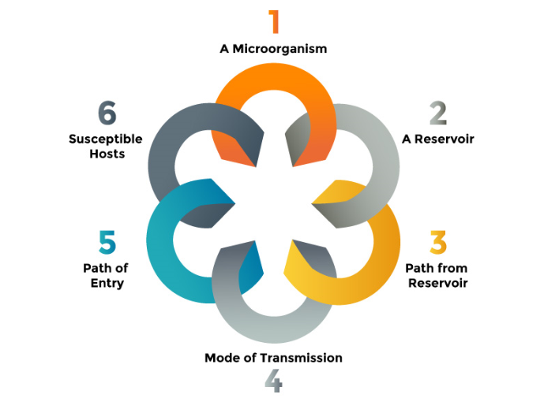
Implications for IPC: breaking the chain
Adapted from Leeds Community Health Care
Notes:
IPC aims to break the chain of transmission - For a microorganism, such as the covid virus (SARS – CoV – 2), to spread and potentially lead to an infection there needs be an interaction between the virus, the host and the environment.
When the virus leaves the host (infected person) through a way out (path from reservoir), it passes on (via a mode of transmission) and enters (through a path of entry) into a susceptible host. This is called the chain of infection (CDC, 2016). Each step is a link in this chain, and if all the links are present, then an infection will be transmitted from one person to another.
If one or more links are broken then the infection will not occur therefore a range of measures need to be in place to control COVID 19
Routes of transmission for COVID – 19 include:
Direct person to person via respiratory droplets – generated when breathing, sneezing, coughing, or physical contact
Indirect contact via contaminated surfaces and hand to mouth, nose or eye contacts
Aerosol transmission – via aerosols carried through the air that are breathed in

Slide 4
Implications for IPC: hand hygiene
The single most important measure for preventing the spread of infection
Gloves don’t replace the need for hand-washing
E.g. Gloves Are Off campaign from GOSH
Adapted from East Riding IPC & PH team
Notes:
People touch their faces frequently, one study observed medical students who touched their faces around 23 times per hour, of which around 44% of times resulted in contact with mucous membrane – risk for infection. https://pubmed.ncbi.nlm.nih.gov/25637115/
Regular and thorough handwashing should be promoted, including use of handgels where soap and water are not available
Cross-contamination whilst wearing gloves is a risk – see evidence from GOSH: https://www.england.nhs.uk/atlas_case_study/the-gloves-are-off-campaign/
https://infectioncontrol2019.co.uk/wp-content/uploads/2017/08/Helen-Dunn-Gloves-and-Hand-Hygiene.pdf
https://www.bmj.com/content/366/bmj.l4498
5 moments for hand hygeine: https://www.who.int/gpsc/tools/5momentsHandHygiene_A3.pdf

Slide 5
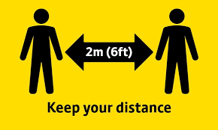
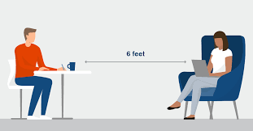
Implications for IPC: physical distancing
Adapted from East Riding IPC & PH team
Notes:
With COVID – 19 close contact in crowded, poorly ventilated, indoor conditions is known to drive transmission through both direct and indirect contact.
If you are further away from someone there’s less risk of catching the virus from droplets or aerosol transmission. However, distance isn’t the only thing that matters.
Duration - the longer you are close to an infectious person, the higher the risk.
Fresh air - the risk is lower if you are outdoors, or in a well ventilated area,
Direction - the risk is lower if you are not face-on with the infectious person
Maintaining a 2 metre distance wherever possible, minimising contact with others and meeting outdoors will all reduce this risk of transmission.
There is evidence that the risk of transmission increases 2 – 10 times at 1m compared to 2m, however if 2 metres is not possible, precuations include:
Limit the number of people or households that you come into contact with, e.g. avoid peak travel
Sit / stand side by side or behind other people, rather than facing them
Meet people outdoors, rather than indoors
Keep interactions brief
Wear a face covering on public transport, in shops or crowded indoor environments – this will protect others if you are infected
Increase ventilation
Avoid loud talking or singing with others

Slide 6
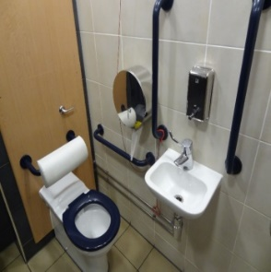
Implications for IPC: Frequently touched areas
Placeholder
Clean and disinfect all shared equipment.
Where possible, reduce the number of people using each item of equipment
Adapted from East Riding IPC & PH team
Notes:
To minimise the risk of transmission via surface contact, you should:
Regularly wash your hands using soap and water or use hand sanitiser
Avoid touching surfaces and do not touch your face
Dispose of waste safely, including items such as paper face masks or gloves

Slide 7
Implications for IPC: Infection Control and Cleanliness
Are cleaning roles and responsibilities clear? It is EVERYONE’S JOB to clean as they go.
Is there a robust cleaning schedule in place for the environment and patient equipment?
Good old elbow grease - without cleaning an item first, it may not be possible to disinfect properly.
The definition of cleaning in its simplest term is ‘the removal of unwanted material without damaging the surface to which it adheres’.
In a healthcare environment, ‘unwanted material’ includes dust, debris, marks and spillages, as well as microorganisms that can harm patients.
The environment therefore needs to be visibly clean, as well as clinically clean: i.e. meeting safe standards appropriate to the (health)care setting.
Adapted from Leeds Community Health Care

Slide 8
Summary
A range of measures need to be in place to break the chain of transmission, including:
Promoting regular handwashing
Avoid touching surfaces and putting hands to face
Physical distancing
Improving ventilation in indoor spaces
Encouraging use of face coverings or screens particularly where distancing not possible
Minimising social contact and having contact outdoors where possible
Minimising the duration of contact where possible
Regular cleaning of touch surfaces and shared spaces
Rapid isolation of cases and close contacts
Notes:
Further guidance here;
https://www.gov.uk/government/publications/review-of-two-metre-social-distancing-guidance/review-of-two-metre-social-distancing-guidance

