Slide 1
Delivery models and interventions
Samantha Dorney-Smith
Nursing Fellow, Pathway
Samantha.dorney-smith@nhs.net
@PathwayUK

Slide 2

Barriers to health care for people experiencing homelessness
Literacy and language
Poverty (no credit on phone, unable to travel)
Digital exclusion
Mental health and addiction
Cognitive / memory issues
Mobility
Practical challenges – who will look after my dog
Power dynamics

Slide 3
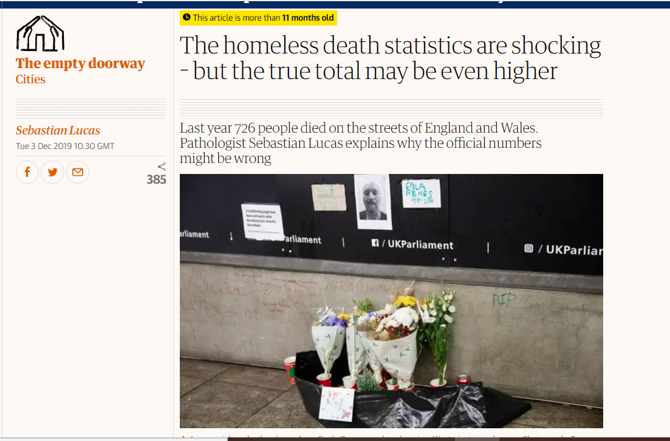
And death statistics are terrible…
726 ‘homeless’ deaths in 2018, up 22% since series began
Mean age at death was 45 years for males and 43 years for females in 2018 (general pop 76 for men, 81 for women.)
ONS data

Slide 4
Delivery models / interventions
Improve mainstream GP practice responses and/or:
Specialist GPs
Locally Enhanced Service Session Contracts
Specialist district / community nursing teams
Community matrons
Homeless health peer advocacy
Specialist mental health teams
Street outreach interventions / vans
Targeted public health programmes
Hospital discharge teams

Slide 5

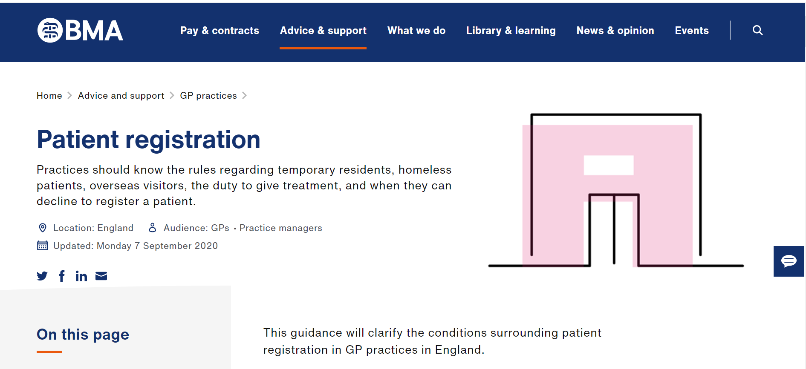
Improve mainstream GP practice responses
There is no regulatory requirement to prove identity, address or immigration status to register at a GP surgery
Patients do not need to provide an NHS number
Inability to provide documents is not reasonable grounds to refuse registration
Reiterate GP registration rules

Slide 6

Invest in receptionists
7 minute video
Slide pack
Interactive quiz
Faculty of Homeless and Inclusion Health
‘Standards for GP reception’
https://www.healthylondon.org/resource/homeless-health-elearning/

Slide 7
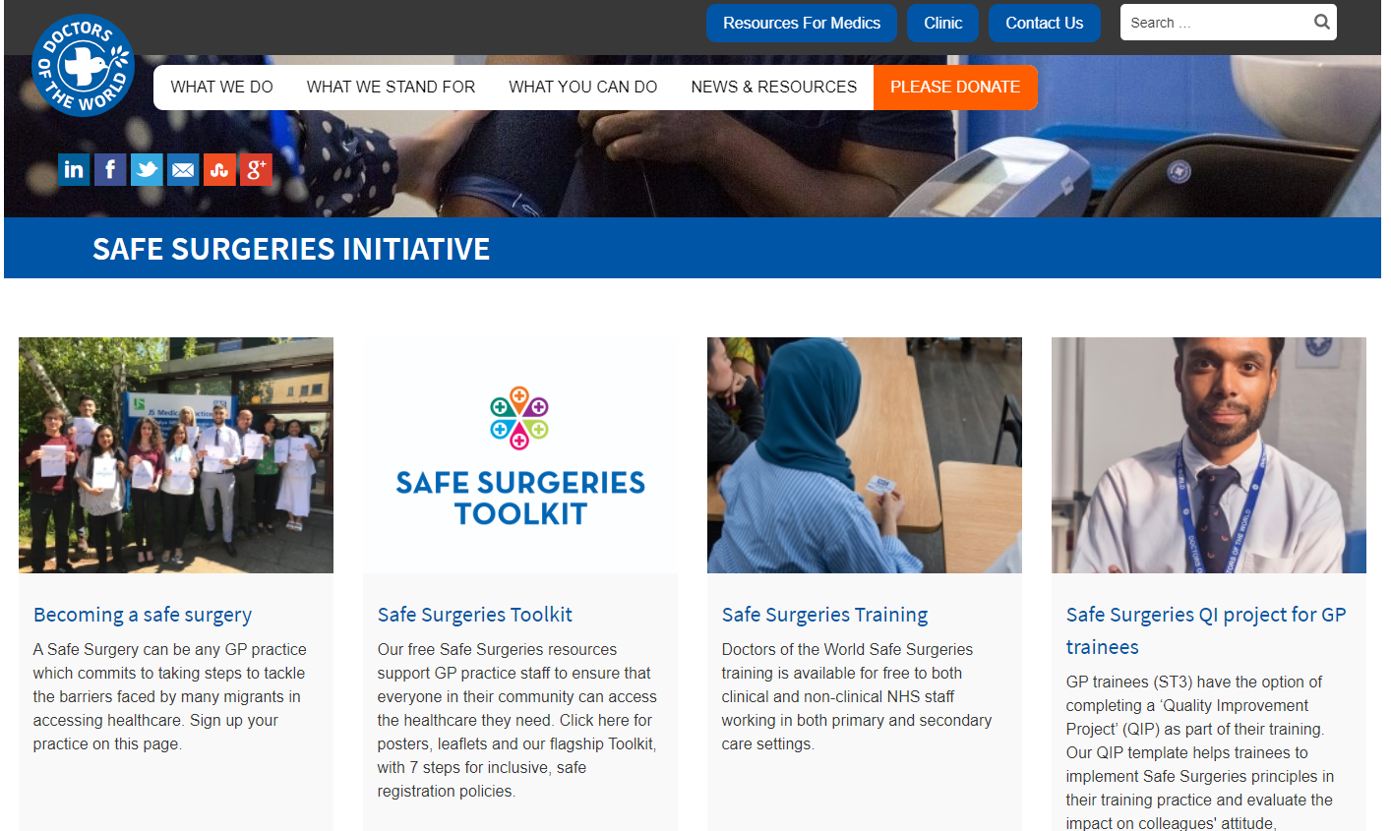

Doctors of the World – Safe surgeries

Slide 8
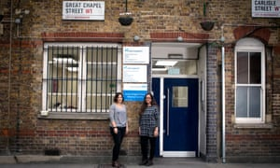
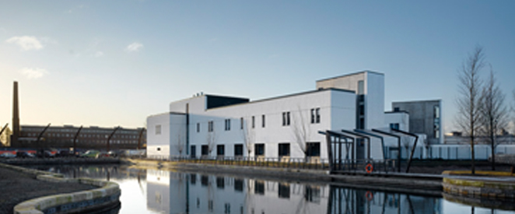
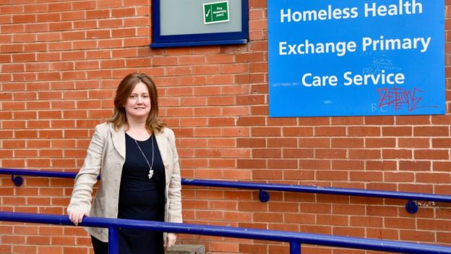
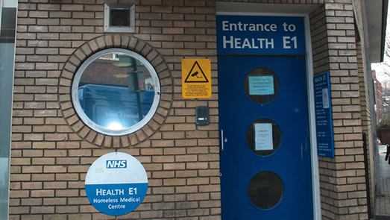
Specialist GP practices

Slide 9
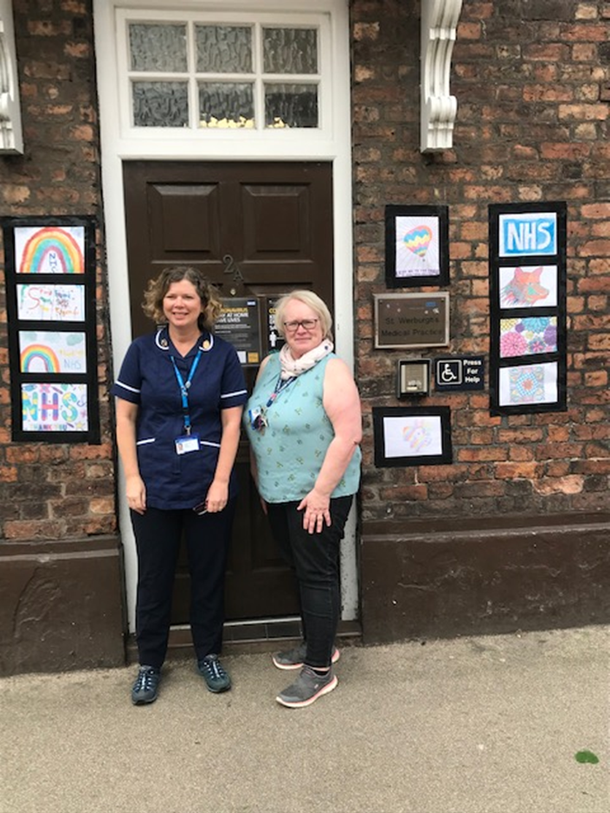
Chester – St Werburgh’s Practice for the Homeless during Covid
Reviewed practice list and rang every patient
Created a Hot Hub in practice
Outreach to hotels and hostels
Telephone welfare checks
Enabled lots of new registrations
Subsistence and support work
Case Study

Slide 10

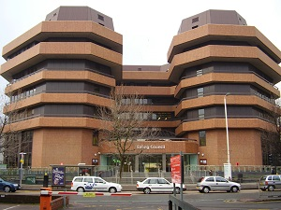
Locally enhanced service contracts
Out of Hospital Contract - financial rewards for meeting screening / vaccination targets etc for people experiencing homelessness
Any GP practice can be involved
92 staff were directly trained from 27 practice across 4 sessions on the contract. Mix of clinicians to support staff was about 50:50.

Slide 11
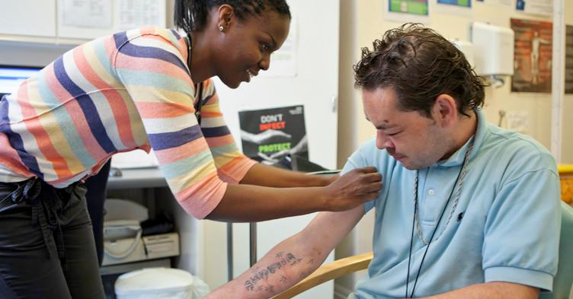
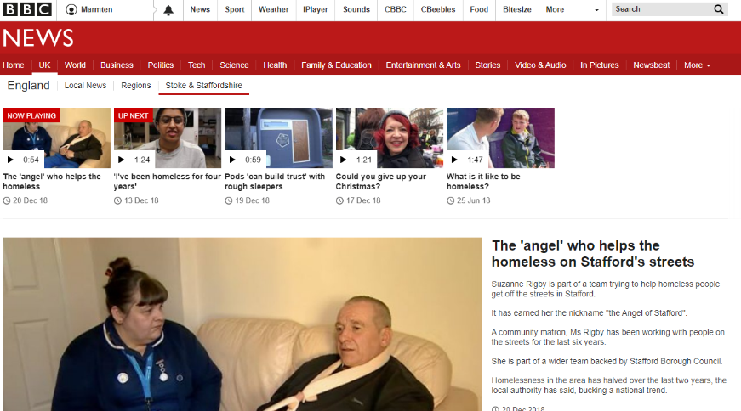
Community nurse outreach to hostels, day centres, night shelters
Community matrons

Slide 12
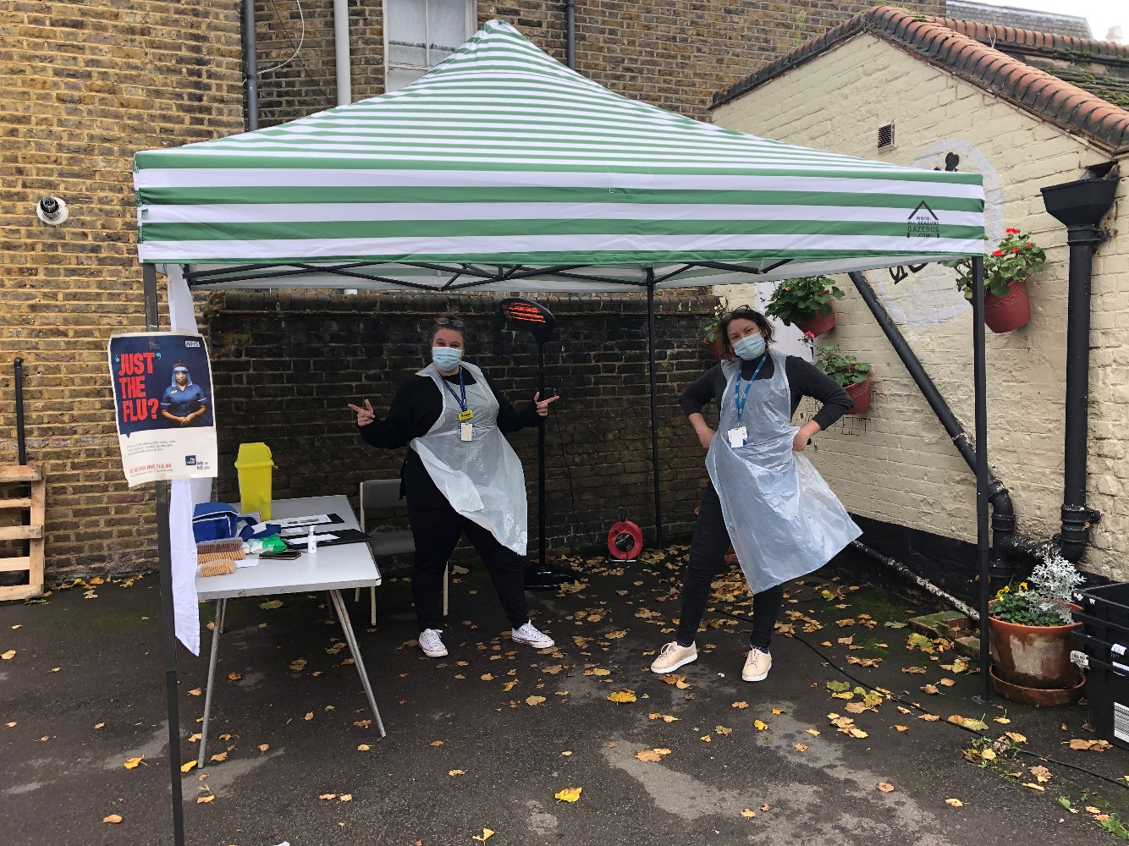
Flu vaccination at a day centre during Covid

Slide 13
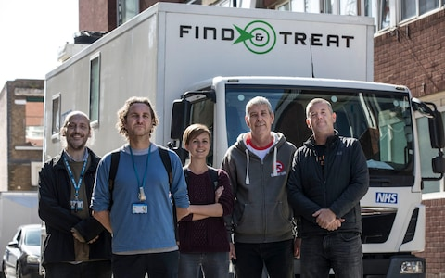
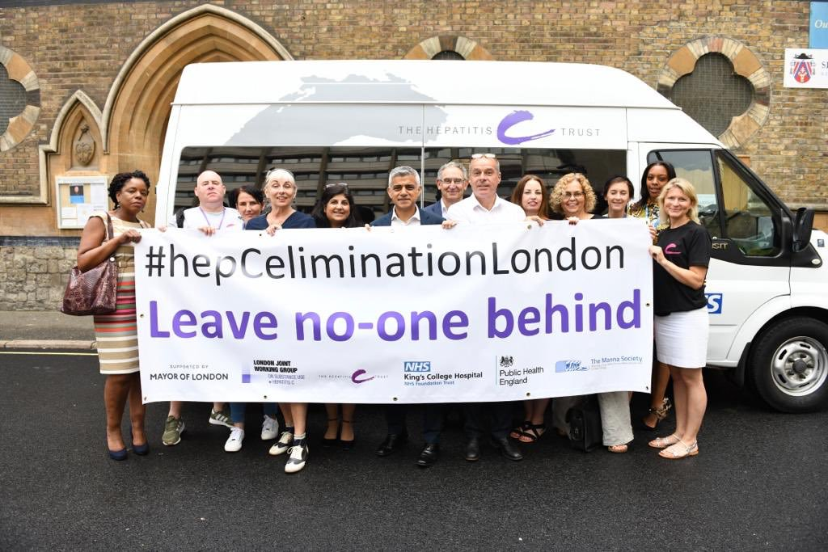
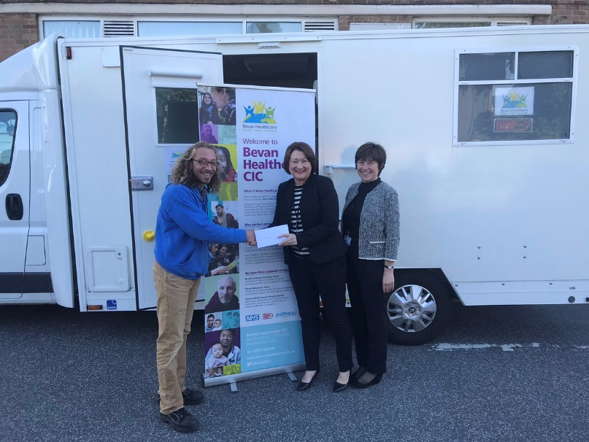
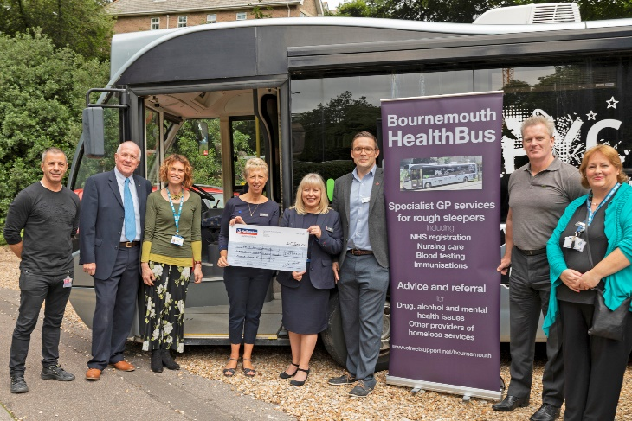
and bus and van outreach…
Usually using EbEs

Slide 14
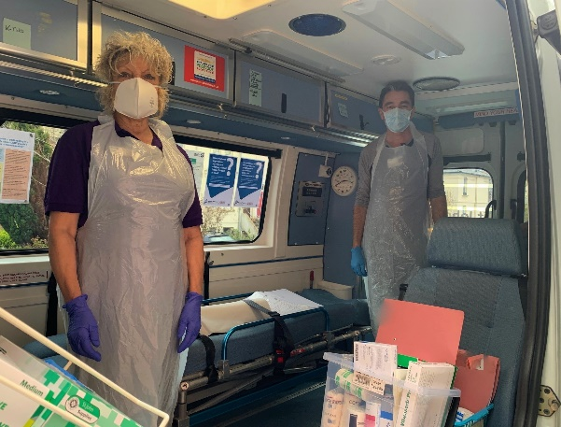
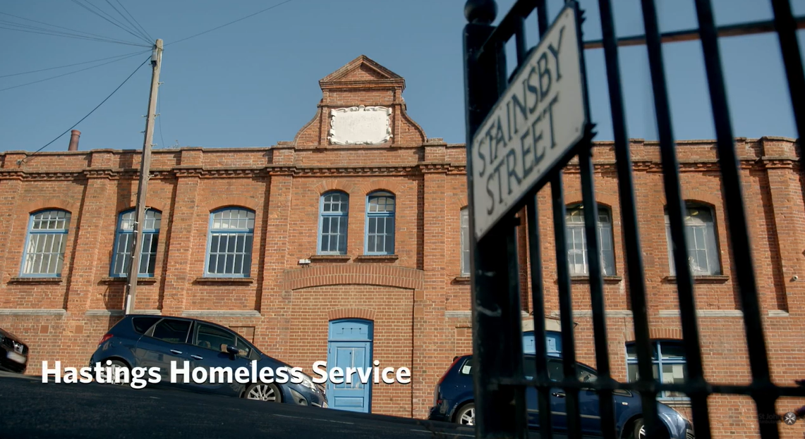
Hastings – St John’s Ambulance Homeless Health Service during Covid
Took service out of the day centre and into the community using new van
Kept in contact with clients that stayed out
Supported and maintained wound care
Blog

Slide 15
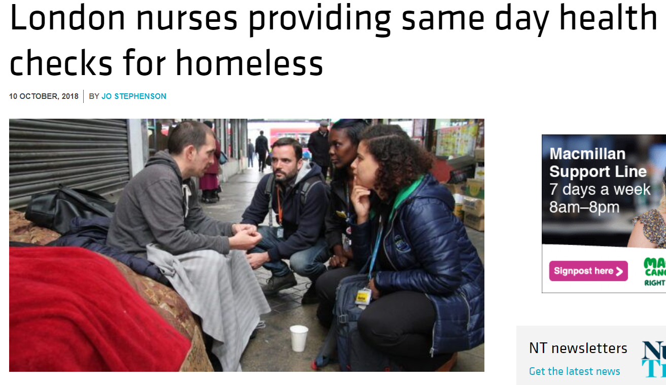
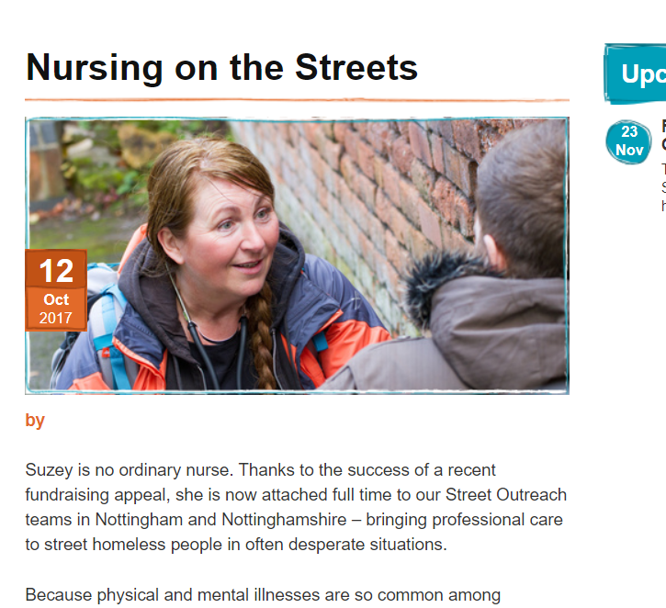
Street outreach
Expertise is needed in engagement, non-engagement, mental capacity and housing and immigration law
Outreaching alongside voluntary sector outreach teams

Slide 16
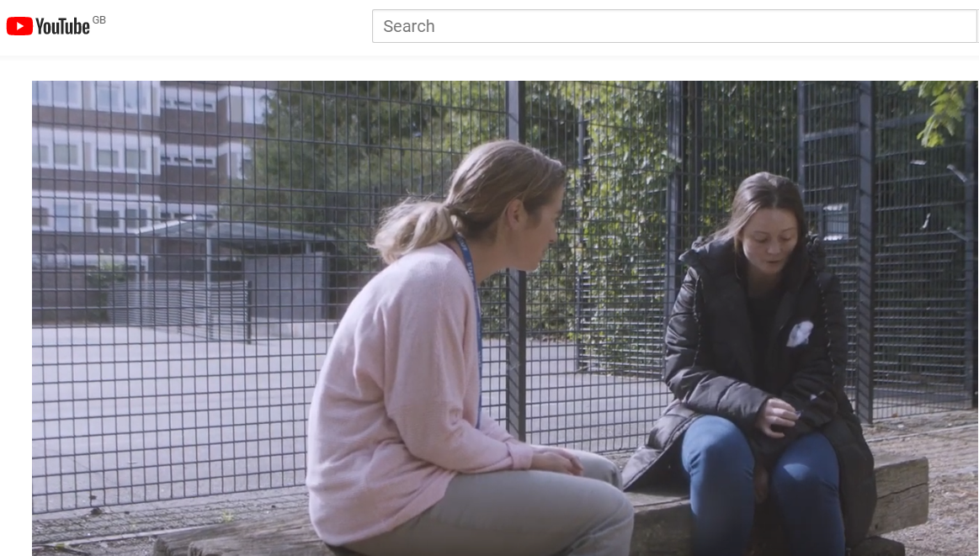
Mental health street outreach

Slide 17
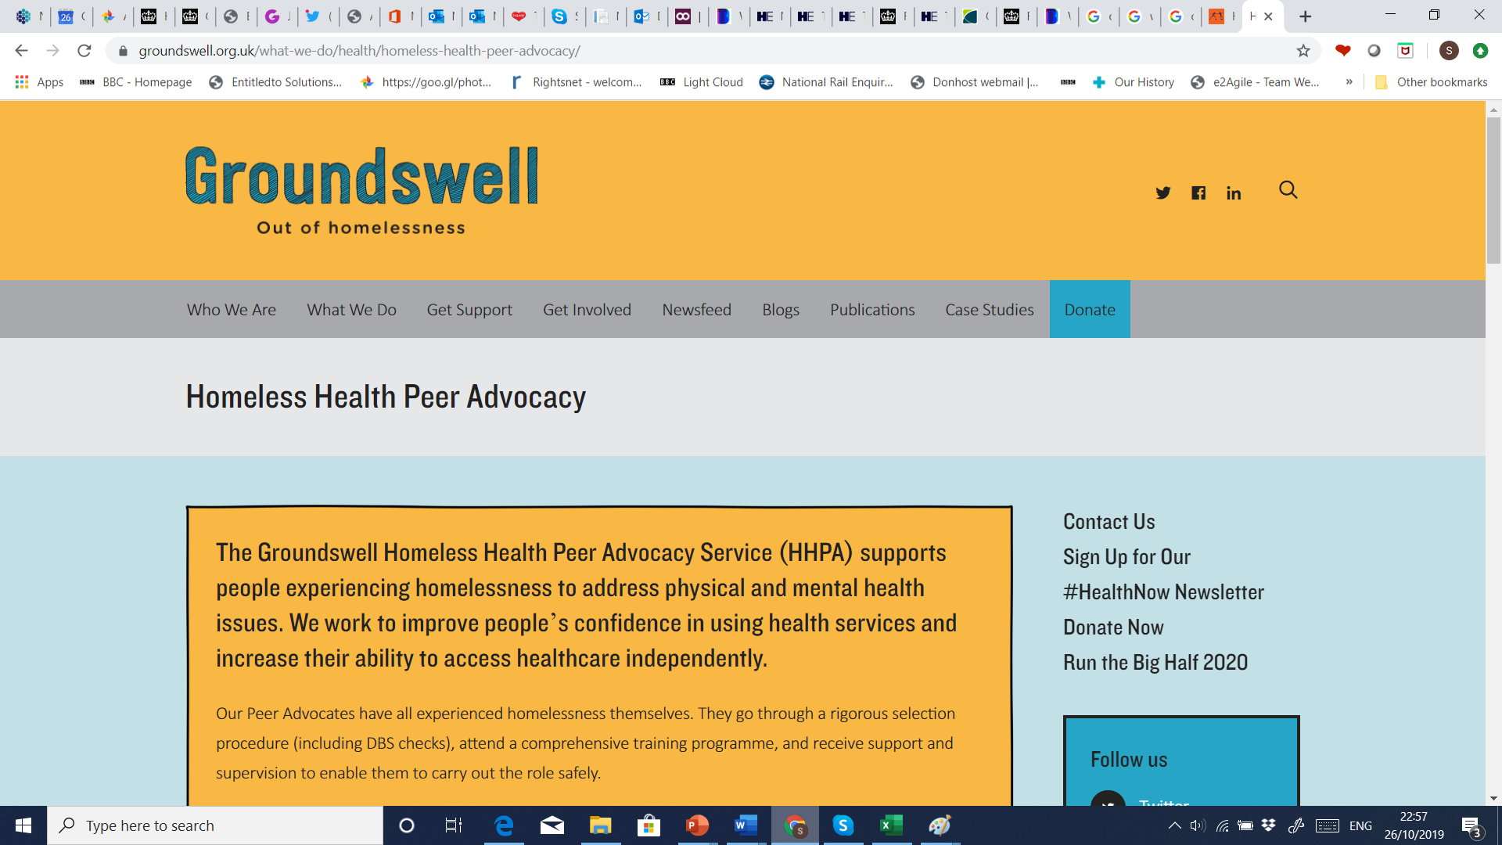
Homeless health peer advocacy

Slide 18
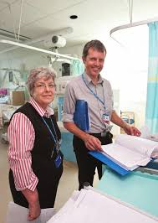
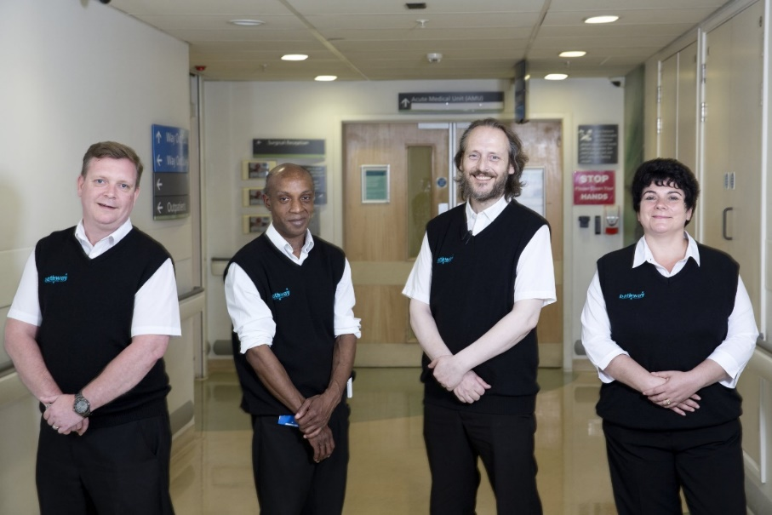
Intervening in hospital the ‘Pathway’ model –
Multi-disciplinary, multi-agency care coordination
in hospital

Slide 19
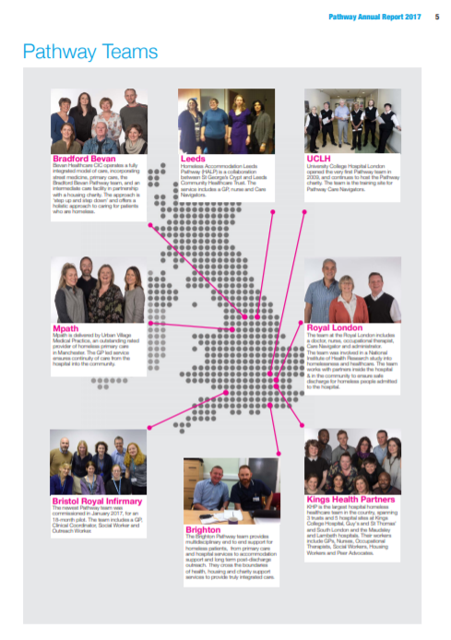
Pathway model
First team launched 2009
Cited as best practice in NHS long term plan (p42) https://www.england.nhs.uk/long-term-plan/
GP led
MDT approach involving community
Focus on health gain and long term recovery rather than just housing
Involving people with lived experience

Slide 20
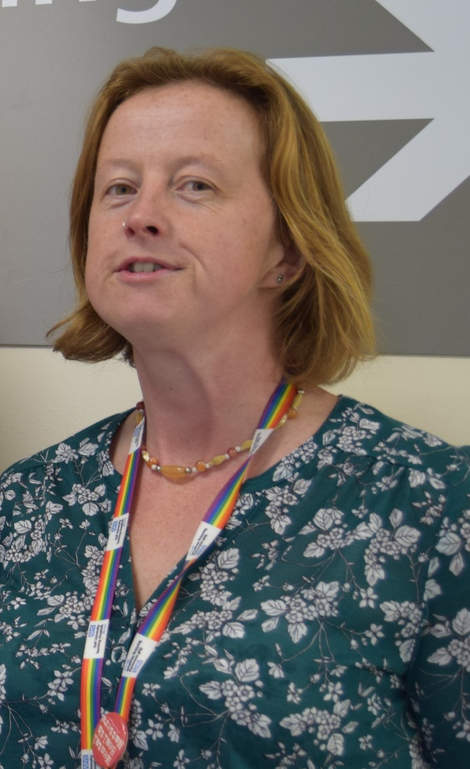
Hull – Homeless Pathway Team
MDT partnership with LA Housing Options and Outreach Team (Emmaus) to manage the ‘Covid Protect’ Accommodation set up in Hull.
Routine follow up on clients has continued – routinely at 2 and 6 weeks, but increased follow-up support in the community - now 50% of work time
Case Study

Slide 21
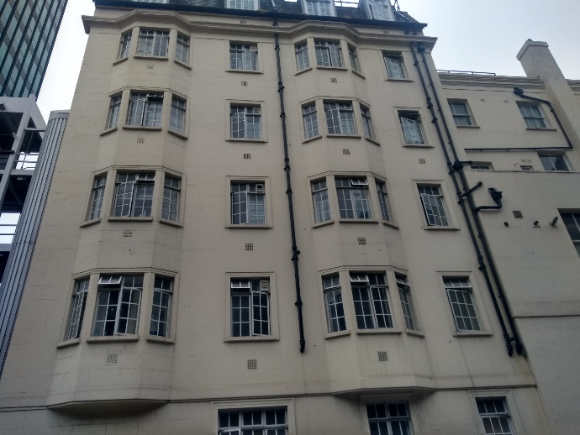
Specialist step down
A place for:
Teams to continue with housing and health work
Encouragement, empowerment, pastoral care, good food, safe space
End of life care
Needs to be:
Accessible
Have access to substitute prescribing
Have clear behavior rules on site
18% reduction in A&E attendance

Slide 22
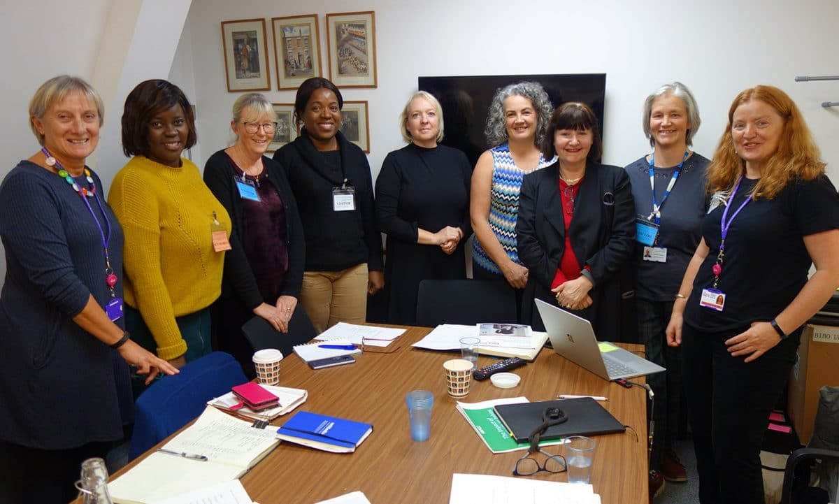
Health Visitors working with Homeless families – UK wide
Redeployment has been a challenge
Health visitors have been:
Outreaching at food banks
Working in car parks
Providing phones / tablets
Providing house essentials
Enabling access to support
Continuing to visit when everyone else has stepped back
Letter, article and campaigning…

Slide 23

Pathway / Faculty of Inclusion Health Standards
Aimed at:
Commissioners within Local Authorities and CCGs
Public Health officials
Health and Wellbeing Boards
Officers with responsibility for JSNAs
Sustainability and Transformation Partnerships (STPs)
Accountable Care Systems (ACS)
Councillors and MPs seeking to ensure their areas provide the best care
Providers of services to inclusion health groups

Slide 24
Networks
Faculty of Homeless and Inclusion Health – regular newsletter and meetings: ​http://www.pathway.org.uk/faculty/join/
London Network of Nurses and Midwives Homelessness Group - hosts resources and runs cheap conferences, welcomes health support workers: http://homelesshealthnetwork.net
Queens Nursing Initiative Homeless Health Network - hosts resources, and runs newsletter: https://www.qni.org.uk/explore-qni/homeless-health-programme/

