Slide 1
Helen Aitchison – Area Manager
Sophie Joyce – Project Lead

Slide 2
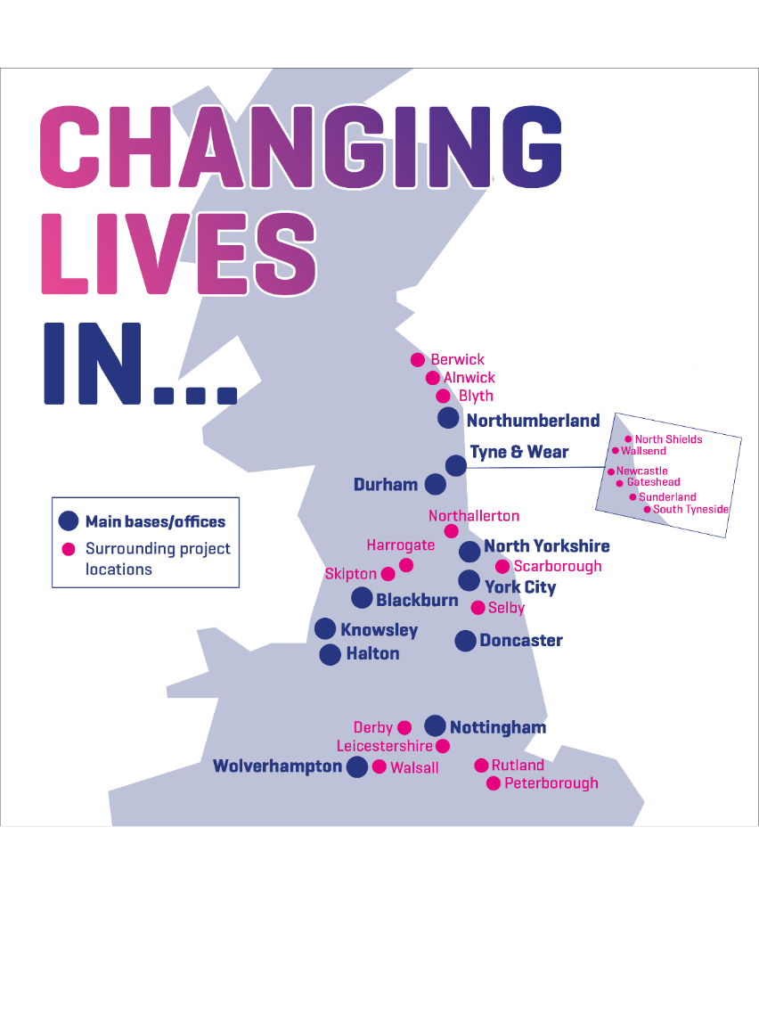
We support:
Over 10,000 people supported each month
Over 150 projects offering life-changing support
Our services:
Homelessness
Drug and Alcohol
Women and Families
Employment

Slide 3
Homeless Provision
Rough Sleeping Outreach
24/7 staffed supported accommodation units
Dispersed / Community based accommodation
Specialist provisions – women, young people, veterans, families, domestic abuse, MDS
HomeLife Properties – permanent tenancies through our RSL

Slide 4
Homeless Response Model – Rough Sleeping
Model
Emphasis on Peer Led
Assertive Outreach
Partnership Solution
Strength based approach
Refer & Acc / Stickability
Trauma informed / DBT
Challenge and transform systems
Open Door Policy / Ban 3 strikes

Slide 5
Health and Wellbeing Covid Management
Pandemic crisis – response needed for homeless people. LA’s lack of resources, suitable accommodation. Overuse of B&B’s
Vulnerable became more vulnerable – health inequalities, access to services, fear and lack of advocacy. Less likely to gain info on safeguarding their health during Covid
Existing Blue Light cohort already needing health education and engagement – barrier to on-line appointments, up to date info etc.
Reactive, immediate, pragmatic solution needed by services that could keep their doors open

Slide 6
Health and Wellbeing Covid Management
Partnership response – LA, Housing Association, Changing Lives. MHCLG / LA funding
Increase in rough sleeping outreach, supported by Police
Options available for current homeless people bed blocking in hospital
Mobilisation of Covid response properties – single people and families
LA flexibility on policy e.g local connection

Slide 7
Rough Sleeping & Covid Housing
Engaged 38 Rough sleepers during Covid
Supported 25 males, 9 females and 20 children to access temporary supported accommodation with CL’s
Assisted 13 to acquire permanent, sustainable tenancies
CASE STUDY

Slide 8
Case Studies
Male T is 38 years old lived previously with his partner and their three children. T had suffered domestic abuse for a number of years and during the lockdown decided, he was unable to take it anymore and did not want his children to witness the abuse any longer. T decided to leave along with the children and he was placed in temporary accommodation by Sunderland City Council following a completion of a homeless application.
We then received a referral from the housing options team. We identified a three bedroom (fully furnished) property for him and his children. T engaged very well with his support worker and created a home hunt account with Gentoo to begin looking for his forever home. As T made regular rent payments, had no issues around ASB or previous arrears he was placed on band 1. He then identified a property in an area which was suitable for him and his family. It was close to the children's school and has good transport links.
The only issue we faced was T was in receipt of Universal Credit and had no savings to furnish his new property. His support worker made an application to the MHCLG Covid Domestic Abuse fund for furniture and carpets. This was accepted and the team were able to support him with making the house his home. T was extremely grateful for this.
T has been living in his new property for around three weeks now and still regularly contacts his support worker thanking them for their help. He will now safely enjoy his first Christmas in his own home with his children.
Client T –
“This is all I ever wanted, a chance to be able to be safe. I can see a future now”
“By changing nothing, nothing changes but Changing Lives helped me change everything”

Slide 9
Useful Links: www.changing-lives.org.uk www.homeless.org.uk www.gov.uk – MHCLG www.shelter.org.uk
Helen Aitchison AREA Manager
helen.aitchison@changing-lives.org.uk
SOPHIE JOYCE PROJECT LEAD
SOPHIE.JOYCE@CHANGING-LIVES.ORG.UK

